Slide 1
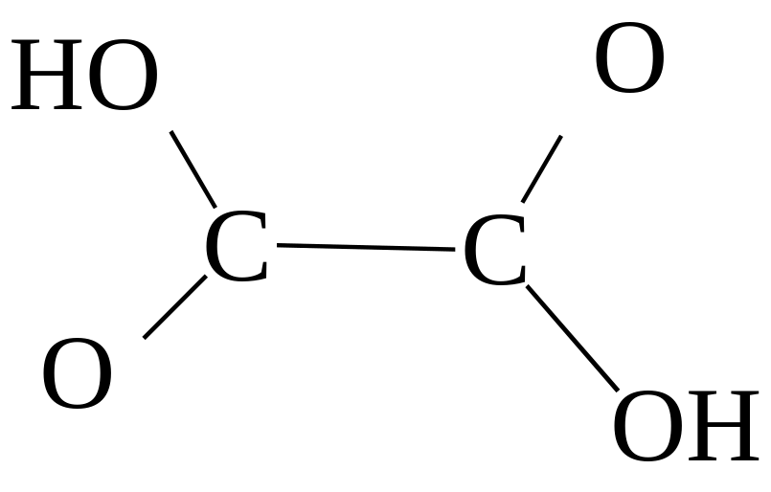
Buddy Question # 1
Complete the Lewis structure and determine the number of multiple bonds in the molecule.
1 double bond
2 double bonds
3 double bonds
1 triple bond

Slide 2
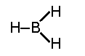
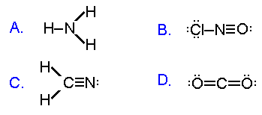
Buddy Question # 2
Which is a correct Lewis electron-dot structure?
●
●

Slide 3
Buddy Question # 3
Are these Lewis structures correct?
F-H-F H-C-H H-O-H-H HC-CH
If not, how can you fix them?

Slide 4
Buddy Question # 3
H
I
F - F⁺- H H-C-H H-O⁺-H HC CH
●
●
●
●
●
●
●
I
H
≡
●
●
●
●
●
I
H

Slide 5

Formal Charges
-
6 – 6 – 1 = -1
Formal
Charge =
# valence e⁻
in unbound atom
-
-
# non-bonding e⁻
# bonds

Slide 6
-
+
-
-
-
-
O -
Cl
- O
I
-
-
-
I
Valence e: 6 + 7 + 6 + 1 = 20
Electrons in bonds: 4
Extra e: 20 – 4 = 16
O: 6 – 6 – 1 = -1
Cl: 7 – 4 – 2 = +1
Formal
Charge =
# valence e⁻
in unbound atom
-
-
# non-bonding e⁻
# bonds

Slide 7
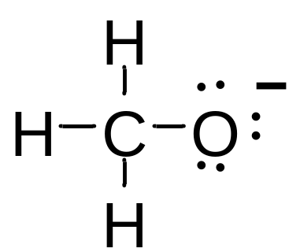
Buddy Question # 6
Draw the correct Lewis structure for this molecule:
CH₃O⁻

Slide 8
Buddy Question # 7
What are the shapes of these molecules:
HF BF₃ SiH₄ CO₂ H₂C=C=CH₂
Linear trigonal planar tetrahedral linear linear

Slide 9
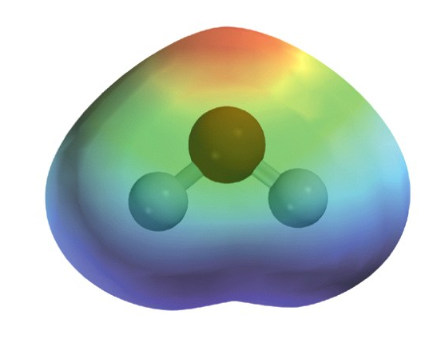
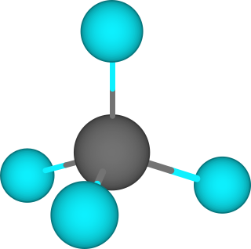
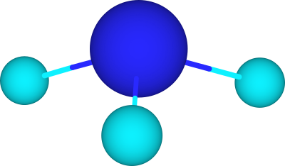
Buddy Question # 8
H₂O
bent
CH₄
tetrahedral
NH₃
trigonal pyramidal

Slide 10
Buddy Question # 9
Are these molecules polar or nonpolar?
CH₄
nonpolar
NH₃
polar

Slide 11
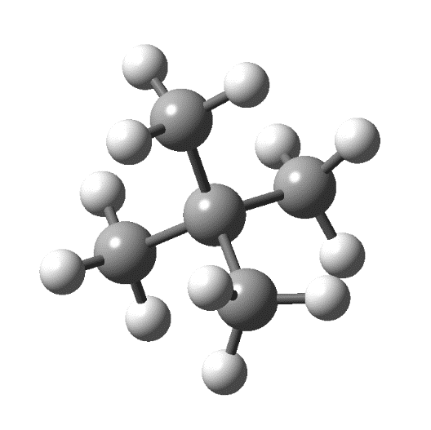

Buddy Question # 10
Draw the carbon skeleton formula for this molecule:

Slide 12
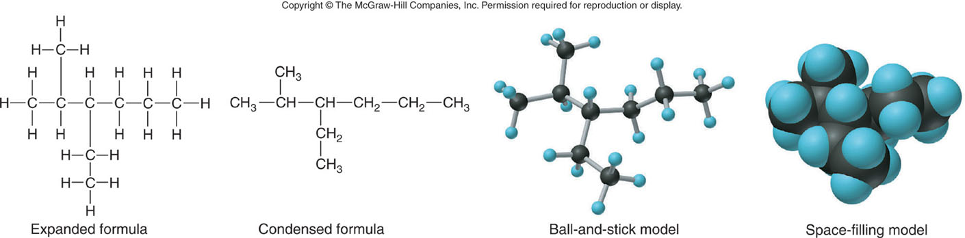
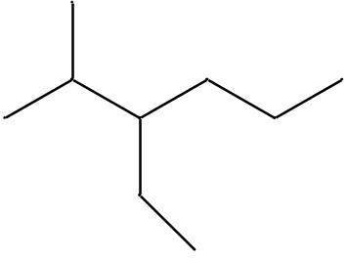
Buddy Question # 11
Draw the carbon skeleton formula for this molecule:

Slide 13
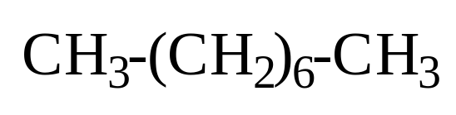
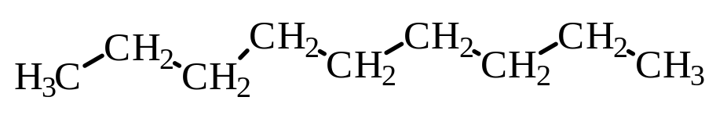
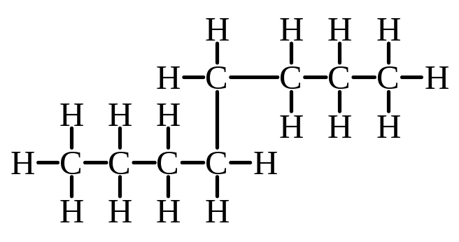
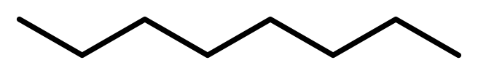
Buddy Question # 12
The combustion quality of automobile gasoline is rated in comparison to “octane” (C₈H₁₈). Which one(s) of the following structures do(es) not represent octane:
A
C
B
D

Slide 14
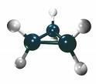
Buddy Question # 13
Draw the carbon skeleton formula for this molecule:

Slide 15
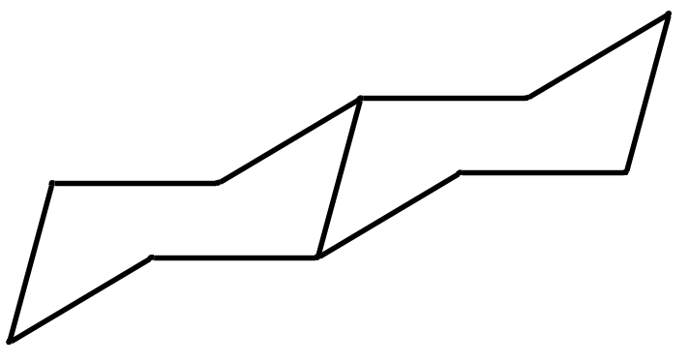
Buddy Question # 14
How many H atoms are on each C atom?
1
2
2

Slide 16
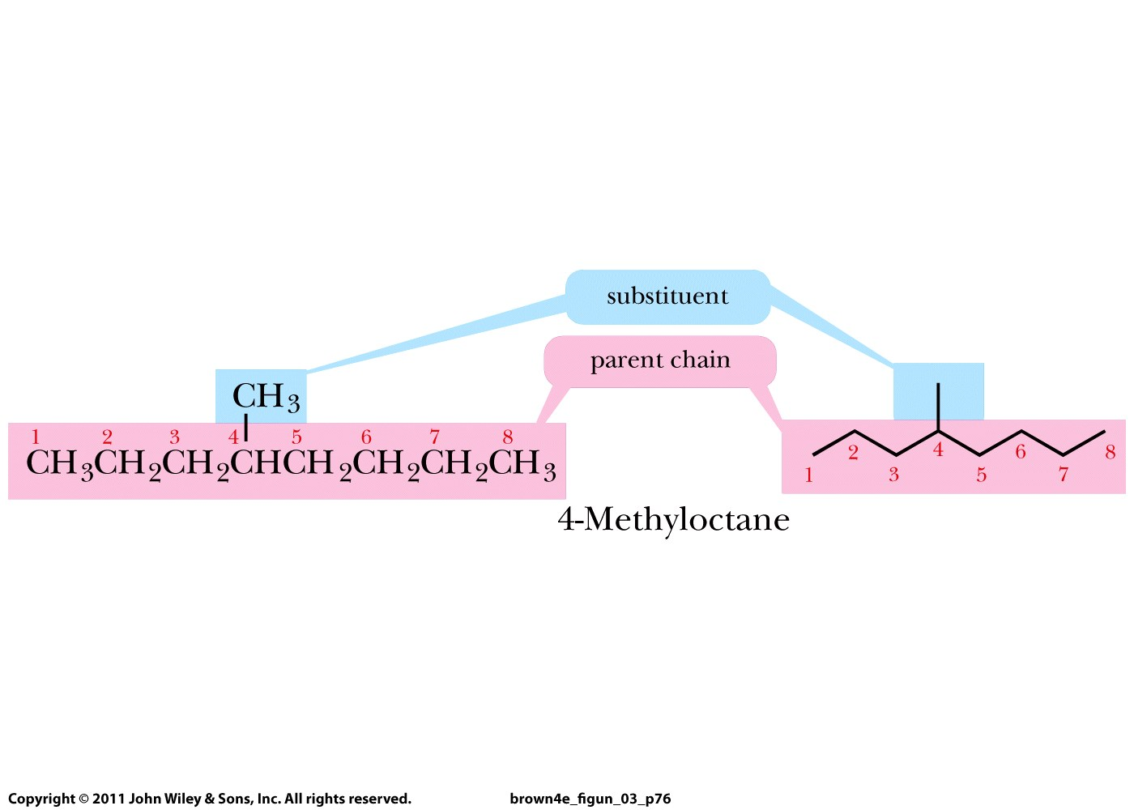
Buddy Question # 15
4-methyloctane

Slide 17
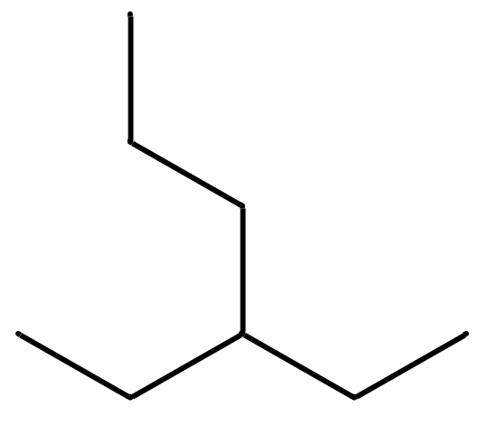
Buddy Question # 16
3-ethylhexane

Slide 18
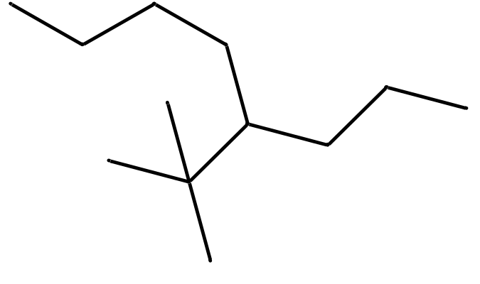
Buddy Question # 17
4-tert-butyloctane

Slide 19
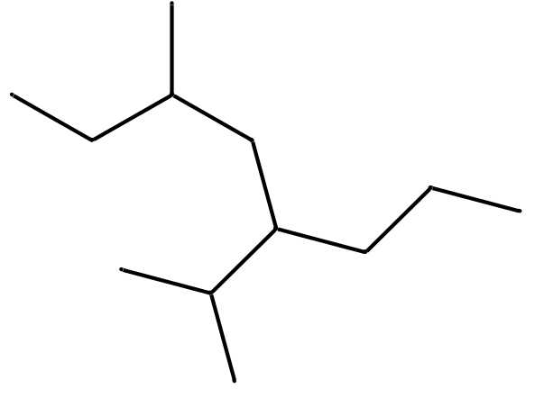
Buddy Question # 18
5-isopropyl-3-methyloctane

Slide 20
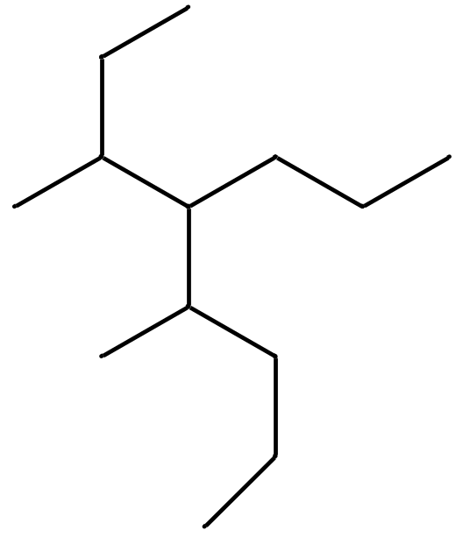
Buddy Question # 19
3,5-dimethyl-4-propyloctane

Slide 21
Buddy Question # 20
2,2,3-trimethylpentane

Slide 22
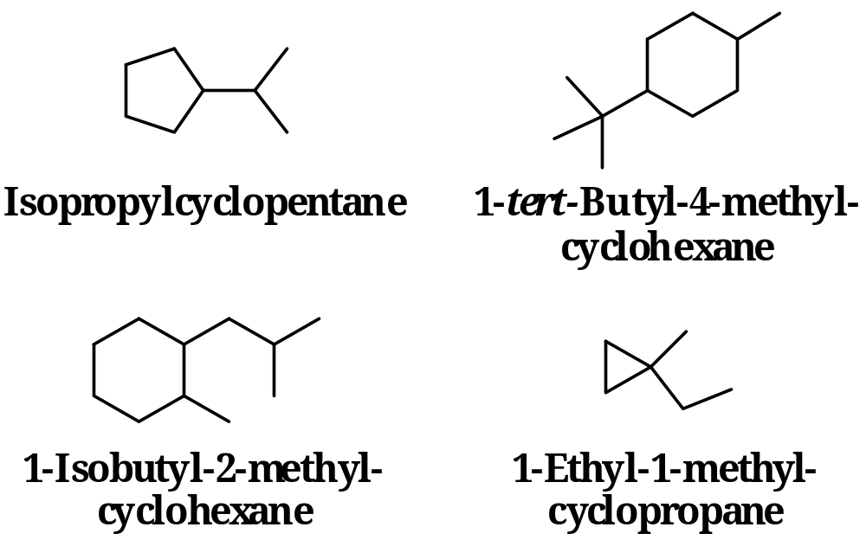
Commonly written as carbon skeleton (line-angle) formulas
Buddy Question # 21:
Name them

Slide 23
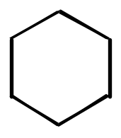

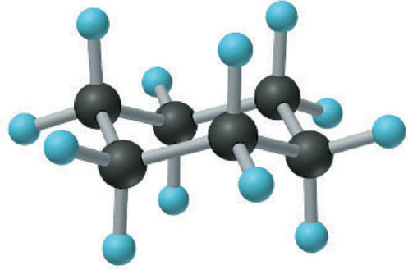
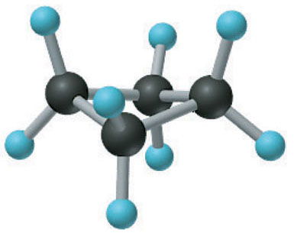
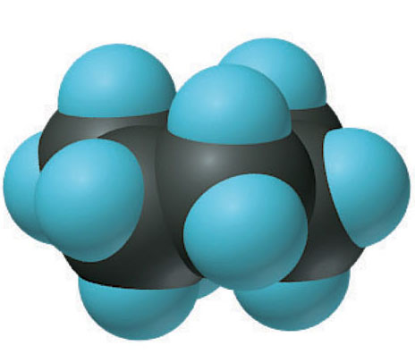
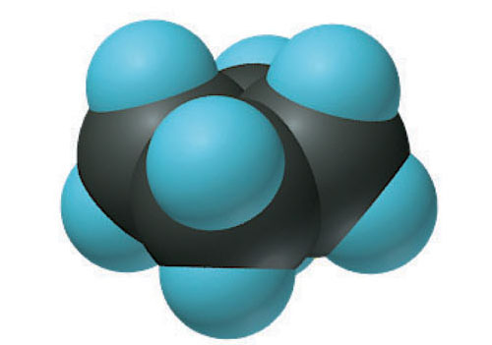
Buddy Question # 24:
Staggered or eclipsed conformations?
eclipsed
staggered

Slide 24
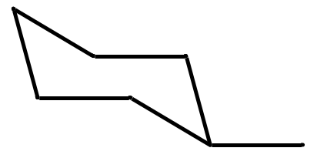
Buddy Question # 25:
Draw a three-dimensional structure for
below molecule that has the methyl-group
in an equatorial position

Slide 25
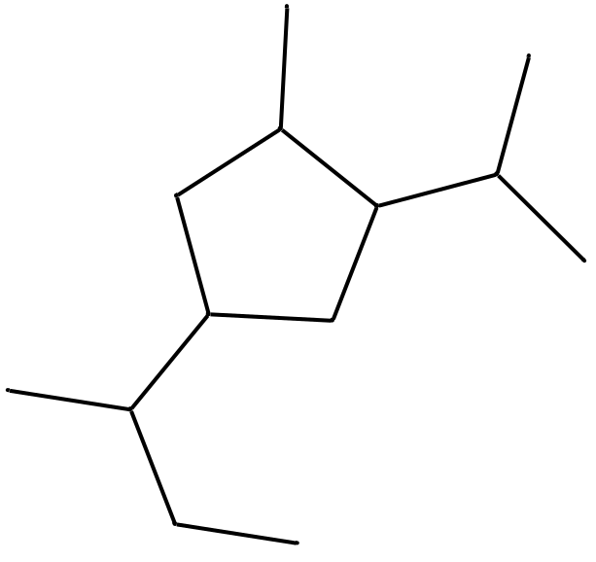
Draw a correct Lewis structure for this compound:
1-sec-butyl-3-isopropyl-4-methylcyclopentane

Slide 26
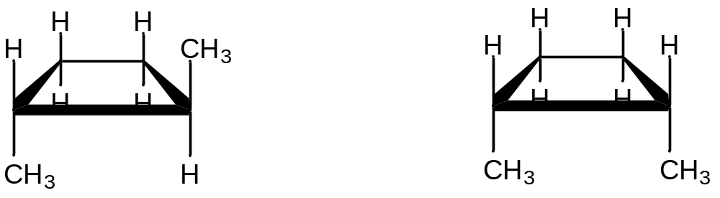
Buddy Question # 26:
Are below compounds
cis- or trans-isomers?
trans cis

Slide 27
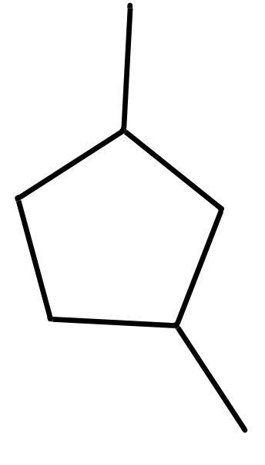
Buddy Question # 27:
Draw three-dimensional structures for
below molecule that are cis- and trans- isomers

Slide 28
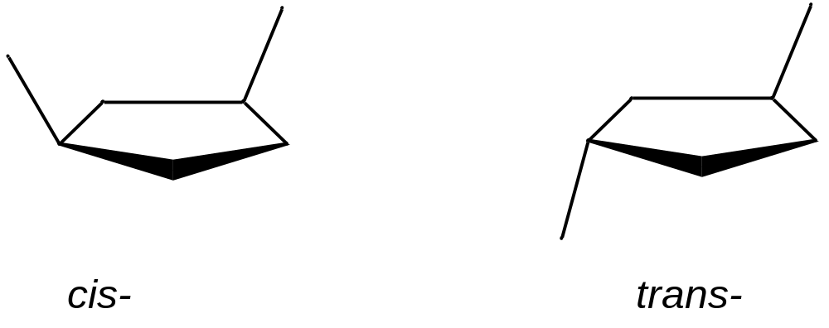

Slide 29
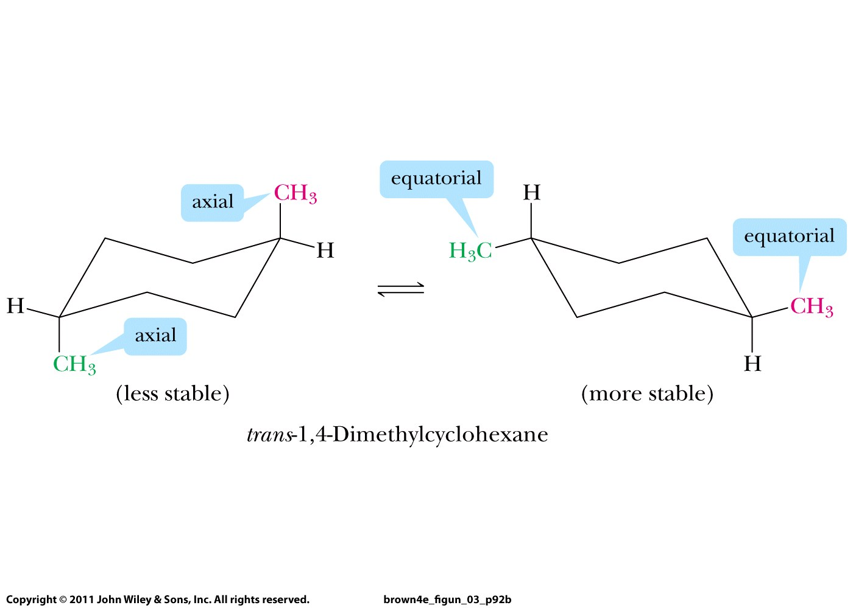
Buddy Question # 28:
Draw a trans-isomer
of 1,4-dimethylcyclohexane
Cis- or trans-?
UP
DOWN
UP
trans-
DOWN

Slide 30
(conformational isomers)

Slide 31
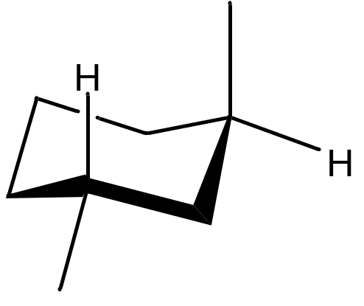
Buddy Question # 29:
Draw a trans-isomer
of 1,3-dimethylcyclohexane
Axial
UP
Cis- or trans-?
Equatorial
DOWN
trans-

Slide 32
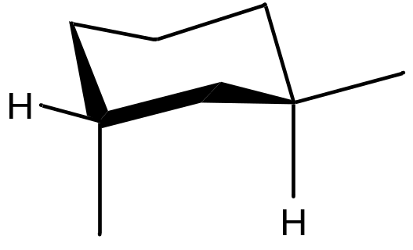
Buddy Question # 29:
Draw a trans-isomer
of 1,3-dimethylcyclohexane
Axial
UP
Equatorial
UP
Cis- or trans-?
Axial
DOWN
Equatorial
DOWN
Conformational isomers of trans-1,3-dimethylcyclohexane

Slide 33
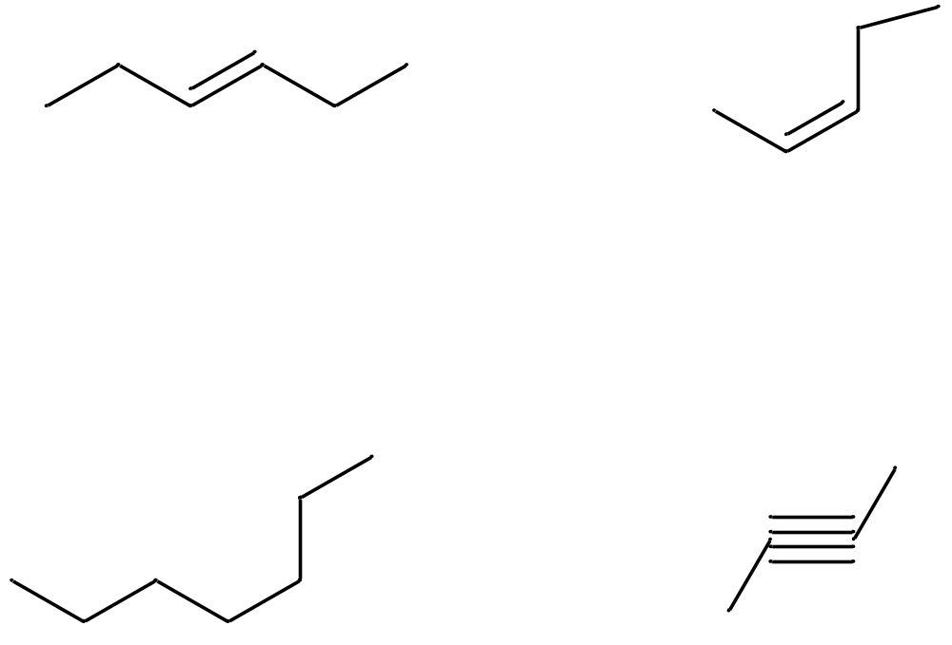
Buddy Question # 30:
Which compounds display cis-trans-isomerism?
If yes, which one is shown, the cis isomer or the trans isomer?
This one; it is trans- this; it is cis-
Not this one not this one

Slide 34
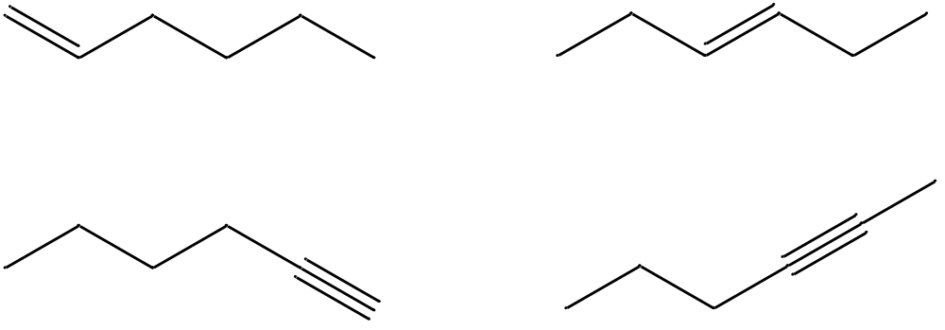
Buddy Question # 31:
Name these molecules:
1-hexene
trans-3-hexene
1-hexyne
2-hexyne
Two pairs of constitutional isomers!!

Slide 35
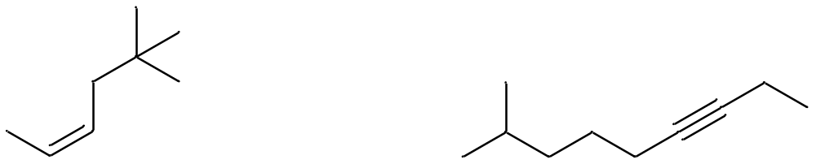
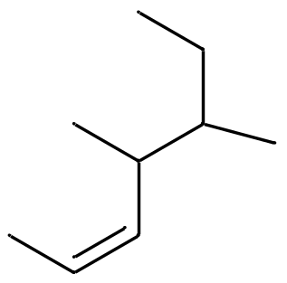
Buddy Question # 32:
Name these molecules:
7-methyl-2-octyne
cis-5,5-dimethyl-2-hexene
cis-4,5-dimethyl-2-heptene

Slide 36
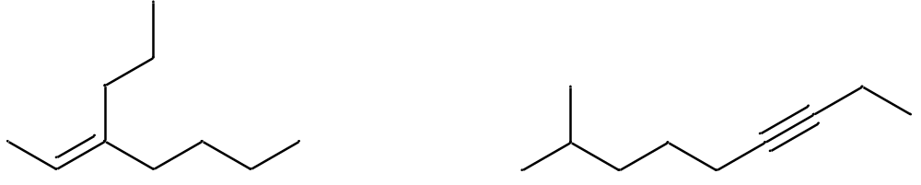
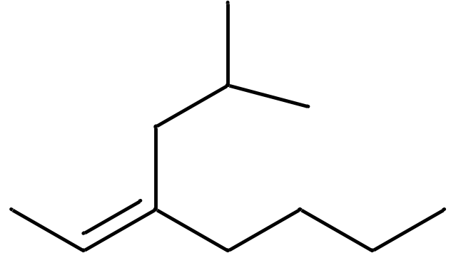
Buddy Question # 33: names?
(E)-3-propyl-2-heptene
(Z)-3-isobutyl-2-heptene

Slide 37
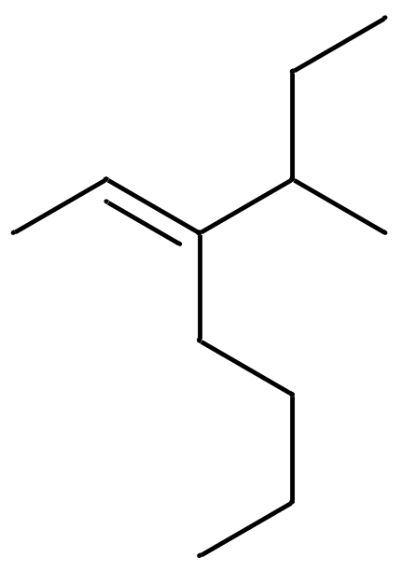
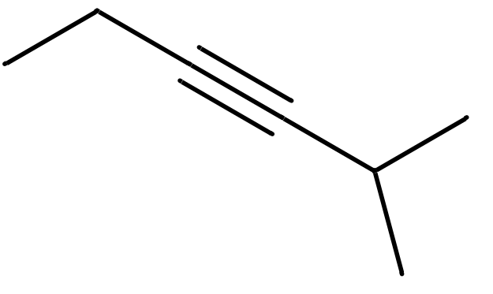
Buddy Question # 34: names?
2-methyl-3-hexyne
(E)-3-sec-butyl-2-heptene

Slide 38
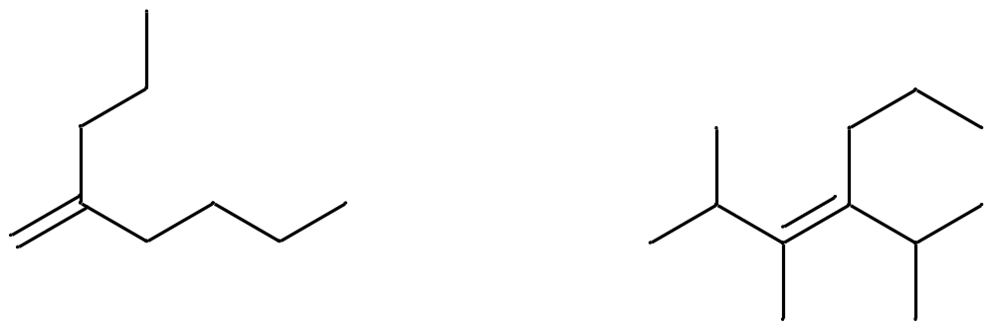
Buddy Question # 35: names?
2-propyl-1-hexene
(E)-2,3-dimethyl-4-isopropyl-3-heptene

Slide 39
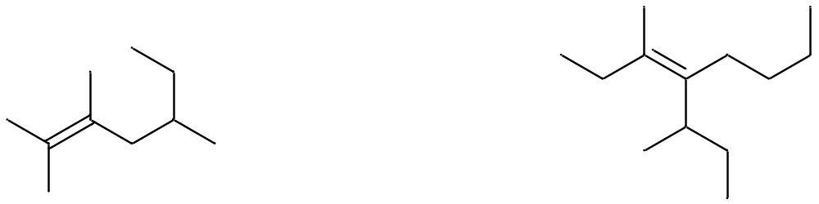
Buddy Question # 36: names?
2,3,5-trimethyl-2-heptene

Slide 40
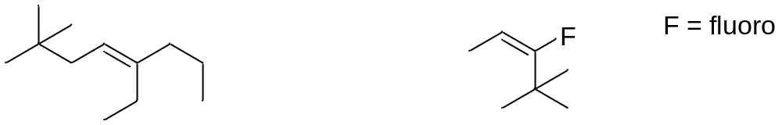
Buddy Question # 37: draw the structure of this molecule
(E)-3-fluoro-4,4-dimethyl-2-pentene

Slide 41
Buddy Question # 38: name/structure?
(E,trans)-3-isobutyl-2,4-heptadiene

Slide 42
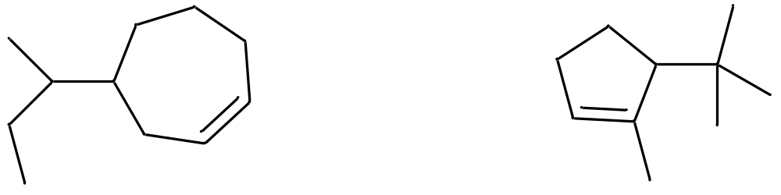
Buddy Question # 39
Name/structure
4-sec-butylcycloheptene

Slide 43
Buddy Question # 39:
Name/structure
4-sec-butylcycloheptene
5-tert-butyl-1-methylcyclopentene

Slide 44
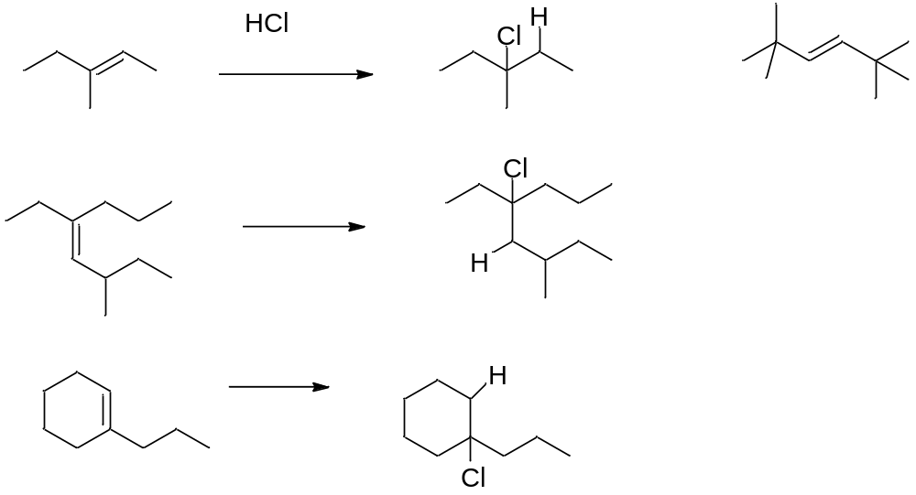
Buddy Question # 40
HBr

Slide 45
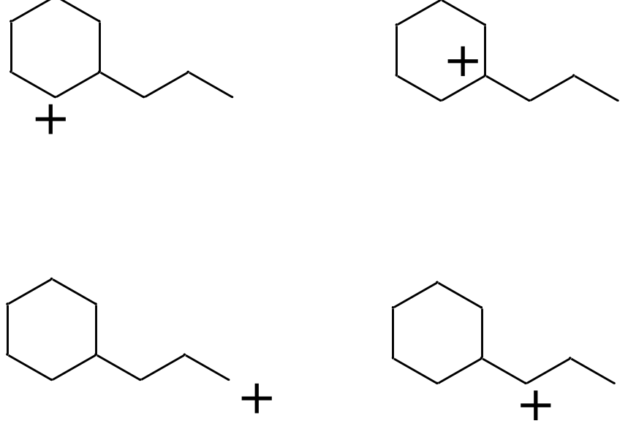
Buddy Question # 41
Which carbocation is most stable?
This one

Slide 46
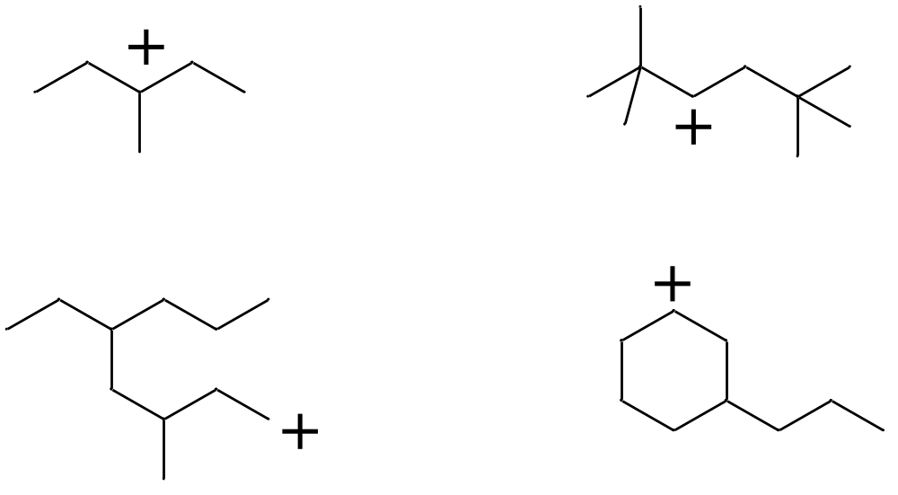
Buddy Question # 42
Which carbocation is most stable?
This one

Slide 47

Buddy Question # 43
What products are formed in these reactions?

Slide 48

Buddy Question # 44
Which ones rearrange and to what?

Slide 49

Buddy Question # 45
What products are formed in these reactions?
H₂SO₄
H₂SO₄
H₂SO₄

Slide 50


Buddy Question # 46
What product is formed in this reaction?

Slide 51


Buddy Question # 47
What products are formed in this reaction?
BH₃
NaOH, H₂O₂

Slide 52


Buddy Question # 48
What products are formed in this reaction?
BH₃
NaOH, H₂O₂
BH3

Slide 53

Buddy Question # 49
What products are formed in this reaction?
H₂
Pd
BH3

Slide 54


Buddy Question # 51
Do these molecules contain chiral centers? How many?
one
none
none
one
*
*
two

Slide 55
Buddy Question # 52
Which of below molecules contain a chiral center (stereocenter)? How many?
None one none one one one

Slide 56
Buddy Question # 53
Which of below molecules contain a chiral center (stereocenter)? How many?
None none
None two

Slide 57

Buddy Question # 46
Draw enantiomers where they exist

Slide 58

Buddy Question # 47
Which ones are enantiomers (if any)?

Slide 59

Buddy Question # 48
Assign priority to the groups on chiral center
3
3
3
3
1
1
1
1
2
2
2
2
Same as first

Slide 60
Buddy Question # 48
Assign the absolute configuration (S or R) to each chiral center
3
3
3
3
1
1
1
1
2
2
2
2
R
R
“R” = S
R
Lying H!!!

Slide 61
Buddy Question # 49
Which one of below enantiomers has S and which one R absolute configuration? How about the rest?
R constitutional isomer R “S” = R
S
A lying H!!!

Slide 62

Buddy Question # 50
Assign the absolute configuration (S or R) to each chiral center
(R)-
(S)-

Slide 63

Buddy Question # 51
Assign the absolute configuration (S or R) to each chiral center
Chiral compounds are optically active,
i.e., enantiomers bend plane-
polarized light into opposite directions

Slide 64

S-enantiomer
R-enantiomer

Slide 65

S-enantiomer
S-enantiomer

Slide 66

Buddy Question # 52
Name these:
Br
3-bromo-2-methylpentane 4-bromocyclohexene (1S,2S)-1-bromo-2-
(no stereochemistry indicated) (same here) chlorocyclohexane

Slide 67



Buddy Question # 53
Name these:
(3R,5R)-3-chloro-5-isopropylcyclopentene
(S)-3-fluoro-2-methylpentane
(S)-4-iodo-5-isopropyl-3-methyl-(Z)-2-octene

Slide 68

Buddy Question # 54
Give the products:

Slide 69

Buddy Question # 55
Give the products

Slide 70

Buddy Question # 56
Give the products

Slide 71

Buddy Question # 57
Give the products

Slide 72

Buddy Question # 58
Give the products

Slide 73

Buddy Question # 59
Which substrate reacts fastest via this mechanism?
Which reacts slowest?
Fastest
slowest

Slide 74

Buddy Question # 60
Which substrate reacts fastest via this mechanism?
Which reacts slowest?
Slowest fastest

