Slide 1
Lecture 36:
Reactions of Carboxylic Acids
Carboxylic Acid Derivatives

Slide 2
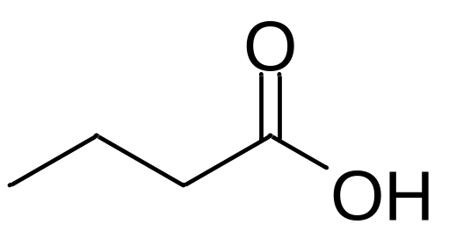
Carboxylic acids:
Highly polar
Form strong hydrogen bonds
Weak acids
Can be reduced to alcohols
Can be esterified to form esters

Slide 3
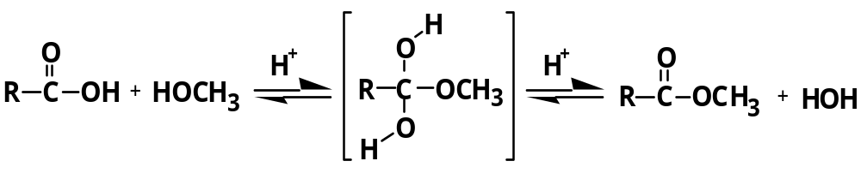
Fischer esterification:

Slide 4
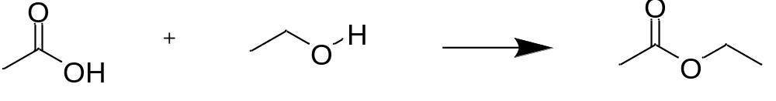
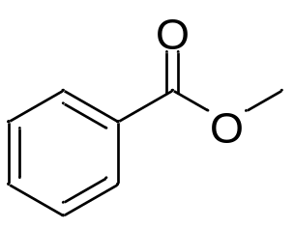
H₂SO₄
Ethanoic acid Ethanol Ethyl ethanoate
(Ethyl acetate)
Methyl benzoate

Slide 5
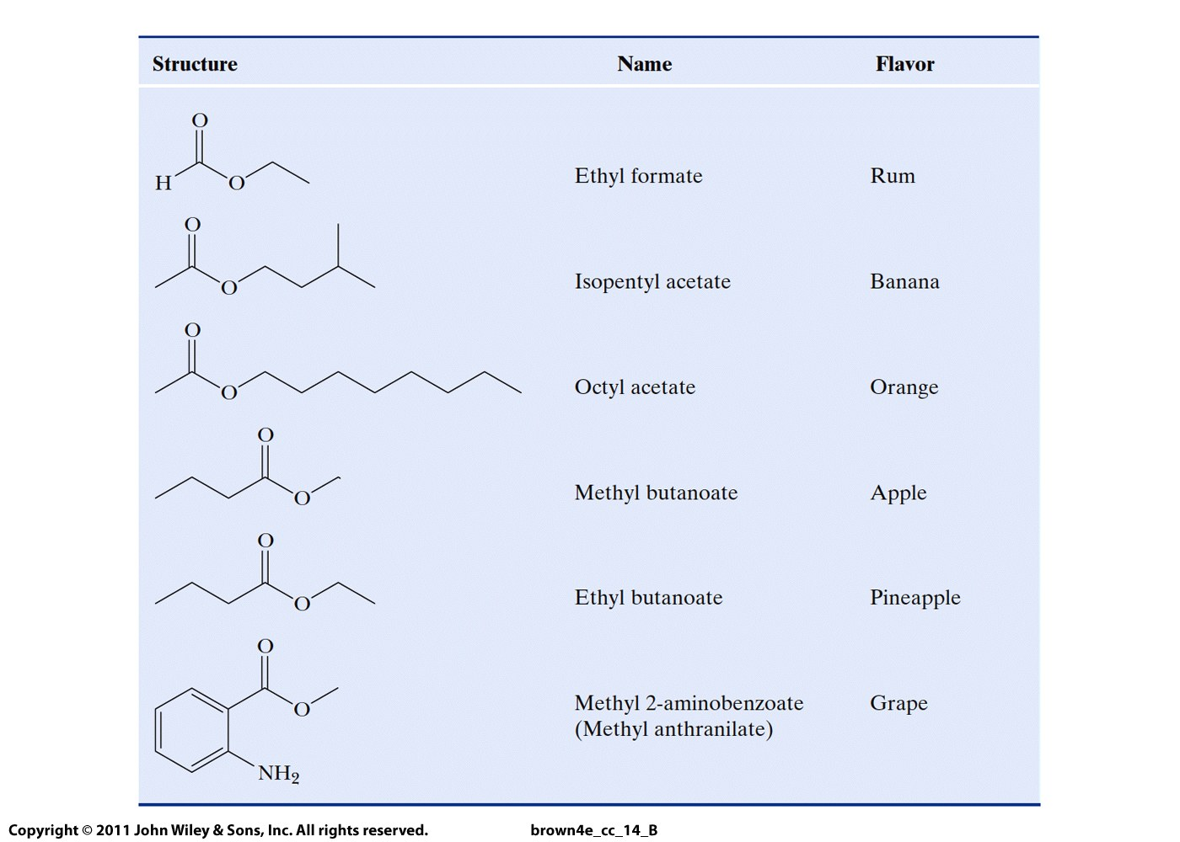
Ethyl methanoate
Isopentyl ethanoate
Octyl ethanoate

Slide 6
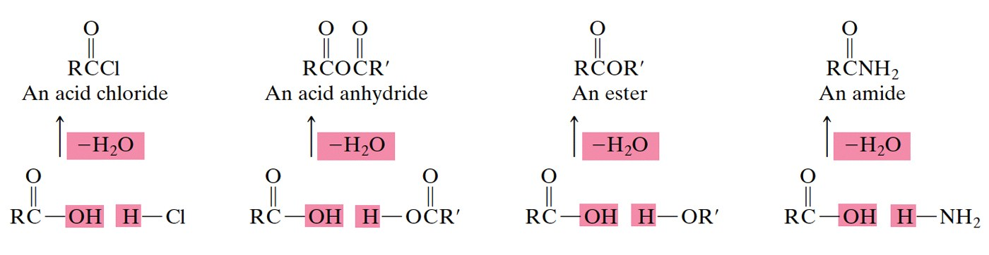
Derivatives of carboxylic acids

Slide 7
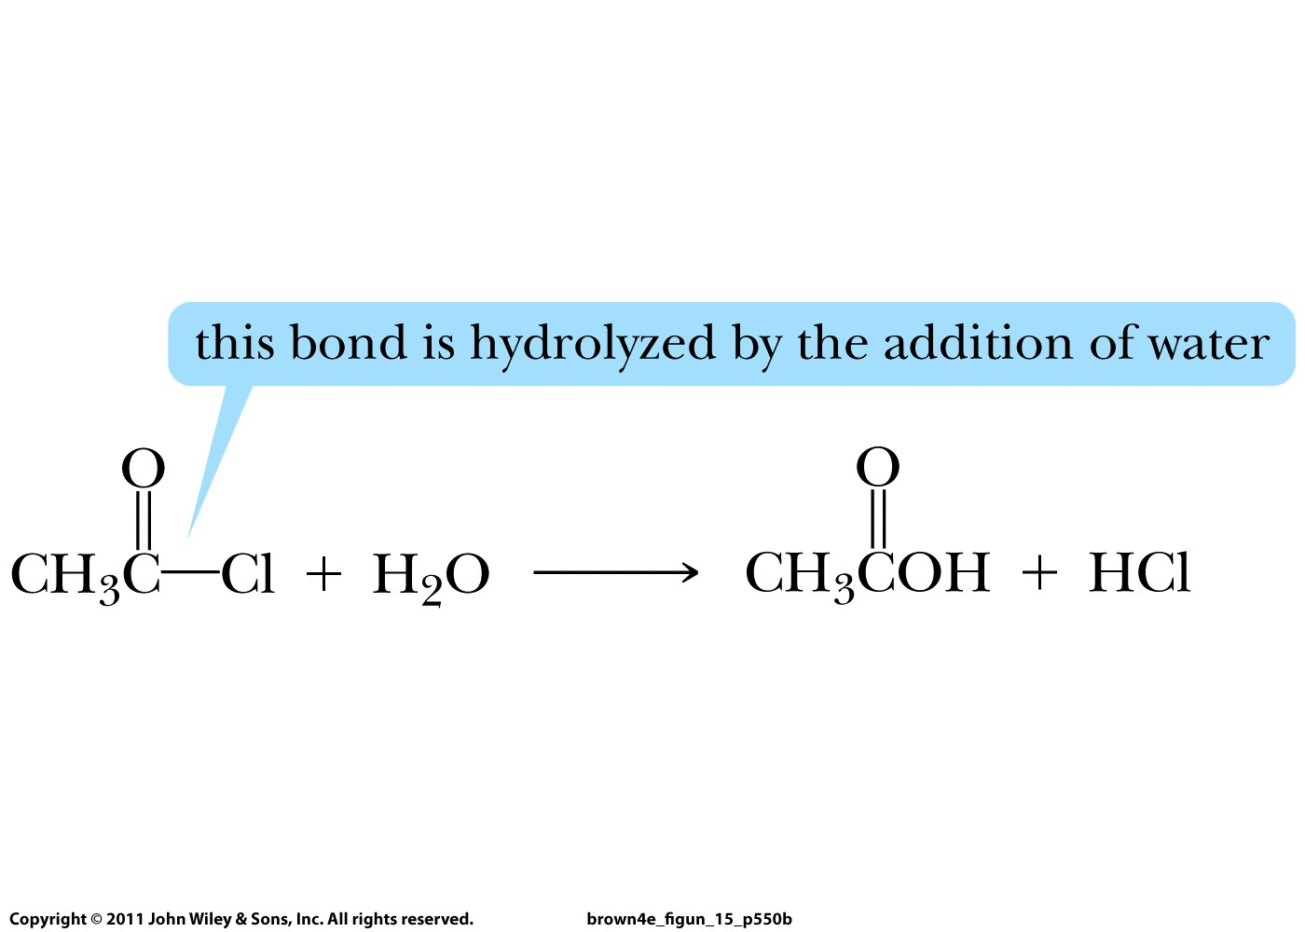

Slide 8
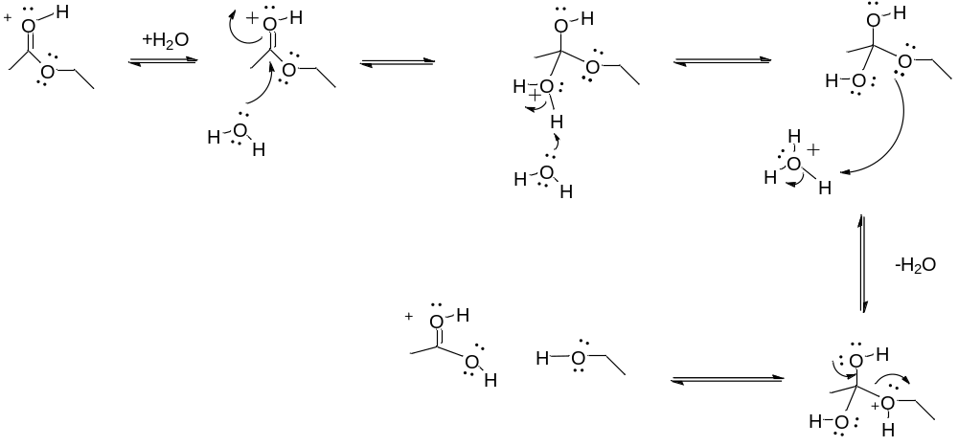
Hydrolysis of an ester:

Slide 9
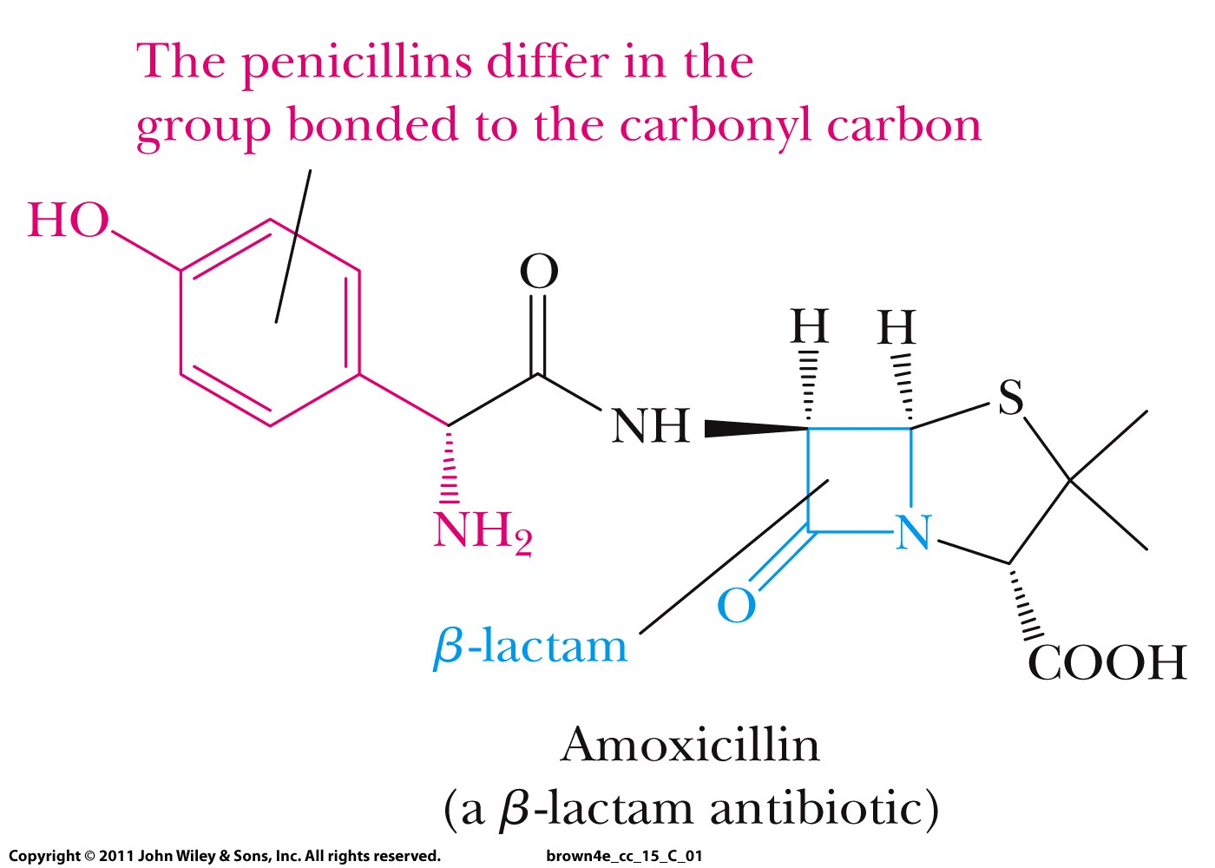

Slide 10
