Slide 1
Lecture 22:
Elimination reactions

Slide 2
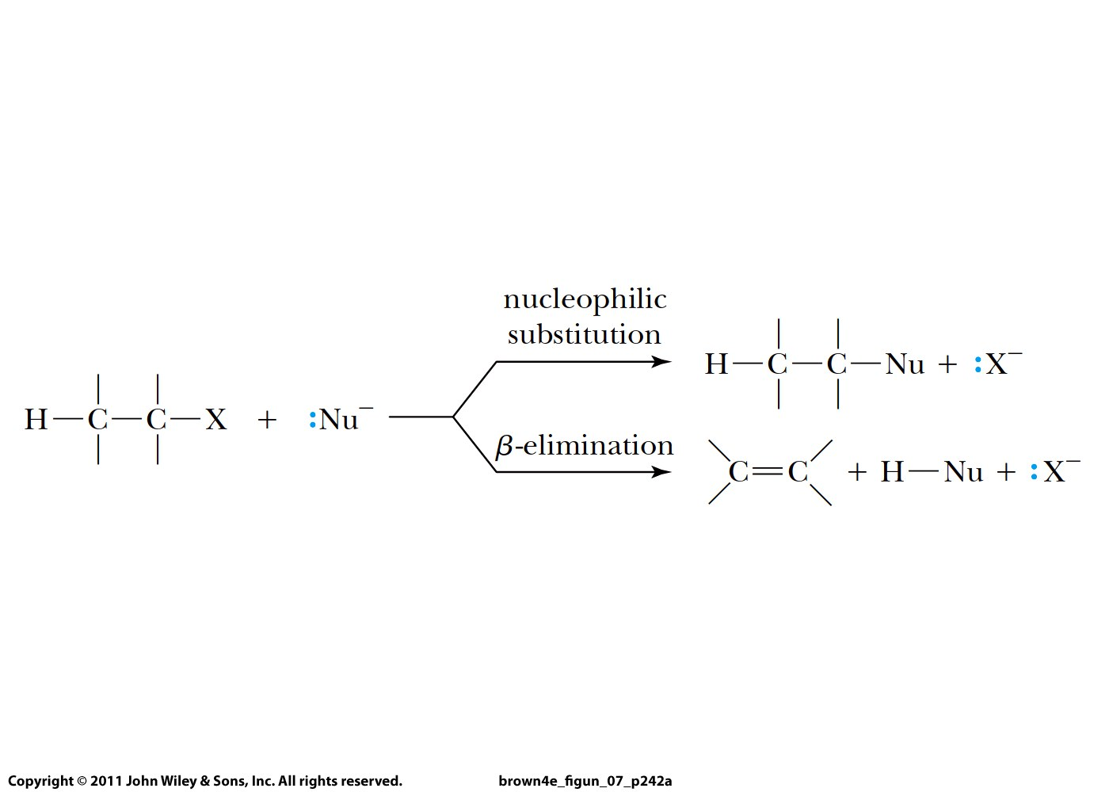

Slide 3
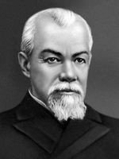
За́йцев
Alexander Mikhaylovich Zaitsev
the University of Kazan (Russia)
1875: "The alkene formed in greatest amount is the one that corresponds to removal of the hydrogen from the β-carbon having the fewest hydrogen substituents."
Zaitsev’s or Saytzeff's or Saytsev's rule

Slide 4
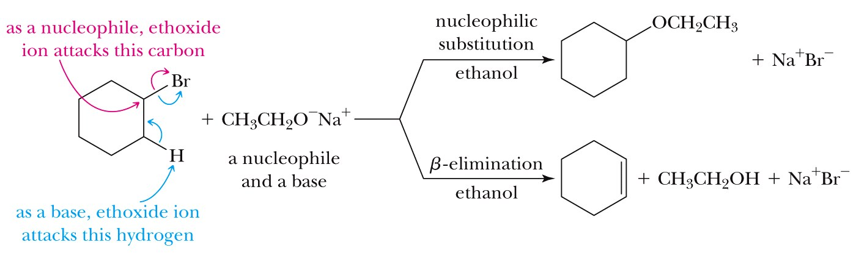
E2 elimination mechanism: two molecules present in TS
Occurs always when a strong base is used and always for 1º halides!

Slide 5
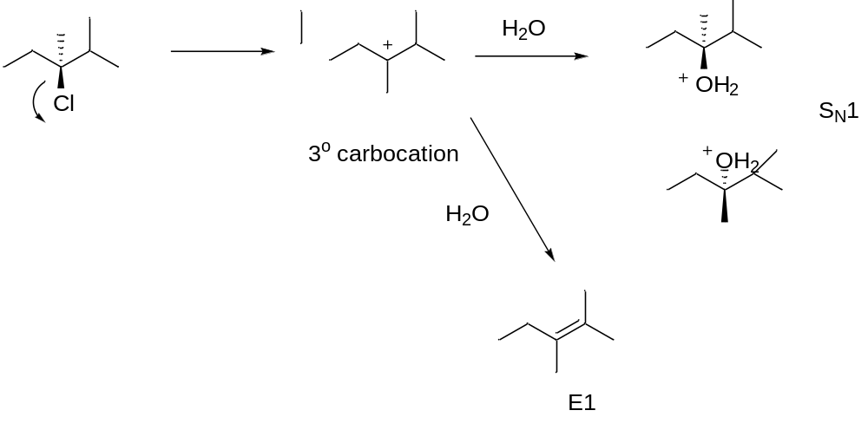
E1 elimination mechanism: one molecule present in rate-determining TS

Slide 6
E1 and E2 mechanisms:
E2 occurs for ALL primary alkyl halides
E2 occurs for ALL strong bases
E1 only occurs for secondary and tertiary alkyl halides
and only with a weak base

Slide 7
