Slide 1
Lecture 11:
E/Z nomenclature for alkenes
Nomenclature for cyclic alkenes

Slide 2
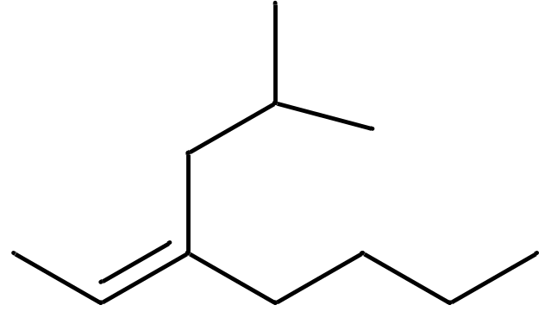
(Z)-3-isobutyl-2-heptene
Alkenes:
Both carbon atoms of C=C must be part of the parent chain
Find the longest chain that satisfies above requirement
Start numbering from the end that gives the smallest
number to the first carbon of C=C encountered
Give the next lowest number to the second carbon of C=C
Number the remaining substituents so that the first
encountered gets the smallest possible number
Remember to test for cis-, trans- and E-, Z-isomerism

Slide 3
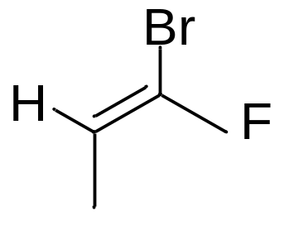
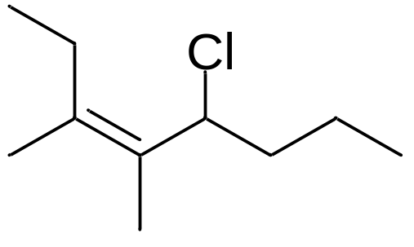
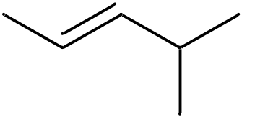
Priority rules for E, Z – nomenclature
when C=C carries three or four substituents
Rule 1: Examine atoms directly attached to each of the carbons in C=C.
A substituent with a higher atomic number takes priority
Rule 2: If there are substituents with an equal rank,
proceed to the next substituents until you find the first point of difference.
The chain with the substituent of a higher atomic number takes priority
Assign Z (= zusammen) to C=C with high priority atoms on the same
Side of C=C but E (= entgegen) if they are on opposite sides

Slide 4
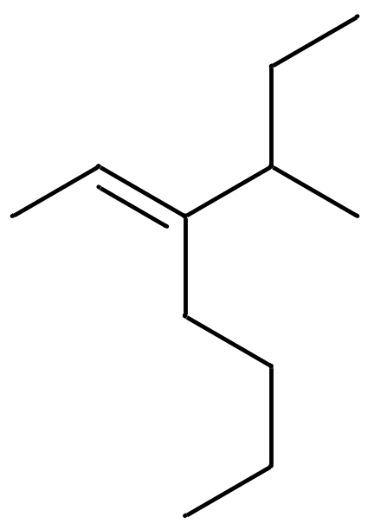
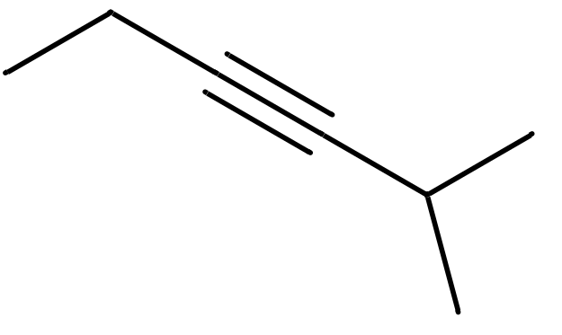
Buddy Question # 34: names?

Slide 5
Buddy Question # 34: names?
(E)-3-sec-butyl-2-heptene

Slide 6
Buddy Question # 34: names?
2-methyl-3-hexyne
(E)-3-sec-butyl-2-heptene

Slide 7
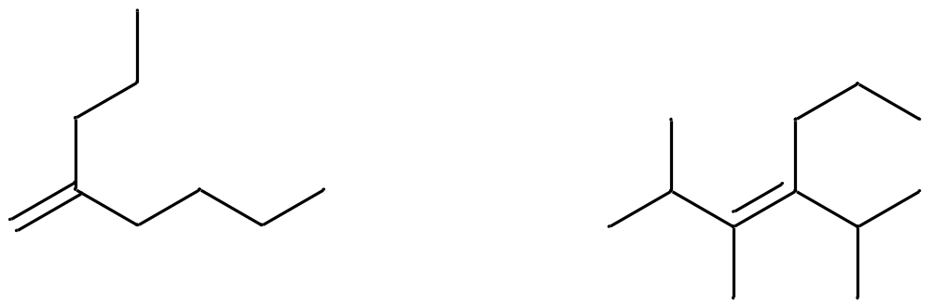
Buddy Question # 35: names?
2-propyl-1-hexene
(E)-2,3-dimethyl-4-isopropyl-3-heptene

Slide 8
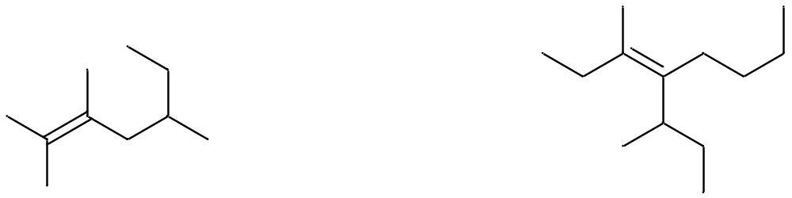
Buddy Question # 36: names?
2,3,5-trimethyl-2-heptene

Slide 9
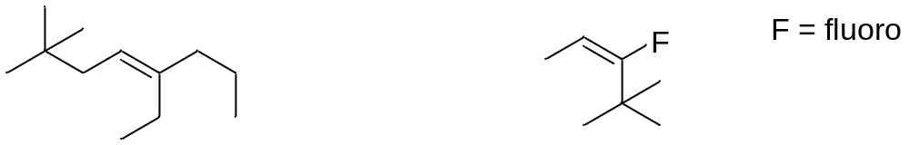
Buddy Question # 37: draw the structure of this molecule
(E)-3-fluoro-4,4-dimethyl-2-pentene

Slide 10


Slide 11

Dienes and trienes
trans,cis-2,5-octadiene

Slide 12
Buddy Question # 38: name/structure?
(E,trans)-3-isobutyl-2,4-heptadiene

Slide 13
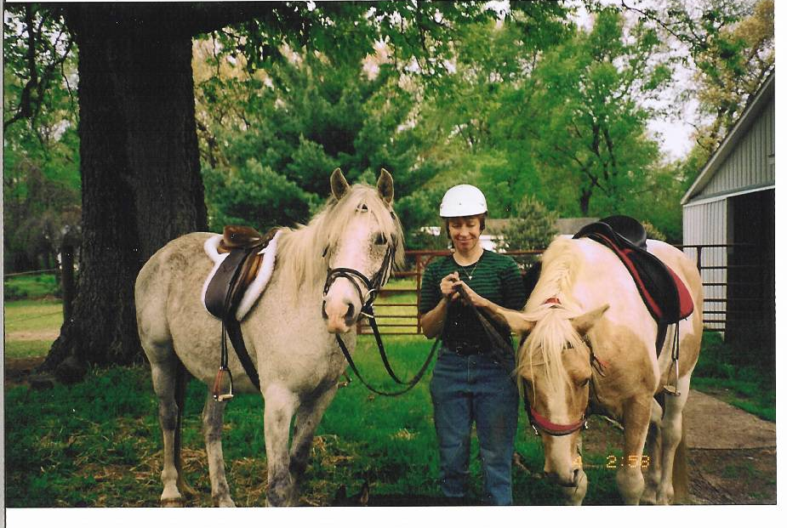
Image of Silver
Buddy

Slide 14
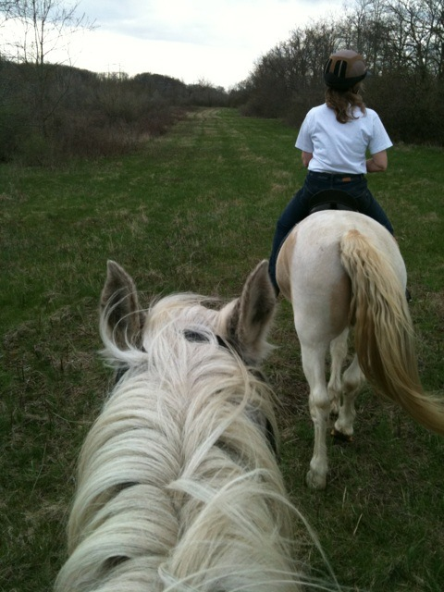

Slide 15
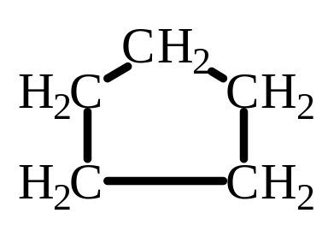

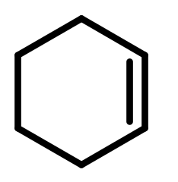
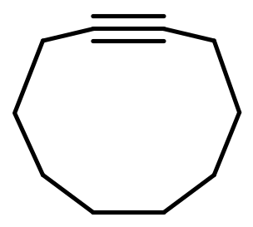
Cyclic Hydrocarbons
Cycloalkane (cyclic alkane)
Cycloalkene (cyclic alkene)
Cyclic alkynes are known, but usually only with very large rings (C₁₀) (problem: linear geometry)
Start numbering at the first
carbon in C=C or C=C
Five membered ring: cyclopentane
3
4
2
1
4-methylcyclohexene
Cyclodecyne

Slide 16
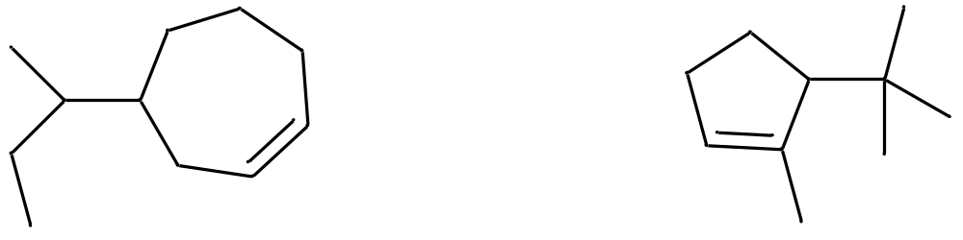
Buddy Question # 39:
Name/structure

Slide 17
Buddy Question # 39
Name/structure
4-sec-butylcycloheptene

Slide 18
Buddy Question # 39:
Name/structure
4-sec-butylcycloheptene
5-tert-butyl-1-methylcyclopentene

Slide 19
Buddy Question # 39:
Name/structure
4-sec-butylcycloheptene
5-tert-butyl-1-methylcyclopentene

Slide 20
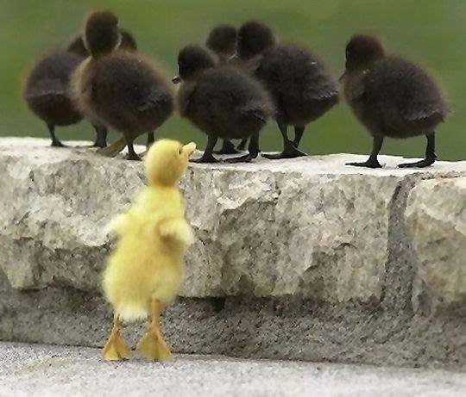

Slide 21
QUIZ

Slide 22
QUIZ
Draw the structure for this molecule:
(Z)-4-sec-butyl-3-methyl-3-octene

