Slide 1
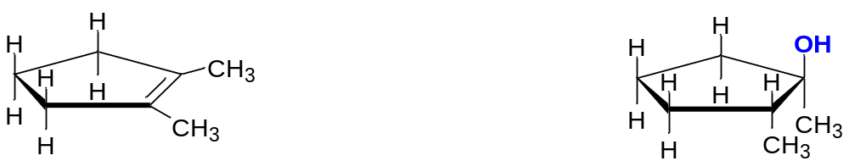
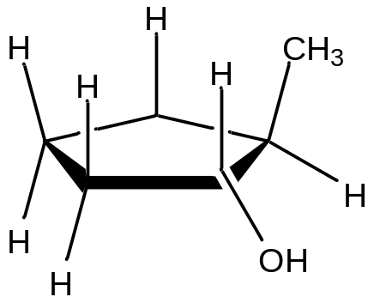
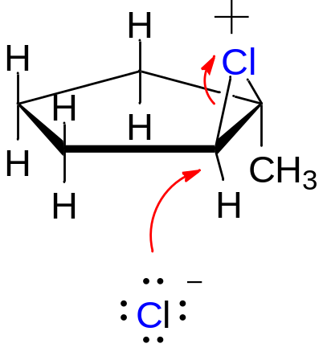
QUIZ = Buddy Question # 48
What products are formed in this reaction?
BH₃
NaOH, H₂O₂
BH3

Slide 2
Lecture 18:
Nomenclature of haloalkanes
Reactions of haloalkanes

Slide 3
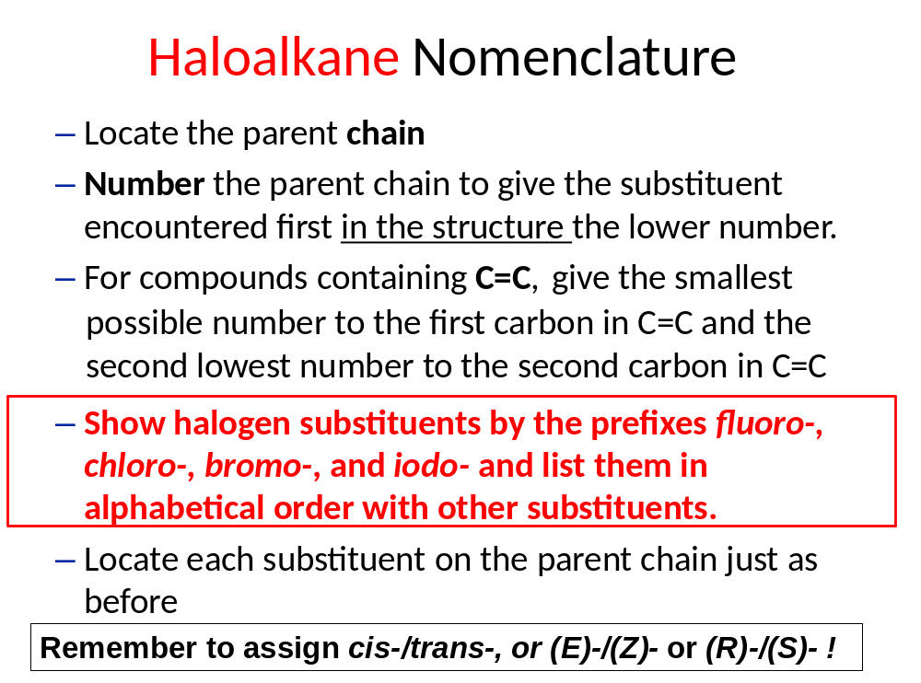

Slide 4
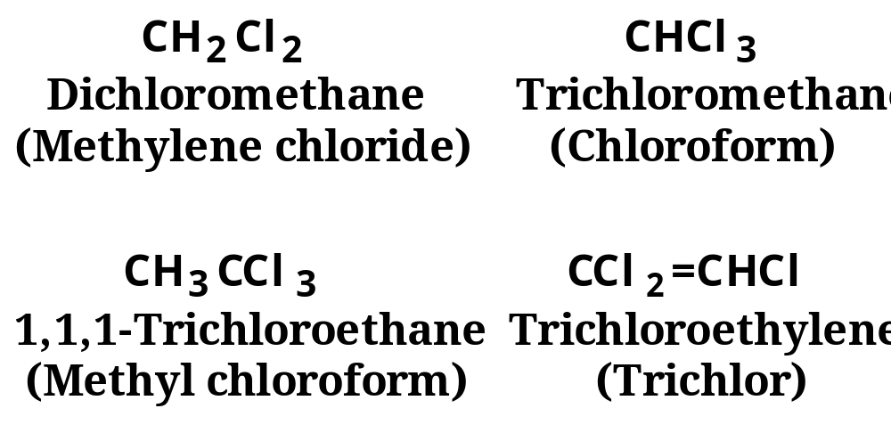
Nomenclature
Several polyhaloalkanes are common solvents and are generally referred to by their common or trivial names.

Slide 5
Common names for simple compounds:
Alkyl halide:
Ethyl iodide iodoethane
Hexyl fluoride 1-fluorohexane
tert-Butyl bromide 2-bromo-2-methylpropane

Slide 6
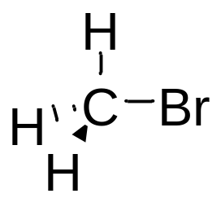
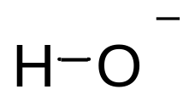
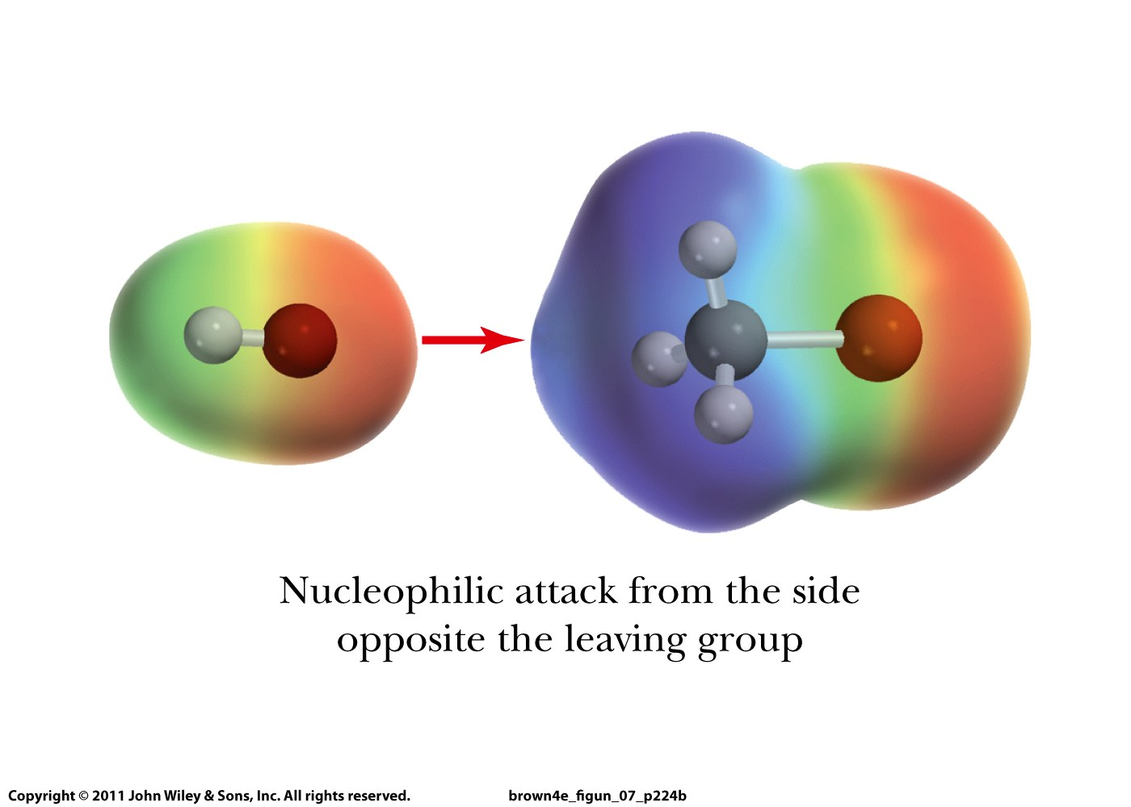

Slide 7
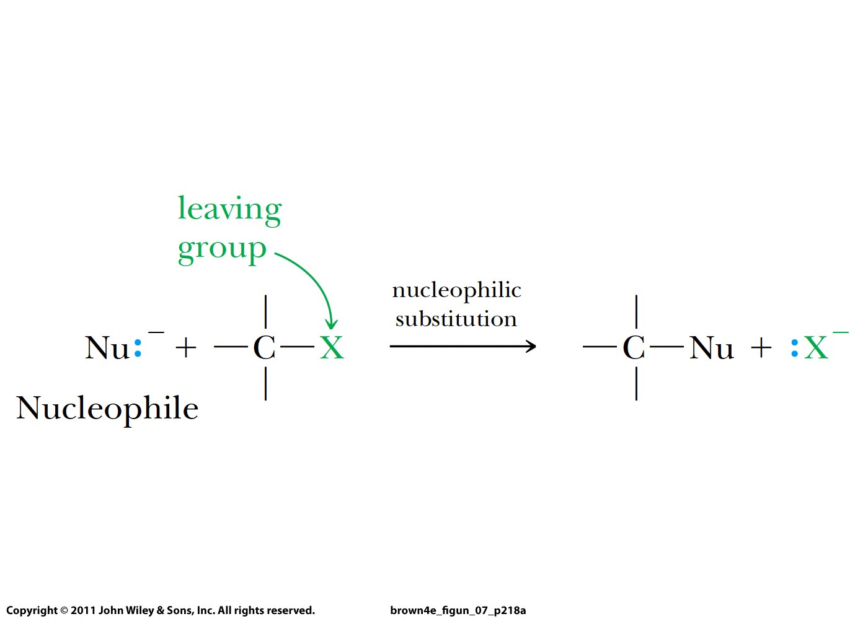

Slide 8
