Slide 1
Lecture 4
Lewis structures of molecules
Formal charges

Slide 2
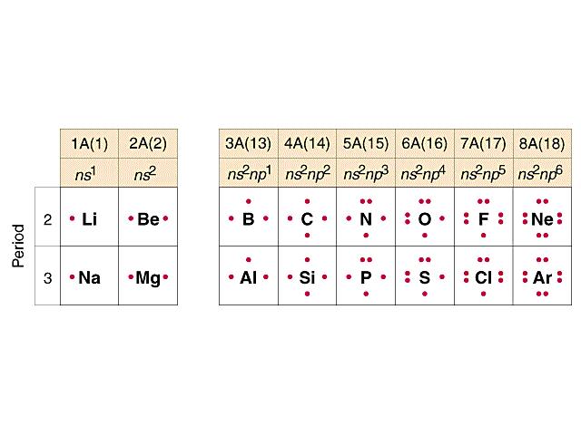
Lewis electron-dot structures
8 - number of dots = number of covalent bonds
that nonmetals form

Slide 3
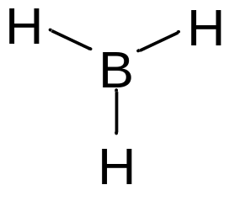
Lewis structures of molecules
  the atoms in a molecule (or covalent ion)
  what atoms are bound to each other
  the location and type of bonds
  the location and number of lone pairs
  formal charge of each atom

Slide 4
Lewis Structures
●
●
●
●
●
●
●
●
O N-Cl
●
●
●
●
1. Choose the central atom
2. Draw bonds to other atoms
3. Count valence electrons
4. Count the remaining electrons (after bonds)
Distribute them as lone pairs and/or multiple bonds
Verify that all atoms have 8 electrons

Slide 5
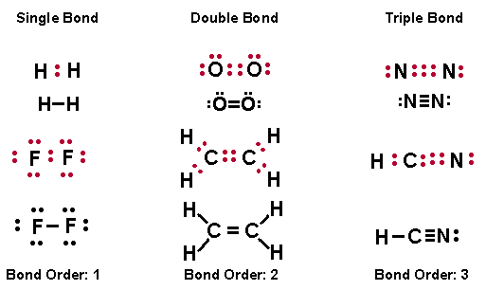
Multiple Bonds
Commonly, double and triple bonds are limited to C, O, and N.
In addition, P, S, and Se may form double or triple bonds

Slide 6
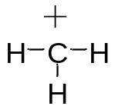
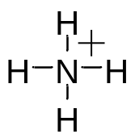

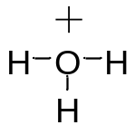

C 4 bonds 0 lone pairs no charge
C 3 bonds 0 +1
N 3 1 no charge
N 4 0 +1
O 2 2 no charge
O 1 3 -1
O 3 1 +1
F 1 3 no charge
F 0 4 -1
Too few electrons
Sharing too many e’s
Too many electrons
Sharing too many e’s
Too many electrons

Slide 7
Formal Charge
Formal charge is a “bookkeeping” tool to help predict the arrangement of atoms in a molecule and the validity of Lewis structures.
To determine the formal charge:
Formal
Charge =
# valence e⁻
in unbound atom
-
-
# non-bonding e⁻
# bonds

