Slide 1
Exam III covers material from lectures 20 - 28
(starting at reactions of secondary alkyl halides and ending with amine lecture)
All Buddy Questions with and without answers and old exams will be on Blackboard

Slide 2

CHM 257
7:30-8:30 PM WTHR 360
6:30-7:30 WTHR 360
SUPPLEMENTAL INSTRUCTION
Friday 11:30-12:30 PM KRCH 431

Slide 3
Lecture 30:
Nuclear Magnetic Resonance
(NMR) spectroscopy

Slide 4

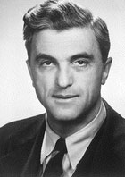
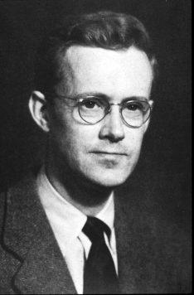
Nobel Price in Physics 1952:
NMR of liquids and solids
Felix Bloch, Swiss-born,
Stanford
Edward Purcell, Harvard

Slide 5
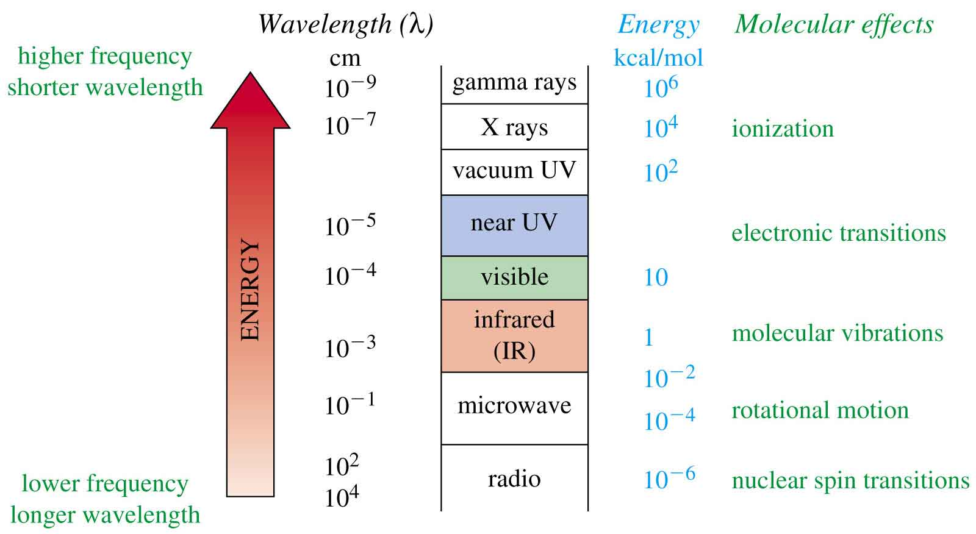
The Spectrum and Molecular Effects
=>

Slide 6
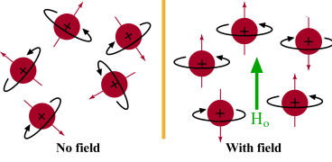
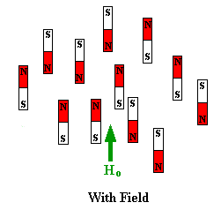
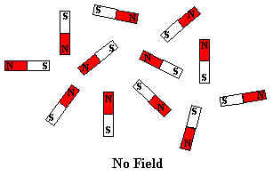

Slide 7
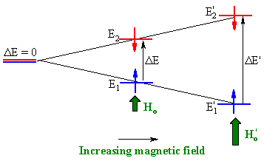

Slide 8
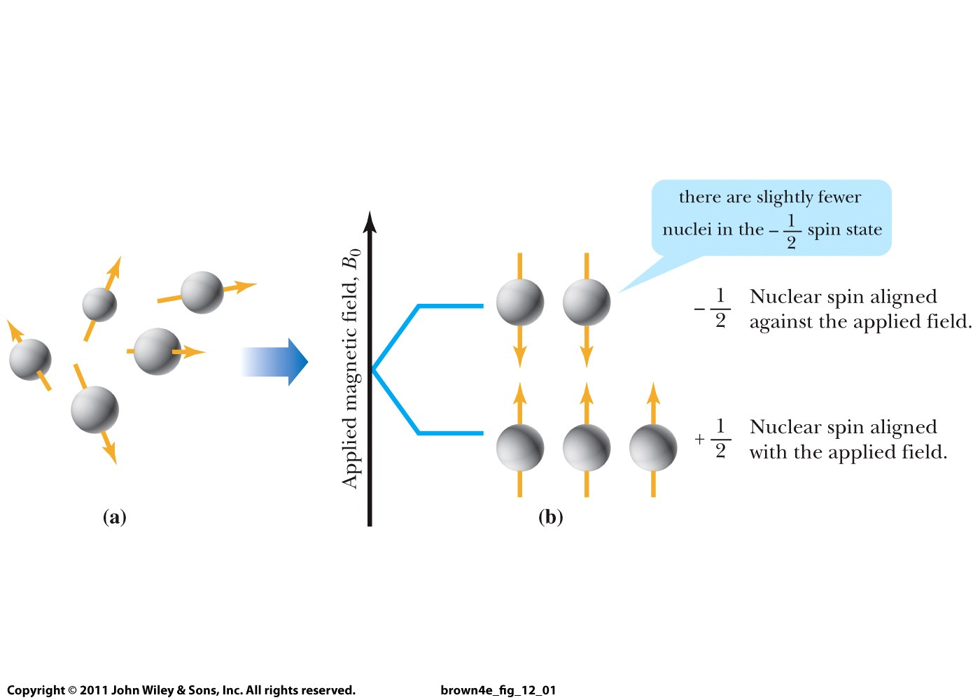
Nucleii have random spins
In a magnetic field, the spins are aligned

Slide 9
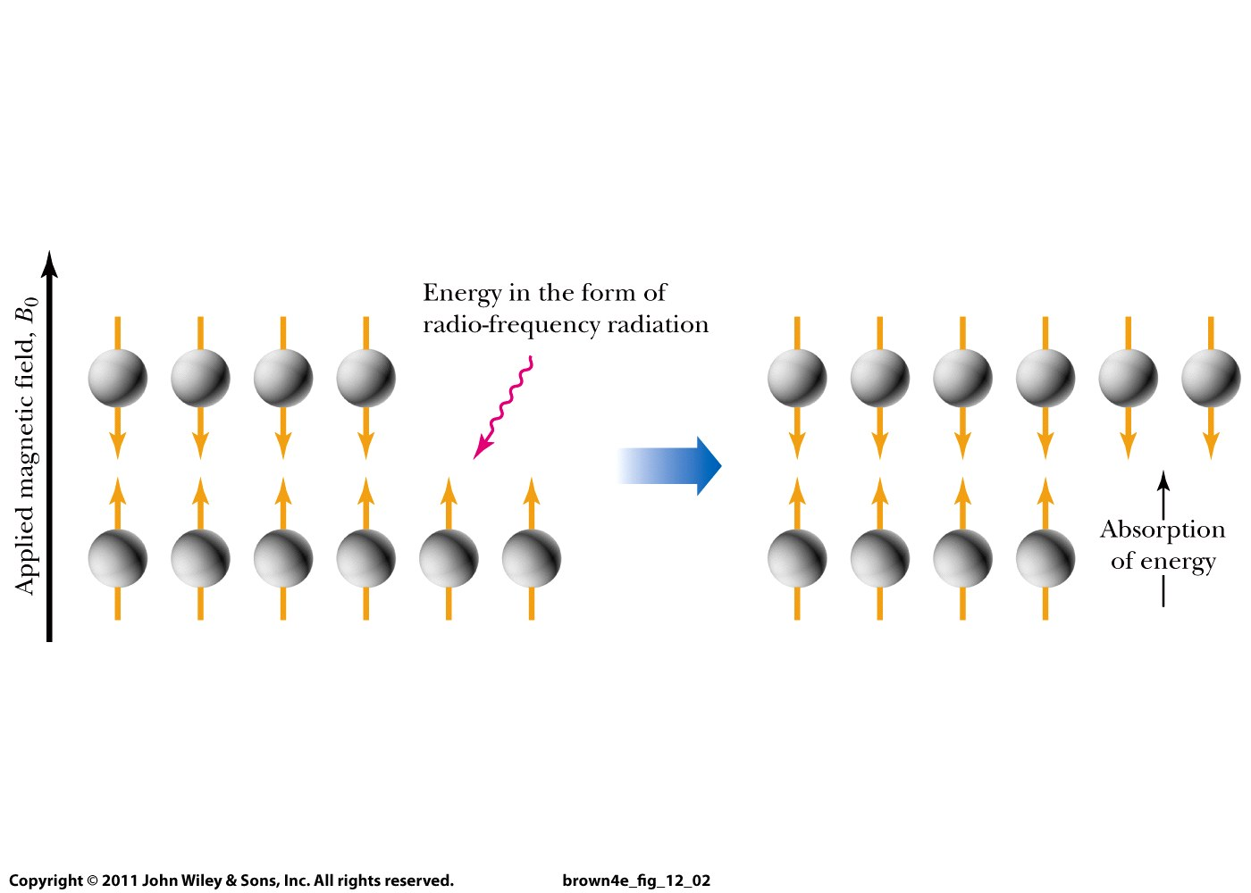

Slide 10
NMR
In an applied field strength of 7.05 tesla (T), which is readily available with present-day superconducting electromagnets, the difference in energy between nuclear spin states for
  ¹H is approximately 0.120 J (0.0286 cal)/mol, which corresponds to electromagnetic radiation of 300 MHz (300,000,000 Hz).
  ¹³C is approximately 0.030 J (0.0072 cal)/mol, which corresponds to electromagnetic radiation of 75 MHz (75,000,000 Hz).

Slide 11
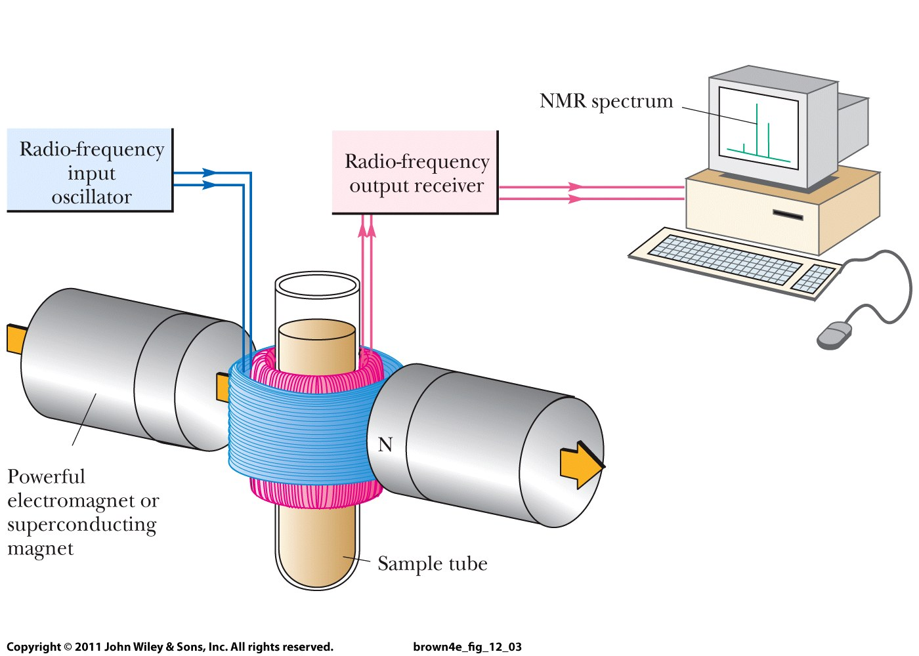

Slide 12
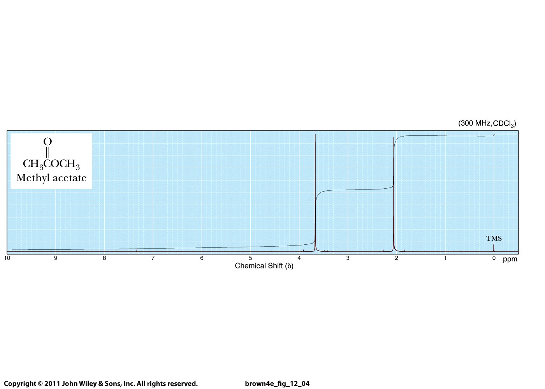

Absorption of energy measured as a function of frequency of rf radiation and expressed as ppm relative to the
frequency of absorption for tetramethylsilane (TMS)
Tetra-
methyl-
silane

Slide 13
Two different types of H-atoms
These Hs are less shielded than TMS
Less highly
shielded
More highly
shielded

Slide 14
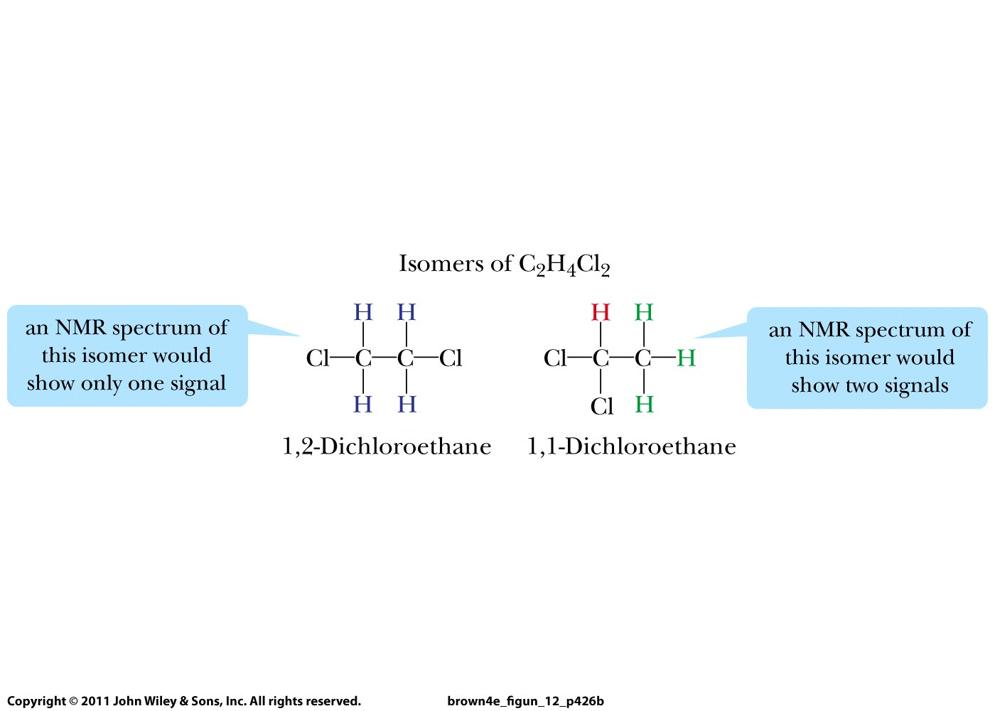
Number of NMR signals =
Number of differently shielded atoms

Slide 15
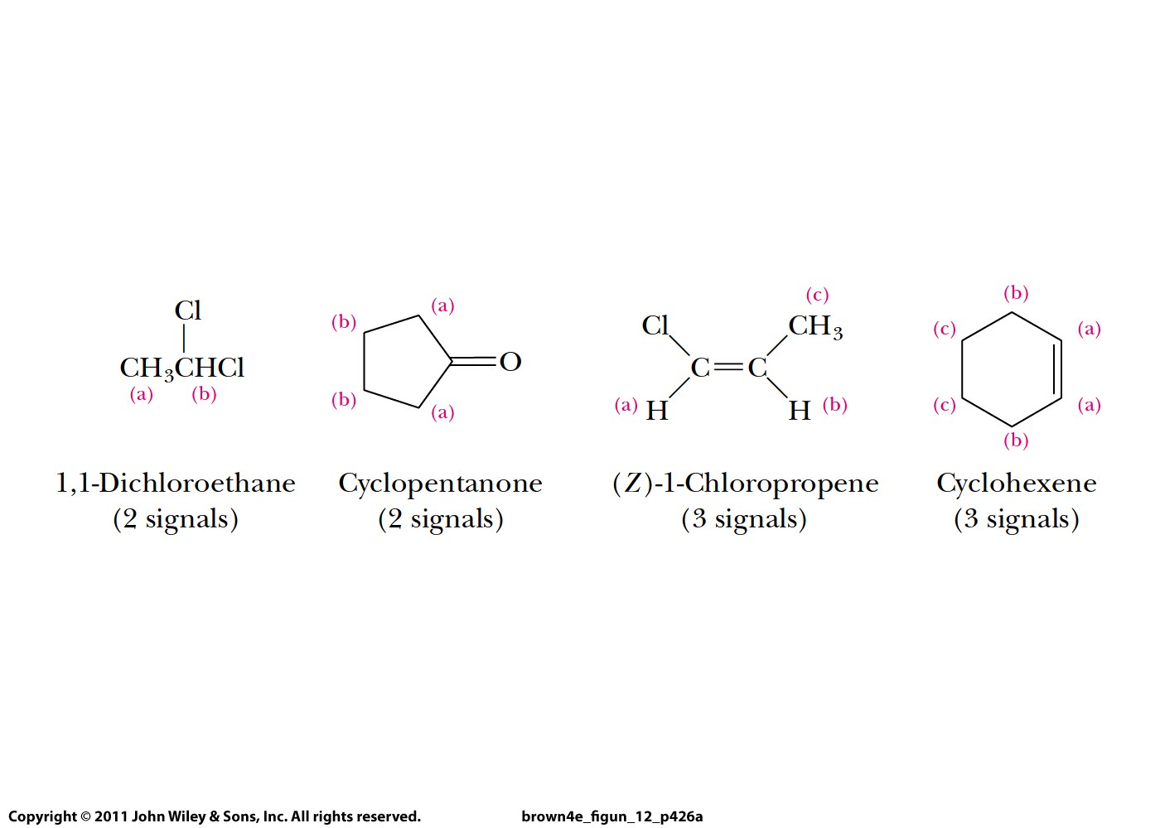

Slide 16
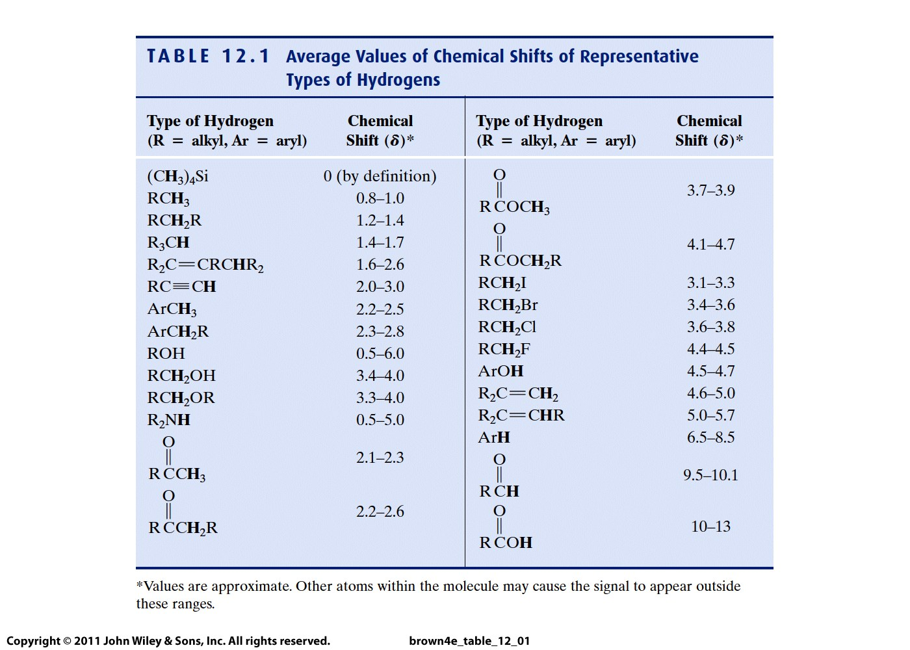
More
highly
shielded
Less
shielded

Slide 17
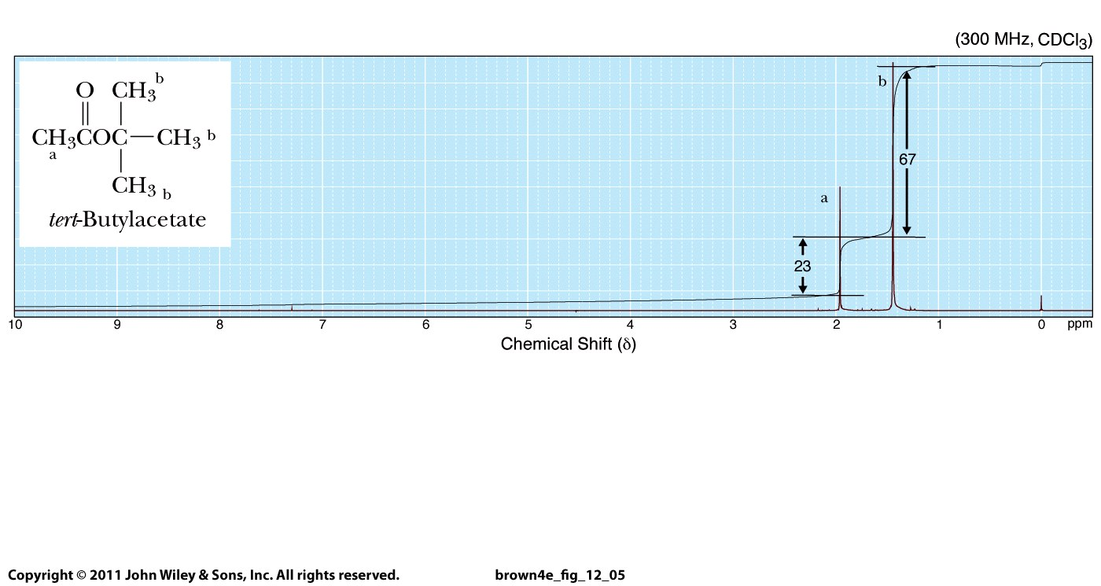

Slide 19
More
highly
shielded
Less
shielded

Slide 20
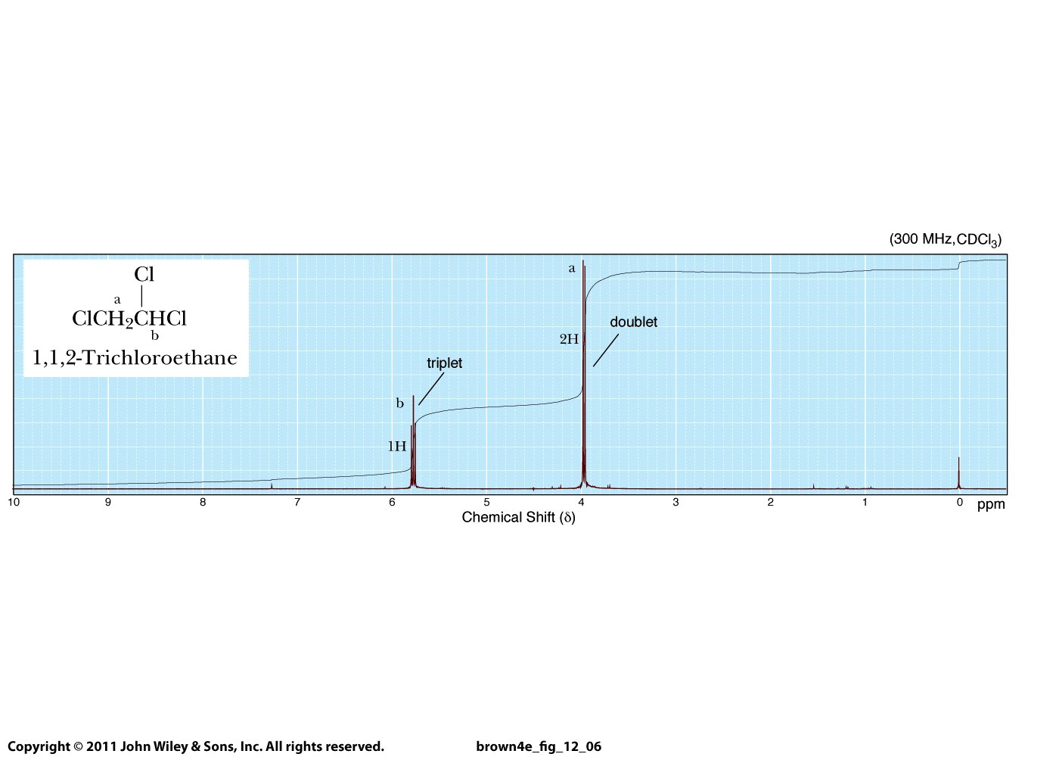

Slide 21
