Slide 1
Lecture 24:
Reactions of alcohols

Slide 2
Characteristic Reactions of Alcohols:
Reduction with active metals: 2 ROH + 2 Na 2 RONa + H₂
Conversion to alkyl halides: ROH + HX RX + H₂O
3. Dehydration to alkenes: ROH H₂O + alkene (acid catalyst)
4. Oxidation to aldehydes, ketones or carboxylic acids:
ROH R’-CHO or R’R”CO or R’COOH

Slide 3
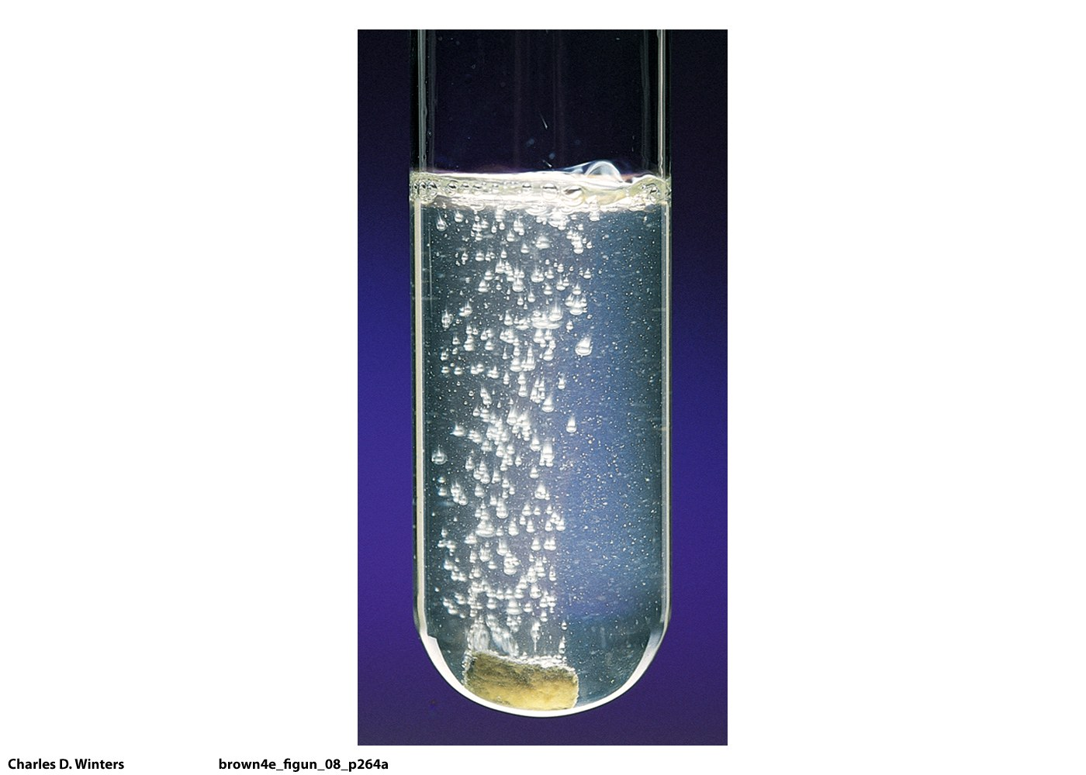

Slide 4
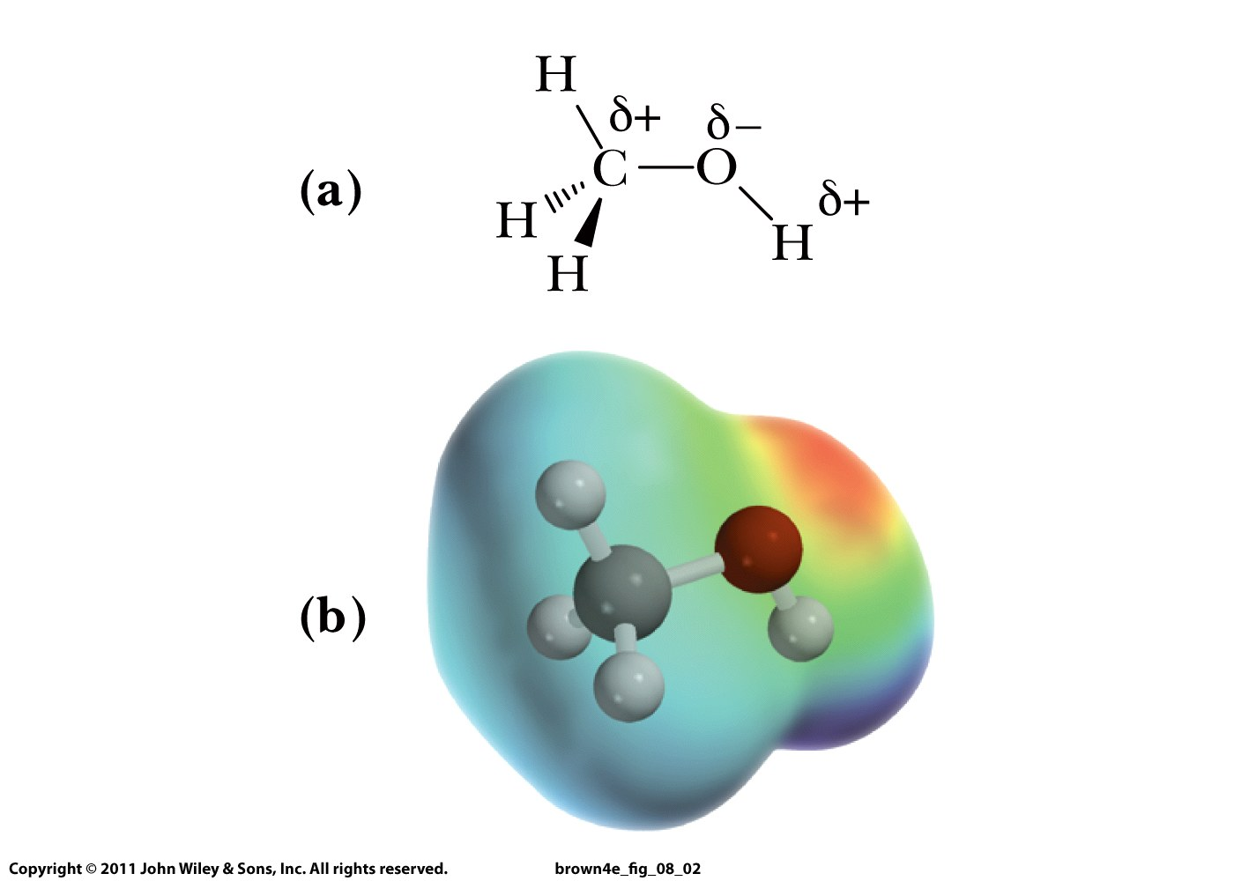

Slide 5
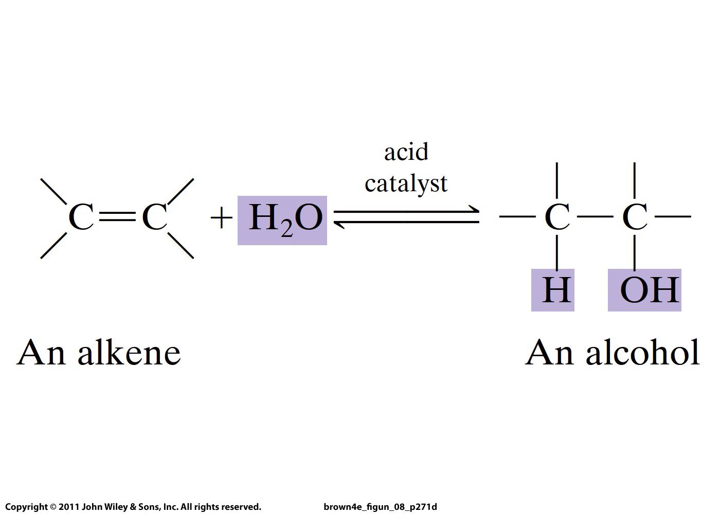
Weak nucleophile
and base!

Slide 6
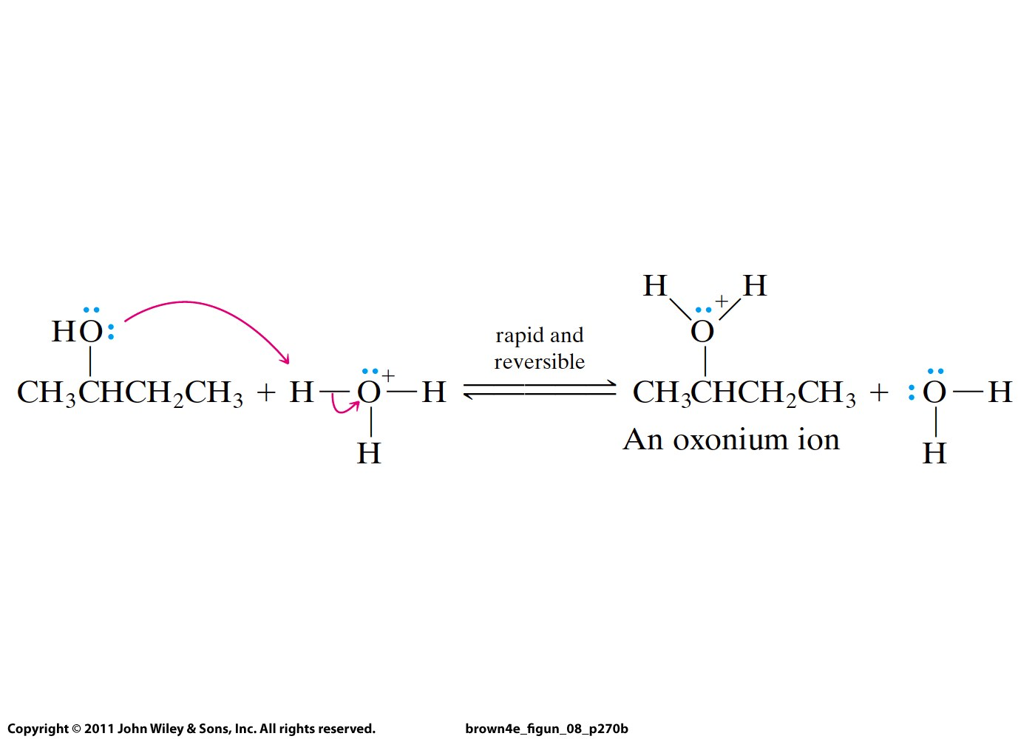
Formed due to
the acid catalyst
(e.g., H₂SO₄)

Slide 7
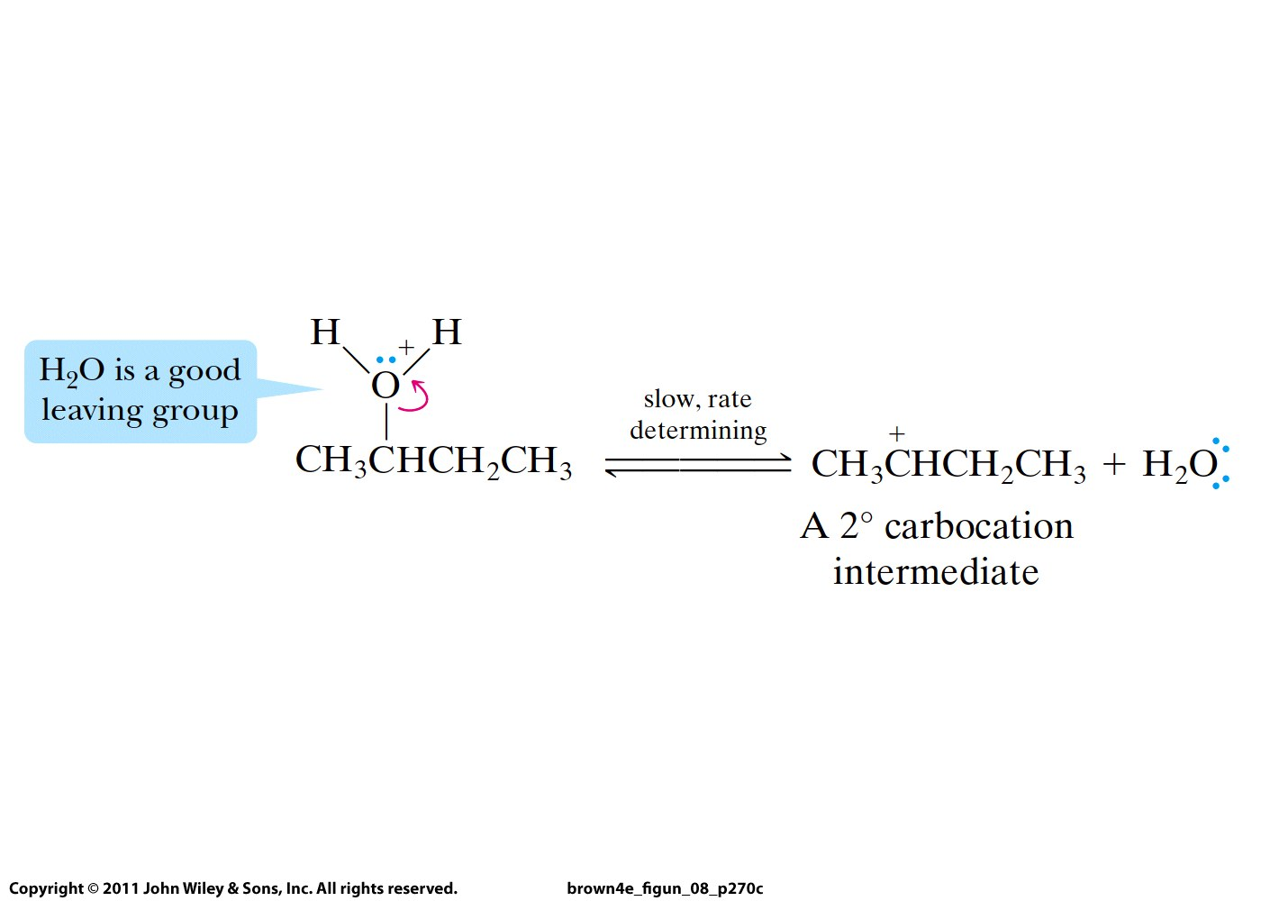
Secondary and tertiary alcohols:
H₂O is a weak nucleophile => E1/S_{N}1 reaction
(but S_{N}1 gives back the alcohol so no products)

Slide 8
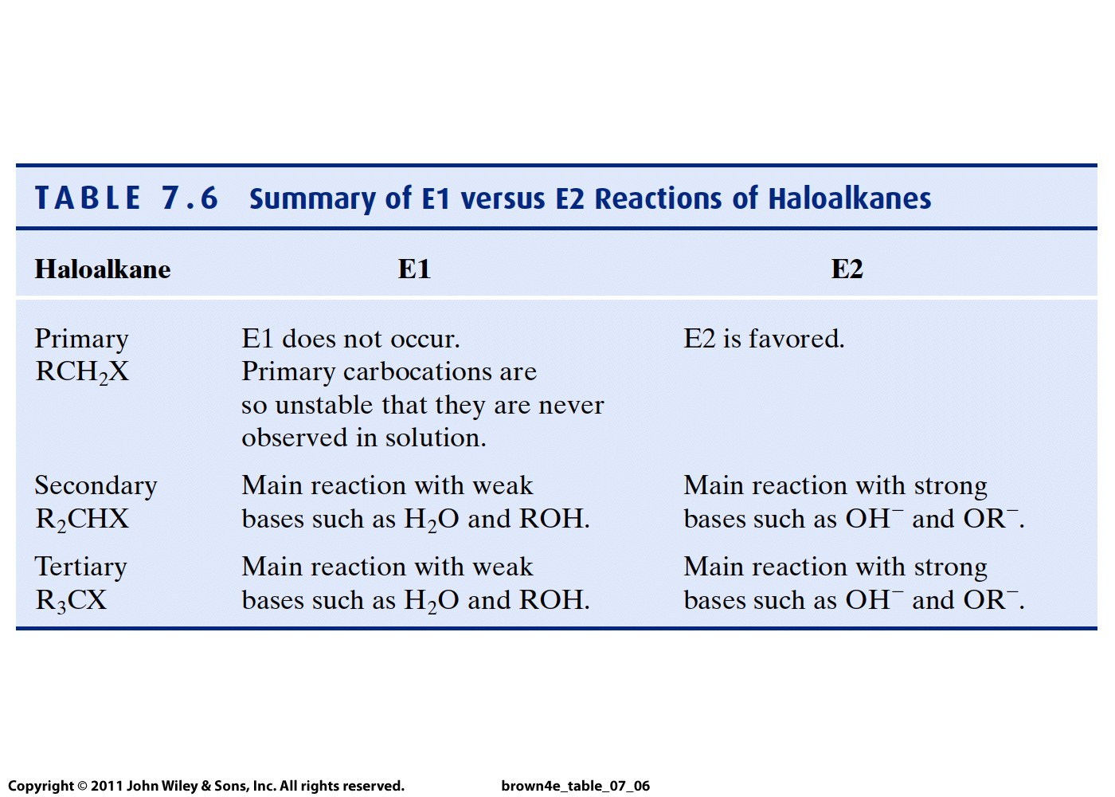

Slide 9
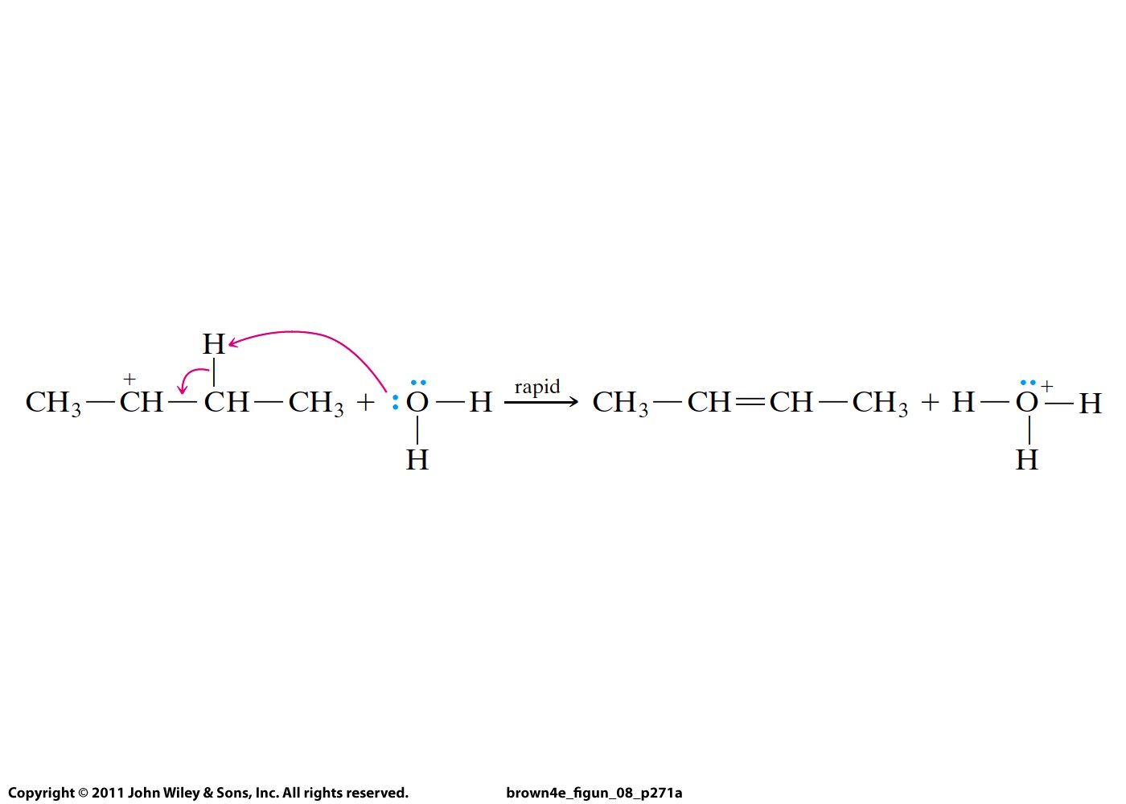
E1 for secondary and tertiary alcohols:

Slide 10
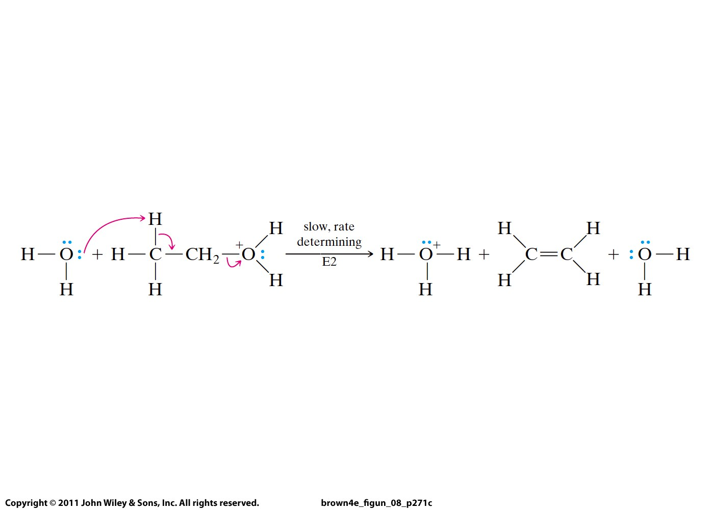
For primary alcohols, E2 takes place:

