Slide 1
Lecture 33:
Reactions of Ketones and Aldehydes

Slide 2
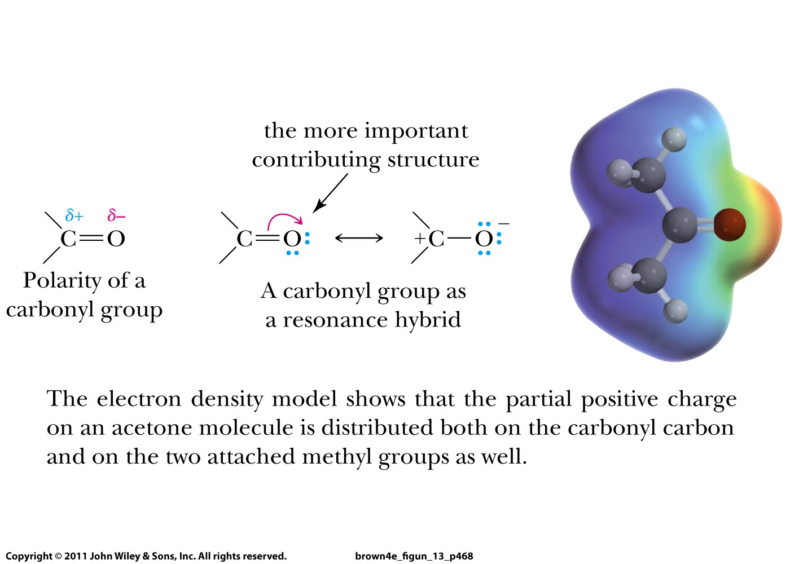

Slide 3
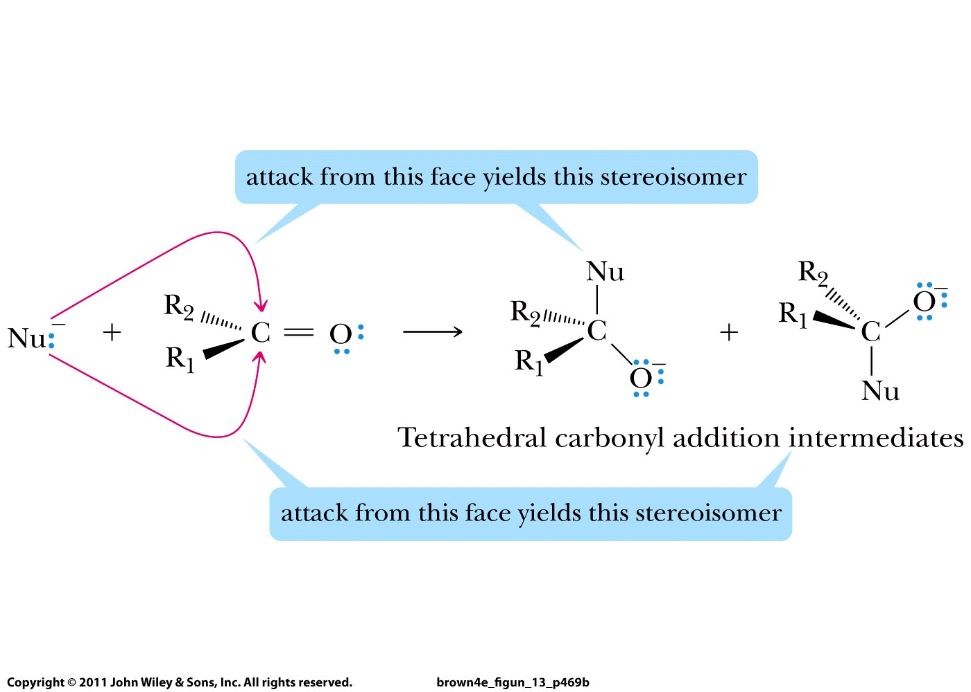

Slide 4
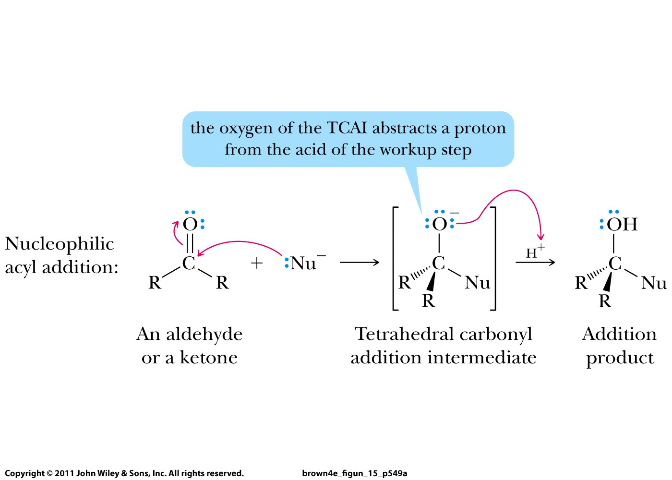

Slide 5
Reactions of ketones and aldehydes
Grignard reaction
Reactions with alcohols (acid/base catalyst)
Reactions with amines (acid catalyst)
Keto-enol tautomerism (acid/base catalyst)
Reduction

Slide 6
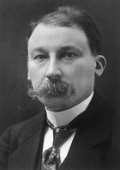

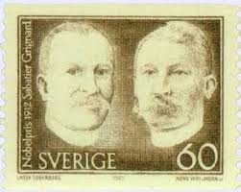
Victor Grignard:
Nobel Price in 1912 in Chemistry
French mathematician turned into an organic chemist

Slide 7
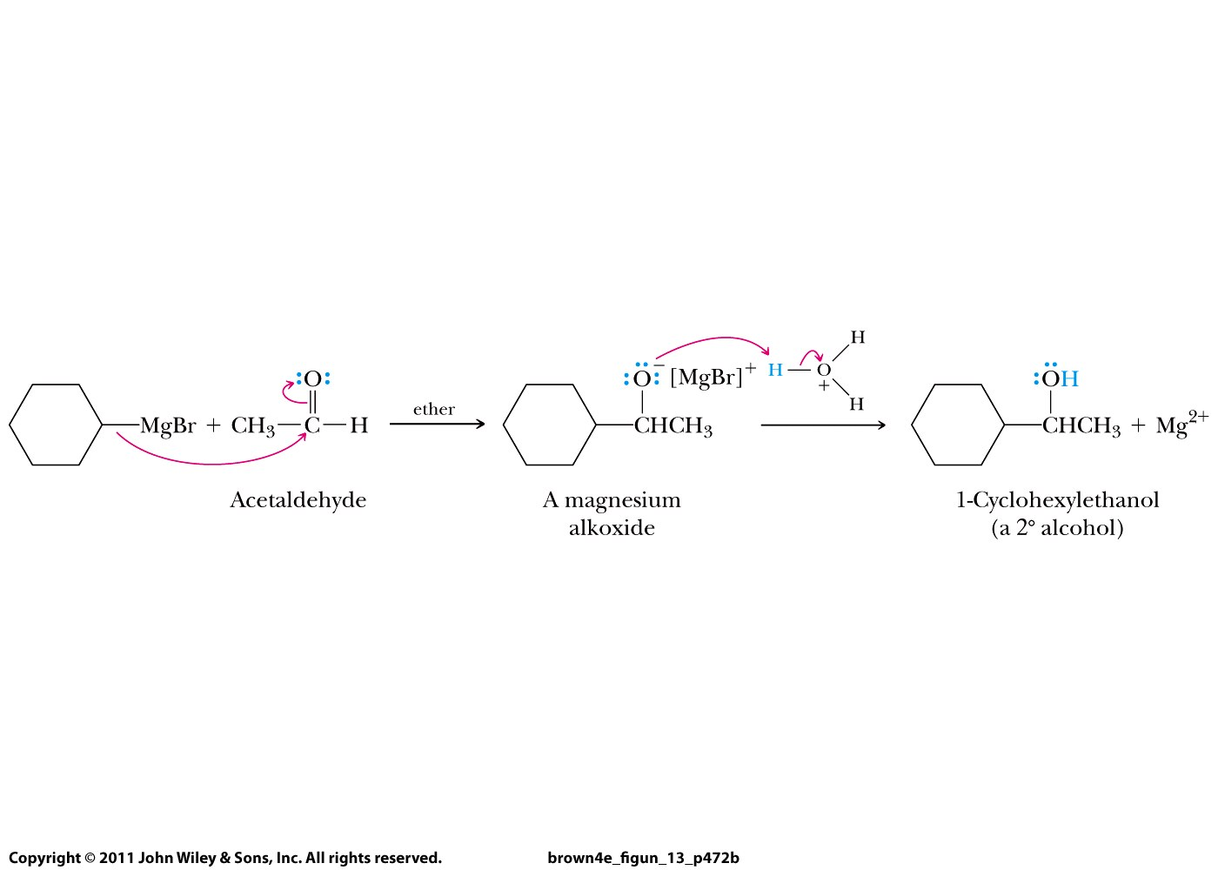
Grignard
reagent

Slide 8
Reactions of ketones and aldehydes
Grignard reaction
Reactions with alcohols:
  Acid catalysis
  Base catalysis
Reactions with amines
Keto-enol tautomerism
Reduction

Slide 9
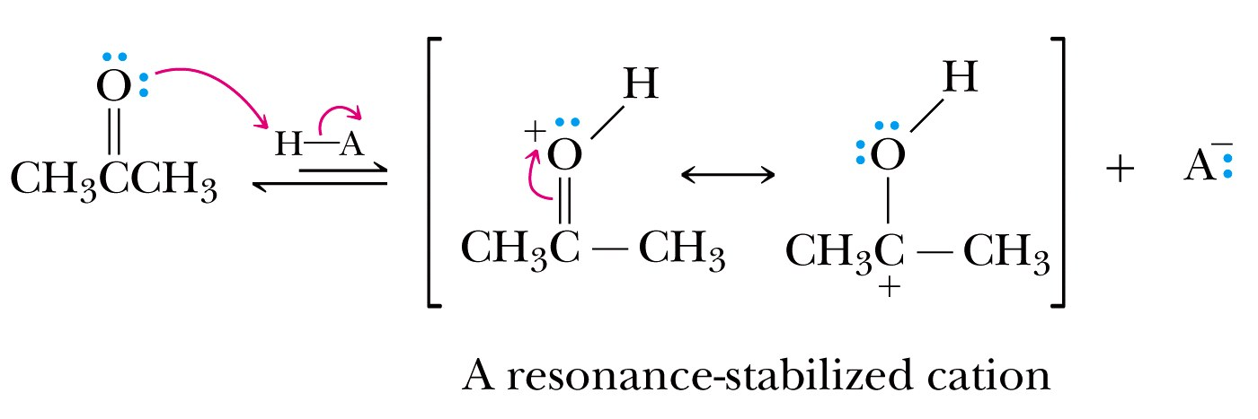
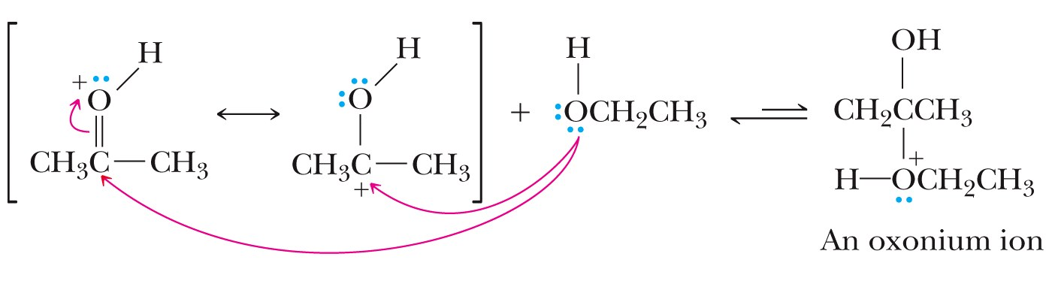

Slide 10
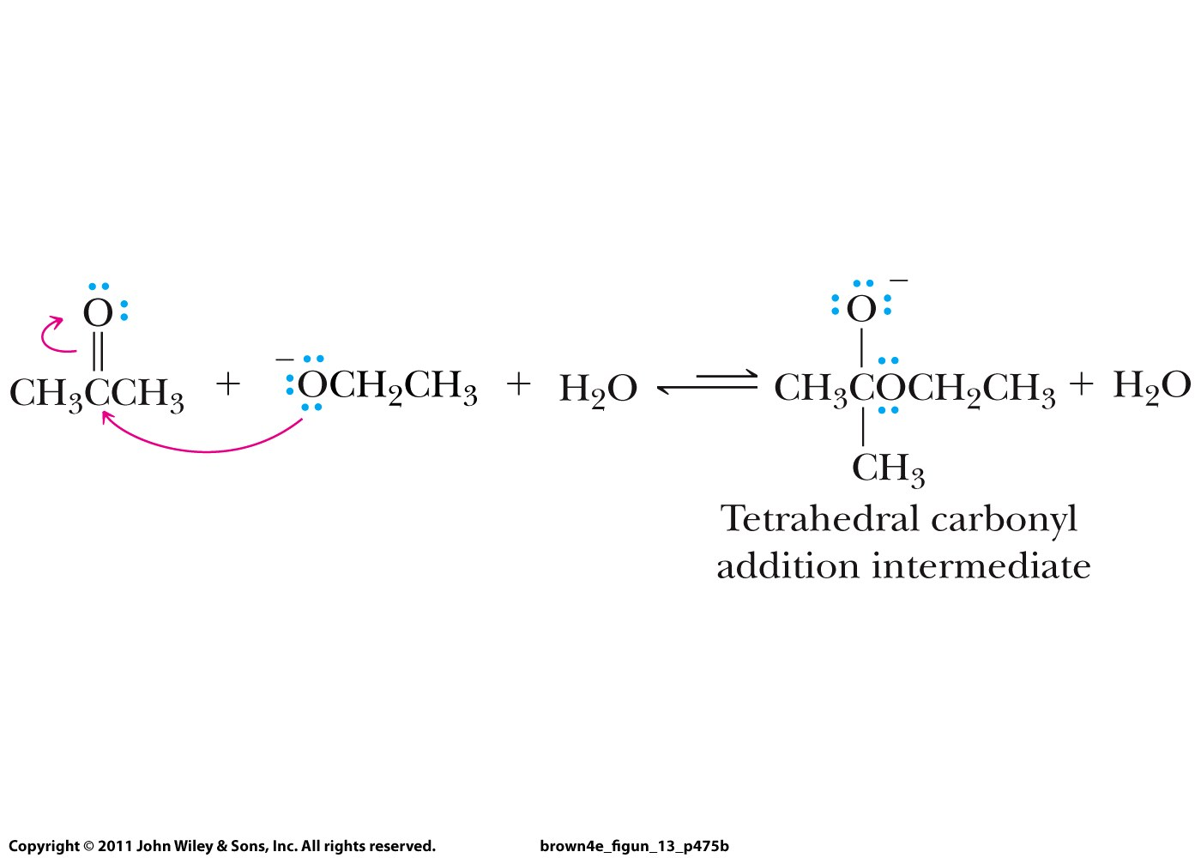
Base catalysis:

