Slide 1
Lecture 34:
Reactions of Ketones and Aldehydes

Slide 2
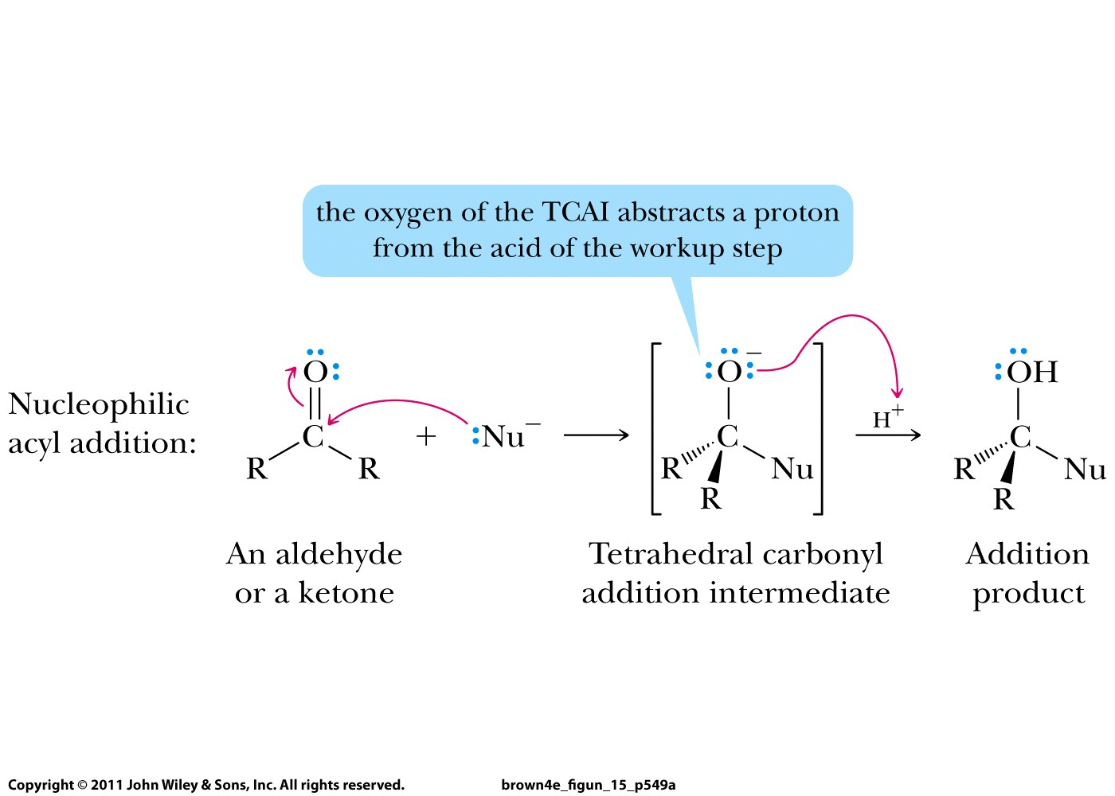

Slide 3
Reactions of ketones and aldehydes
Grignard reaction
Reactions with alcohols (acid/base catalyst)
Reactions with amines (acid catalyst)
Keto-enol tautomerism (acid/base catalyst)
Reduction

Slide 4
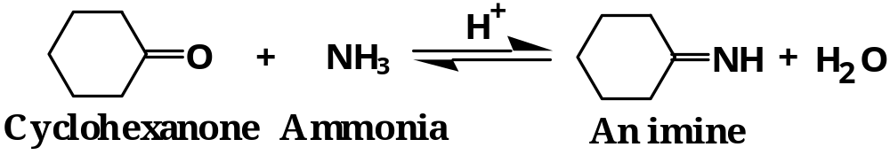
Reactions of ammonia and primary amines:
Elimination of H₂O explains why secondary
(R₂NH) and tertiary amines (R₃N) do not react

Slide 5
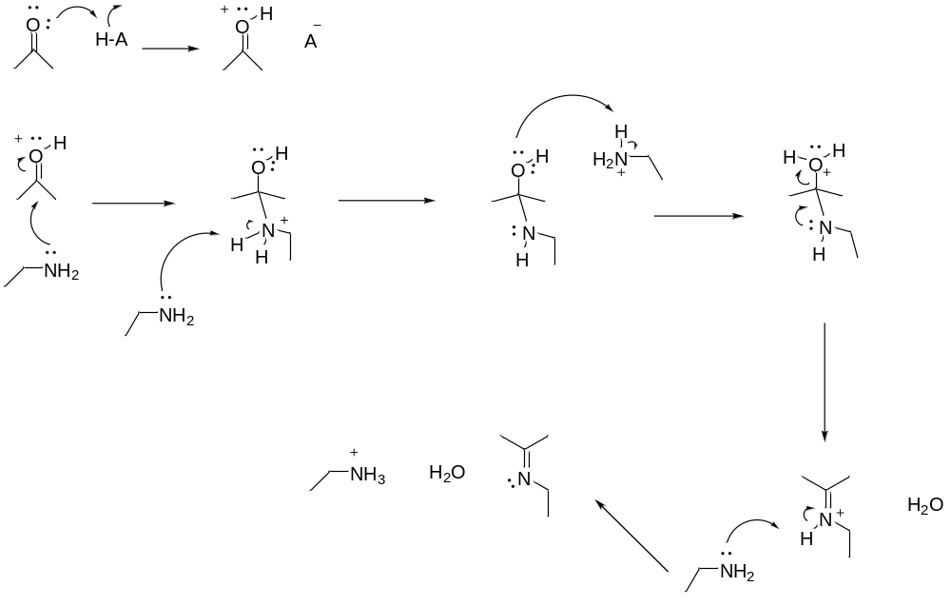
Occurs only for ammonia
and primary amines

Slide 6
Reactions of ketones and aldehydes
Grignard reaction
Reactions with alcohols (acid/base catalyst)
Reactions with amines (acid catalyst)
Keto-enol tautomerism (acid/base catalyst)
Reduction

Slide 7
Reactions of ketones and aldehydes
Grignard reaction
Reactions with alcohols (acid/base catalyst)
Reactions with amines (acid catalyst)
Keto-enol tautomerism (acid/base catalyst)
Reduction

Slide 8
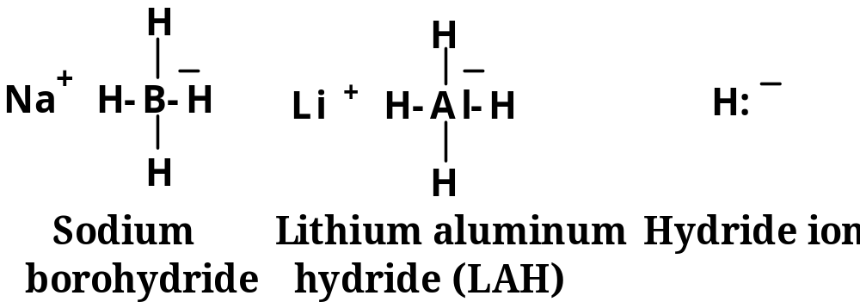
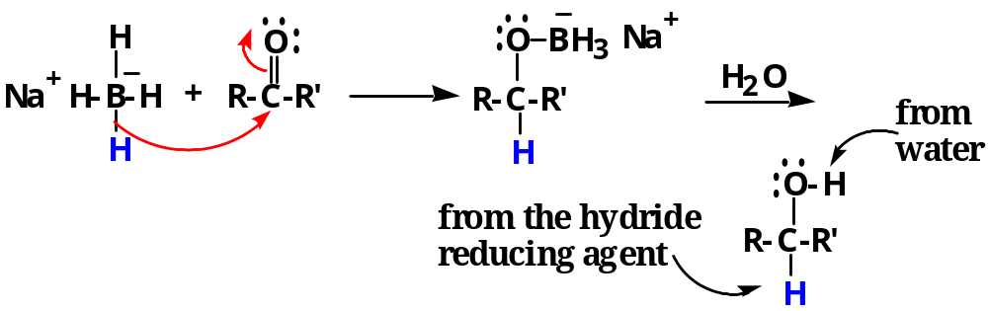

Slide 9
QUIZ

