Slide 1
Lecture 19:
Reactions of haloalkanes

Slide 2
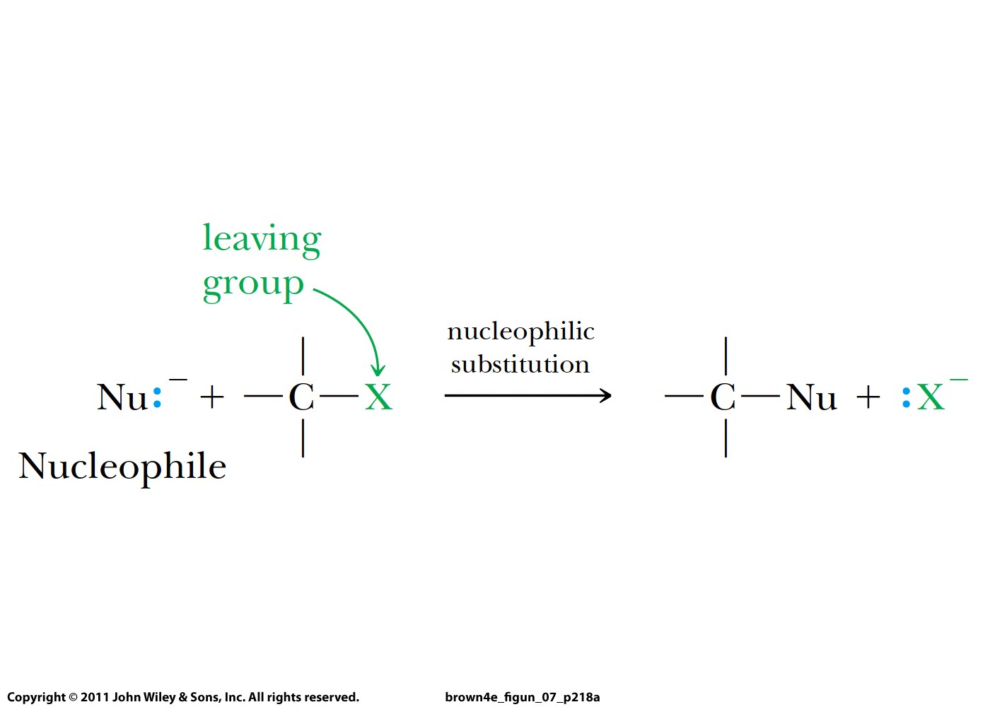

Slide 3
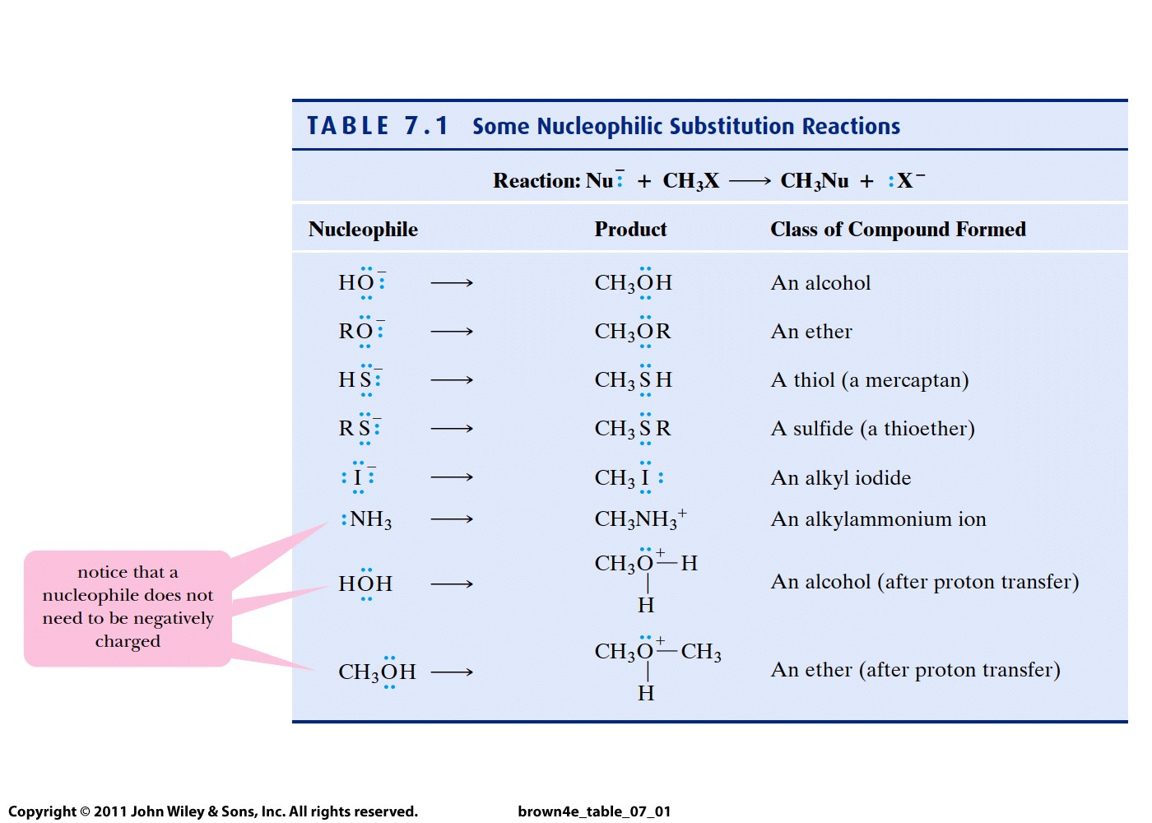

Slide 4
Two mechanisms:
S_{N}2 or bimolecular nucleophilic substitution
2. S_{N}1 or unimolecular nucleophilic substitution

Slide 5
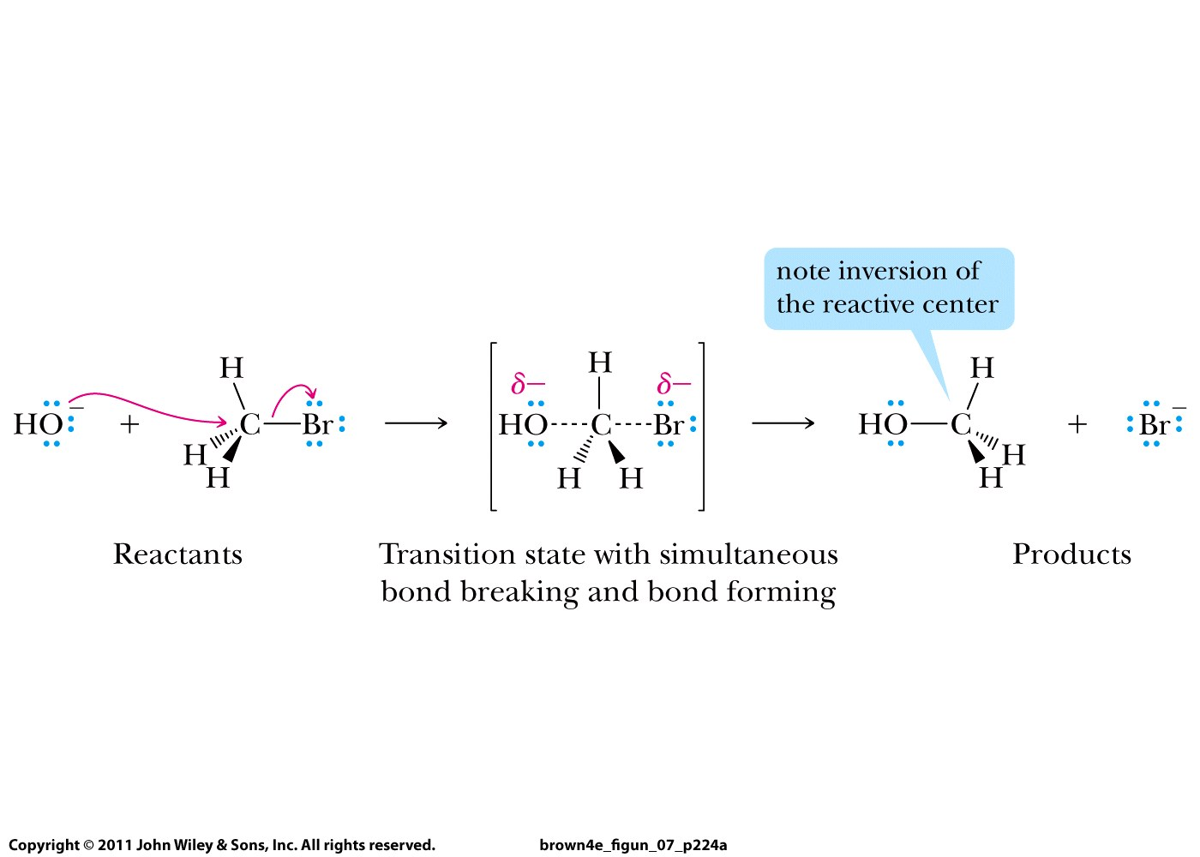
S_{N}2 or bimolecular nucleophilic substitution
(two species are invoved in TS)
Concerted mechanism

Slide 6
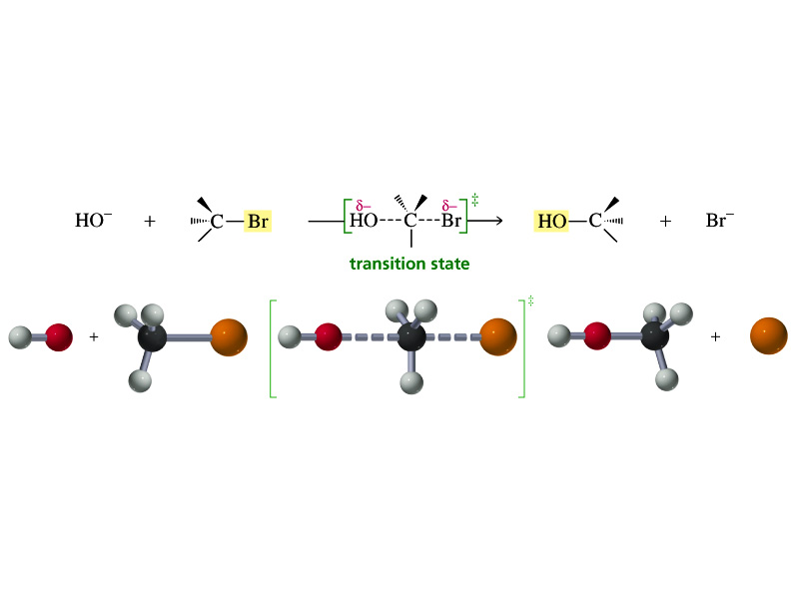

Slide 7
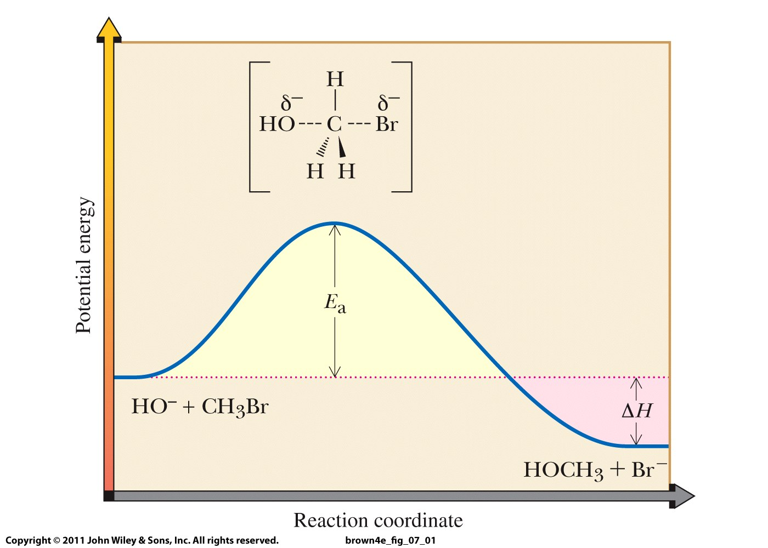

Slide 8
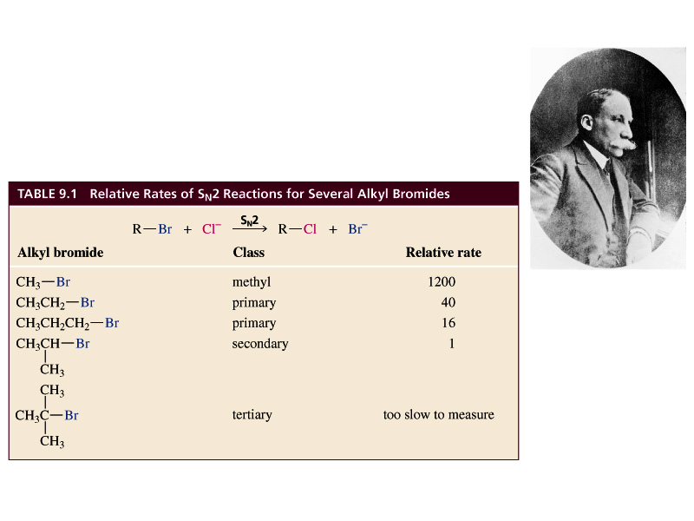

Slide 9
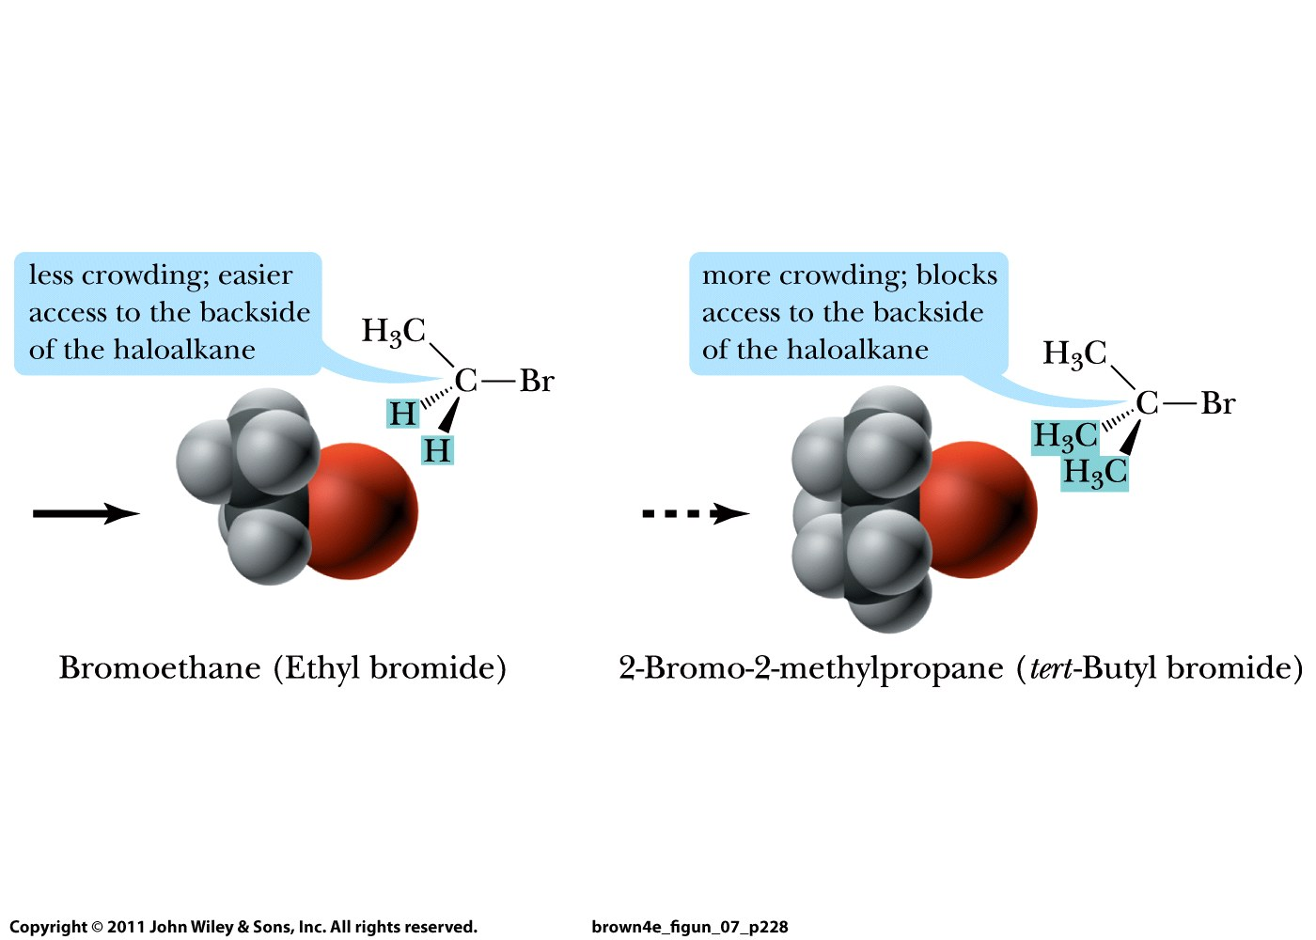

Slide 10
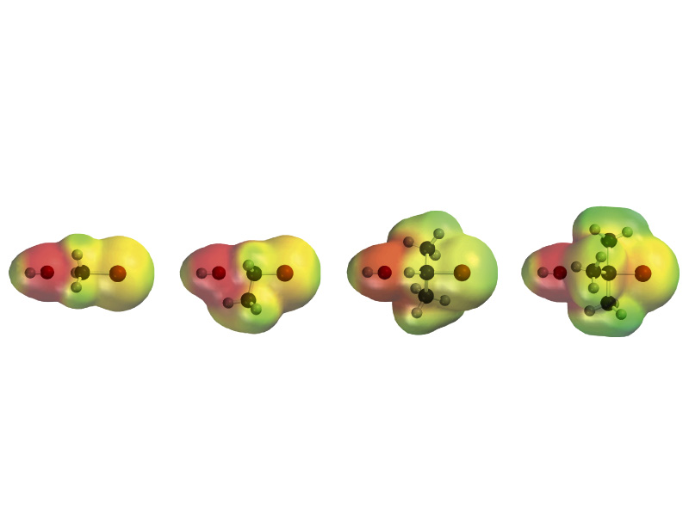

Slide 11
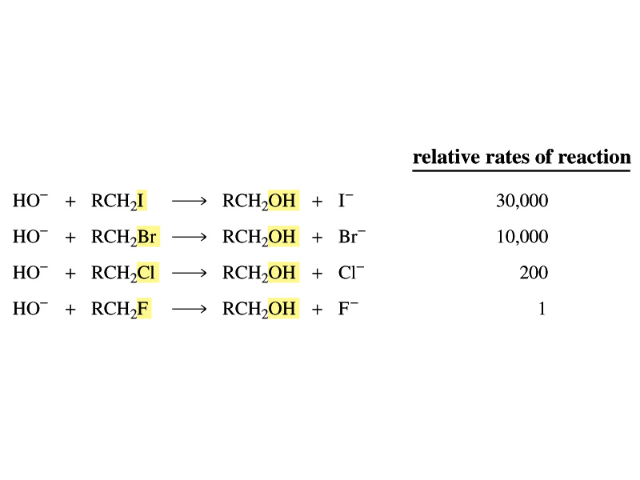
Leaving group:

