Slide 1
Exam II covers material from lectures 10 - 20
(starting at alkenes and ending with today’s lecture)
All Buddy Questions with and without answers are on Blackboard
So are old exams

Slide 2
Lecture 20:
Reactions of haloalkanes
S_{N}2 reactions
S_{N}1 reactions

Slide 3
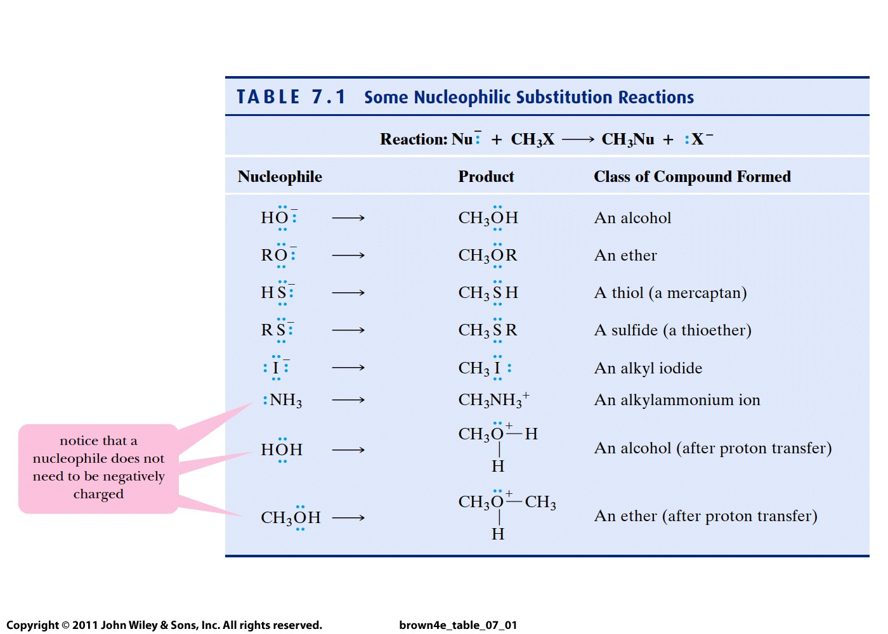

Slide 4
Two mechanisms:
S_{N}2 or bimolecular nucleophilic substitution
2. S_{N}1 or unimolecular nucleophilic substitution

Slide 5
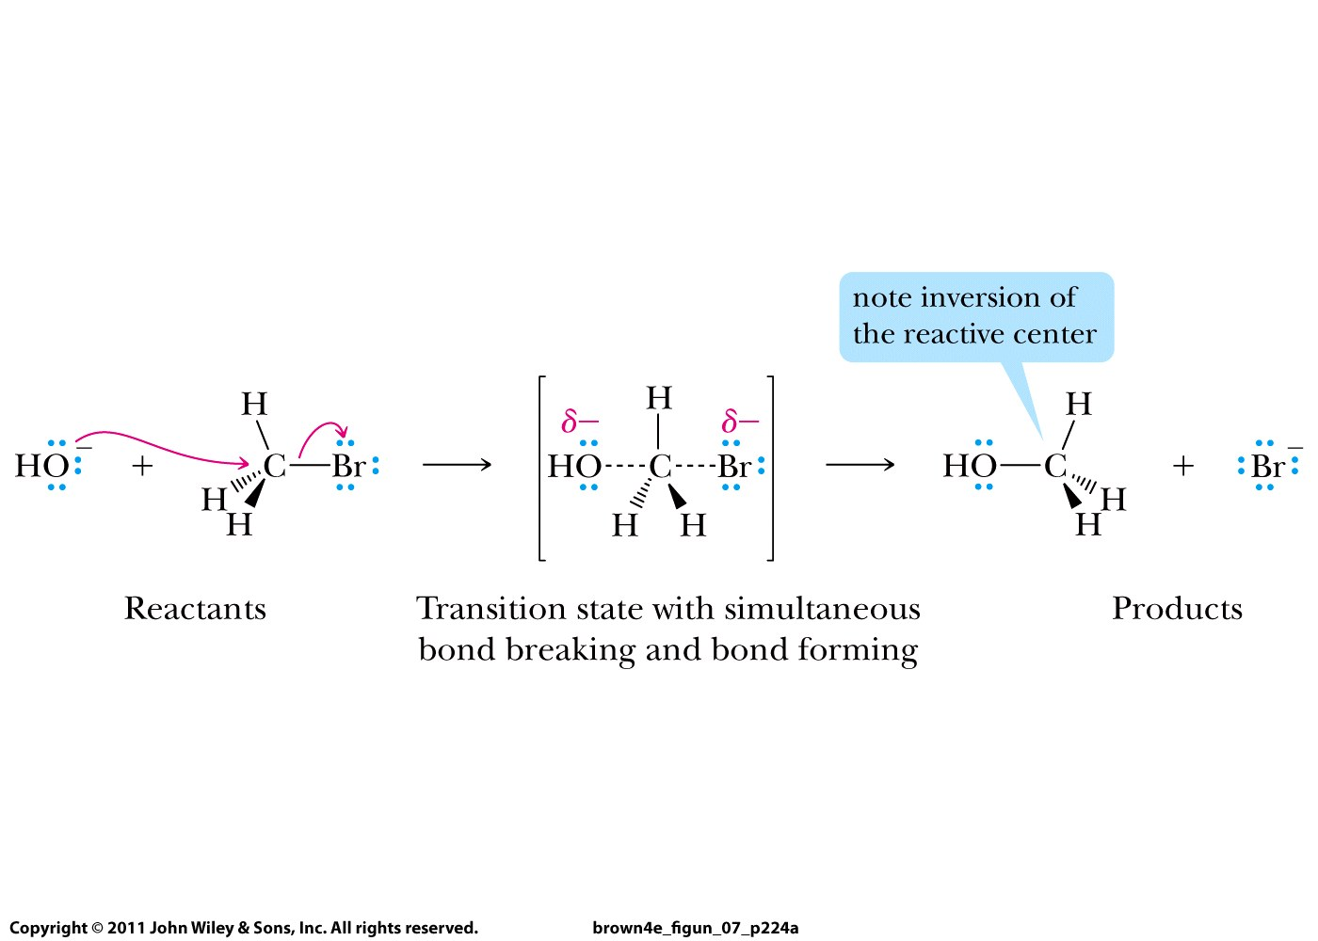
S_{N}2 or bimolecular nucleophilic substitution
(two species are involved in TS)
Always occurs for primary alkyl halides!
Never occurs for tertiary alkyl halides!

Slide 6
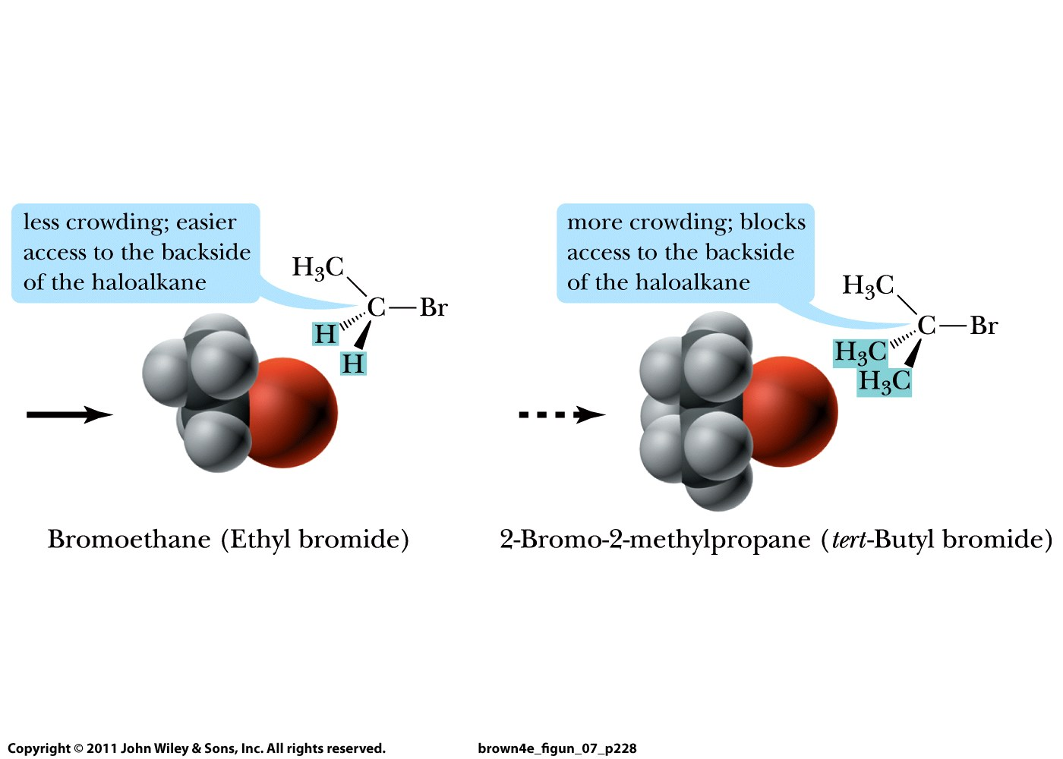
ALWAYS!! NEVER!!

Slide 7
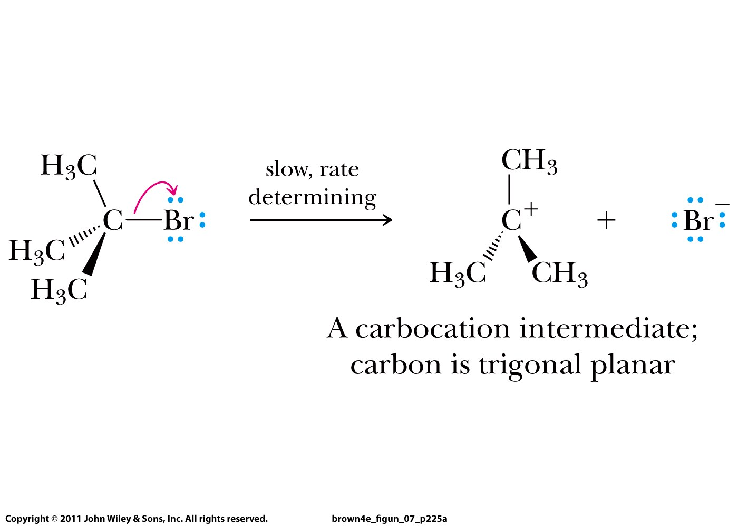
S_{N}1 or unimolecular nucleophilic substitution
(one species in the rate-determining TS)
Always occurs for tertiary alkyl halides

Slide 8
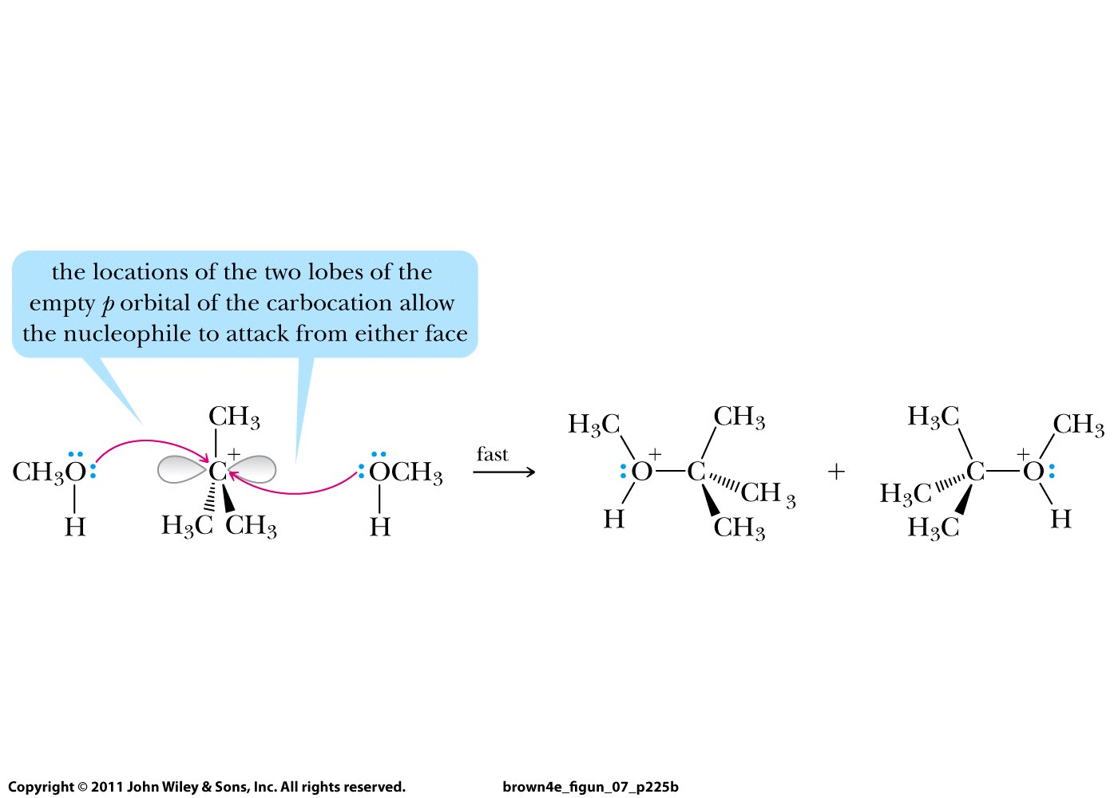
Two enantiomers are formed

Slide 9
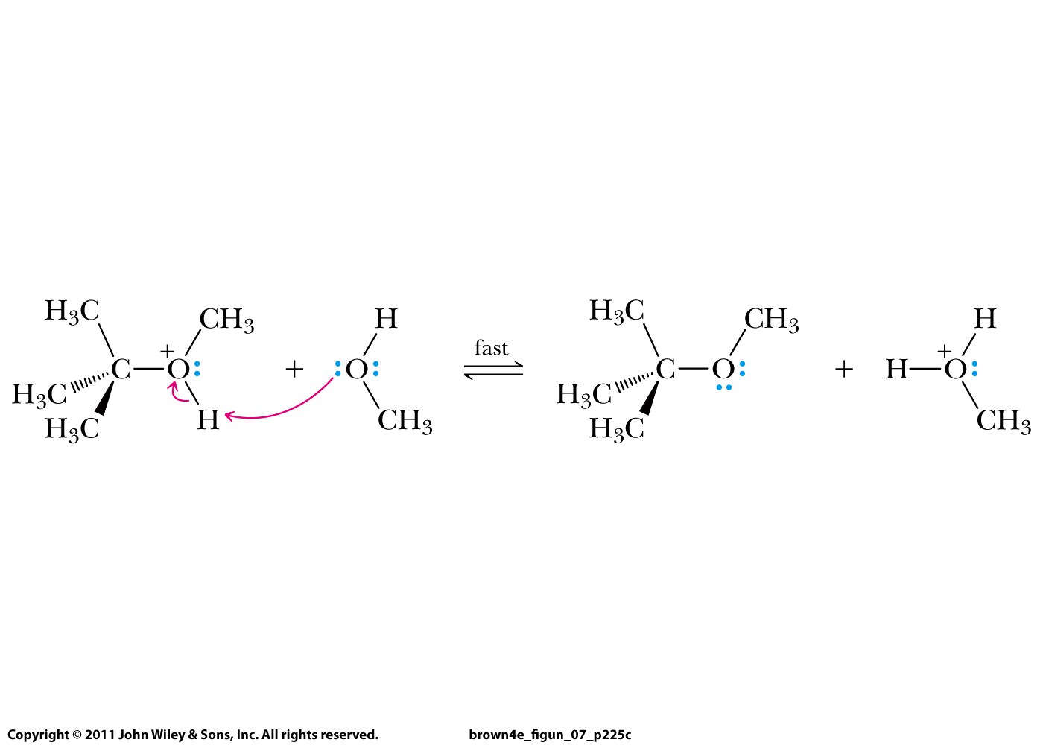

Slide 10
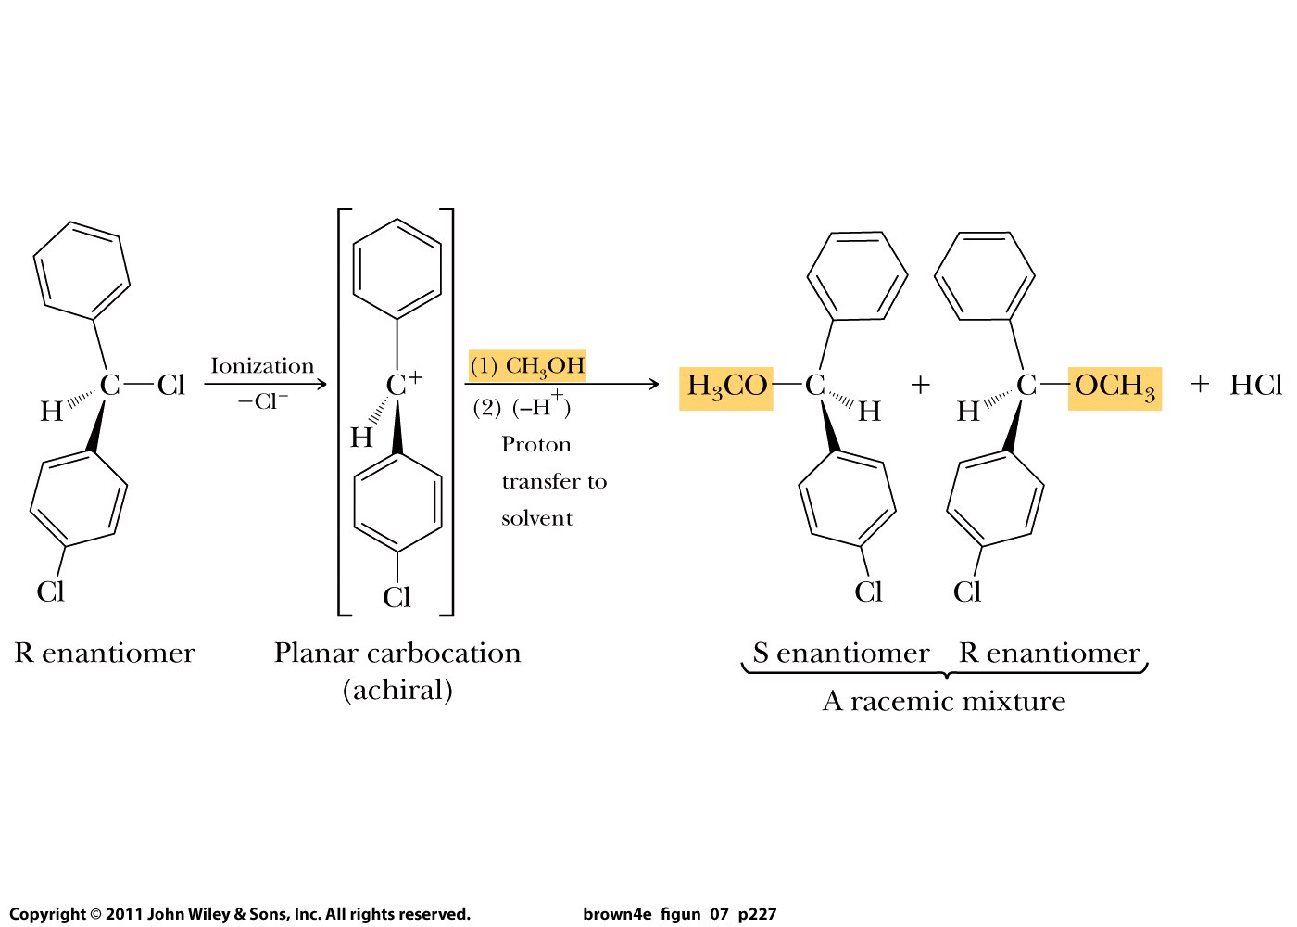

Slide 11
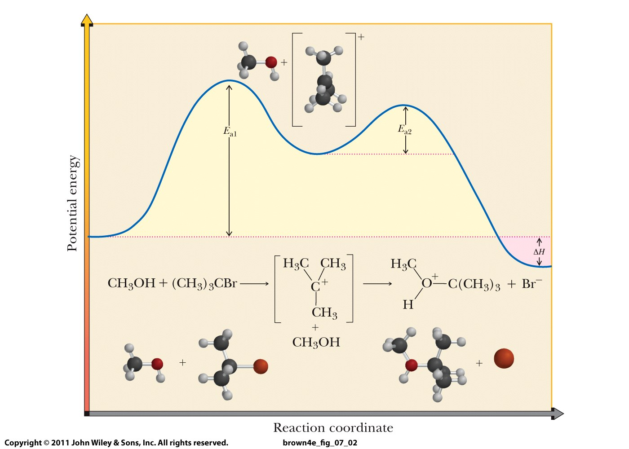

Slide 12
Two mechanisms:
S_{N}2 or bimolecular nucleophilic substitution
occurs always for primary alkyl halides
S_{N}1 or unimolecular nucleophilic substitution
occurs always for tertiary alkyl halides

