Slide 1
DESIGN SPECIFICATION REVIEW
Team 59
Kathryn Atherton
Ryan Hellyer
Natalie Zimmermann

Slide 2
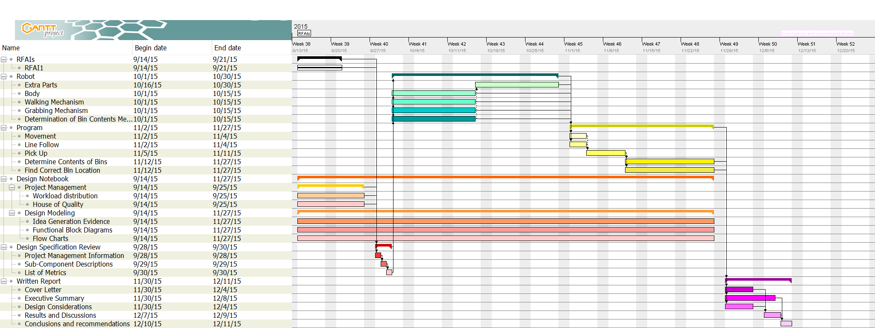
Project Management Information
Gantt Chart

Slide 3
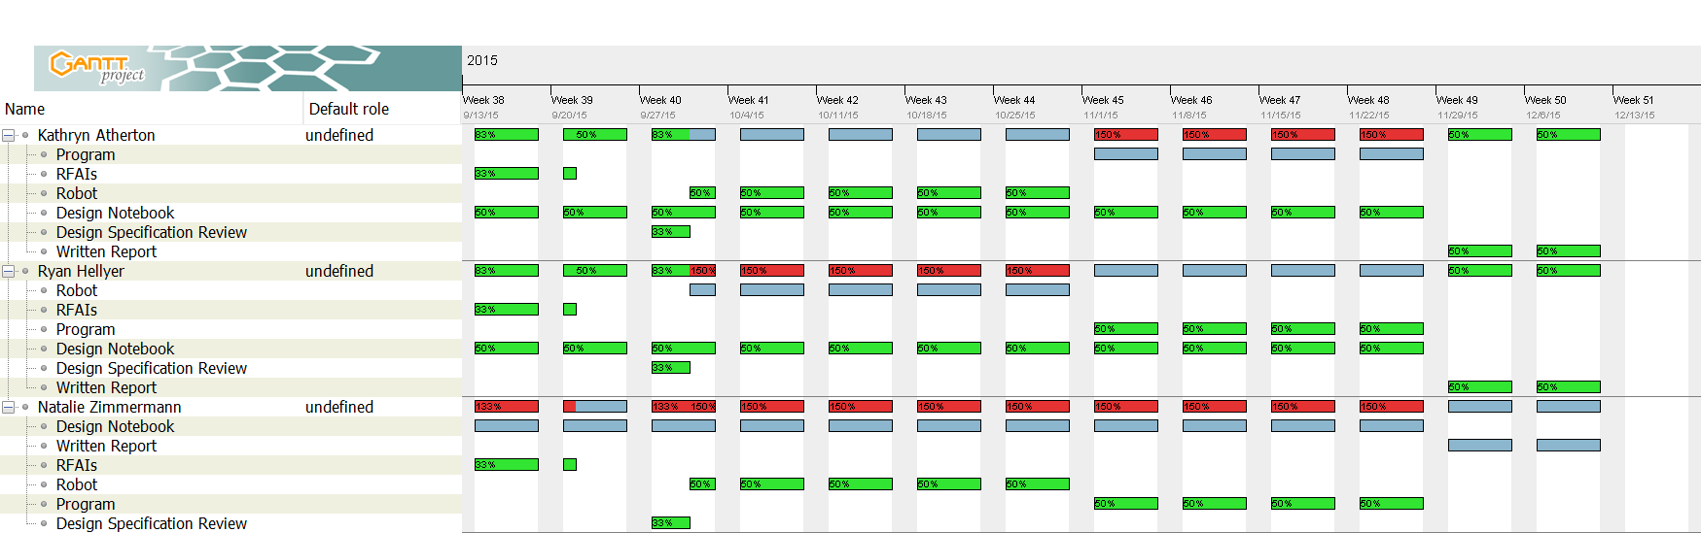
Project Management
Workload Distribution

Slide 4
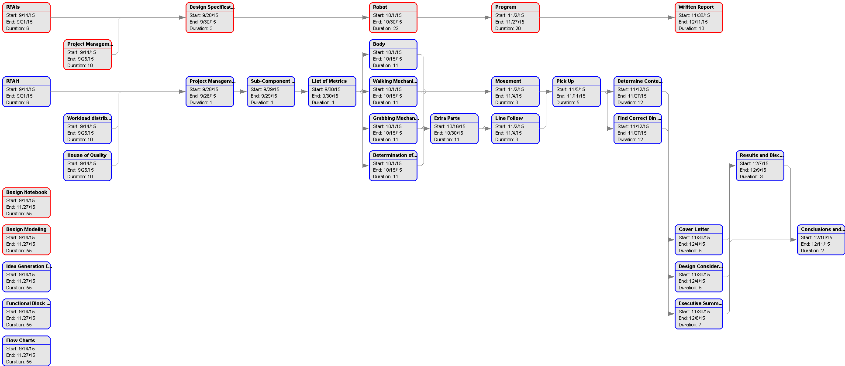
Project Management
Work-Breakdown Structure

Slide 5
Sub-Components of Robot
Chassis
Function: to hold the robot sub-components together
Features: compact, efficient use of materials, sturdy
Locomotion Mechanism
Function: to move the robot around the closed-loop path
Features: is not a wheel, able to go over uneven terrain, move robot at least 0.3 feet per second
Grabbing Mechanism
Function: to pick up bins of shredded material
Features: able to grasp bin, quickly picks up bins, able to hold the maximum weight of the bins
Bin Content Determination Mechanism
Function: to autonomously determine the contents of the bin of shredded material
Features: accurate and quick in determination, autonomous
Bin Storage
Function: to hold the bins of shredded material while the robot moves from the shredder hopper to the final bin location
Features: able to store bins without tipping/spilling materials,

Slide 6
Metrics
Sub-Component | Feature/Function | Technical Need | Technical Requirement | Target Value
Chassis | Sturdy Compact | Weight supported Dimensions of chassis | Can support at least weight of heaviest bin Can fit in shipping container | Can support twice the weight of the heaviest bin Fits in shipping container with room to turn around
Locomotion Mechanism | Able to go over uneven terrain Move quickly from shredder hopper to final bin location | Height able to step over Speed | Can step over bump of 0.5 inches or shorter Move at least 18 feet every 60 seconds | Can step over bump of 1 inches or shorter Move at least 30 feet every 60 seconds
Grabbing Mechanism | Grasp bin | Dimensions able to grasp Weight able to lift Time to pick up | 5cm x 5cm x 7cm At least 125 grams Less than 3 seconds | 5cm x 5cm x 7cm At least 250 grams Less than 1 second
Bin Content Determination Mechanism | Able to autonomously determine contents of bin Quick in determination | Accuracy of determination Time | Correct 75% of time Less than 5 seconds | Correct 100% of time 1 second
Bin Storage | Stores without spilling contents of bin/tipping robot | Amount of spillage | Less than 20% of bin contents | 0% of bin contents

