Slide 1
Opportunities for Driverless Cars
Team 45
Kathryn Atherton, Joshua Hahn, Hannah Mackin Schenck

Slide 2
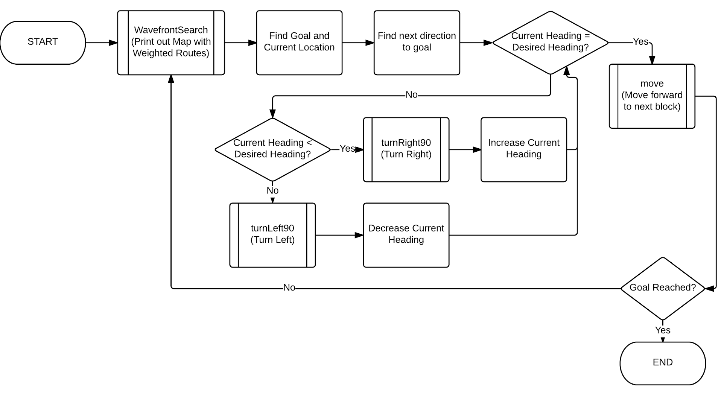
Overall Logic

Slide 3
Logic Details
Move Forward
Convert Number of blocks to travel into degrees wheels need to turn (degrees)
Reset Encoder Values to 0
Set Target Values to degrees
Turn on the motors
Run motors until target is reached
Stop for 1/2 second

Slide 4
Logic Details
Turn Right/Left 90 degrees
Convert Number of blocks to travel into degrees wheels need to turn (degrees)
Reset Encoder Values to 0
Set Target Values to degrees
Set motors to opposite directions
Turning Right -- (-50, 50)
Turning Left -- (50, -50)
Turn on the motors
Run motors until target is reached
Stop for 1/2 second

Slide 5
Logic Details
PrintWaveFrontMap
Iterates through the map
Prints “R” for the robot’s current position, “G” for the goal, “X” for any obstacles, “*” for any square the robot has moved over, and the numbers for the wavefront search algorithm (explained later)

Slide 6
Logic Details
WavefrontSearch
Finds location of the goal by setting currentWave to 2 and searching for currentWave value in the map
Checks in every direction around the goal. If the square exists and contains a zero, it sets it to currentWave + 1
After checking all directions, it increments currentWave, prints the map, and waits half a second
Repeats the process with currentWave = 3
Ends when there are no locations equal to the currentWave value

Slide 7
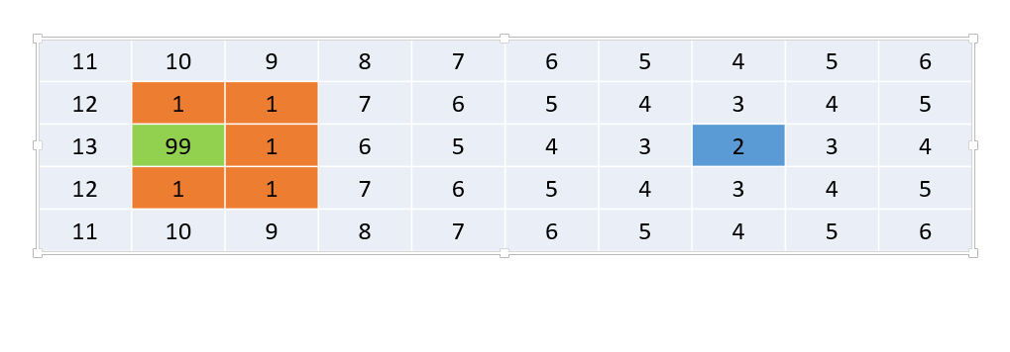
Output of PrintWavefrontMap at Beginning

Slide 8
Logic Details
NavigateToGoal
Finds starting location of the robot
Checks in every square around the robot, searching for the lowest value not equal to 1 (a barrier) and setting nextDirection
Set’s the robot location to the square with the lowest value
Compares currentDirection to nextDirection to determine how it needs to turn. It changes currentDirection as it turns in 90 degree increments
Moves forward 1 block and waits .5 seconds
Repeats until it reaches the goal

Slide 9
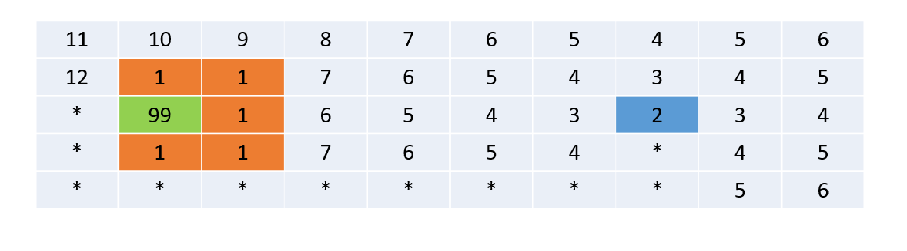
Output of PrintWavefrontMap after Robot Reaches Goal

Slide 10
Advantages and Disadvantages of the Code
Advantages:
Determines path before movement begins
Error checking is good
Good Naming Convention within Code
Disadvantages:
Robot can only turn in increments of 90 degrees.
If Robot is facing West and wants to go North, it must turn 90 degrees three times.
Robot moves one block at a time, and waits 0.5 seconds per block moved.

