Slide 1


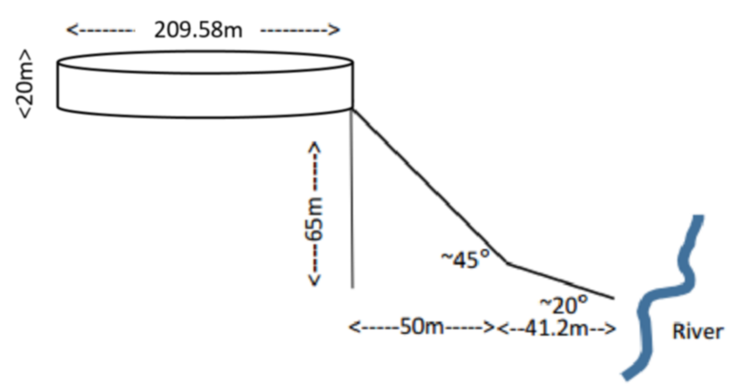
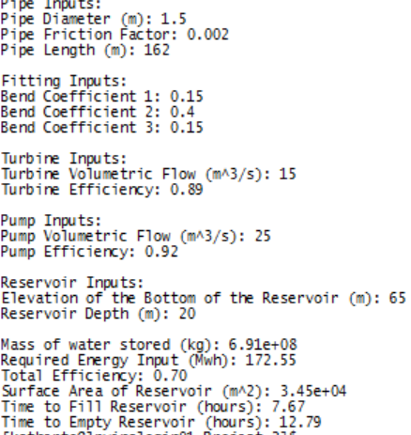
Modeling Hydro Solar Storage Systems
Kathryn Atherton, Joshua Hahn, Hannah Mackin Schenck
Purdue College of Engineering, Purdue Honors College
Goals of Project
Model
Factors
Objective: model a system to store solar energy in the form of potential energy
Minimize energy losses in system
Loss due to inefficiency in turbine and pump
Loss due to pipe friction
Loss due to bends in pipes
Minimize cost of total system
Fill and empty in reasonable amount of time
Priority: Optimize Ratio of Cost to Loss
Site Illustration
Environmental: budget of sites 1 and 3
Social: rejection of site 2
Cost-to-loss ratio: choosing parts
Practicality: choosing flow rates, rejection of site 1
Conclusions
Used most cost-effective materials in the most practical site
Efficiency is fairly high for current technology
The ratio of cost to efficiency could be better, but that can improve as technology advances
Design Approach
Model Inputs and Outputs
Research equations and possible factors in design
Choose factors that are most relevant to the performance of the design
Create an outline of the model based on the known values
Decide upon parts that balance low cost and high efficiency
Finalize model with chosen parts
Estimate cost of construction
References
Evaporation from Water Surfaces. (n.d.). Retrieved March 23, 2016, from http://www.engineeringtoolbox.com/evaporation-water-surface-d_690.html
Fairley, P. (2015, March 18). A Pumped Hydro Energy-Storage Renaissance. Retrieved March 22, 2016, from http://spectrum.ieee.org/energy/policy/a-pumped-hydro-energystorage-renaissance
Hazen-Williams Equation - calculate Head Loss in Water Pipes. (n.d.). Retrieved March 23, 2016, from http://www.engineeringtoolbox.com/hazen-williams-water-d_797.html
Make Solar Energy Economical. (n.d.). Retrieved March 22, 2016, from http://www.engineeringchallenges.org/challenges/solar.aspx
Minor Loss Coefficients in Pipes and Tubes Components (n.d.). Retrieved March 23, 2016 from http://www.engineeringtoolbox.com/minor-loss-coefficients-pipes-d_626.html
Cost and Efficiency
Acknowledgements
Total Cost of Model: $585,938.00
Efficiency of Model: 70%
Ratio of Cost to Efficiency: $8,370.54
We would like to thank Dr. Nauman for his entertaining and educational lectures, our Grad TA, Michael for his lectures and one-on-one help with all of our various problems during this project, our Peer TA, Peter for giving us feedback on all of our work, and our Peer Mentors for giving us guidance and motivation throughout the semester.

