Slide 1

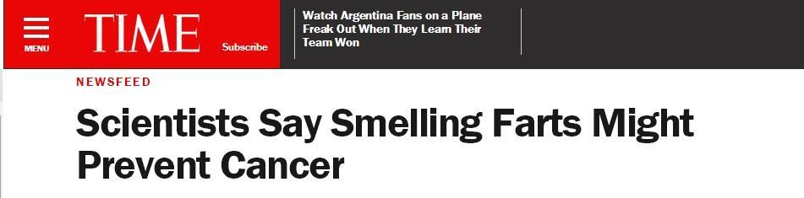
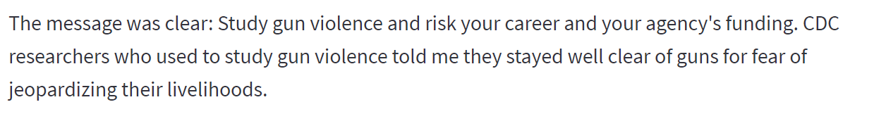
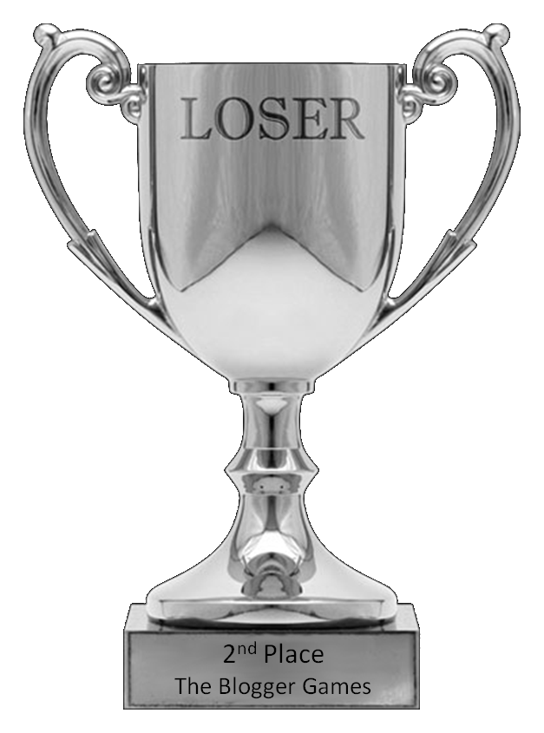
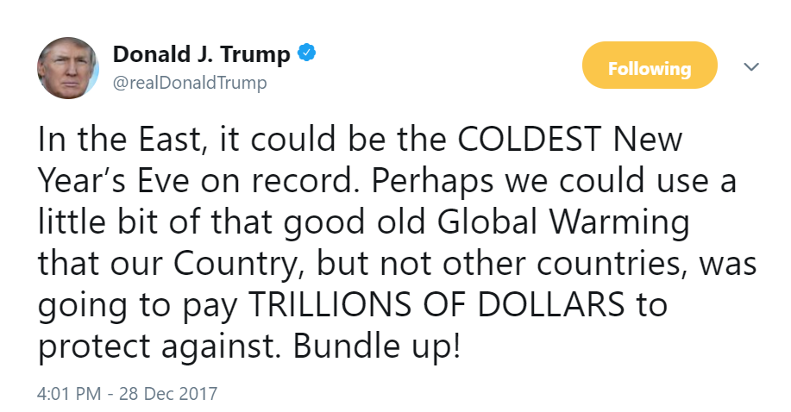
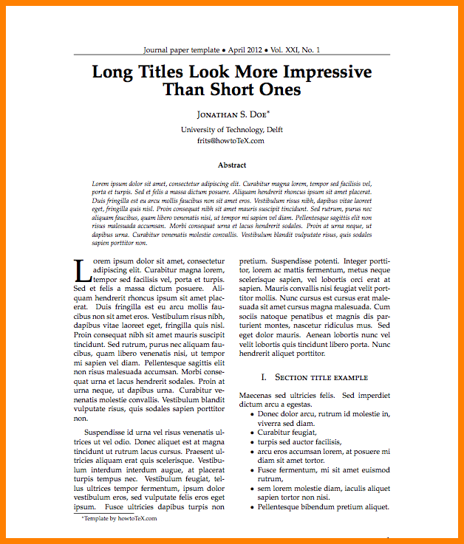
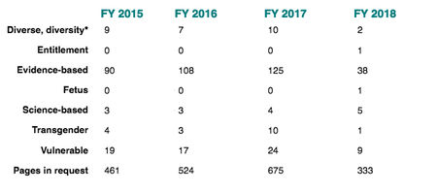
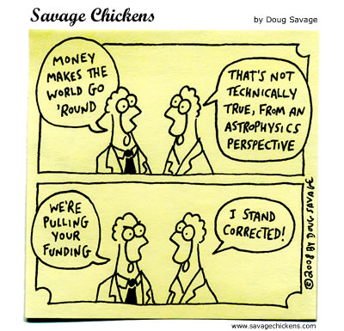

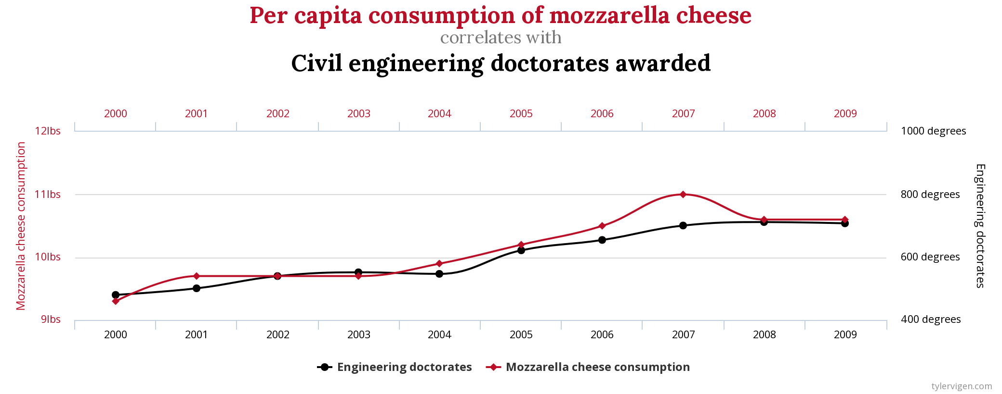
A Study of SCIENCE VS. THE MEDIA, POLITICS, & CAPITALISM
(Actual) Fake News!
No value in replication (except scientific)
The (potential) format... still playing with the idea
Politics determines what gets studied
P-hacking to get cool results
$$$cience costs money
This will (hopefully) be me!

