Slide 1
Group 3
Madalyn Alm, Barbara McAnulty, Kathryn Atherton, Sarah McGinness

Slide 2

Genes 67-90
40900-50341bp
24 genes originally called 23 genes in final annotation
two deletions and one addition

Slide 3
General Characteristics
All features were read in the backward direction (3’ to 5’ end) in the complementary strand
Start codon frequency: 8.7% TTG, 37.1% ATG, 52.2% GTG
(According to the Annotation Guide, TTG should be around 7% and GTG and ATG should be about 46.5% each)
Most BLAST results were hypothetical proteins
Phages most closely related to JewelBug based on BLAST:
VOHMINGHAZI
ISIPHIWO
MCFLY
KAZAN
CLOUDWANG9
ARTEMIS2UCLA

Slide 4
Major Annotation Alterations
One added feature and two feature deletions

Slide 5
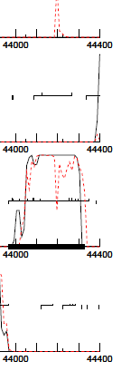
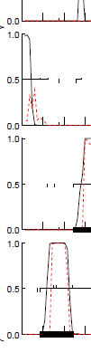
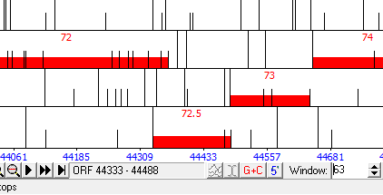
Feature 72.5: Adding a Feature
119 bp gap between features 72 and 73
Coding potential in GeneMark

Slide 6
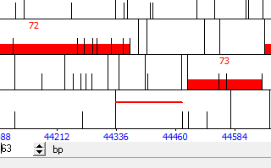
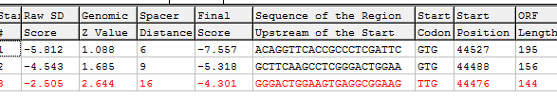
Feature 72.5: Inserting the Feature
In DNA Master, select the open reading frame corresponding to the coding potential in GeneMark (Complementary frame 1 in GeneMark, Complementary frame 3 in DNA Master)
Select the best start site based on the coding potential and BLAST results for each of the different start sites
Under “Sequence” tab, highlight the sequence that corresponds to the feature and hit “add feature”

Slide 7
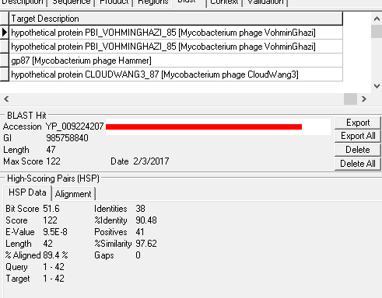
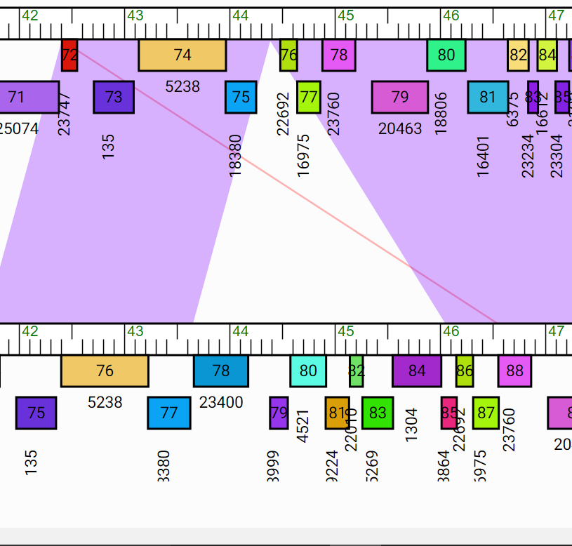
Feature 72.5: BLAST Results and Phamerator

Slide 8
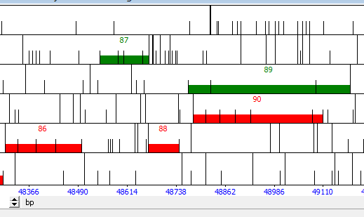
Features 87 and 89: deletion of forward-reading genes
Both features 87 and 89 were in the forward direction, even though all of the other features in this part of the genome were in the reverse direction
The features did not have strong BLAST results, if any, and there is not enough space between the surrounding genes to suggest a reversal of direction. Features 86, 88, and 90, on the other hand, have stronger evidence supporting their existence

Slide 9
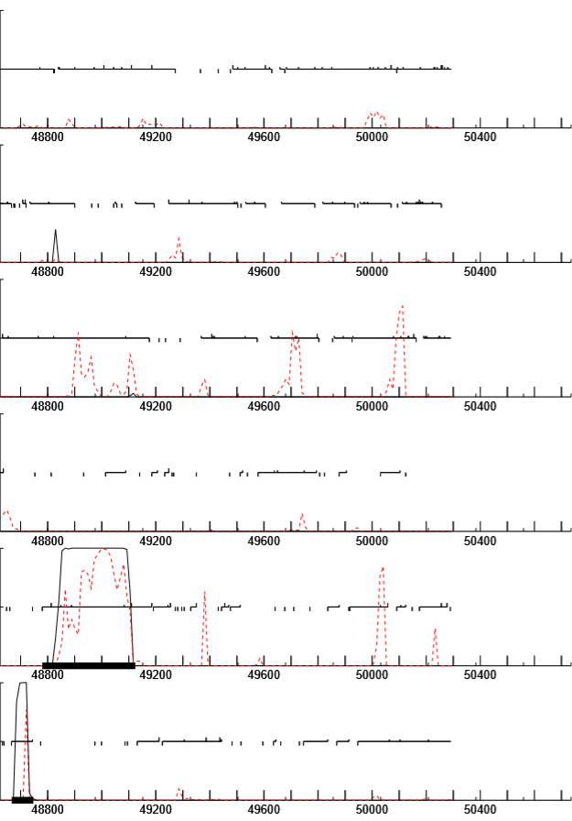
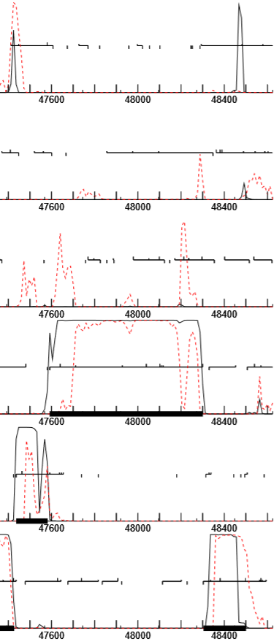
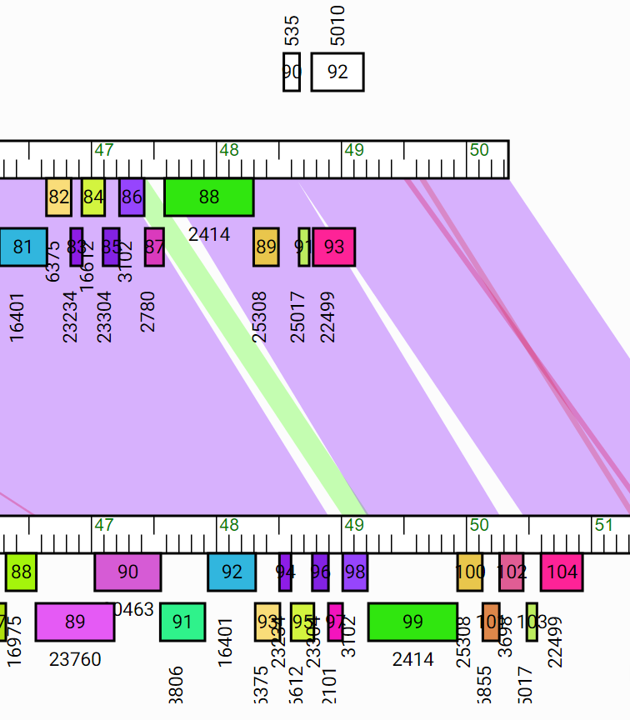
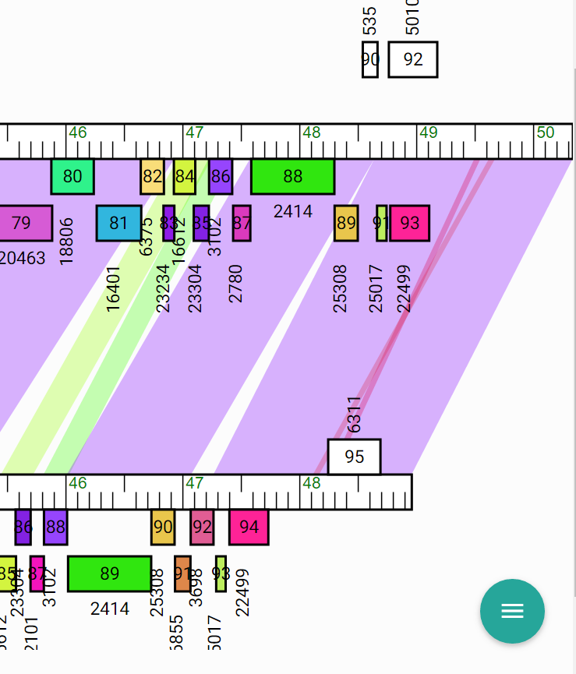
Features 87 and 89: deletion of forward-reading genes
Evidence for Features 86, 88, 90: GeneMark Map (86 circled in blue, 88 circled in red, 90 circled in yellow) Example Phamerator Maps JewelBug vs. Kazan: JewelBug feature 89 extremely similar to Kazan feature 100 JewelBug vs. JeffaBunny: JewelBug features 91, 93 extremely similar to JeffaBunny Features 93, 94 JeffaBunny has a forward-reading feature, but it is not in same area as JewelBug and does not overlap any reverse-reading features like JewelBug, so it does not support the existence of the forward-reading features of JewelBug

Slide 10
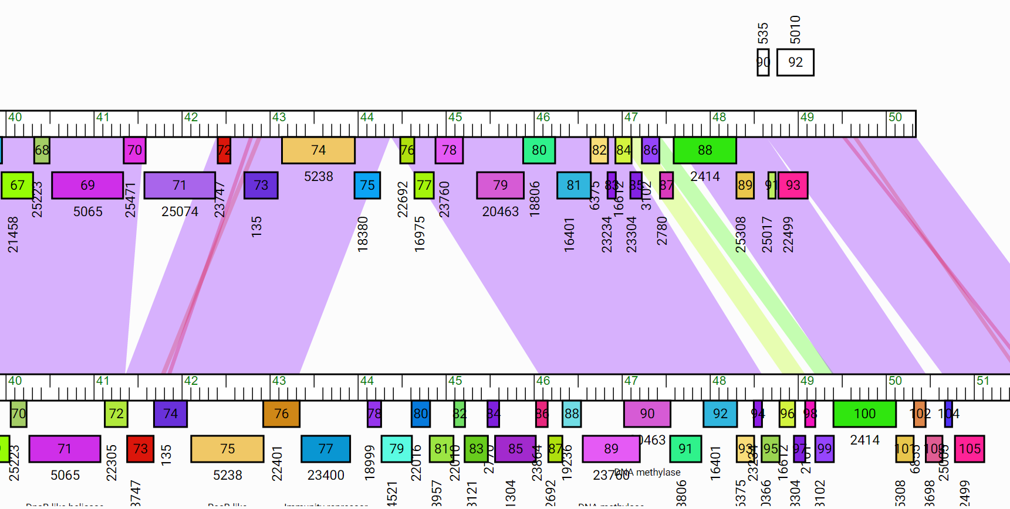
Features 87 and 89: deletion of forward-reading genes
Additionally, every other Phamerator map of phages in the A6 Phamily does not include the forward-reading genes in the areas that were suggested for JewelBug
(JewelBug vs. Artemis2UCLA shown)

Slide 11
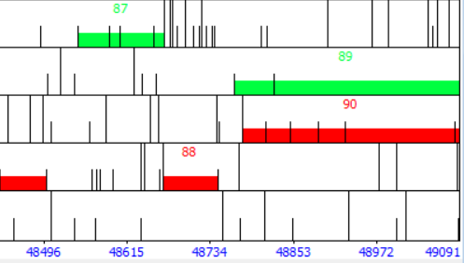
Features 87 and 89: deletion of forward-reading genes
Finally, in the regions where these genes are called, there is not a significant amount of coding potential. (Feature 86 circled in blue, Feature 88 circled in red, Feature 90 circled in yellow; region for 87 boxed in black, region for 89 boxed in green)

Slide 12
Discussion of Notable Functions
High incidence of No Known Function with some Regulatory Proteins

Slide 13
Functions

Slide 14
Conclusions and Future Work

Slide 15
Overall Improvement

