Slide 1
<SmartGreenhousing>
<Cherry farmers in greenhouse cultivation >
Team.SmartGreenhousing
P.O SUZUKI Takahiro
S.M Yoshioka Keima
Notes:
Project name – pick a cool sounding name for your project
Sponsors – list your project sponsors here (the people with the money)
Putting your sponsors name boldly out there for all to see is a great way to get their engagement and attention (necessary for any successful project).

Slide 2

Why are we here?
Because…
We want to assist the agriculture by using ICT .
We want to introduce the new remote system which features embedded and ICT .
We want to assist the agriculture by using ICT .
Notes:
Write down all the reasons why your company would want to spend money on this project in the first place.
Then pick and highlight the most important one.

Slide 3
The elevator pitch
For [Farmers in greenhouse cultivation ]
who [want to remote control of greenhouse]
the [SmartGreenhousing]
is a [agricultural assist tools]
that [can get status information of greenhouse , and control farming machine remotely].
Unlike [current sensing system]
our project [can control farming machine remotely].

Slide 4
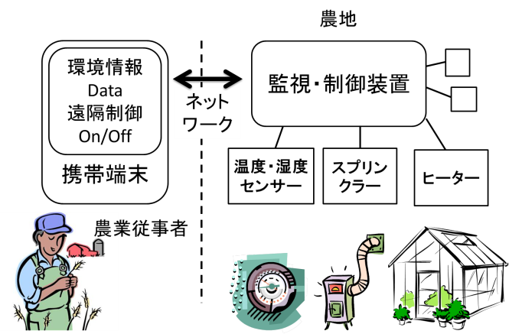
Product box
<SmartGreenhousing>
<Smart Management of Greenhouse with the Network >
<Remote control of heater or sprinkler>
<Check the status with mobile!>
Notes:
If you could walk into a store, and buy the shrink wrapped version of your software, what the design of the box look like and what would it say?
Point here is to get your team looking at your project through the eyes of your end customer.

Slide 5
The NOT list
IN | OUT
Estimate of the target | Live from the greenhouse
Decide the method of machine control | Automated Machine Control
Develop the remote control program | Selling
Design GUI Web application | Support of feature phone
Use the web sever
Greenhouse-Model Test
Develop with Android ADK | Test in greenhouse
Remote sensing of humidity and Temperature
Ensure scalability
Server configuration
System analysis and modeling
UNRESOLVED
Notes:
List all the big ticket items you are (and are NOT) going to deliver within the scope of this project.
Before starting your project move all the UNRESOLVED ones to either IN or OUT.

Slide 6



Your project community
<another Project of sensor network ,
remote control .>
Your core team
<Farmers>
<Lab Member>
Everyone else !
... is always bigger than you think!
Notes:
List everyone you are going to have to interact with at some point during the course of your project.
Goal is to start building relationships with these people and let them know we are coming down the tracks (before we actually get there).

Slide 7

Technical solution
Technologies of Android:
app:Java
library:SDK
tool:SDK ADK
Browse the data
and to send the ON/OFF signal of switch .
Sakura VPS server
To send the data and receive
push notifications .
Android
Arduino
Technologies of Server:
webpage:HTML5,jsp,javascript
Server:apache,java servlet
tools git,HTML IDE
technology Tomcat,server push
Technologies of Arduino:
app:Arduino lang
library:Android ADK
tool:ADK IDE
Notes:
This is about letting people know how we plan on building this thing.
If there are any tools or libraries assumptions you are making list them here.
Also if there are areas of the application architecture that are risky highlight those too.

Slide 8

What keeps us up at night
<give up>
<get a disease>
<lose our data>
<electronics is broken>
<not followed by a motivation>
Notes:
This is your chance to call out any craziness you’ve heard while building the deck, and having a frank conversation with your sponsors and your team about how you are going to handle it.
This is perhaps on of the most powerful slides in the deck – it’s your chance to ask for whatever you need to be successful and the consequences if you don’t get it.
Use it!

Slide 9
Team SmartGreenhousing
Member | Features | Competencies/Expectations
SUZUKI | Product Owner | Knows about cherry greenhouse cultivation.
 |  | Have the responsibility of our product.
 | Knowledge | C, Arduino development,
 |  | Mainly In charge of embedded system
K-ma | Scrum Master | Have the responsibility of our schedule
 | Knowledge | C#, MVC.NET, jQuery, SQL Unit testing, refactoring, TDD, continuous integration
 |  | Mainly in charge of server setting/web development
Notes:
Set expectations around who you are going to need and what kind of skills they will need to have to pull this off.
Use names if specific people are important (i.e. Billy is the only guy who can do X).

Slide 10

How big is this thing?
Ship it!
Apply for using in greenhouse
Construction
Model test
~September
1 month
1 month
This is a guess. Not a commitment.
Notes:
Give your sponsors some idea of how big this thing is (1, 3, or 6 monther).
Before you can complete this slide you and the team should create and estimate a high-level story list for the project.
This isn’t a commitment (too many unknowns). It’s just a really rough guess. Don’t treat it as anything else.

Slide 11
Trade-off sliders
 | The classic four
 | Feature completeness (scope)
 | Stay within budget (budget)
 | Deliver project on time (time)
 | High quality, low defects (quality)
ON
OFF
ON
OFF
ON
OFF
ON
OFF
 | Other important things
 | Ease of use
 | Don’t make me think!
 | Detailed audits (log everything)
ON
OFF
ON
OFF
ON
OFF
Notes:
When push comes to shove, something has to give. Here we want to be clear on what that is.
On agile projects we flex on scope. But there could be others factors at play here so get ready to listen as you customer tells you which forces can bend (scope) and which are written in stone (usually budget).
Slider rules:
1. No two sliders can occupy the same level.
2. List other important project factors down below.

Slide 12
The first release
First System : Detect temperature & humidity of Greenhouse. Show the log on web site(SmartGreenhousing)
Coding and debug
investigation
System design
finish
～July
～Aug.
Ship it!
2 people, months,
Notes:
Stakeholders are usually interested in two things:
How much is this going to cost.
When is it going to be done.
Here we do our best to answer those two questions so they can decide if the project is still worth doing by showing them what it’s going to take.

