Slide 1


Threat modeling
SFS – Project
Gerald Spenlingwimmer
25. January 2019
Primetals LBS5 (FH2.326), Hagenberg

Slide 2





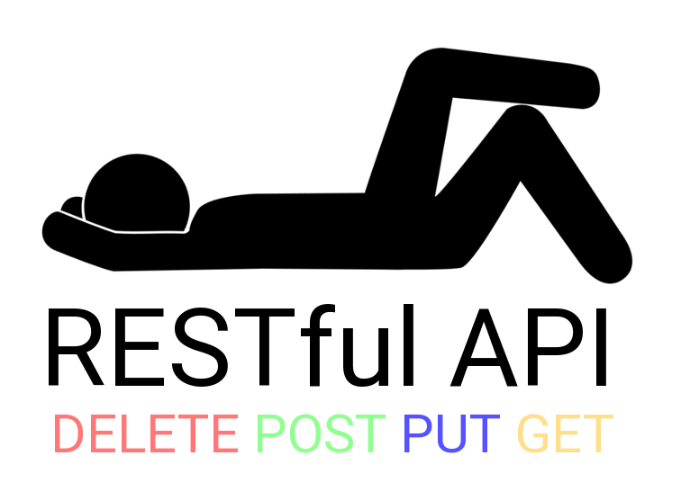
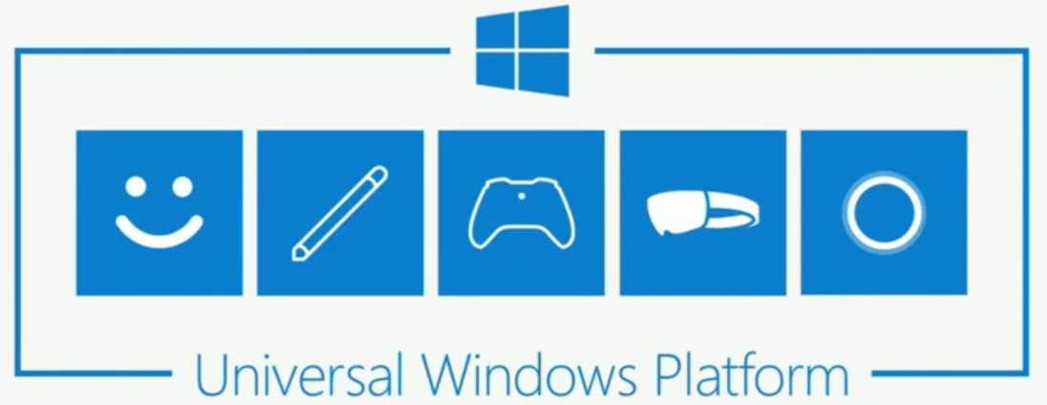

The Project

Slide 3
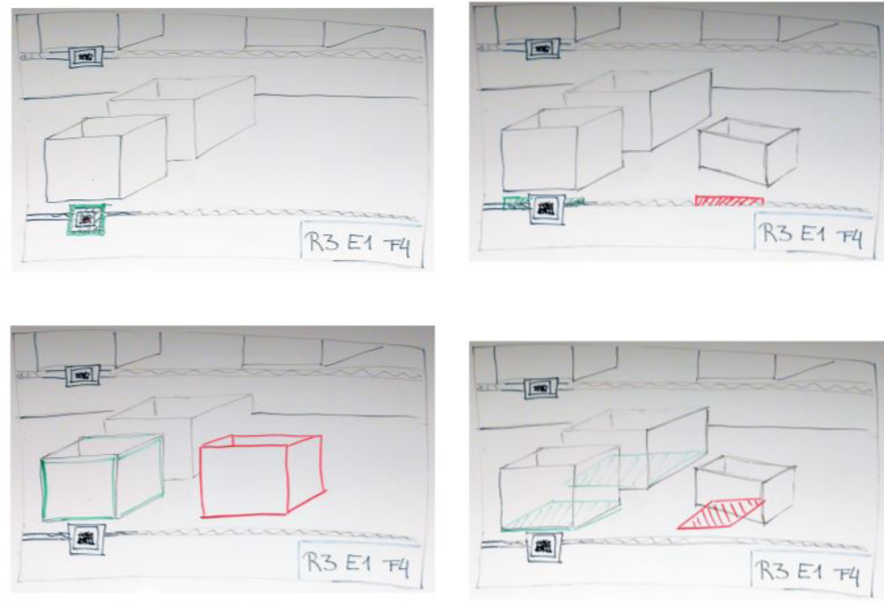
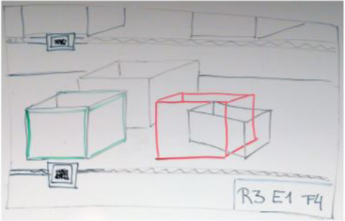
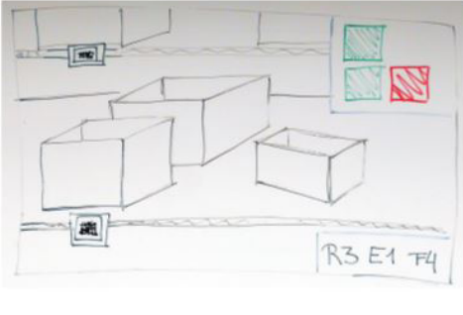
Use case

Slide 4
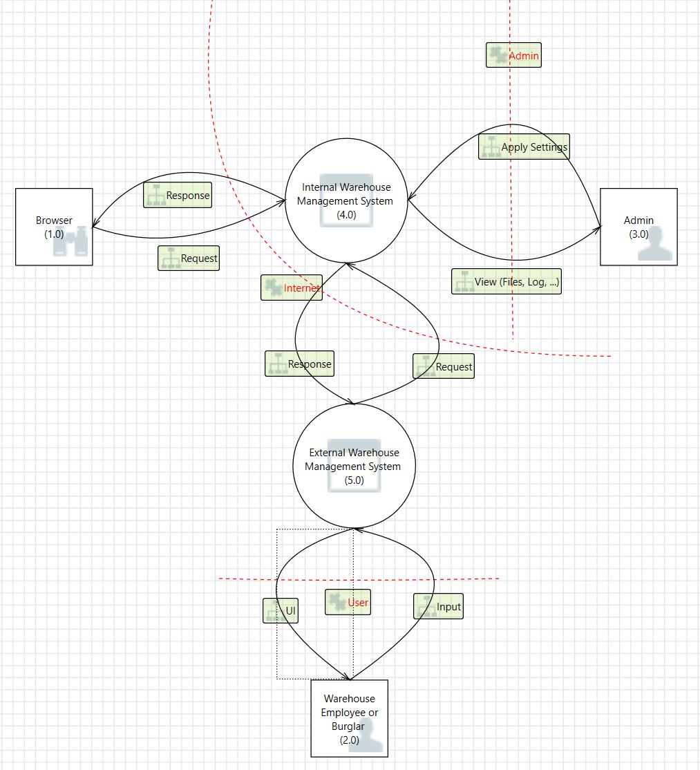
Context Diagram

Slide 5
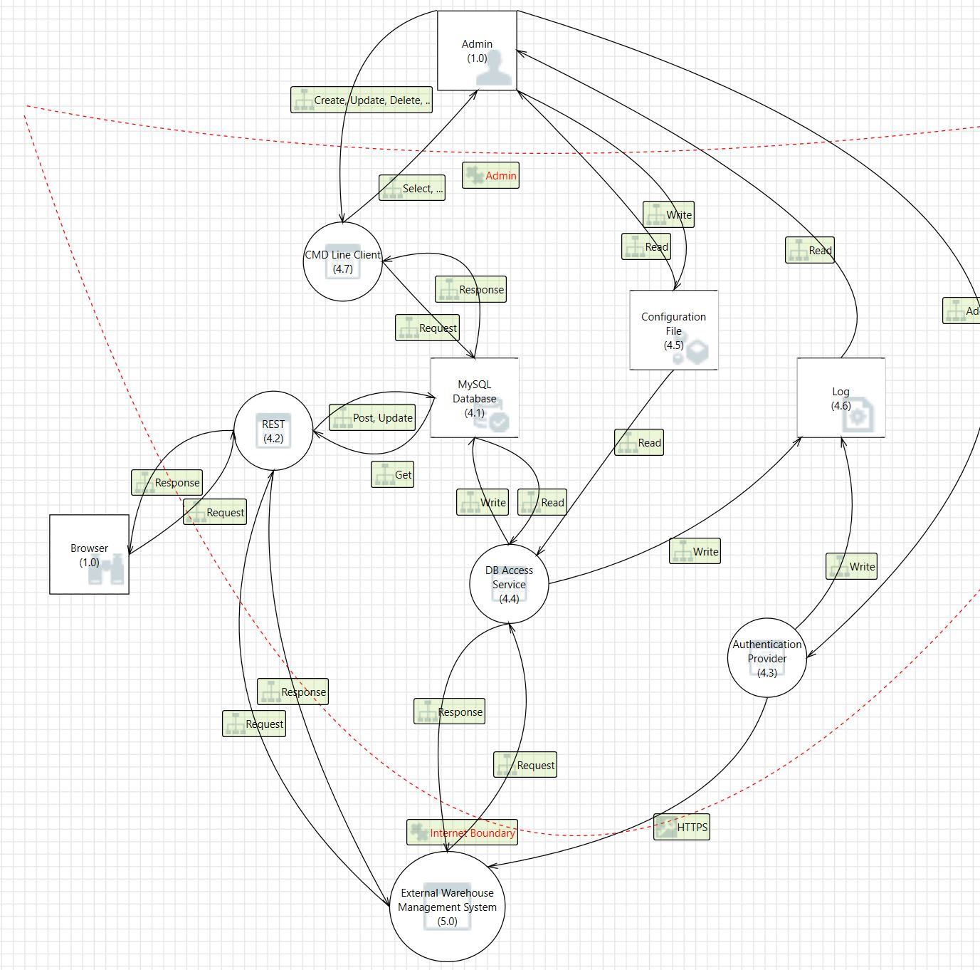
Level 0 - internal

Slide 6
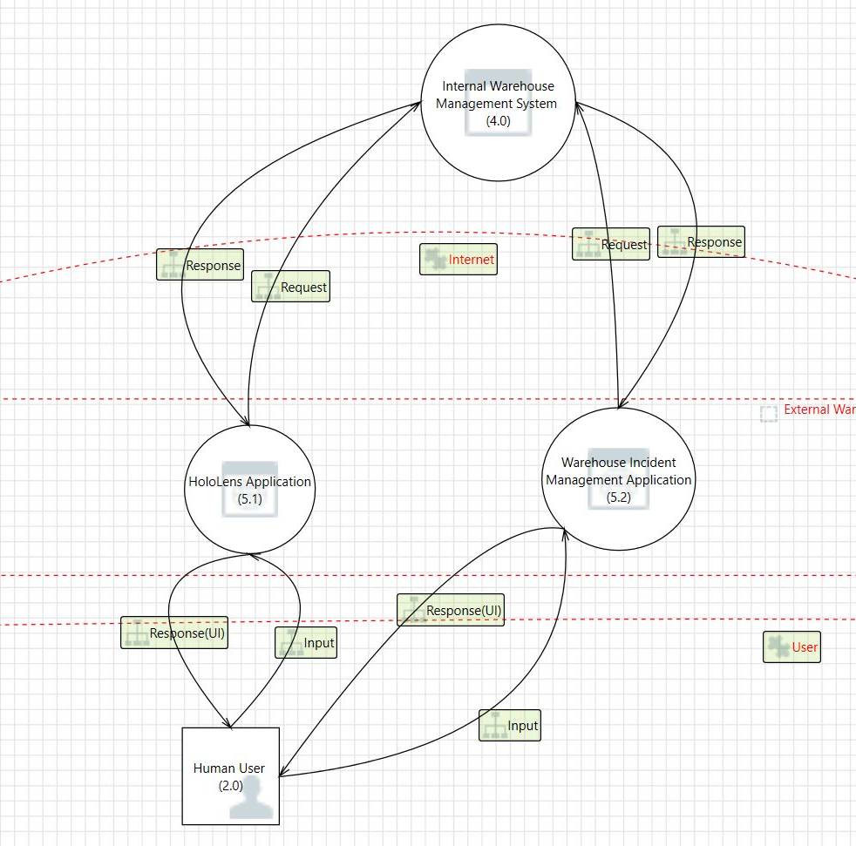
Level 0 - External

Slide 7
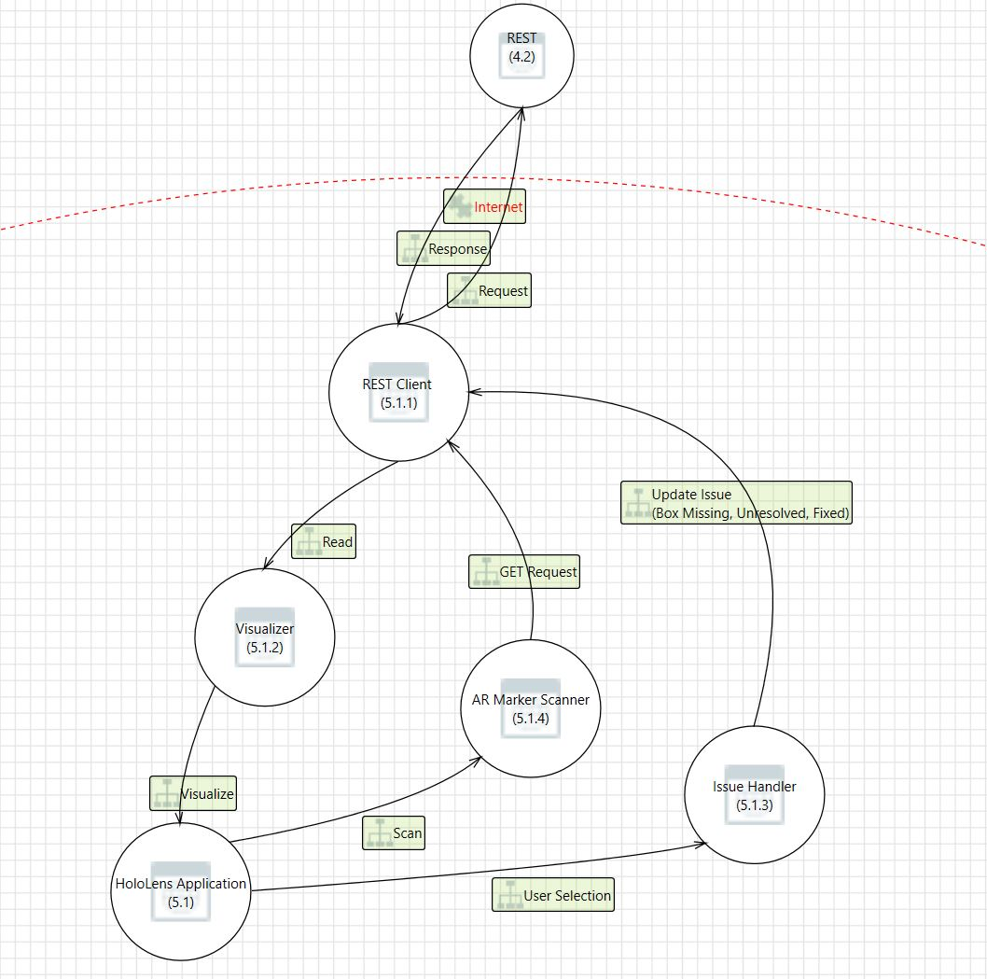
Level 1 – External (Use Case)

Slide 8
Mitigation
Rest:
Spoofing: authentication provider
Tampering: not a real threat
Repudiation: REST methods
Information disclosure: ID response, get => warehouse goods
Denial of Service: caching, docker containers
Elevation of privileges: REST => not a real threat
HoloLens App:
Uncritical
DB:
Via REST service => JSON with 2 int values (POST)
Else GET

Slide 9
Changes
Use logging
Create admin access for hololens app
Use authentication provider
Offline mode => DoS
Docker scaling => DoS
Encrypt communication between REST and HoloLens App (minimum authorize + HTTPS)

Slide 10
Throw new Presentationfinishedexception()

