Slide 1
Classbench-ng: recasting Classbench after a decade of network evolution
Gianni Antichi
gianni.antichi@cl.cam.ac.uk
http://www.cl.cam.ac.uk/~ga288/

Slide 2
Packet Classification is the fine art of:
Matching header fields of incoming packets against a set of rules and performing the corresponding action
1

Slide 3
Packet Classification is the fine art of:
Matching header fields of incoming packets against a set of rules and performing the corresponding action
packet forwarding
2

Slide 4
Packet Classification is the fine art of:
Matching header fields of incoming packets against a set of rules and performing the corresponding action
packet forwarding
application of security policies
3

Slide 5
Packet Classification is the fine art of:
Matching header fields of incoming packets against a set of rules and performing the corresponding action
packet forwarding
application of security policies
application-specific processing
4

Slide 6
Packet Classification is the fine art of:
Matching header fields of incoming packets against a set of rules and performing the corresponding action
packet forwarding
application of security policies
application-specific processing
application of QoS guarantees
5

Slide 7
Is the packet classification mechanic still a problem in 2017?
6

Slide 8
Is the packet classification mechanic still a problem in 2017?
Increasing transfer rate => faster classification
7

Slide 9
Is the packet classification mechanic still a problem in 2017?
Increasing transfer rate => faster classification
Increasing number of rules => larger data structures
8

Slide 10
Is the packet classification mechanic still a problem in 2017?
Increasing transfer rate => faster classification
Increasing number of rules => larger data structures
Growing adoption of IPv6 => longer IP prefixes
9

Slide 11
Is the packet classification mechanic still a problem in 2017?
Increasing transfer rate => faster classification
Increasing number of rules => larger data structures
Growing adoption of IPv6 => longer IP prefixes
Adoption of OpenFlow/SDN => more header fields
10

Slide 12
Is the packet classification mechanic still a problem in 2017?
Increasing transfer rate => faster classification
Increasing number of rules => larger data structures
Growing adoption of IPv6 => longer IP prefixes
Adoption of OpenFlow/SDN => more header fields
NEW CHALLENGES FOR HW DESIGNERS
11

Slide 13
lot of research effort in the past identified better packet classification techniques leveraging the characteristics of real rule sets for faster searches.
12

Slide 14
lot of research effort in the past identified better packet classification techniques leveraging the characteristics of real rule sets for faster searches.
the capacity and efficiency of Ternary Content Addressable Memories (TCAMs) are also subject to the characteristics of rule sets.
13

Slide 15
lot of research effort in the past identified better packet classification techniques leveraging the characteristics of real rule sets for faster searches.
the capacity and efficiency of Ternary Content Addressable Memories (TCAMs) are also subject to the characteristics of rule sets.
new algorithms needs to be benchmarked
14

Slide 16

…characteristics of real rule sets….
Dear DC/network/cloud
operator, can you please
send me a snapshot of your
forwarding tables so
I can use them?
15

Slide 17

Not sure it is going to be so easy….
16

Slide 18
Not sure it is going to be so easy….
OR
Create a tool for automatic generation of synthetic rule sets with the same characteristic of real ones.
17

Slide 19
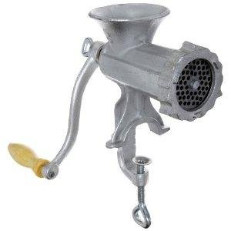
In a nutshell….
input parameters
Classification rules
18

Slide 20
In a nutshell….
seed
input parameters
Classification rules
19

Slide 21
Available tools use as an input either statistic distributions of real sets [1] or user-defined characteristics [2]
[1] ClassBench: A Packet Classification Benchmark, D. E. Taylor and J. S. Turner. In Transactions on Networking, 15(3). ACM/IEEE, 2007.
[2] FRuG: A benchmark for packet forwarding in future networks, T. Ganegedara, W. Jiang, and V. K. Prasanna. In IPCCC. IEEE, 2010.
20

Slide 22
Available tools use as an input either statistic distributions of real sets [1] or user-defined characteristics [2]
[1] is good if we are seeking for an output as close as possible to a real set, but can become easily obsolete if the seeds are not updated accordingly.
[1] ClassBench: A Packet Classification Benchmark, D. E. Taylor and J. S. Turner. In Transactions on Networking, 15(3). ACM/IEEE, 2007.
[2] FRuG: A benchmark for packet forwarding in future networks, T. Ganegedara, W. Jiang, and V. K. Prasanna. In IPCCC. IEEE, 2010.
21

Slide 23
Available tools use as an input either statistic distributions of real sets [1] or user-defined characteristics [2]
[1] is good if we are seeking for an output as close as possible to a real set, but can become easily obsolete if the seeds are not updated accordingly.
[2] is more flexible in the long term, but does not guarantee output characteristics similar to real sets
[1] ClassBench: A Packet Classification Benchmark, D. E. Taylor and J. S. Turner. In Transactions on Networking, 15(3). ACM/IEEE, 2007.
[2] FRuG: A benchmark for packet forwarding in future networks, T. Ganegedara, W. Jiang, and V. K. Prasanna. In IPCCC. IEEE, 2010.
22

Slide 24
What we want is the best of both worlds:
23

Slide 25
What we want is the best of both worlds:
Fidelity
24

Slide 26
What we want is the best of both worlds:
Fidelity
Longevity
25

Slide 27
What we want is the best of both worlds:
Fidelity
Longevity
Classbench-ng is the tool for you!!!
26

Slide 28
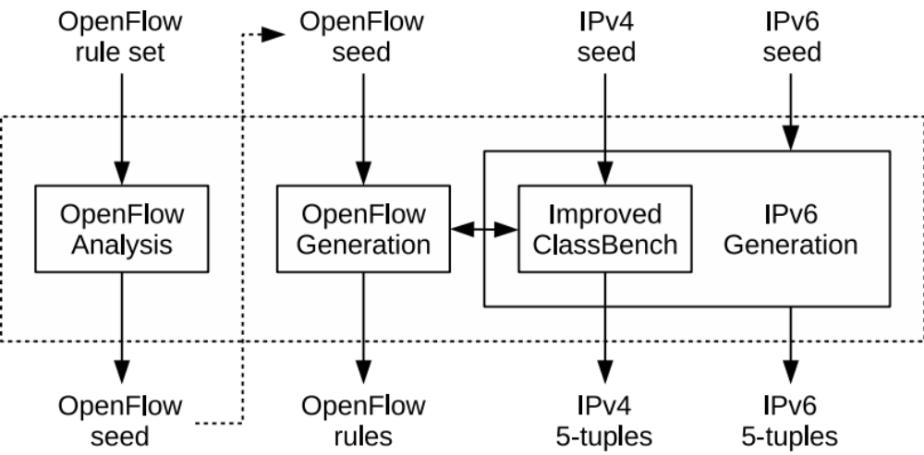
27

Slide 29
In constrast to Classbench, Classbench-ng can successfully generate IPv4, IPv6 and OpenFlow rules.
28

Slide 30
Classbench-ng, as Classbench, relies on seeds as input for the rule generation
29

Slide 31
Classbench-ng is based on Classbench, but improves its IPv4 generation fidelity
30

Slide 32
Classbench-ng provides modules for IPv6 and OpenFlow rules generation
31

Slide 33
Classbench-ng includes an analysis module, which is able to extract seeds from input rule sets.
32

Slide 34
The main idea behind Classbench-ng is to create a repository where researchers can upload just the seeds of the rule sets they might have/use.
This will foster reproduciability, but also will help reseachers that do not have access to real rule sets to create synthetic ones.
33

Slide 35
To start with, Classbench-ng already provide some initial seeds, created after we analysed the following rule sets:
34

Slide 36
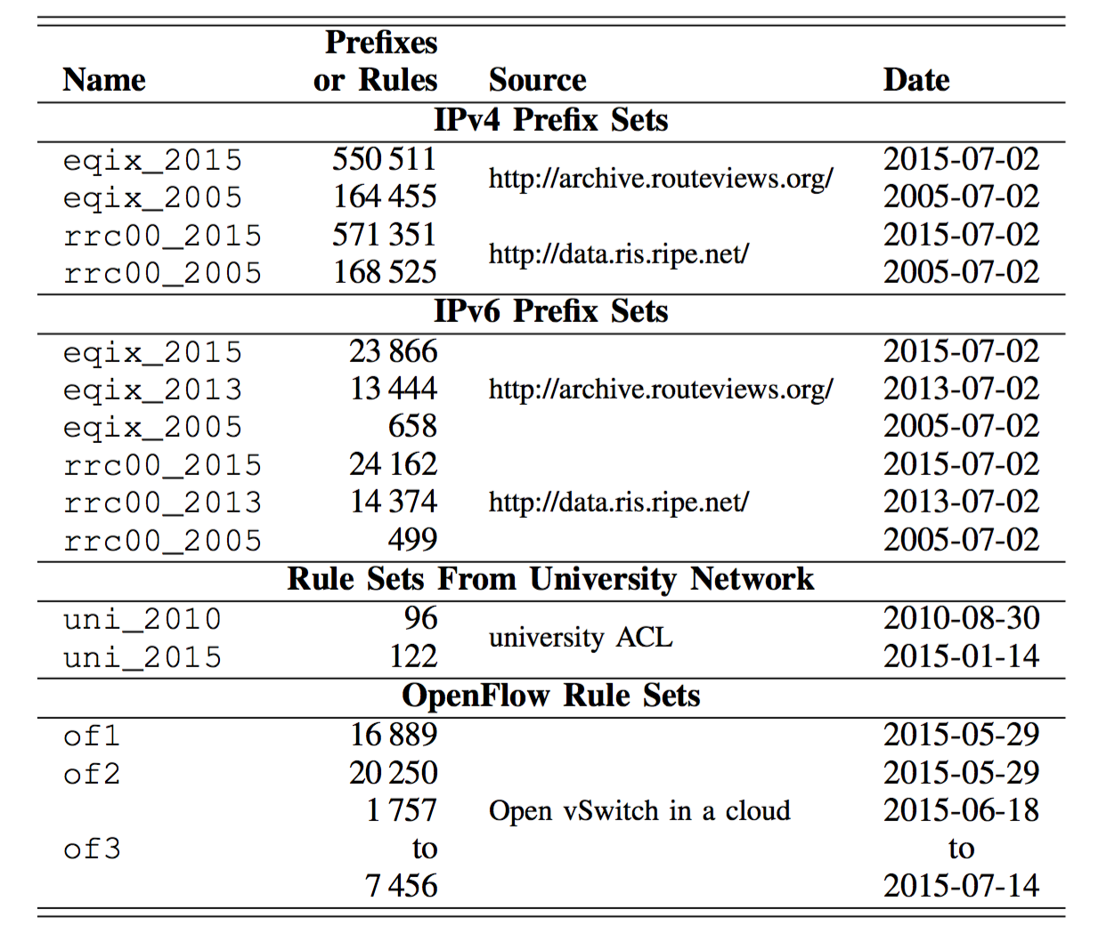
35

Slide 37
some of the results from our analysis of IPv4 datasets

Slide 38
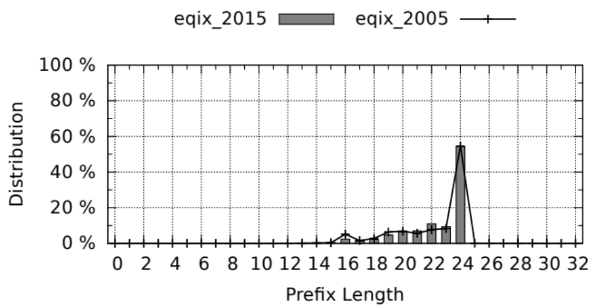

Slide 39
3 times more prefixes after 10 years
Prefix length quite stable

Slide 40
some of the results from our analysis of IPv6 datasets
36

Slide 41
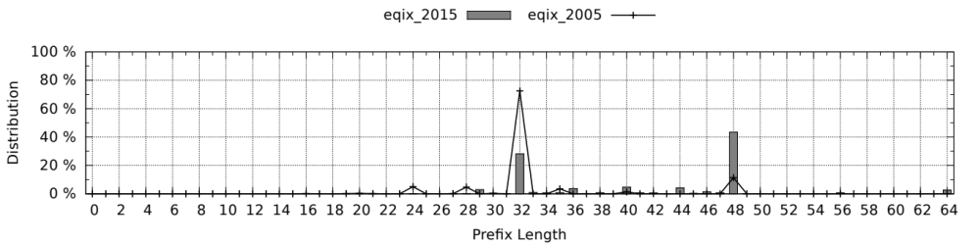
37

Slide 42
36 times more prefixes after 10 years of evolution
the most common prefix length shifted from 32 (RIRs/ISPs) to 48 (end users/organizations)
38

Slide 43
some of the results from our analysis of OF rules deployed in a cloud datacenter
39

Slide 44
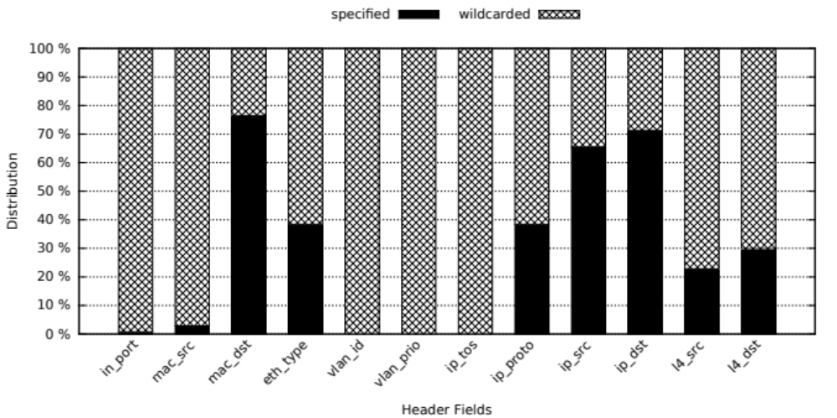
Destination MAC based forwarding.
Not much interest on the application side: l4 ports and protocols are specified less then 30% of the times.
40

Slide 45
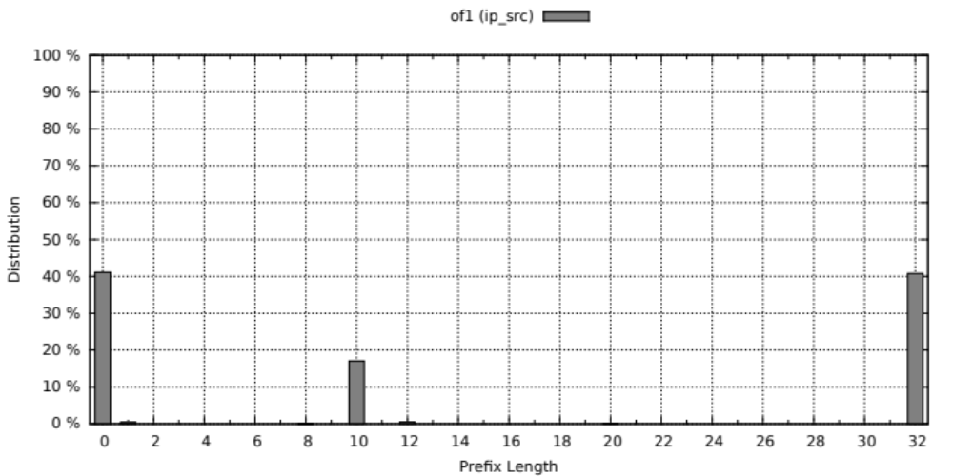
Forwarding is based on either the exact destination or in a big subnet.
41

Slide 46
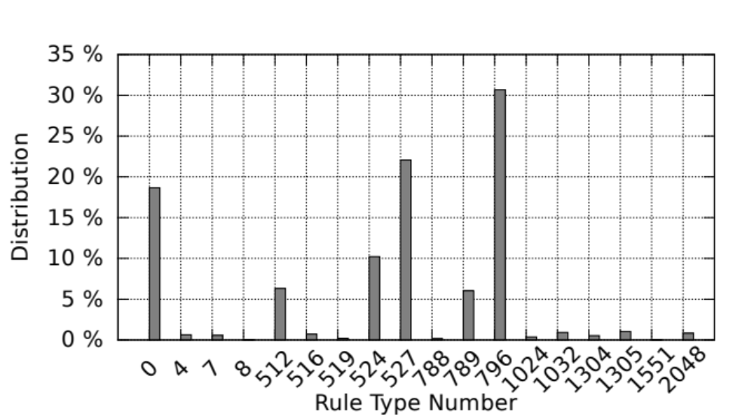
Rule type is a template that indicate which header fields are specified.
rule type number 796 refers to rules where mac dst, eth type, ip proto, ip src, and ip dst present specified values
42

Slide 47
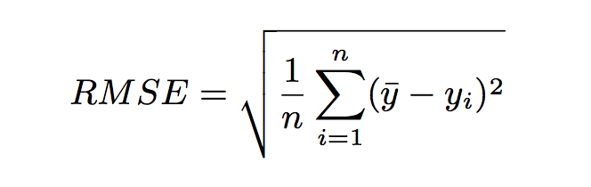
Evaluation of generation fidelity is based on the Root Mean Square Error (RMSE)
43

Slide 48
Evaluation of generation fidelity is based on the Root Mean Square Error (RMSE)
Target Value
44

Slide 49
Evaluation of generation fidelity is based on the Root Mean Square Error (RMSE)
Generated Value
45

Slide 50
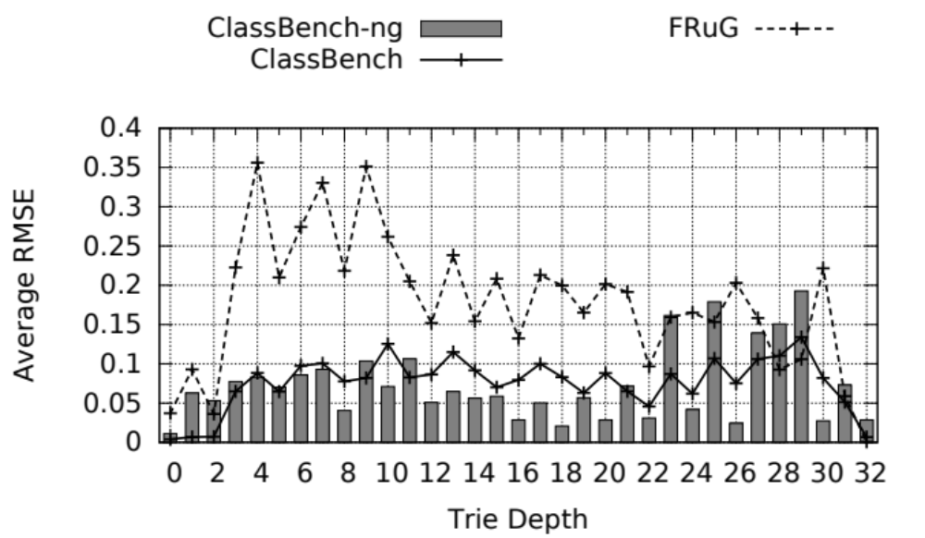
46

Slide 51
The beta-version of the code is released OpenSource.
We invite everyone from the community to contribute with new seeds taken from different scenarios
https://classbench-ng.github.io/
47

Slide 52
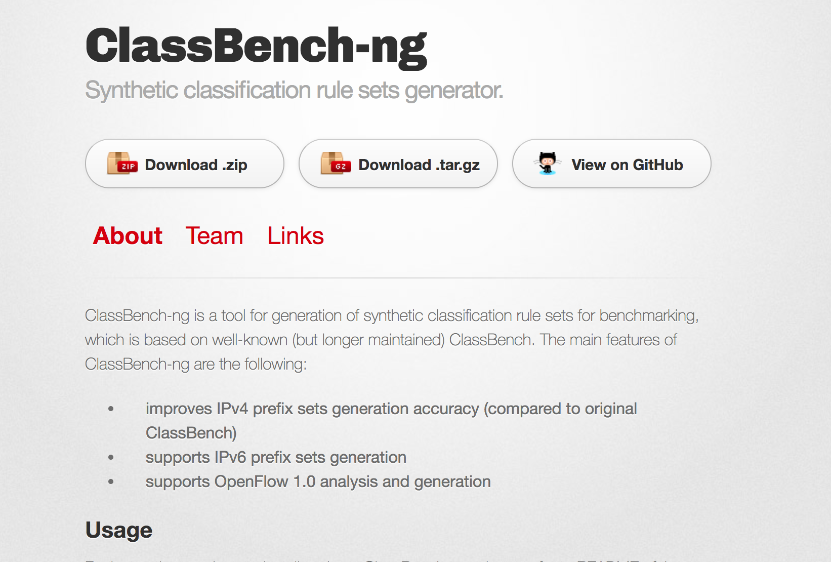
The beta-version of the code is released OpenSource.
We invite everyone from the community to contribute with new seeds taken from different scenarios
https://classbench-ng.github.io/
48

Slide 53

49

