Slide 1
SCIENCE FOUNDATIONS
Experimental
Error
How good is my data?
Notes:
Opening. Every measurement has some error. Today: where error comes from, how to describe it (precision vs. accuracy), and how to report it honestly (percent error).

Slide 2
PART 1
Where Does Error
Come From?

Slide 3
STATISTICS GETS YOU CLOSER TO THE TRUTH
Why We Repeat Experiments
↕
Some Trials Are High, Some Are Low
~
The Trendline IS the Average
One measurement is a guess. Repeat it, and some trials come out a bit high, others a bit low.
The HIGHS and LOWS cancel each other out when you AVERAGE them — which brings you close to the true value.
When you plot your repeated trials on a graph, the trendline shows the average pattern — it's what you'd expect if random error had cancelled itself out.
More trials → tighter average → better estimate of truth.
Experimental Error
3
Notes:
This is why we always repeat and always graph.

Slide 4
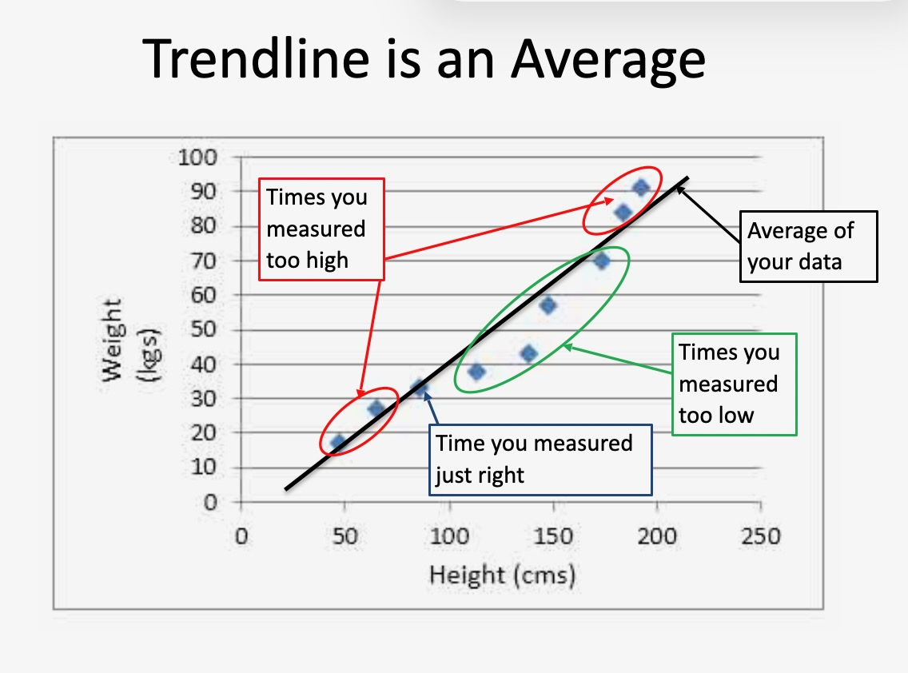
HIGHS CANCEL LOWS
The Trendline IS the Average
Experimental Error
4
Notes:
The trendline runs right through the middle of the scattered points — that IS the average of all your trials.

Slide 5
WHERE EVERY MISTAKE COMES FROM
The Five Sources of Error
1
YOU
2
Your Tools
3
Manipulation
Reaction time, eyesight, technique, mood.
Every ruler, scale, or timer has a limit.
Nudging or moving the setup while measuring.
4
External influences
5
Experimental design
A/C, drafts, vibrations, temperature drift.
Poor controls or too many variables changing.
Experimental Error
5

Slide 6
PART 2
Precision vs. Accuracy

Slide 7
THEY MEAN VERY DIFFERENT THINGS
Two Words That Sound Alike
P
PRECISION
A
ACCURACY
How close your repeated measurements are to EACH OTHER.
Repeatability.
You can spot precision problems DURING the experiment — if one trial is way off, just repeat it.
How close your data is to the EXPECTED (true) value.
Hit the target.
You can only calculate accuracy AFTER the experiment — using percent error.
Experimental Error
7
Notes:
Common mistake: using 'precise' and 'accurate' interchangeably. They're not.

Slide 8
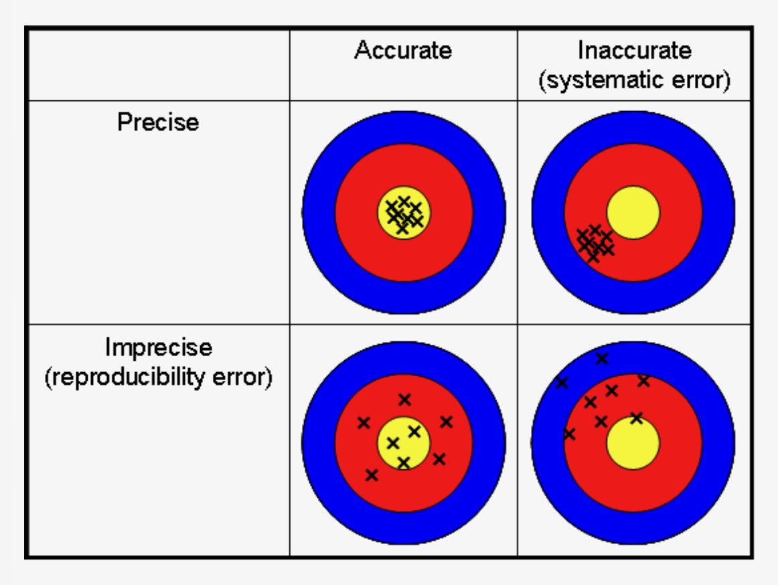
FOUR WAYS YOUR DATA CAN LAND
The Bullseye Test
Top-Left ✓✓
Precise AND accurate — the goal.
Top-Right
Precise but off-target — systematic error (bad calibration).
Bottom-Left
Accurate on average, but noisy — reproducibility error.
Bottom-Right ✗
Neither — go home and start over.
Experimental Error
8
Notes:
The classic diagram. Precision is about clustering; accuracy is about hitting the yellow bullseye. Great data lands in the top-left.

Slide 9
WATCH DATA AS IT COMES IN
Precision — Spot the Outlier
Time for a runner to finish a race (seconds):
TRIAL 1
TRIAL 2
TRIAL 3
TRIAL 4
12 s
27 s
13 s
11 s
consistent
OUTLIER
consistent
consistent
The 27 s is obviously wrong. Repeat that trial — don't average bad data in.
Experimental Error
8

Slide 10
SAME TOOL, BETTER RESULT
Technique Matters Too
Measuring room length with meter sticks — which is more precise?
✗ Sticks END-to-END
IN THE AIR
✓ Sticks END-to-END
ON THE FLOOR
Wobble. Shake. Gaps. Bad joints.
Small errors on every seam add up.
Sticks stay flat. Seams are tight.
Repeatable — much more precise.
Experimental Error
9
Notes:
Precision isn't just about tools — it's about HOW you use them.

Slide 11
PART 3
Error &
Percent Error

Slide 12
|MEASURED − ACTUAL|
The Error Formula
Error = | measured − actual |
|
Why Absolute Value?
kg
Same Units As Original
The vertical bars | | make the result POSITIVE, whether you measured too high or too low.
Error just tells us HOW FAR OFF — never a negative distance.
Error is in the SAME units as your measurement.
Measured 175,000 kg vs. actual 180,000 kg → Error = 5,000 kg.
Experimental Error
11

Slide 13
THE WHALE-AND-CAT PROBLEM
Why Isn't Error Enough?
🐋 A Blue Whale
🐈 A House Cat
Actual mass: 180,000 kg
Actual mass: 8 kg
You measure: 175,000 kg
You measure: 7 kg
Error = 5,000 kg
Error = 1 kg
SOUNDS HUGE!
SOUNDS TINY!
% Error = 2.8%
% Error = 12.5%
Experimental Error
12
Notes:
Whale is actually MORE ACCURATE than the cat, even though the whale's error looks huge. Percent error lets us compare across scales.

Slide 14
HOW TO COMPARE ERRORS FAIRLY
The Percent Error Formula
% Error = |measured − actual| ÷ actual × 100%
The closer your percent error is to 0,
the more ACCURATE your data.
Experimental Error
13

Slide 15
THEY ALL MEAN THE SAME THING
You'll See This Formula In Different Ways
OUR NOTATION
MANY TEXTBOOKS
SCIENCE JOURNALS
| measured − actual |
| experimental − accepted |
| observed − true |
actual
accepted
true
× 100%
× 100%
× 100%
Result: no units,
just add a %
Result: no units,
just add a %
Result: no units,
just add a %
Experimental Error
14

Slide 16
SAME 4 STEPS EVERY TIME
Worked Example — Density of Water
You measure water's density as 0.96 g/mL. The actual value is 1.00 g/mL. Find the error and percent error.
1
2
3
4
IDENTIFY
ERROR
% ERROR
JUDGE
Actual = 1.00 g/mL
Measured = 0.96 g/mL
|1.00 − 0.96|
= 0.04 g/mL
(0.04 ÷ 1.00) × 100%
= 4%
4% error — pretty good
for a middle-school lab.
Experimental Error
15

Slide 17
ESTIMATE. COUNT. COMPARE.
Practice — Counting Raisins
1
ESTIMATE
2
COUNT
How many raisins do you think are in the box?
Pour them out. Count the actual number.
3
FIND ERROR
4
FIND % ERROR
Error = |measured − actual|
% Error = |measured − actual| ÷ actual × 100%
Experimental Error
16
Notes:
This is the raisins lab — a fast way to feel percent error in your hands.

Slide 18
HOMEWORK
Experimental Error
Problem Set #1
Posted on Google Classroom. Due next class meeting.
Remember: identify measured, actual, error, and % error — with units.

