Slide 1
Data Analysis
Understanding your results by making a graph to analyze your data

Slide 2
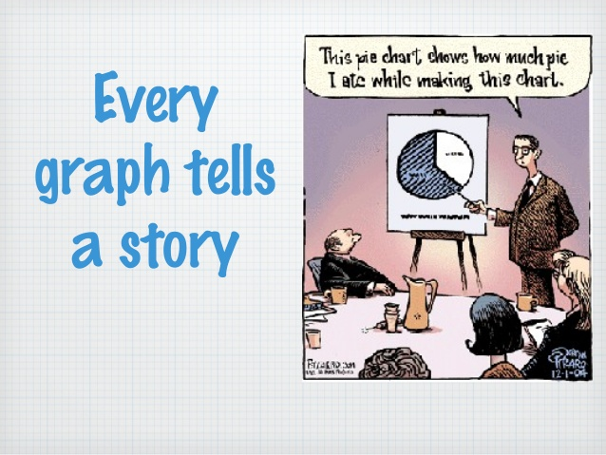
Graphs Tell a Story

Slide 3
Goals for today
Learn how to make a Graph from data you have collected
Data tables, labels, type
Learn how to describe a graph
linear, non-linear, exponential
Learn how to interpret a graph
What is the relationship? – proportional, directly proportional, inversely proportional, negative relationship, positive relationship
What physical quantity does the slope tell you?

Slide 4
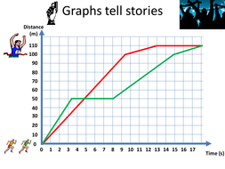
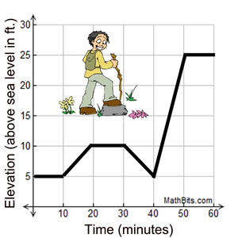
Why Use Graphs
Organizing our data into a graph does more than make it aesthetically pleasing (pretty)
It tells a story

Slide 5
Data Tables
Make a data table and then use it to plot your data
X | Y
0 | 0
1 | 2
2 | 4
3 | 6
IV | DV
0 | 0
1 | 2
2 | 4
3 | 6
Time (seconds) | Distance (meters)
0 | 0
1 | 2
2 | 4
3 | 6
t (s) | d (m)
0 | 0
1 | 2
2 | 4
3 | 6
GENERAL -------------------------------------------------------------SPECIFIC
MATH------------------------------------------------------------------SCIENCE

Slide 6
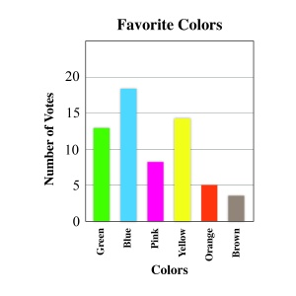
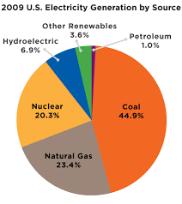
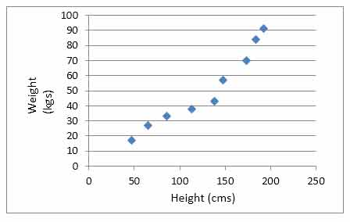
Graph Types
X-Y Scatter Plot
Bar/Column Graph
Pie Chart

Slide 7
X-Y Scatter Plot
used to determine relationships between the two different variables
X-axis – Independent Variable
Y- axis – Dependent variable
most common type of graph you will use in science
Do not connect the dots, instead use a trendline!

Slide 8
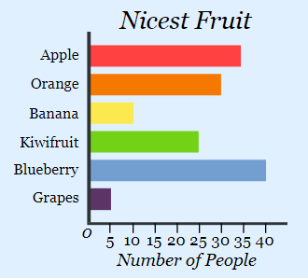
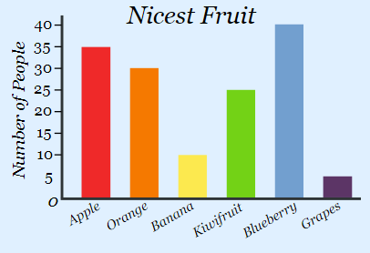
Bar/Column Graph
used to compare two or more different groups
they do not show changes over time
There is no relationship
Both the Bar and the Column charts display data using rectangular bars where the length of the bar is proportional to the data value. Both are used to compare two or more values. However, their difference lies in their orientation. A Bar chart is oriented horizontally whereas the Column chart is oriented vertically.

Slide 9
Pie Chart
used when you are trying to compare parts of a whole
they do not show changes over time
There is no relationship

Slide 10
Where is the Relationship Shown?
RELATIONSHIP BETWEEN Y-VALUE AND X-VALUE
NO RELATIONSHIP

Slide 11
How to Interpret an X-Y Scatter Plot
Is it:
Linear or non-linear
Proportional, directly proportional, or inversely proportional
Positive or negative relationship

Slide 12
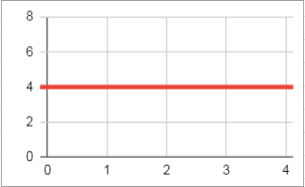
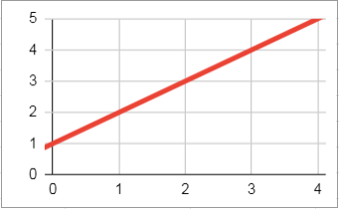
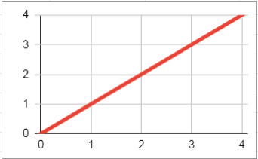
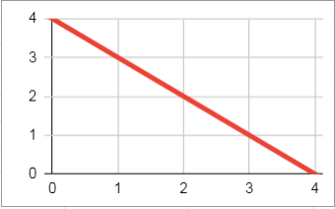
Linear & Constant Slope
These types of graphs will always have straight lines

Slide 13
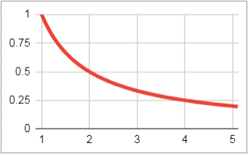
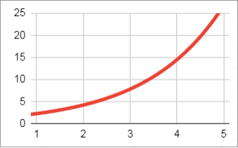
Non Linear & Changing Slope
These types of graphs will always have curved lines

Slide 14
Positive or Negative Relationship
Positive - as x-axis increases, y-axis increases too
Negative -as x-axis increases, y-axis decreases

Slide 15
Proportionality
Proportional – as IV increases, DV increases
Directly Proportional – as IV increases, DV increases and goes through 0,0
Inversely Proportional – as IV increases, DV decreases
PROPORTIONAL DIRECTLY INVERSELY
PROPORTIONAL PROPORTIONAL

Slide 16
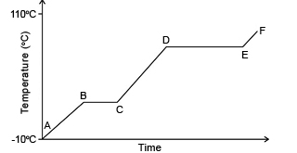
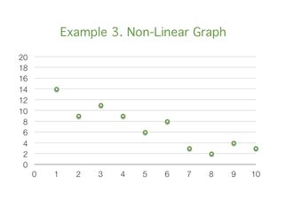
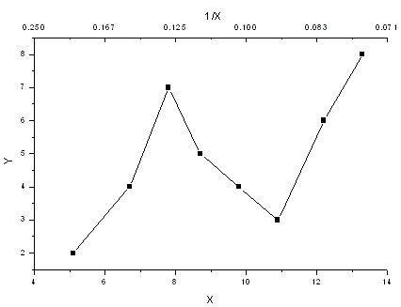
Nonlinear
Not a straight line path
Look at the WHOLE picture for trends or patterns
may or may not be present

Slide 17
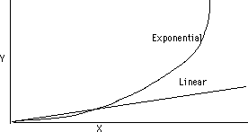
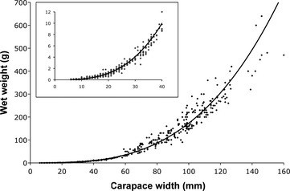
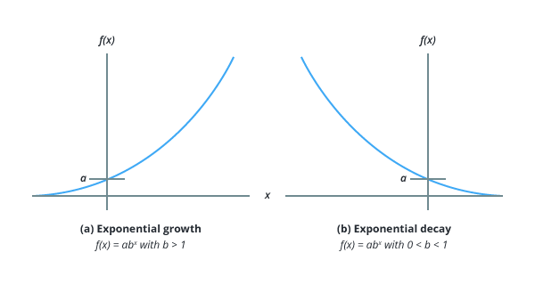
Exponential
Graph increases or decreases by huge factors (shaped as a curve)

Slide 18
Examples
Discuss the following graphs
What shape is the graph? (linear, nonlinear, exponential)
What is the relationship between variables? (positive or negative)
Is it proportional, directly proportional, inversely proportional?
What story does it tell? (as X increases, Y _______)

Slide 19
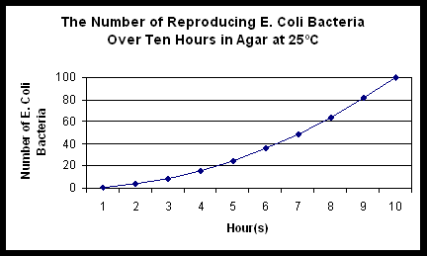

Slide 20
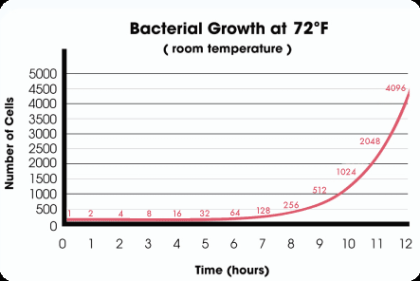

Slide 21
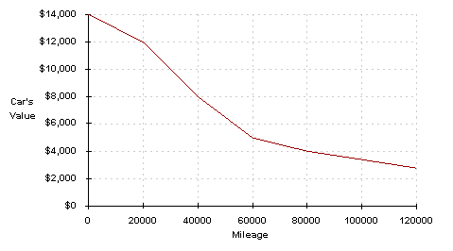

Slide 22
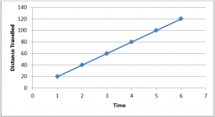

Slide 23
Making a Graph
Make a data table
Choose a graph type
Plot your data
Do not connect the dots
Add a trendline if appropriate
If linear or exponential
Give your graph a title
Label your axes with variable and unit
Scale your axes

Slide 24
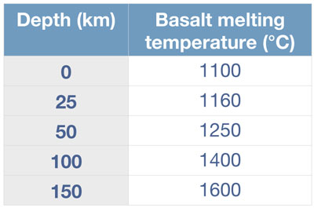
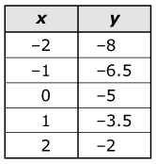
Make a data table
Put your data in two x-y columns and label it
MATH CLASS
SCIENCE CLASS
ONLY WRITE UNITS IN TOP BOXES WITH LABELS

Slide 25
Label Your Scatterplots in this Manner
Give your graph a descriptive title
“The relationship between DV (y-axis quantity) and IDV (x-axis quantity)”
Label your axes with 3 things
What it is measuring
i.e. temperature, time, mass
Units of measurement
i.e. Celsius, seconds, grams
Show your scale
numbers

Slide 26
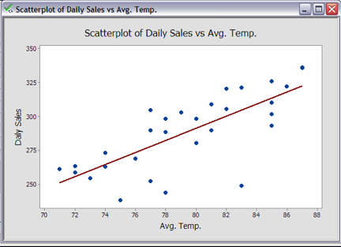
Add a Trendline
DO NOT CONNECT THE DOTS
Add a trendline, linear, exponential or power series as appropriate
A trendline is the average of your data

Slide 27
Label Your Bar and Pie Charts in this Manner
Give your chart a descriptive title
DO NOT call it a relationship
Explain what the chart is telling you
“Comparison” might be a good title word
For Bar/Column Charts
Label your axes appropriately
if necessary provide a key to identify what bars are telling you

Slide 28

Let’s Try it In Google Sheets!
Everybody open a blank Google Sheets file and follow along with your instructor.

Slide 29
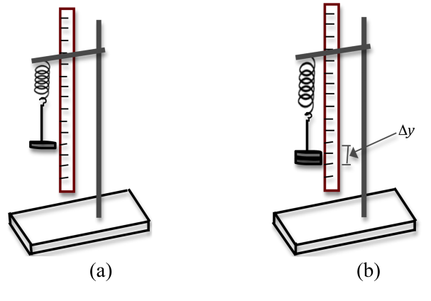
Let’s Plot a Relationship!
The Force (F) a spring exerts is directly proportional to the distance it is stretched and can be written in the form of a linear [y = f(x)] equation as F = kx, where k is the spring constant. Let’s make a scatterplot of F = kx for x = 0, .025, .045, .080 & .095 m where k equals 100.
F= 100x

Slide 30
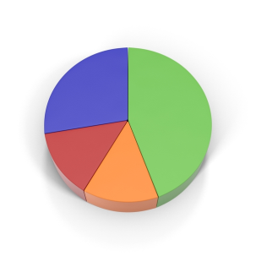
Let’s Make a Pie Chart!
What percentage of students in this class have birthdays during the following quarters?
Q1 Jan-Mar- 25%
Q2 Apr-Jun-10%
Q3 Jul-Sep- 5%
Q4 Oct-Dec-60%

Slide 31
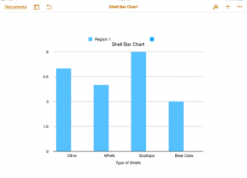
Let’s Make a Bar/Column Graph!
Compare the different cars at the car rental agency when the following cars are available for rent:
10 Jeeps, 25 SUVs, 15 Economy Cars, 25 mid-size cars, 5 luxury cars, and 15 convertibles.

