Slide 1
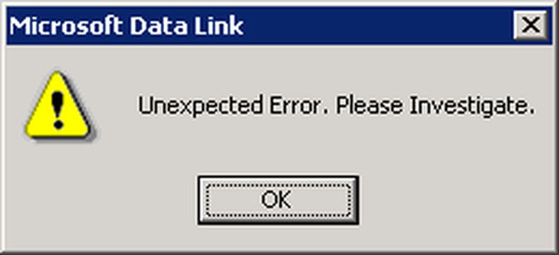
Experimental Error
How good is my data?

Slide 2
Experimental Error
Why do you repeat your experiment?
How come when you do an experiment you do not get the exact same result every time?
Where does error come from?

Slide 3
Repeating Experiments
Allows for statistics to get you closer to the correct answer
When you do multiple experiments you might be higher than actual and lower than actual approximately the same amount of times
An average of your results gets you close to the true value (Graphically this is a trend line!)

Slide 4
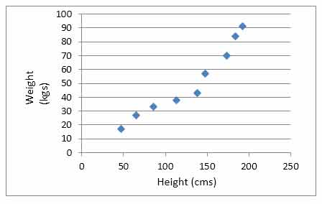
Trendline is an Average
Times you measured too high
Average of your data
Times you measured too low
Time you measured just right

Slide 5
Sources of Error
You (reaction time, sight, etc.)
Tools you use (limitations come from how small of measurements they can take)
Manipulation/changing the environment slightly (moving something from its original position)
External influences
Experimental design (not well controlled)

Slide 6
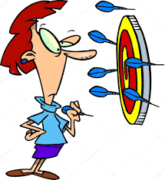
Analyzing Data
Look for:
Precision
Accuracy
Error
% Error

Slide 7
Analyzing Data
Precision: how close your data is when you repeat the experiment
Accuracy: how close your data is to the expected value

Slide 8
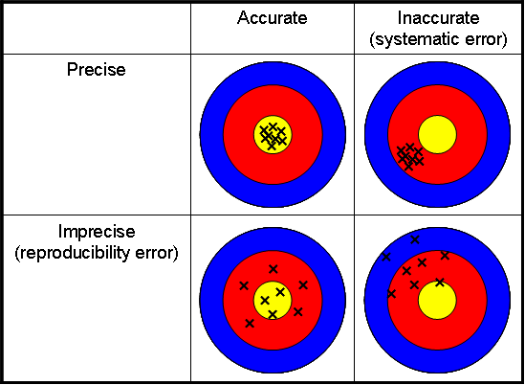

Slide 9
Precision – During Experiment
Repeatability
Can be observed and potentially corrected during experiment
If you notice an “outlier” or a data
point that is totally off, just repeat
measurement
Trial # | Time to finish line (s)
1 | 12
2 | 27
3 | 13
4 | 11

Slide 10
Precision – During Experiment
When measuring the room's volume with meter sticks, which method do you think will give you a more precise measurement?
Placing the meter sticks end to end while holding them in the air
Placing the meter sticks end to end while laying them on the floor

Slide 11

Accuracy
Proximity (closeness) to target
Analyzed after data collection using percent error

Slide 12
Error and Percent Error
error = | measured − actual |
Absolute value means NO NEGATIVES
Why can’t we just use this value?
% error = |measured − actual| ÷ actual × 100
No units, just put a % at the end

Slide 13
Why is “Percent Error” Important?
A blue whale has a mass of 180,000 Kg. YOU measured it to be 175,000 Kg
What is your error?
180,000 kg - 175,000 kg = 5,000 kg
Your cat has a mass of 8 Kg. YOU measured it to be 7 Kg.
What is your error?
8 kg – 7 kg = 1 kg
Much better!....Right?

Slide 14
Accuracy and Percent Error
A blue whale has a mass of 180,000 Kg. YOU measured it to be 175,000 Kg
What is your error?
5,000
What is your % error?
Your cat has a mass of 8 Kg. YOU measured it to be 7 Kg.
What is your error?
1
What is your % error?
THE CLOSER YOUR PERCENT ERROR IS TO 0, THE MORE ACCURATE YOUR DATA IS!

