Slide 1
Introduction to R: A small program
Steve Simon

Slide 2
Special note
This PowerPoint slide show was created using R.
Not complicated
But beyond scope of this class
Source
https://github.com/pmean/introduction-to-r/tree/master/part1/src
A second resource
http://blog.pmean.com/powerpoint-with-r-markdown/
Notes:
If you are viewing this PowerPoint presentation, I need to point out that it was developed using R. The process is not very complicated, but it is beyond the scope of this class.
If you are curious, you can look at the code that I used to develop this PowerPoint presentation. Or you can watch a short video on how this works.
But don’t feel obligated to look at it. You will not be responsible for any of this in an introductory class.
It may seem a bit weird to have an R program that creates a PowerPoint presentation that talks about a different R program, but it works well for me.

Slide 3
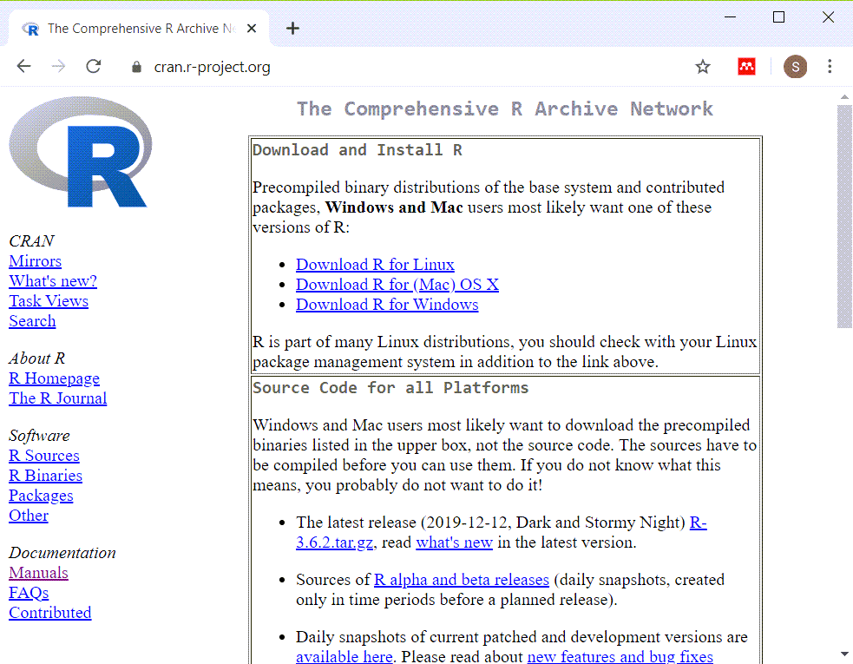
Installing R (https://cran.r-project.org/)
Screenshot of webpage for installation of R
Notes:
Here is the main page for CRAN. CRAN stands for the Comprehensive R Archive Network. This is where you can download a Linux, Mac, or Windows version of R. Ignore the source code. That is only needed for very advanced applications.

Slide 4
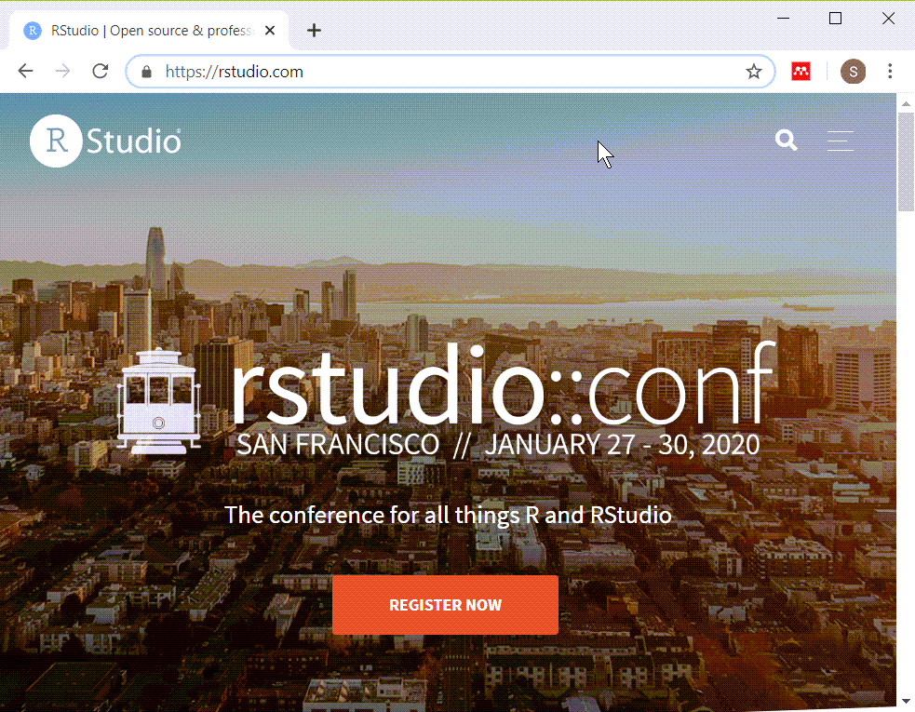
Installing RStudio (https://rstudio.com/)
Screenshot of main page for RStudio

Slide 5
Installing R and R Studio
R is required
RStudio is strongly recommended
Do not delay in getting this software installed
Find me if you have ANY problems
Notes:
It should be very easy to install R and RStudio on your computer, but don’t wait. Sometimes installations can get hung up and you won’t be able to make any progress in this class without first getting the software installed.
If you have any problems at all with installation, see me right away.

Slide 6
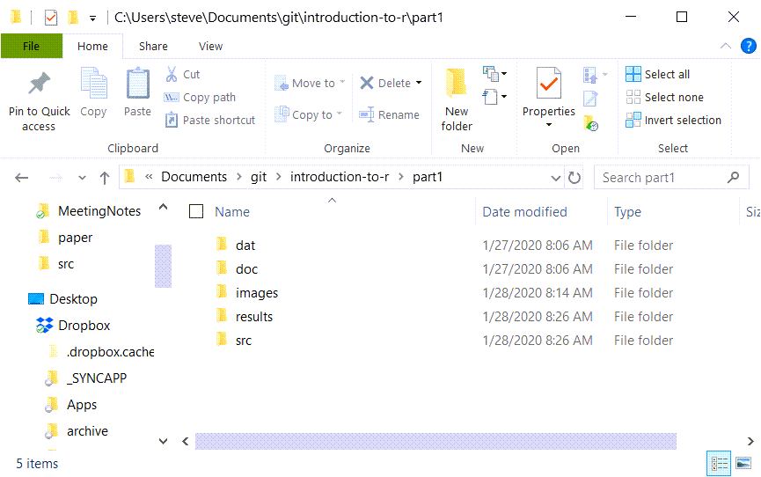
Recommended directory structure
Screenshot of the directory structure I use
Notes:
Here is the directory structure that I use. You do not have to follow this structure, but it is recommended, not by me, but by the expert programmers at a group known as Software Carpentry. I’ll elaborate in greater detail about this later, but wanted to mention it now. If you are relatively new to programming, you want to start off using good programming practices. A standardized directory structure helps a lot with this especially if you are working with others.

Slide 7
“A place for everything, everything in its place”
dat
raw/intermediate data files
doc
documentation
images
graphs
results
program output
src
program code
Notes:
The quote at the top of the slide is an organizational principle espoused by Benjamin Franklin. If you’ve seen my office, you’ll know that I am probably the last person to lecture you on organization. But I have found that a standardized directory structure has made my life a lot easier.
The dat folder contains any raw data files. It’s also where I put intermediate files, files that I create and save for later re-use. Some people put intermediate files in the results folder, and that’s a fine alternative. Just be sure to be consistent about it.
The doc folder contains any documentation associated with the work. The IRB approved protocol, if I have one, will go here. If I am working with someone and they send me a paper that helps describe the type of data analysis they want, I put it in this folder. I also print key emails from the other team members to pdf format and store them here as well.
If my programs produce any graphs, I will store them in the images folder. I use screenshots of various web pages a lot in my work and I put those here as well.
I usually store program output in the results folder, but not always, for reasons I don’t want to get into.
The program code goes in the src folder.

Slide 8
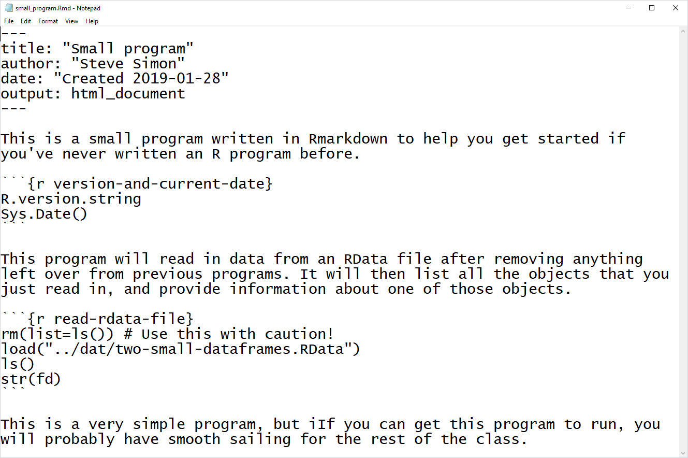
Anatomy of a small R program, overview
Full listing of small_program.Rmd
Notes:
This is a full listing of a small program written in Rmarkdown. The font is too small to read. Don’t worry, I just wanted you to see the full picture. I’ll look at small pieces of this program using a readable font size.

Slide 9
Anatomy of a small R program, header
Rmarkdown code
--- title: "Small program" author: "Steve Simon" date: "Created 2019-01-28" output: pdf_document: default html_document: default ---
Notes:
Here is the typical header for an Rmarkdown program.

Slide 10
Anatomy of a small program, free text comments
Rmarkdown code
This is a small program written in Rmarkdown to help you get started if you've never written an R program before.

Slide 11
Anatomy of a small program, code chunk
Rmarkdown code
```{r version-and-current-date} R.version.string Sys.Date() ```

Slide 12
Anatomy of a small program, second set of free text comments
Rmarkdown code
This program will read in data from an RData file after removing anything left over from previous programs. It will then list all the objects that you just read in, and provide information about one of those objects.

Slide 13
Anatomy of a small program, second code chunk
Rmarkdown code
```{r read-rdata-file} rm(list=ls()) # Use this with caution! load("../dat/two-small-dataframes.RData") ls() str(fd) ```

Slide 14
Anatomy of a small program, third set of free text comments
Rmarkdown code
This is a very simple program, but if you can get this program to run, you will probably have smooth sailing for the rest of the class.
Notes:
After the second chunk of R code, I add a couple of extra comments.

Slide 15
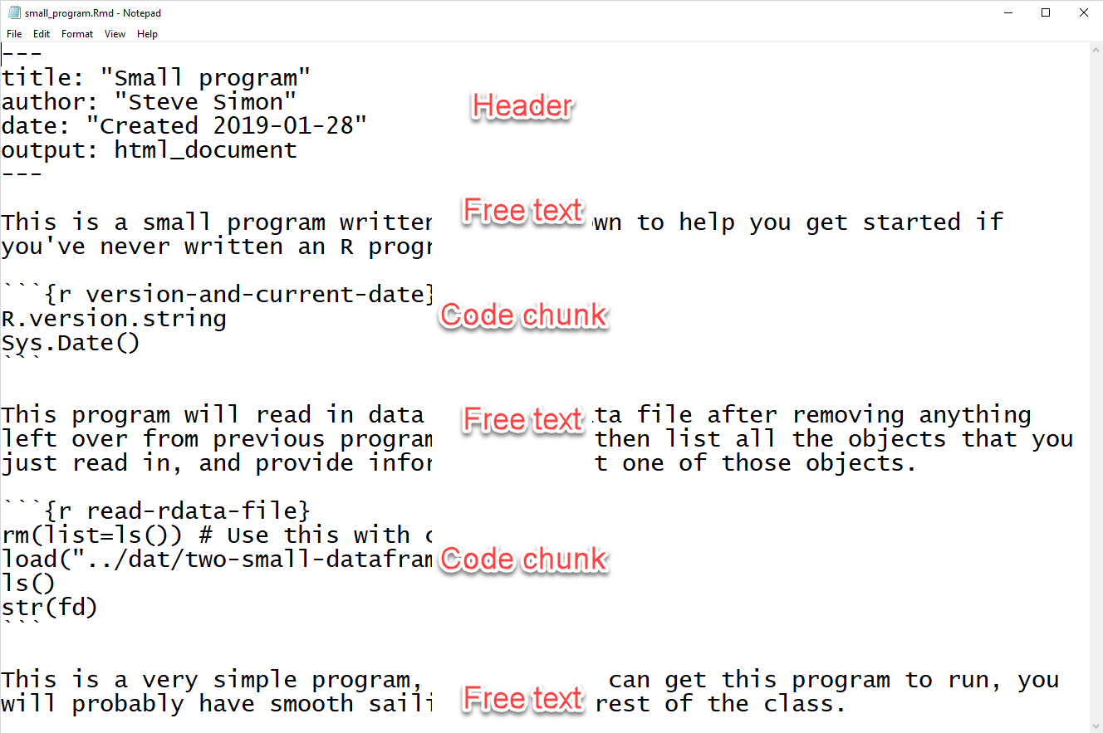
Anatomy of a small program, review
Full listing of small_program.Rmd with annotations
Notes:
Here is the full program again. You can see that it starts with a header, and alternates between free text and R code.

Slide 16
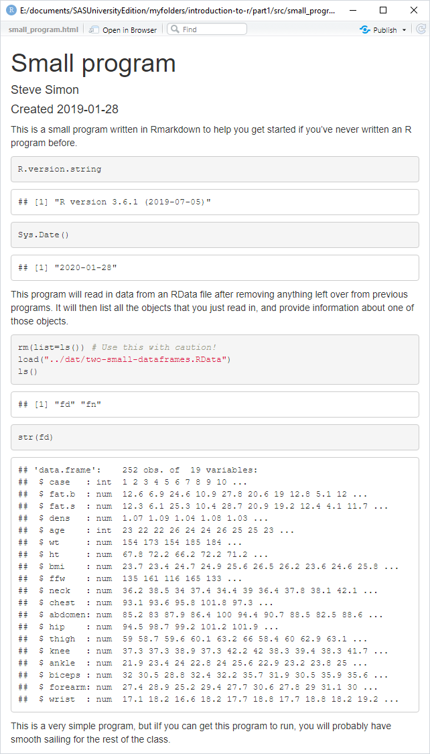
Program output, overview
Screenshot of entire output
Notes:
Here is the full output. The fonts are too small to read, so let’s zoom in again on individual pieces.

Slide 17
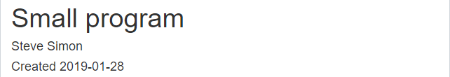
Program output, header
Screenshot of output header
Notes:
This is the header. It displays the title, author, and date from the code header.

Slide 18
Program output, free text
Screenshot of output free text
Notes:
This is first set of free text. Rmarkdown will reflow the text, if needed, to fit inside the margins.

Slide 19
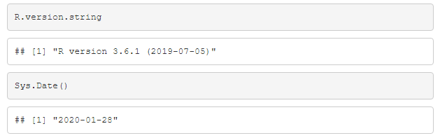
Program output, code chunk
Screenshot of output code chunk
Notes:
This is the first code chunk. By default, Rmarkdown will display the individual commands in a gray box, followed by the output in a white box.

Slide 20
Program output, more free text
Screenshot of output free text
Notes:
This is second set of free text.

Slide 21
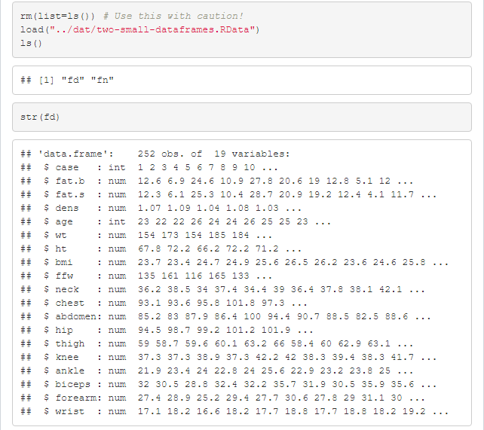
Program output, second code chunk
Screenshot of output code chunk
Notes:
This is the second code chunk. It displays the title, author, and date from the code header.

Slide 22
Program output, last set of free text
Screenshot of output free text
Notes:
This is last set of free text.

Slide 23
Review
In this video, you saw
Installation pages for R, RStudio
Anatomy of a small program
Output from the small program
Review Canvas for the work assigned to this module
Notes:
This is a very basic start. You saw the web pages where you install R and RStudio from. Then you saw the pieces of a small program written in Rmarkdown, as well as the output.
Take a look at Canvas, please, to see the work that you need to do for this module.

