Slide 1
Lecture03 - A mix of categorical and continuous variables
Steve Simon

Slide 2
Topics in this lecture
Review
proc format, proc freq, proc means
proc corr
proc sgplot
scatterplot
boxplot
by statement
Notes:
Here are the topics we will cover. It is a lot of material, but you will pick it up very easily.

Slide 3
1. Introduction
Today, you will analyze some data sets that have a mix of categorical and continuous variables. The first data set looks at pumonary function in a group of children.
You can find a description of this data set at
http://jse.amstat.org/datasets/fev.txt

Slide 4
fev data set
"V1","V2","V3","V4","V5" 9,1.708,57,0,0 8,1.724,67.5,0,0 7,1.72,54.5,0,0 9,1.558,53,1,0 9,1.895,57,1,0 8,2.336,61,0,0 6,1.919,58,0,0 6,1.415,56,0,0 8,1.987,58.5,0,0
Notes:
Here are the first ten rows of the fev data set.

Slide 5
2. Data and output locations
filename raw_data "../data/fev.txt"; libname intro "../data"; ods pdf file="lecture03.pdf";
Notes:
Here are the standard commands to tell SAS where to find the data, where to place its own data files and where to store the output.

Slide 6
3. Labels for categorical data
proc format; value fsex 0 = "Female" 1 = "Male" ; value fsmoke 0 = "Nonsmoker" 1 = "Smoker" ; run;
Notes:
There are several categorical variables in this data set with number codes, so you should define labels for those codes.

Slide 7
4. Reading the data using a data step
data intro.fev; infile raw_data delimiter="," firstobs=2; input age fev ht sex smoke; label age=Age in years fev=Forced Expiratory Volume (liters) ht=Height in inches sex=Sex smoke=Smoking status ; run;
Notes:
The data file is comma delimited and the first row includes variable names.
Normally, this means that you can save a bit of time by using proc import, but I chose to read in the data using a data step. The number of variables was so small that this didn’t matter that much. It also allowed me to define variable labels in the initial data step rather than later.

Slide 8
5. Print the first ten rows of data
title1 "Pulmonary function study"; title2 "Partial listing of fev data"; proc print data=intro.fev(obs=10); format sex fsex. smoke fsmoke. ; run;
Notes:
It’s alsways a good idea to peek at the first few rows of data.

Slide 9
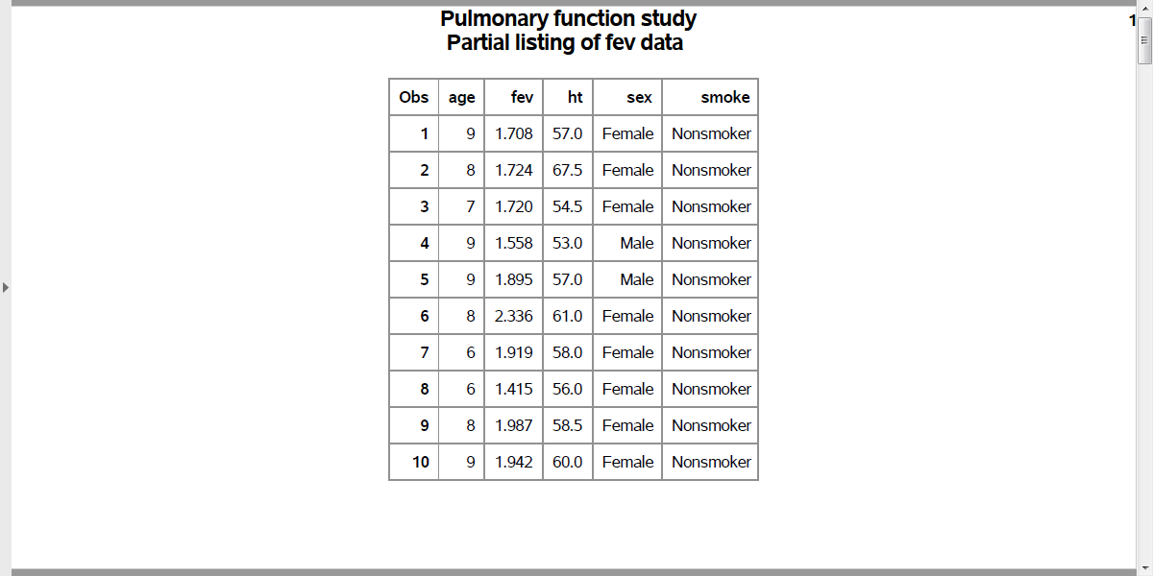
5. Print the first ten rows of data
Output, proc print
Notes:
Here are the first ten rows of the data .

Slide 10
6. Proc freq and proc means
title2 "Frequency counts"; proc freq data=intro.fev; tables sex smoke / missing; format sex fsex. smoke fsmoke. run; title2 "Descriptive statistics"; proc means n nmiss mean std min max data=intro.fev; var age fev ht; run;
Notes:
There is a mix of categorical and continuous variables in this data set. Recall that you use proc freq for categorical variables and proc means for continuous variables.
Always get in the habit of checking for missing values.

Slide 11
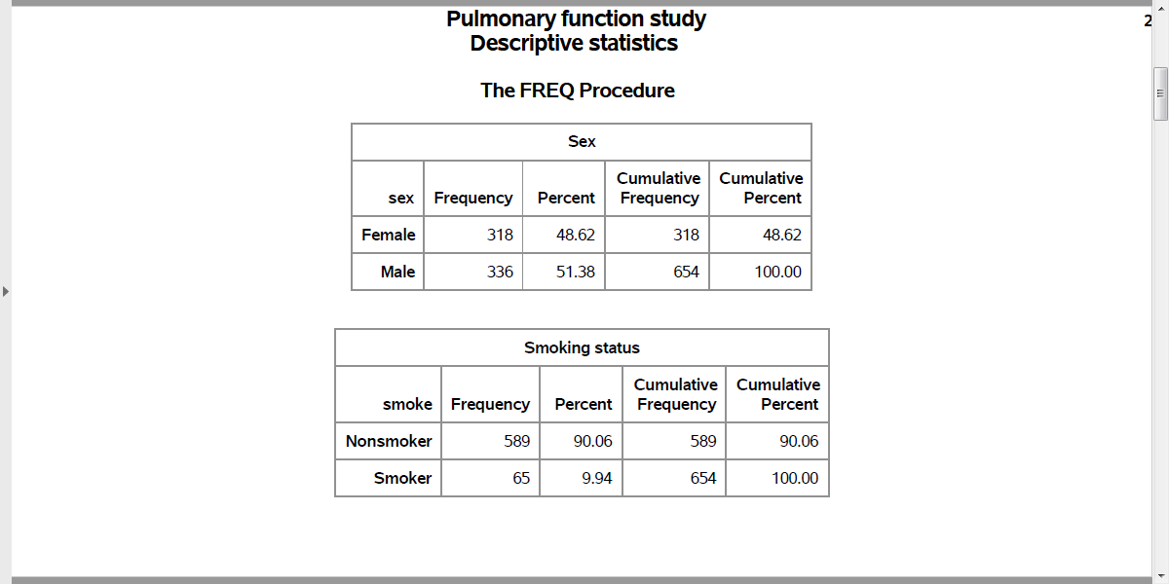
6. Proc freq and proc means
Output, proc freq

Slide 12
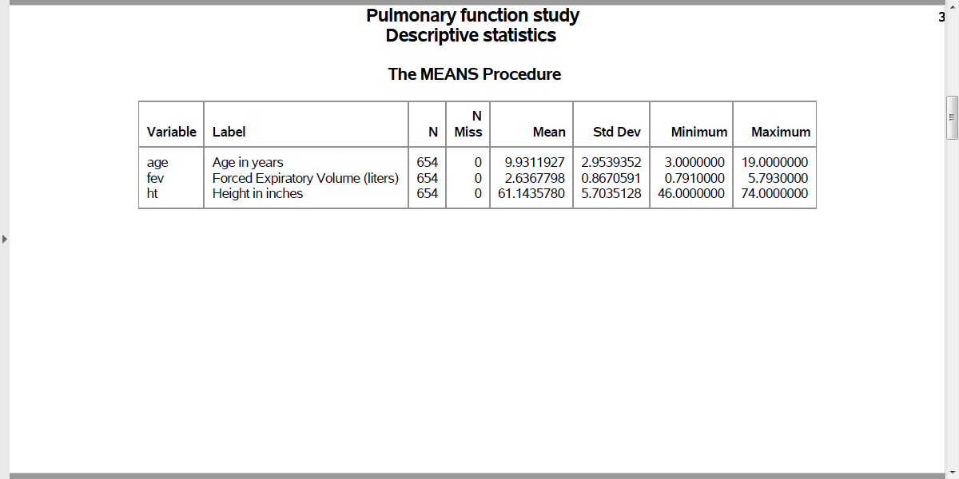
6. Proc freq and proc means
Output, proc means

Slide 13
7. Pearson correlation, proc corr
title2 "Correlations"; proc corr nosimple noprob data=intro.fev; var age fev ht; run;
Notes:
The Pearson correlation coefficient gives you a numeric measure of the strength of association between two continuous variables.

Slide 14
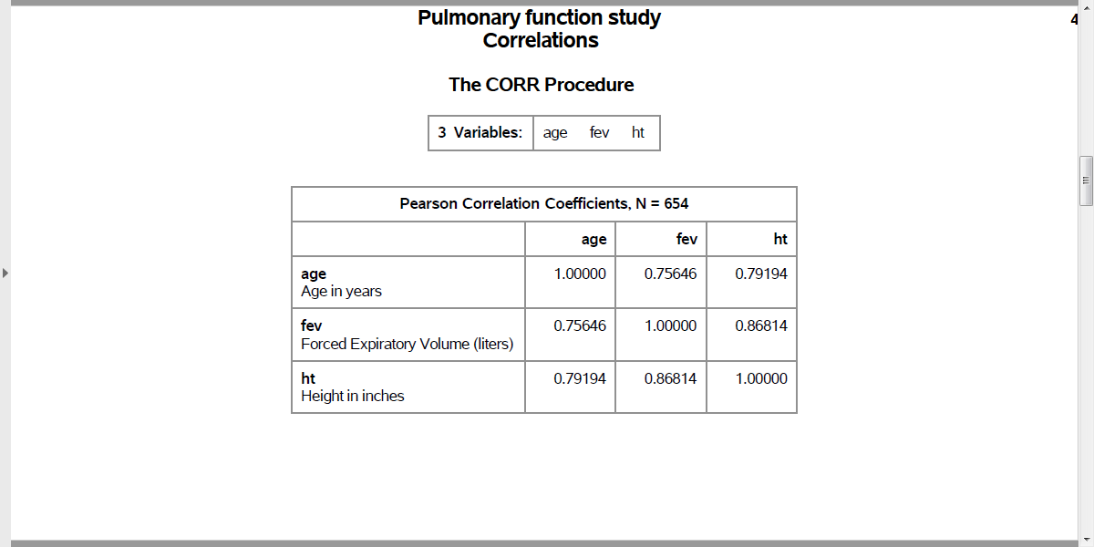
7. Pearson correlation, proc corr
Output, proc corr

Slide 15
8. Scatterplot, proc sgplot
title2 "Scatterplots"; proc sgplot data=intro.fev; scatter x=age y=fev; run;
Notes:
You should also examine the association between continuous variables using a scatterplot.
I am only showing the plot of ht versus fev, but you should also examine the plot of age versus fev.

Slide 16
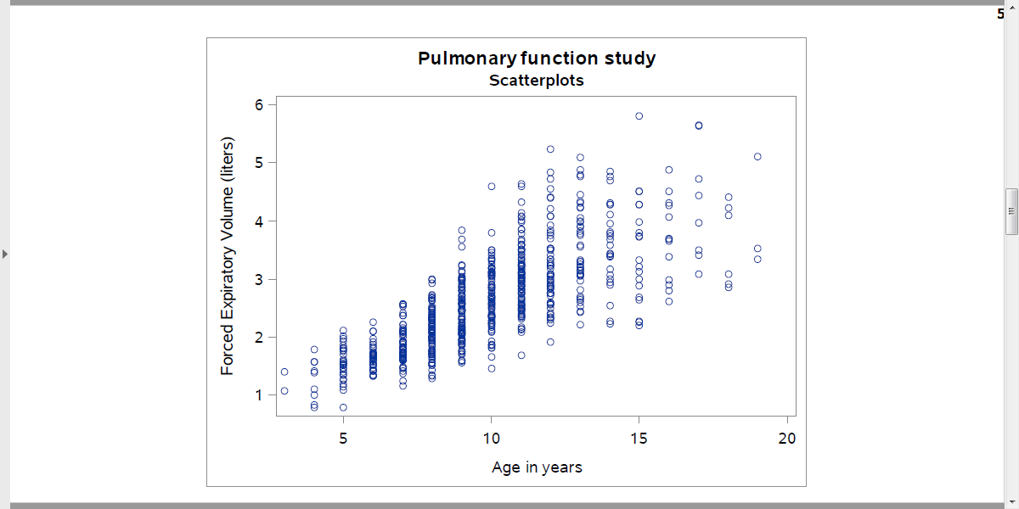
8. Scatterplot, proc sgplot
Output, proc sgplot

Slide 17
9. Scatterplot, smoothing curve
title3 "with loess, smooth=0.1"; proc sgplot data=intro.fev; scatter x=ht y=fev; loess x=ht y=fev / nomarkers smooth=0.1 lineattrs=(color=Red); run;
Notes:
Sometimes a trend line can help. You should consider a smoothing method like loess or pbspline, as this will help you visualize any potential nonlinear relationships.

Slide 18
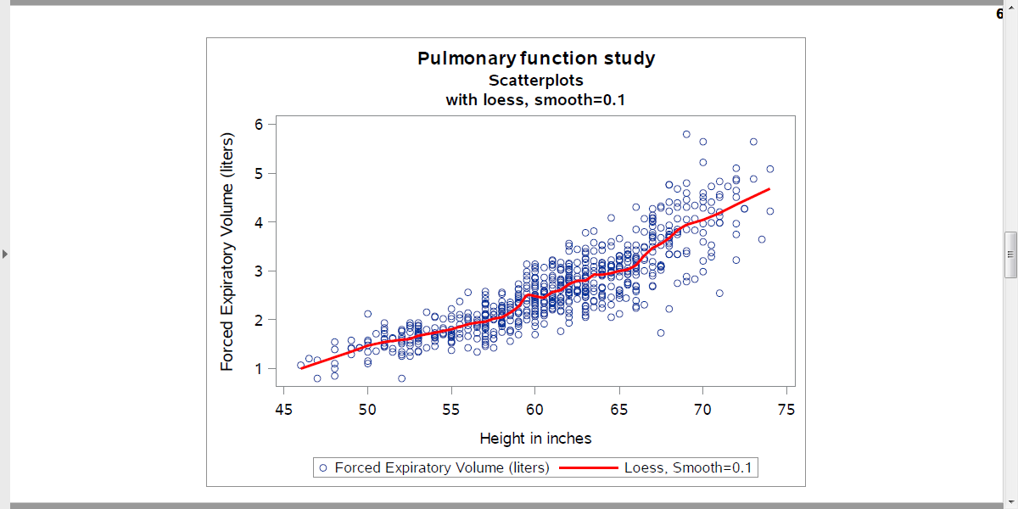
9. Scatterplot, smoothing curve
Output, proc sgplot

Slide 19
10. Boxplot, proc sgplot
title2 "Boxplots"; proc sgplot data=intro.fev; vbox fev / category=smoke; format smoke fsmoke.; run;
Notes:
When you want to look at a relationship between a categorical variable and a continuous variable, you should use a boxplot.
Notice that you use proc sgplot for both a scatterplot and a boxplot. This is a big improvement over previous methods in SAS to produce plots because it is easier to learn one procedure and minor variations in that procedure rather than having to learn multiple procedures.

Slide 20
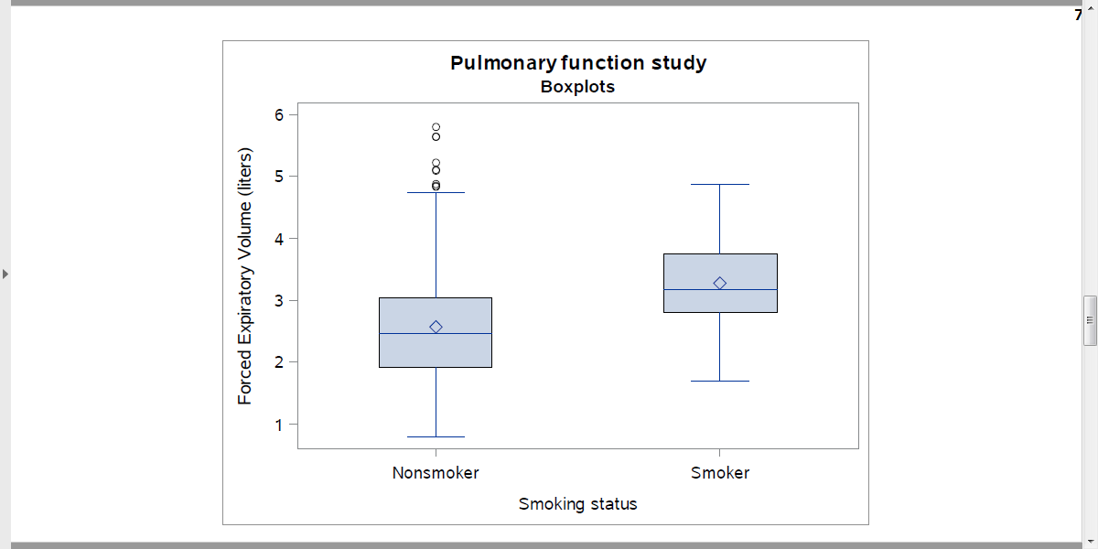
10. Boxplot, proc sgplot
Output, proc sgplot

Slide 21
11. Descriptive statistics, by statement
proc sort data=intro.fev; by smoke; run; proc means data=intro.fev; var fev; by smoke; format smoke fsmoke.; title2 "Descriptive statistics by group"; run;
Notes:
Also look at how the means and standard deviations of your continuous variable change for each level of your categorical variable.

Slide 22
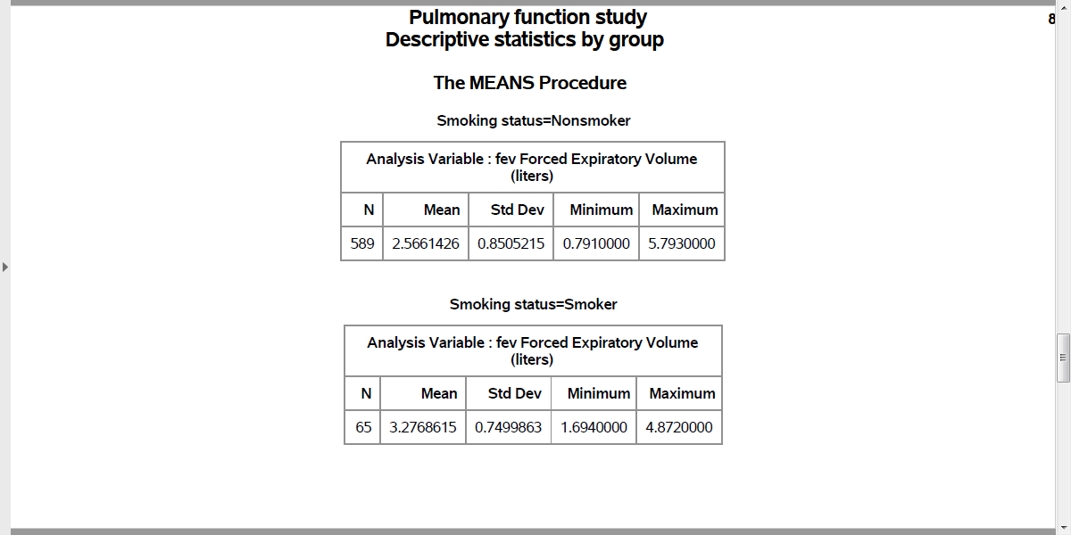
11. Descriptive statistics, by statement
Output, proc means with by statement

Slide 23
12. Investigate unusual trend, proc sgplot and means
proc sgplot data=intro.fev; vbox ht / category=smoke; format smoke fsmoke.; title2 "Boxplots"; run; proc means data=intro.fev; var ht; by smoke; format smoke fsmoke.; title2 "Descriptive statistics by group"; run;
Notes:
This is very odd. You can get a hint as to why smokers might have higher fev values than non-smokers by looking at how age and smoking status are related.

Slide 24
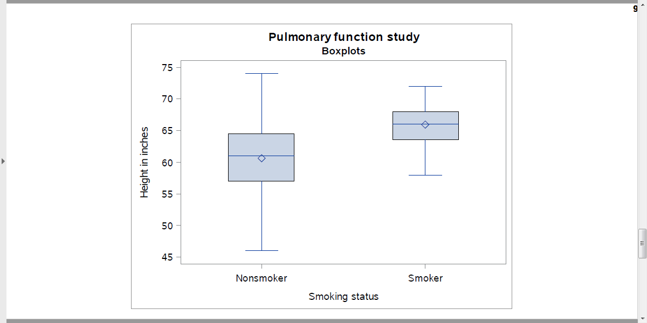
12. Investigate unusual trend, proc sgplot and means
Output, proc sgplot

Slide 25
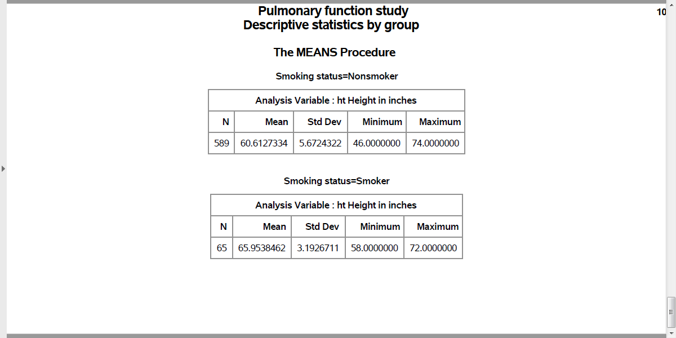
12. Investigate unusual trend, proc sgplot and means
Output, proc means with by statement

Slide 26
13. Further investigation on your own
You should also examine the relationship between sex and fev. Do this on your own, but there is no need to turn anything in.

Slide 27
Homework assignment (1/5)
Your homework assignment will use a data set of housing prices and factors that influence the price.
Details for this data set can be found on the DASL web site.

Slide 28
Homework assignment (2/5)
Read in the data housing.txt.
Convert the asterisks in the AGE and TAX variables to missing. How many missing values are there for AGE and for TAX?
Create factors for NE, CUST, and COR. Draw bar charts for each of these factors.

Slide 29
Homework assignment (3/5)
Find the largest house (biggest SQFT) in the data set. Is the largest house also the most expensive house?
Calculate frequency counts for FEATS. Are there any houses with the no features? Are there any houses with every possible feature?

Slide 30
Homework assignment (4/5)
Evaluate the relationship between PRICE and SQFT using a scatterplot. Include a smooth curve. Do larger houses tend to cost more?
Evaluate the relationship between CUST and PRICE using a boxplot. Calculate the mean price and standard deviation by CUST.

Slide 31
Homework assignment (5/5)
What is the difference in average prices between northeast houses and other houses? What is the difference in average taxes?
Are custombuilt houses more likely to appear on corner lots? Calculate the percentages and compute a relative risk.

