Slide 1
Introduction to SAS, Lecture03
Steve Simon

Slide 2
Test slide
* test.sas written by Steve Simon 2020-09-25; options papersize=(8in 4in) nodate;
Notes:
* test.sas written by Steve Simon 2020-09-25; options papersize=(8in 4in) nodate;

Slide 3
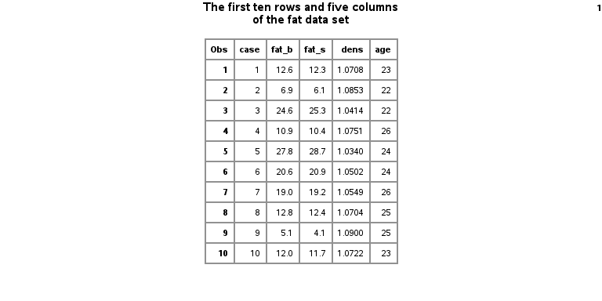
Test image
Ten rows of the fat dataset

