Slide 1
Homework 02
Steve Simon

Slide 2
1. Homework 02 (1 / 4)
The Gardasil vaccine requires three shots in order to be effective. A study conducted at Johns Hopkins looked at how often patients failed to get all three shots. They wanted to see if insurance status, age, and other factors could predict who was at greatest risk for failing to get all three shots.

Slide 3
2. Homework 02 (2 / 4)
The data set is available as an Excel spreadsheet at
http://www.amstat.org/publications/jse/v19n1/gardasil.xls
and a description of the file is available at
http://www.amstat.org/publications/jse/v19n1/gardasil.txt

Slide 4
3. Homework 02 (3 / 4)
Q1. Create factors for AgeGroup, Race, Completed, Location.
Q2. Report which variables have missing data and how many of these values are missing.
Q3. What proportion of patients completed all three shots?

Slide 5
4. Homework 02 (4 / 4)
Q4. Draw a bar chart showing the percentage of patients at each of the four locations.
Q5. Use a crosstabulation to compare Age to AgeGroup, and Location to LocationType. Are the recodings into AgeGroup and LocationType done properly?
Q6. Create a new variable that combines the race categories into white, and non-white. Calculate the proportion of white patients at each of the four locations.

Slide 6
Gardasil data set
Age,AgeGroup,Race,Shots,Completed,InsuranceType,MedAssist,Location,LocationType,PracticeType 21,1,0,3,1,3,0,1,0,1 21,1,0,3,1,3,0,1,0,1 20,1,0,1,0,1,0,1,0,1 14,0,0,3,1,3,0,1,0,0 17,0,3,2,0,3,0,1,0,1 11,0,1,1,0,0,1,1,0,0 17,0,0,1,0,3,0,1,0,1 15,0,3,3,1,1,0,1,0,0 13,0,3,3,1,1,0,1,0,0
Notes:
Here are the first ten rows of the Titanic data set.

Slide 7
5. Output and data locations
ods pdf file="hw02.pdf"; filename raw_data "../data/gardasil.csv"; libname intro "../data";
Notes:
This is the first few lines of SAS code, showing where to store the output, where to find the input and where to store the SAS binary data set the program creates.

Slide 8
6. Reading, proc import
proc import datafile=raw_data out=intro.gardasil dbms=dlm replace; delimiter=','; getnames=yes; run;
Notes:
You should think about proc import here because the names of the variables are in the first row of data and there is nothing too unusual going on.

Slide 9
7. First ten lines, proc print
proc print data=intro.gardasil(obs=10); title1 " "; run; ods pdf close;
Notes:
If you look at the first few rows of data, you will see that the import went reasonably well.

Slide 10
First ten rows of the Titanic data set
CHANGE !!!

Slide 11
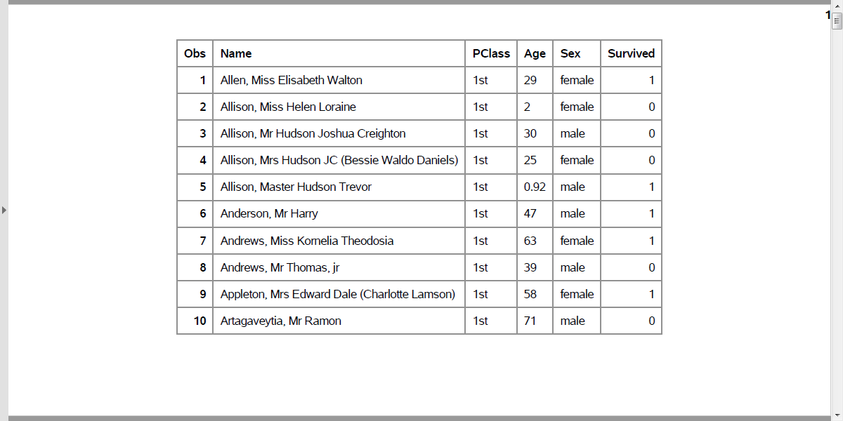
Output, proc print
Notes:
At first glance, everything looks fine. But if you look closely, you will see that age is left justified. It is caused by the NA code for missing value, which doesn’t appear until about line 14 or 15 of the code.

