Slide 1
Lecture02 - Mostly categorical variables
Steve Simon

Slide 2
Categorical data
proc format
recoding
proc freq
barcharts
Notes:
We’re going to look at a different data set, one with mostly categorical variables. I’ll introduce proc format, which allows you to attach labels to categorical data, talk about recoding, and show some tables using proc freq. I’ll also show you a simple bar chart.

Slide 3
Titanic data set
Name PClass Age Sex Survived "Allen, Miss Elisabeth Walton" 1st 29 female 1 "Allison, Miss Helen Loraine" 1st 2 female 0 "Allison, Mr Hudson Joshua Creighton" 1st 30 male 0 "Allison, Mrs Hudson JC (Bessie Waldo Daniels)" 1st 25 female 0 "Allison, Master Hudson Trevor" 1st 0.92 male 1 "Anderson, Mr Harry" 1st 47 male 1 "Andrews, Miss Kornelia Theodosia" 1st 63 female 1 "Andrews, Mr Thomas, jr" 1st 39 male 0 "Appleton, Mrs Edward Dale (Charlotte Lamson)" 1st 58 female 1
Notes:
Here are the first ten rows of the Titanic data set.

Slide 4
1. Output and data locations
ods pdf file="lecture02.pdf"; filename raw_data "../data/titanic_v00.txt"; libname intro "../data";
Notes:
This is the first few lines of SAS code, showing where to store the output, where to find the input and where to store the SAS binary data set the program creates.

Slide 5
2. Reading, proc import
proc import datafile=raw_data out=intro.titanic dbms=dlm replace; delimiter='09'x; getnames=yes; run;
Notes:
As a general rule, proc import works best for simple delimited files where the first row contains the variable names. With complicated text files (such as files where the data for an individual extends across more than one line) or files without variable names in the first row are usually better handled by a data step.

Slide 6
3. First ten lines, proc print
proc print data=intro.titanic(obs=10); title1 " "; run;
Notes:
If you look at the first few rows of data, you will see that the import went reasonably well. It is not always this easy. Do take notice that age is left justified. It is caused by a number of “NA” codes for missing values. You don’t see it here, but if you print a few more observations, you can see the “NA” values. It would have been easier to anticipate these ahead of time, but We’ll fix things up after the fact.

Slide 7
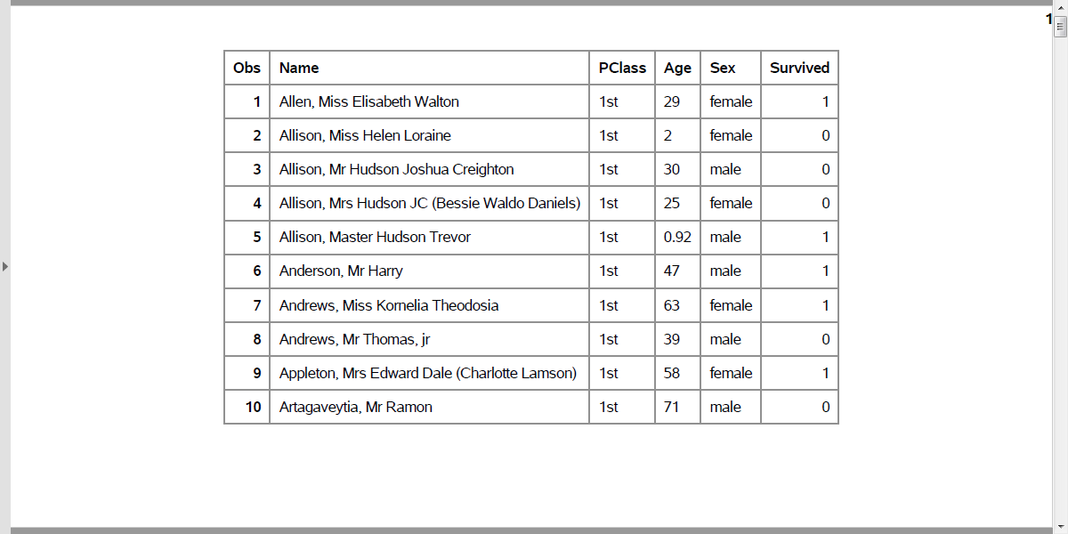
First ten rows of the Titanic data set
Output, proc print
Notes:
At first glance, everything looks fine. But if you look closely, you will see that age is left justified. It is caused by the NA code for missing value, which doesn’t appear until about line 14 or 15 of the code.

Slide 8
4. Counts, proc freq
proc freq data=intro.titanic; tables PClass Sex Survived; run;
Notes:
For any categorical variables, your first step is to get frequency counts.

Slide 9
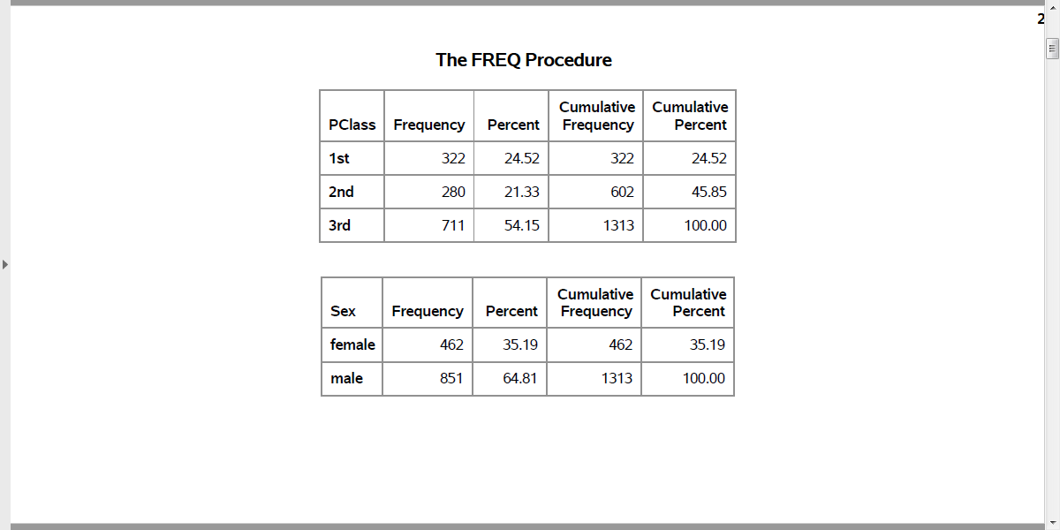
Counts for categorical data (1/2)
Output, proc freq
Notes:
Here are the counts for passenger class and sex.

Slide 10
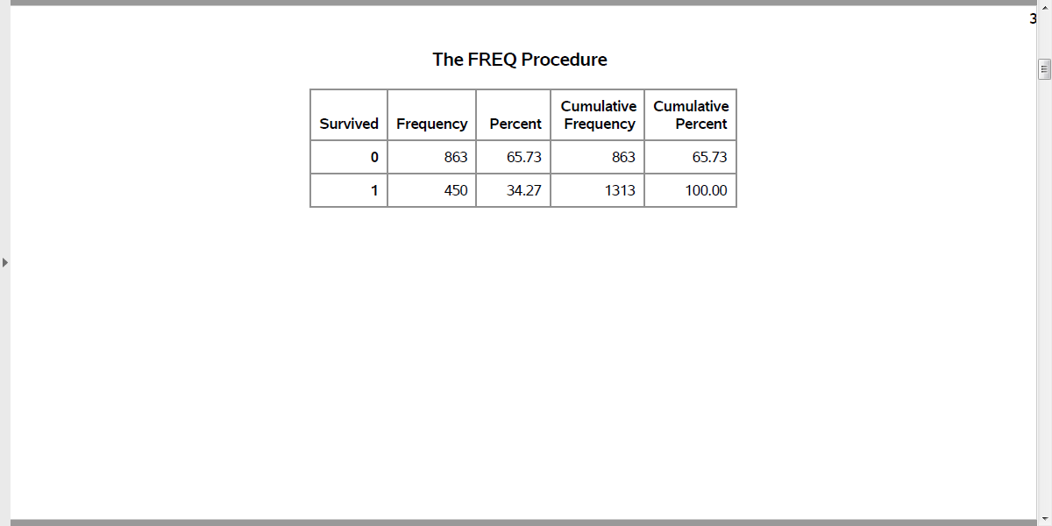
Counts for categorical data (2/2)
Output, proc freq
Notes:
Here are the counts for Survived.

Slide 11
5. Convert string to numeric, data step
data intro.titanic; set intro.titanic; age_c = input(age, ?? 8.); run; proc means n nmiss mean std min max data=intro.titanic; var age_c; run;
Notes:
For the one continuous variable (age) you need to convert the code “NA” to the SAS missing value code, which is a dot. The easiest way to do this is to force the data to numeric with a simple arithmetic equation like adding a zero. But you get a warning message for each occurence of NA, which can get tedious. The input function with two question marks avoids this issue.

Slide 12
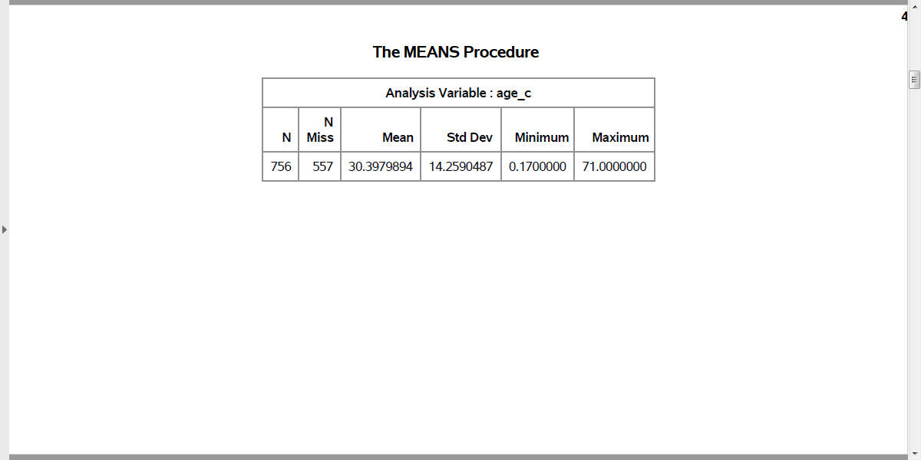
Means and standard deviations for age
Output, proc freq
Notes:
Here are the descriptive statistics for age. Notice the number of missing values.

Slide 13
6. Using proc format to code categorical data
proc format; value f_survived 0 = "No" 1 = "Yes"; run; proc freq data=intro.titanic; tables Survived; format Survived f_survived.; run;
Notes:
For variables like Survived which are numbers, but the numbers represent a particular category, you can document this using a format statement.

Slide 14
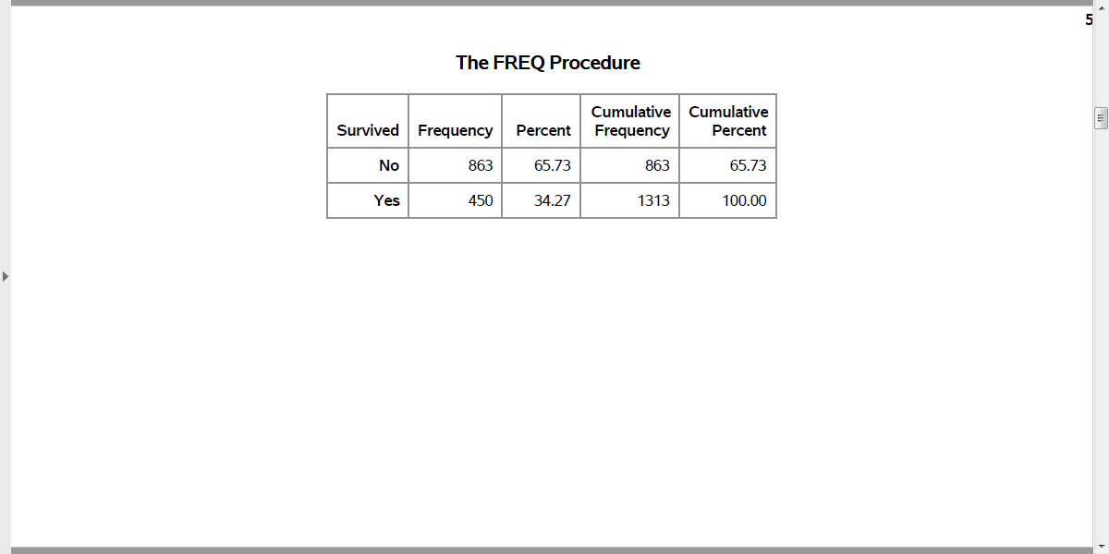
Nicely formatted counts for survival
Output, proc freq
Notes:
Notice that the format statement replaces the cryptic 0-1 code with the words no and yes.

Slide 15
7. Bar charts, proc sgplot
proc sgplot data=intro.titanic; vbar Survived; format Survived f_survived.; run;
Notes:
I don’t normally like bar charts, but they do have their uses.

Slide 16
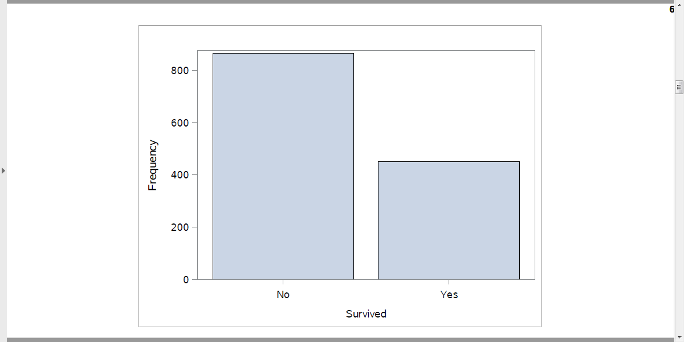
Bar chart
Output, proc sgplot
Notes:
Here are the descriptive statistics for age. Notice the number of missing values.

Slide 17
8. Percentages for bar chart
proc freq data=intro.titanic; tables Survived / noprint out=pct_survived; run; proc print data=pct_survived; format Survived f_survived.; run; proc sgplot data=pct_survived; vbar Survived / response=Percent; yaxis max=100; format Survived f_survived.; run;
Notes:
Getting percentages is a bit tricky. You have to run proc freq and output the results to a new data file, pct_survived. I am using the noprint option, because I only want the percentages for internal use. It wouldn’t have hurt anything to print out a bit extra, but I want to encourage you to limit the amount of output that you present to a consulting client.
Note the yaxis maxx=100 statement which expands the upper limit of the y axis to 100%.

Slide 18
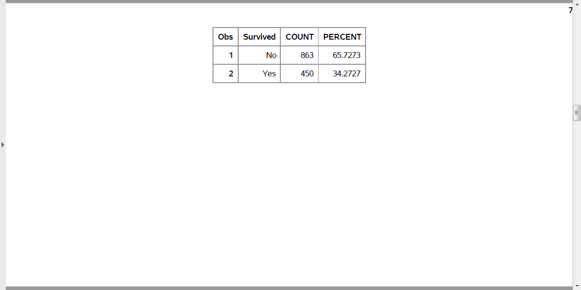
Percentages, proc freq
Output, proc freq
Notes:
Here is what the output from proc freq looks like. Just two rows.

Slide 19
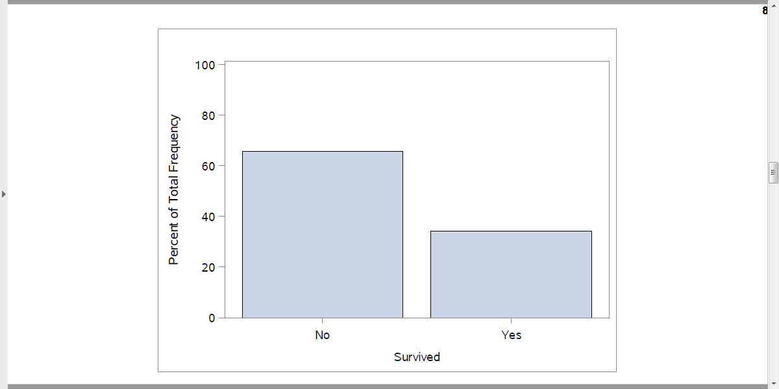
Percentages in a bar chart
Output, proc sgplot
Notes:
Here is what the output from proc freq looks like. Just two rows.

Slide 20
9. Crosstabulation
proc freq data=intro.titanic; tables Sex*Survived / nocol nopercent; format Survived f_survived.; run;
Notes:
To examine relationships among categorical variables use a two dimensional crosstabulation.

Slide 21
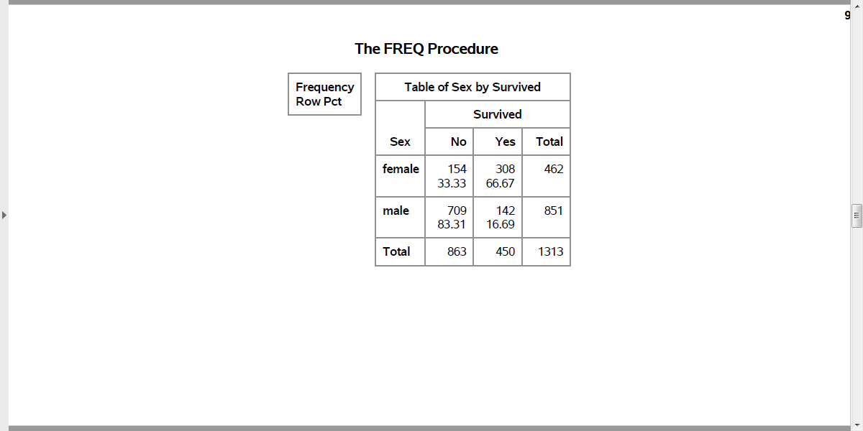
Percentages, proc freq
Output, proc freq
Notes:
Here is what the output from proc freq looks like. Among the males, almost 5/6 died. Among the females only 1/3 died.

Slide 22
10. Converting a continuous variable to categorical
data age_categories; set intro.titanic; if age_c = . then age_cat = "missing "; else if age_c < 6 then age_cat = "toddler "; else if age_c < 13 then age_cat = "pre-teen"; else if age_c < 21 then age_cat = "teenager"; else age_cat = "adult "; run;
Notes:
If you want to create categories from a continuous variable, use a series of
if - then - else
statements

Slide 23
11. Quality check
proc sort data=age_categories; by age_cat; run; proc means min max data=age_categories; by age_cat; var age_c; run;
Notes:
Always cross check your results against the original variable.

Slide 24
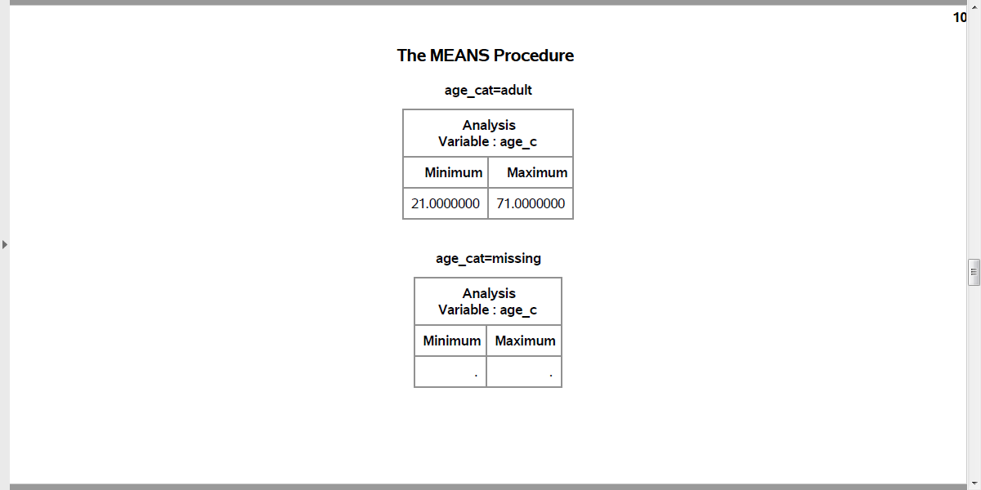
Recoding age (1 / 3)
Output, proc means
Notes:
Here is the quality check. Notice that adult starts at 21. Should adult start at 18 instead?

Slide 25
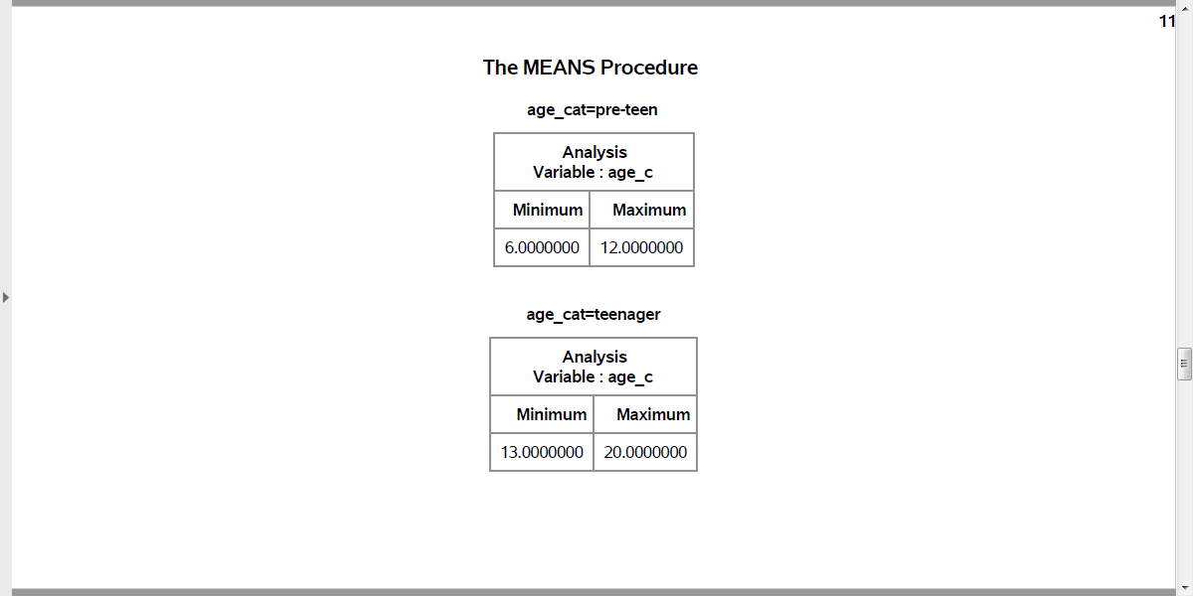
Recoding age (2 / 3)
Output, proc means
Notes:
Are the ranges for pre-teen and teenager reasonable?

Slide 26
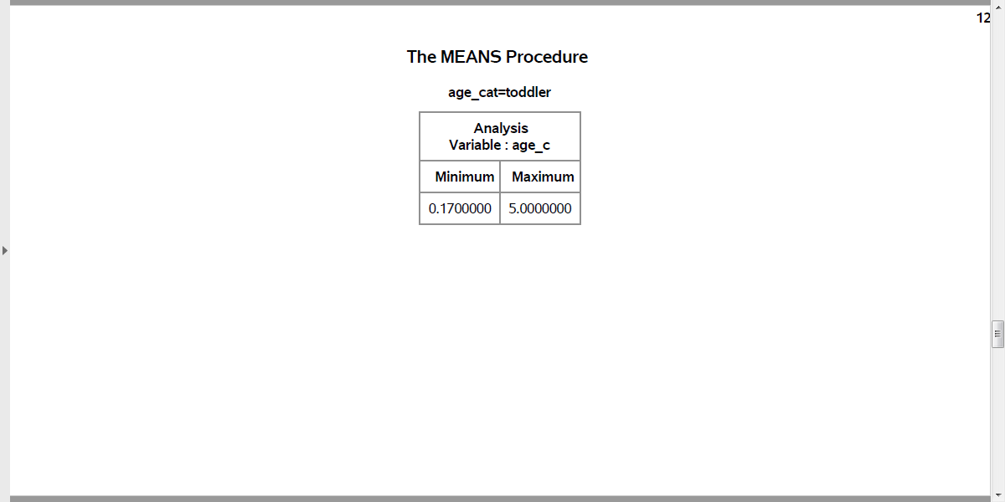
Recoding age (3 / 3)
Output, proc means
Notes:
How about the ranges for toddler?

Slide 27
12. Controlling the display order
data age_codes; set intro.titanic; if age_c = . then age_cat = 9; else if age_c < 6 then age_cat = 1; else if age_c < 13 then age_cat = 2; else if age_c < 21 then age_cat = 3; else age_cat = 4; run;
Notes:
Notice that the order for age_cat is alphabetical, which is probably not what you want. You can control the order by using number codes and formats.

Slide 28
13. With number codes, use proc format
proc format; value f_age 1 = "toddler" 2 = "pre-teen" 3 = "teenager" 4 = "adult" 9 = "unknown"; run;
Notes:
Once you have the number codes, assign an interpretable label using proc format.

Slide 29
14. Quality check
proc sort data=age_codes; by age_cat; run; proc means min max data=age_codes; by age_cat; var age_c; format age_cat f_age.; run;
Notes:
Here’s the quality check again.

Slide 30
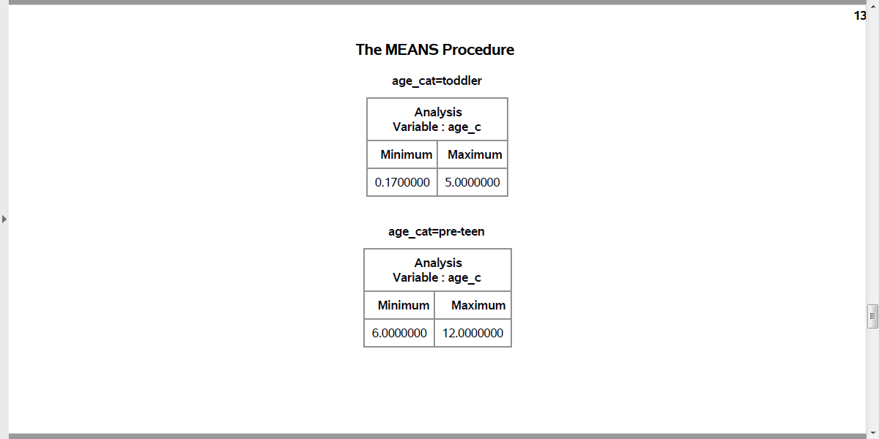
Better age recode (1 /3)
Output, proc means
Notes:
This shows the age categories starting at the youngest: toddler and pre-teen…

Slide 31
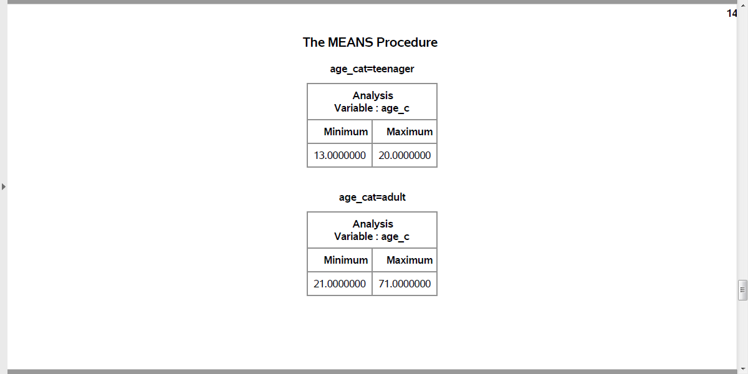
Better age recode (2 /3)
Output, proc means
Notes:
followed y teenager and adult…

Slide 32
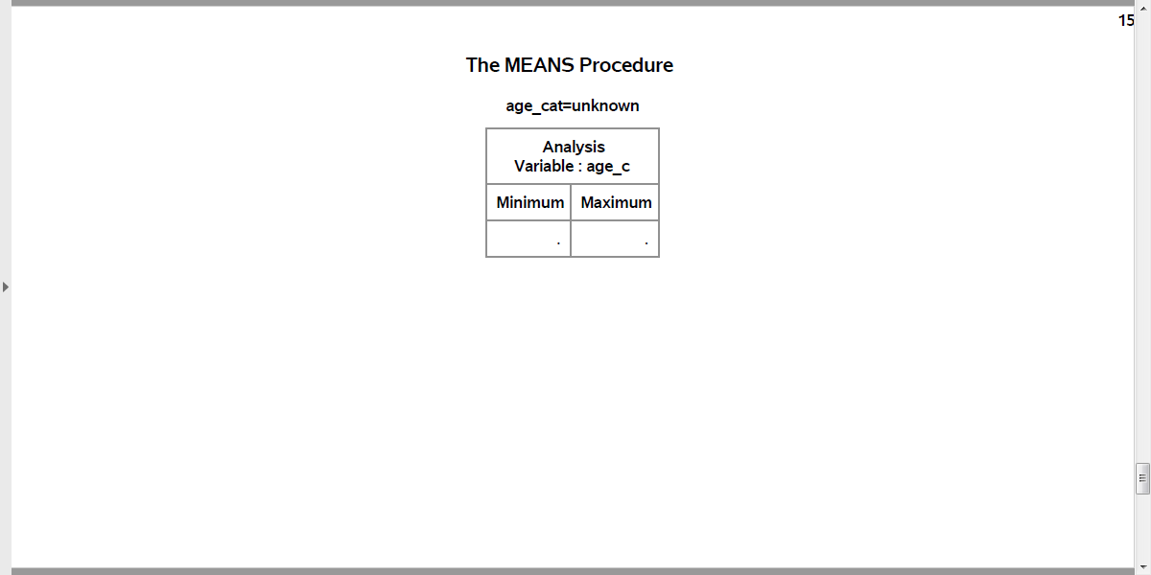
Better age recode (3 /3)
Output, proc means
Notes:
with missing bring up the rear. This order was the order of the number codes. So if you want to display your results in a non-alphabetical order, use number codes.

Slide 33
15. Modifying a categorical variable
data first_class; set intro.titanic; if PClass = "1st" then first_class = "Yes"; else first_class = "No"; run; proc freq data=first_class; table PClass*first_class / norow nocol nopercent; run;
Notes:
Here’s another example where you compare First Class passengers to Second and Third class passengers combined.

Slide 34
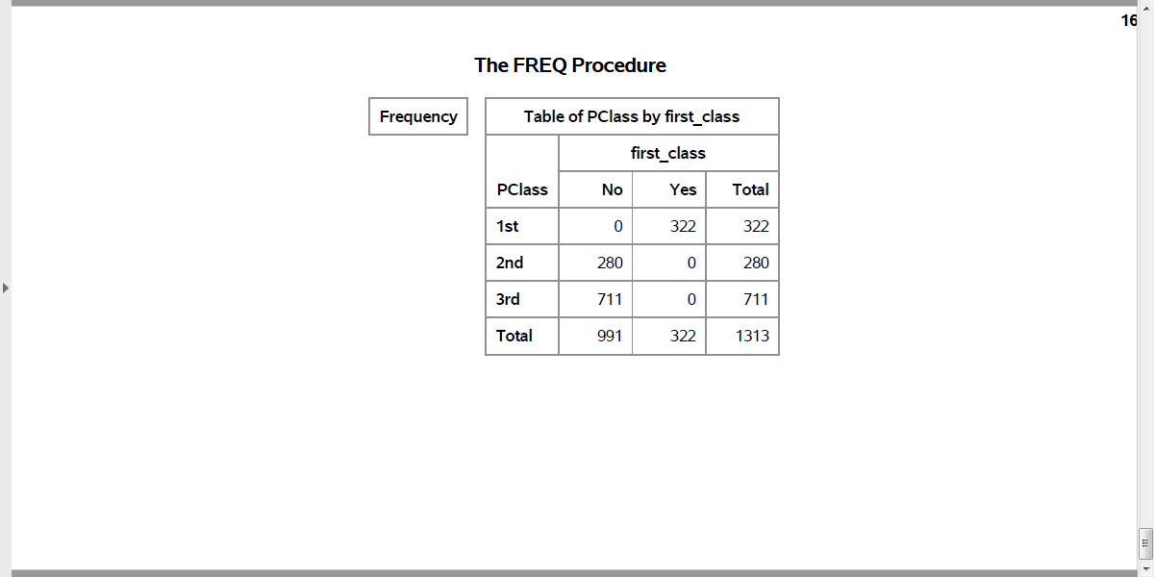
Quality check
Output, proc means
Notes:
Here is the quality check. PClass=1st codes to first_class=Yes. PClass=2nd or 3rd codes to first_class=No.

