Slide 1
Introduction to SAS, Lecture03
Steve Simon

Slide 2
hw-03, preliminaries, part 1
* hw-03.sas written by Steve Simon 2020-10-03; libname binary "q:/5507/module02/data";
Notes:
This program shows how I answered the homework questions for module03. There are other approaches that may also be valid.

Slide 3
hw-03, preliminaries, part 2
data xfer; set binary.sleep; nondreaming1=nondreaming+0; dreaming1=dreaming+0; totalsleep=totalsleep+0; lifespan1=lifespan+0; gestation1=gestation+0; drop nondreaming--gestation; run;
Notes:
This code presumes that you have read in the sleep data already and stored it using a two part name.
You may need to convert some variables stored as strings to variables stored as numeric.
This is a simple approach. You can also use the input function.

Slide 4
hw-03, preliminaries, part 3
data xfer; set xfer( rename=( nondreaming1=nondreaming dreaming1=dreaming totalsleep1=totalsleep lifespan1=lifespan gestation1=gestation ) ); drop nondreaming1--gestation1; run;
Notes:
This step is optional, but I like having the original variable names.

Slide 5
hw-03, preliminaries, part 4
proc print data=xfer(obs=10); var species bodywt; title1 "First ten observations"; run;
Notes:
Print the first few rows as a quality check.

Slide 6
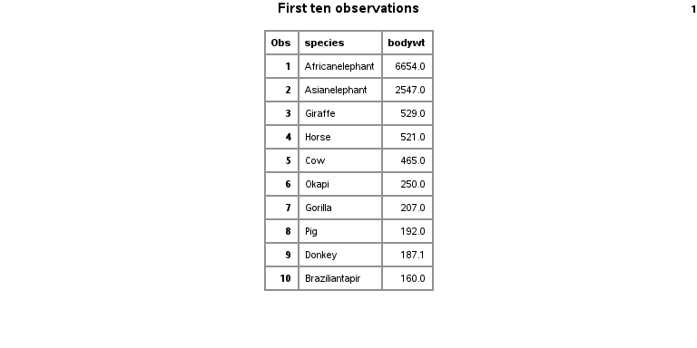
hw-03, preliminaries, output
SAS output from proc print

Slide 7
hw-03, question 1, part a, code
proc sort data=xfer; by bodywt; run; proc print data=xfer(obs=1); title1 "The smallest body weight"; run;
Notes:
Notice that there is a huge range in body weight. Display the information for the smallest and the largest mammals.

Slide 8
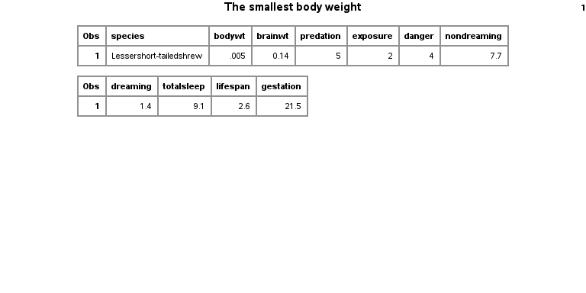
hw-03, question 1, part a, output
SAS output from proc print

Slide 9
hw-03, question 1, part b, code
proc sort data=xfer; by descending bodywt; run; proc print data=xfer(obs=1); title1 "The largest body weight"; run;
Notes:
Use the descending keyword to place the largest value at the top.

Slide 10
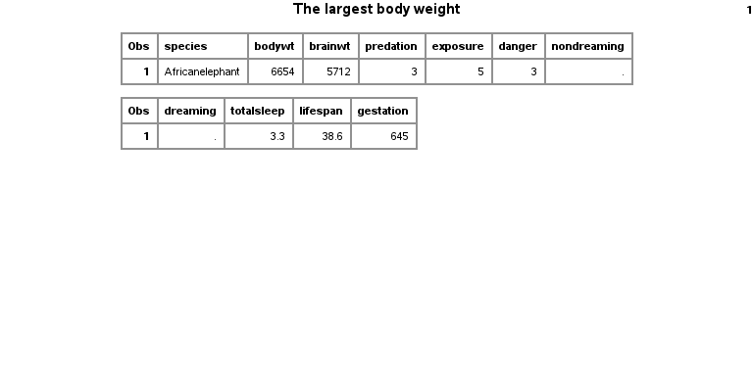
hw-03, question 1, part b, output
SAS output from proc print

Slide 11
hw-03, question 2, code
proc means nmiss data=xfer; var bodywt brainwt nondreaming dreaming totalsleep lifespan gestation predation exposure danger; title1 "Missing value count for all continuous variables"; run;
Notes:
Which variables have missing data?

Slide 12
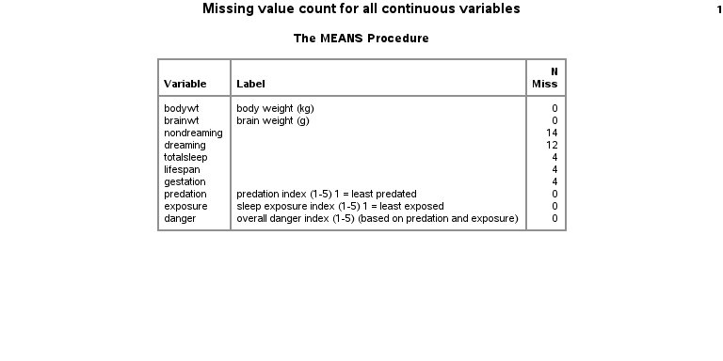
hw-03, question 2, output
SAS output from proc print

Slide 13
hw-03, question 3, code
proc means mean std data=xfer; var totalsleep; title1 "Mean and standard deviation for totalsleep"; run;
Notes:
Calculate the mean and standard deviation for TotalSleep.

Slide 14
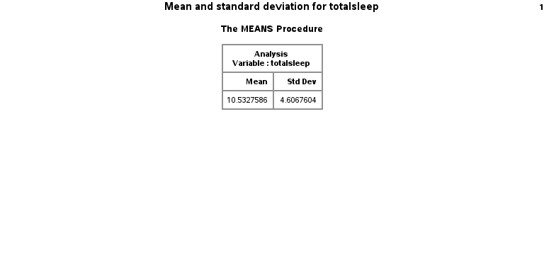
hw-03, question 3, output
SAS output from proc print

Slide 15
hw-03, question 4, part a, code
proc sgplot data=xfer; histogram bodywt; title1 "Histogram of body weight"; run;
Notes:
Draw a histogram for the BodyWt variable. Note that this variable is highly skewed. Re-draw the histogram on the log scale. For exta credit, relabel the axes with values at 0.001, 0.01, etc.

Slide 16
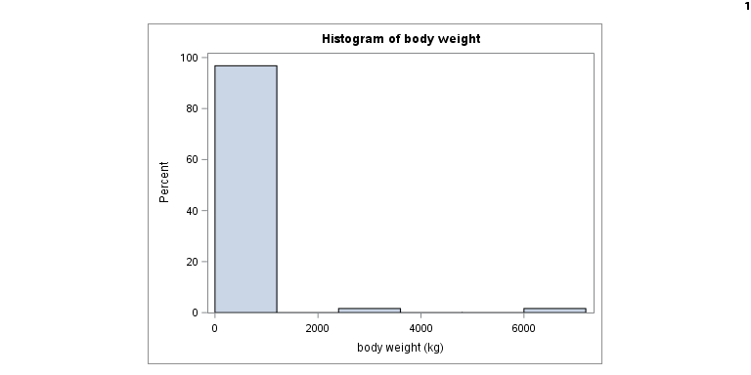
hw-03, question 4, part a, output
SAS output from sgplot

Slide 17
hw-03, question 4, part b, code
data log_weight; set xfer; log_w = log10(bodywt); run; proc sgplot data=log_weight; histogram log_w; title1 "Histogram of log body weight"; run;
Notes:
There are two ways to get a log scale. The approach shown here is simple but does not use nice labels on the X axis.

Slide 18
hw-03, question 4, part b, output
SAS output from sgplot

Slide 19
hw-03, question 4, part c, code
proc sgplot data=xfer; histogram bodywt; xaxis type=log; title1 "Histogram of log body weight"; run;
Notes:
Here’s a better way.

Slide 20
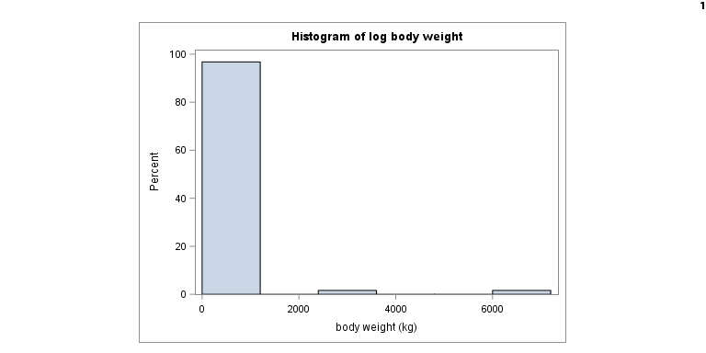
hw-03, question 4, part c, output
SAS output from sgplot

Slide 21
hw-03, question 5, part a, code
data ratio; set xfer; brain_body_ratio = 100 * (brainwt/1000) / bodywt; run; proc sort data=ratio; by brain_body_ratio; run; proc print data=ratio(obs=1); title1 "Lowest brain to body ratio"; run;
Notes:
Calculate the ratio of BrainWt to BodyWt and express it as a percentage. Be sure to convert grams to kilograms (or vice versa) before computing the ratio. What animal has the smallest/largest ratio?

Slide 22
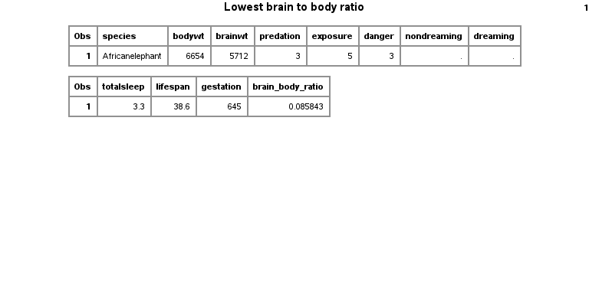
hw-03, question 5, part a, output
SAS output from sgplot

Slide 23
hw-03, question 5, part b, code
proc sort data=ratio; by descending brain_body_ratio; run; proc print data=ratio(obs=1); title1 "Highest brain to body ratio"; run;
Notes:
Use the descending keyword to place the largest

Slide 24
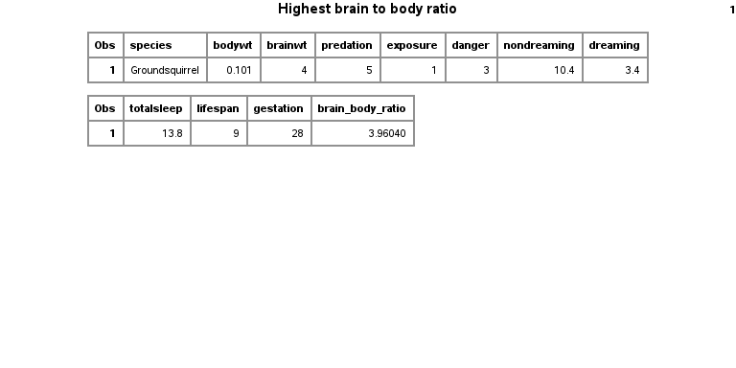
hw-03, question 5, part b, output
SAS output from sgplot

Slide 25
hw-03, question 6, code
proc corr data=xfer; var bodywt; with totalsleep lifespan; title1 "Correlation"; run;
Notes:
Do bigger animals sleep longer or live longer? Show your results using a correlation coefficient.

Slide 26
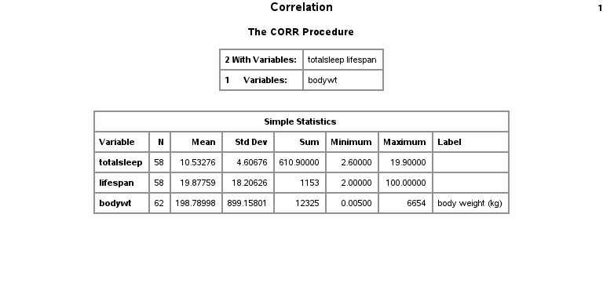
hw-03, question 6, output
SAS output from sgplot

Slide 27
hw-03, question 7
proc sgplot data=xfer; scatter x=totalsleep y=predation; reg x=totalsleep y=predation; title1 "Scatterplot"; run;
Notes:
Do animals who have high degrees of Predation, Exposure, or Danger sleep less? Show your results using a plot and a trendline.

Slide 28
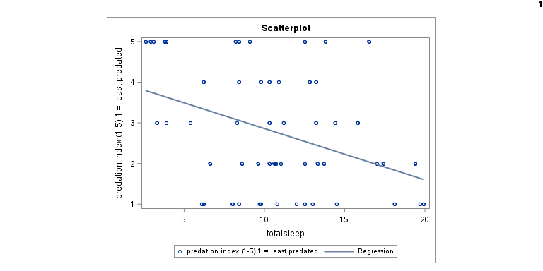
hw-03, question 7
SAS output from sgplot

