Slide 1
Introduction to SAS, Lecture03
Steve Simon

Slide 2
code-03-01-readfat-data.sas, part 1
* code-03-01-read-fat-data.sas written by Steve Simon 2020-09-28;
Notes:
This program shows how to analyze data with mostly continuous variables. It uses a dataset with measurements of body fat. You can measure body fat accurately using hydrostatic weighing, a complex process where you weigh someone will submersed in a tank of water. In addition, you have measures of circumference at various body locations. Measuring circumference is a lot faster and easier. Can these easy measures predict body fat as measured by hydrostatic weighing?
A brief description of this file is available at
www.amstat.org/publications/jse/datasets/fat.txt
Here is the program header and an option that is only needed for me so that my SAS output will fit easily on a PowerPoint slide.

Slide 3
code-03-01-readfat-data.sas, part 2
filename fat "q:/5507/module03/data/fat.txt"; libname intro "q:/5507/module03/data";
Notes:
Before you start any serious SAS programming, tell SAS where everything belongs
The filename statement tells SAS where you have placed your raw data file.
The libname statement tells SAS where you want it to place any permanent SAS data files.
You should also include an ods statement to store your output as a pdf file.
VERY IMPORTANT! You need to turn off ODS at the completion of your program or none of the output gets saved.

Slide 4
code-03-01-readfat-data.sas, part 3
data intro.fat; infile fat delimiter=' '; input case fat_b fat_s dens age wt ht bmi ffw neck ...
Notes:
The data statement creates a new data set. If you want a permanent data set, specify a two part name. The part before the period is the libname and tells SAS where to store your file. The part after the period gives the name of the file. By default, all SAS files use the extension .sas7bdat
This data set did not have a header, a line at the very top of the file that lists variable names. For files with a header, you should consider using the import procedure.
The infile statement tells SAS where to find the raw data. The delimiter option tells SAS how to tell when one number stops and when another begins. In this example, spaces are delimiters.
The input statement tells SAS what the names are for the variables you are reading in.
I’m using the variable names provided but if you create your own names, use brief (but descriptive) name for EVERY variable in your data set. There’s no precise rule, but names should be around 8 characters long. Longer variable names make your typing tedious and much shorter variable names makes your code terse and cryptic.
I’m a bit more terse with these variable names than I normally would be just to reduce the amount of typing you have to do.
You should avoid special symbols in your variable names especially symbols that are likely to cause confusion (the dash symbol, for example, which is also the symbol for subtraction). You should also avoid blanks. These rules are pretty much universal across most statistical software packages.
There are times when you’d like to have a blank in your variable name and you can use two special symbols in SAS (and most other statistical pacakges):
the underscore symbol (above the minus key on most keyboards) and
the dot (period).
These symbols create some artificial spacing that mimics the blanks. Another approach is “CamelCase” which is the mixture of upper and lower case within a variable name with each uppercase designating the beginning of a new “word”.
The label statement provides descriptive labels for your variables. You can use special characters like parentheses, slashes, and dashes that would not be allowed in a variable name. The variable label provides you with the opportunity to give a more detailed description of your variable, including the units of measurement. The variable labels will appear on some of the SAS output, which helps you clarify what the tables and graphs are representing.
The run statement tells SAS that you are ready to go and there is nothing more to input or manipulate.

Slide 5
code-03-01-readfat-data.sas, part 4
label case="Case number" fat_b="Percent body fat, Brozek's equation" fat_s="Percent body fat, Siri's equation" dens="Density" age="Age (yrs)" wt="Weight (lbs)" ht="Height (inches)" bmi="Adiposity index (kg/m^2)" ffw="Fat Free Weight" neck="Neck circumference (cm)" chest="Chest circumference (cm)" abdomen="Abdomen circumference (cm)" ...
Notes:
The label statemet is optional, but strongly recommended. It attaches descrptive labels to your variables. These labels are used in some (but not all) of the SAS output.

Slide 6
code-03-01-readfat-data.sas, part 5
proc print data=intro.fat(obs=10); var case fat_b fat_s dens age; title1 "The first ten rows and five columns"; title2 "of the fat data set"; run;
Notes:
It’s always a good idea to print out a small piece of your data to make sure everything is okay.
The data option tells SAS what data set you want to print. If you omit this, SAS will print the most recently created data set.
The obs=10 option limits the number of rows printed to the first 10. For large data sets, you should always take advantage of this option.
The var statement limits the variables that you print to those that you specify. Again,
The title statement tells SAS to provide a descriptive title at the top of the page of output.
The run statement says you’re done with the procedure.

Slide 7
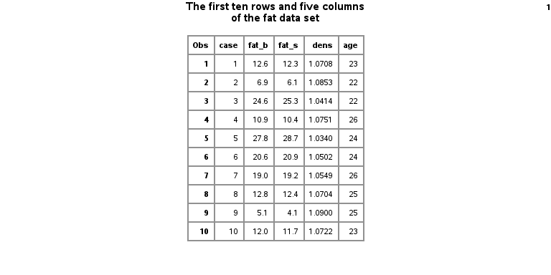
code-03-01-readfat-data.sas, ouptut page 1
Ten rows of the fat dataset
Notes:
The output from this procedure shows the first ten rows and five columns of the fat data.

Slide 8
code-03-01-readfat-data.sas, part 6
proc means n mean std min max data=intro.fat; var ht; title1 "Simple descriptive statistics for ht"; title2 "Notice the unusual minimum value"; run;
Notes:
The means procedure will produce descriptive statistics for your data. By default, it will produce the count of non-missing values, the mean, the standard deviation, and the minimum and maximum values, but I am listing them explicitly here, just for show.
The data option tells SAS which data set you want descriptive statistics on, and the var statement tells SAS which variable(s) you want descriptive statistics on.
This data set did not have a header, a line at the very top of the file that lists variable names. For files with a header, you should consider using the import procedure, which I will describe later.

Slide 9
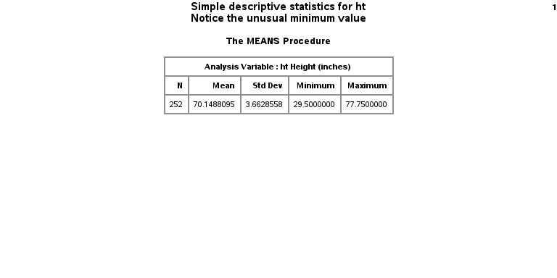
code-03-01-readfat-data.sas, ouptut page 2
Descriptive statistics for patient height
Notes:
There is an unusual data value for ht, 29.5 inches. While this is not totally outside the realm of possibility, you should always ask when you see something unusual like this.

Slide 10
code-03-01-readfat-data.sas, part 7
proc sort data=intro.fat; by ht; run; proc print data=intro.fat(obs=1); title1 "The row with the smallest ht"; run;
Notes:
To investigate further, sort the data and print the first observation.

Slide 11
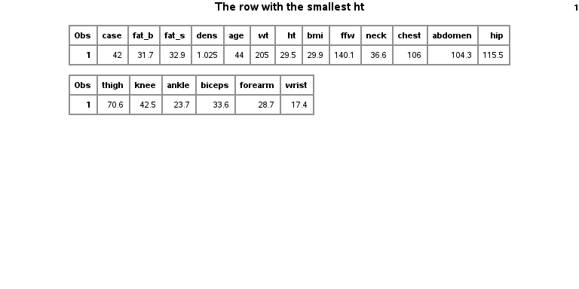
code-03-01-readfat-data.sas, ouptut page 3
Listing of outlier
Notes:
Clearly something is wrong. There’s no way that a person with such a small height would have such a big weight.

