Slide 1
Introduction to SAS, Lecture03
Steve Simon

Slide 2
read-fat-data.sas, part 1
* code-03-01-read-fat-data.sas written by Steve Simon 2020-09-28; * Note: The options statement below insures that my output will fit easily on a PowerPont slide. You should not use this option for your work; options papersize=(8in 4in) nodate;
Notes:
Here is a simple program to read in data. You already know how to do this, but it doesn’t hurt to review things.

Slide 3
read-fat-data.sas, part 2
filename fat "q:/5507/module03/data/fat.txt"; libname intro "q:/5507/module03/data"; * You should use "ods pdf file="your-name.pdf"; ods printer printer=png file="q:/5507/module03/results/code-03-01.png";
Notes:
Before you start any serious SAS programming, tell SAS where everything belongs
The filename statement tells SAS where you have placed your raw data file.
The libname statement tells SAS where you want it to place any permanent SAS data files ;
The ods statement tells SAS where to store your output and in what format.
I am printing to a png file to make it easier to include the output in my Powerpoint presentation. You should print to a pdf file.
VERY IMPORTANT! You need to turn off ODS at the completion of your program or none of the output gets saved.
You can view the output on the screen and then save the output manually, but it is good form to explicity specify the location of output in your program

Slide 4
read-fat-data.sas, part 3
data intro.fat; infile fat delimiter=' '; input case fat_b fat_s dens age wt ht bmi ffw neck ...
Notes:
The data statement creates a new data set. If you want a permanent data set, specify a two part name. The part before the period is the libname and tells SAS where to store your file. The part after the period gives the name of the file. By default, all SAS files use the extension .sas7bdat
This data set did not have a header, a line at the very top of the file that lists variable names. For files with a header, you should consider using the import procedure.
The infile statement tells SAS where to find the raw data. The delimiter option tells SAS how to tell when one number stops and when another begins. In this example, spaces are delimiters.
The input statement tells SAS what the names are for the variables you are reading in.
I’m using the variable names provided but if you create your own names, use brief (but descriptive) name for EVERY variable in your data set. There’s no precise rule, but names should be around 8 characters long. Longer variable names make your typing tedious and much shorter variable names makes your code terse and cryptic.
I’m a bit more terse with these variable names than I normally would be just to reduce the amount of typing you have to do.
You should avoid special symbols in your variable names especially symbols that are likely to cause confusion (the dash symbol, for example, which is also the symbol for subtraction). You should also avoid blanks. These rules are pretty much universal across most statistical software packages.
There are times when you’d like to have a blank in your variable name and you can use two special symbols in SAS (and most other statistical pacakges):
the underscore symbol (above the minus key on most keyboards) and
the dot (period).
These symbols create some artificial spacing that mimics the blanks. Another approach is “CamelCase” which is the mixture of upper and lower case within a variable name with each uppercase designating the beginning of a new “word”.
The label statement provides descriptive labels for your variables. You can use special characters like parentheses, slashes, and dashes that would not be allowed in a variable name. The variable label provides you with the opportunity to give a more detailed description of your variable, including the units of measurement. The variable labels will appear on some of the SAS output, which helps you clarify what the tables and graphs are representing.
The run statement tells SAS that you are ready to go and there is nothing more to input or manipulate.

Slide 5
read-fat-data.sas, part 4
label case="Case number" fat_b="Percent body fat, Brozek's equation" fat_s="Percent body fat, Siri's equation" dens="Density" age="Age (yrs)" wt="Weight (lbs)" ht="Height (inches)" bmi="Adiposity index (kg/m^2)" ffw="Fat Free Weight" neck="Neck circumference (cm)" chest="Chest circumference (cm)" abdomen="Abdomen circumference (cm)" ...
Notes:
The label statemet is optional, but strongly recommended. It attaches descrptive labels to your variables. These labels are used in some (but not all) of the SAS output.

Slide 6
read-fat-data.sas, part 5
proc print data=intro.fat(obs=10); var case fat_b fat_s dens age; title1 "The first ten rows and five columns"; title2 "of the fat data set"; run;
Notes:
It’s always a good idea to print out a small piece of your data to make sure everything is okay.
The data option tells SAS what data set you want to print. If you omit this, SAS will print the most recently created data set.
The obs=10 option limits the number of rows printed to the first 10. For large data sets, you should always take advantage of this option.
The var statement limits the variables that you print to those that you specify. Again,
The title statement tells SAS to provide a descriptive title at the top of the page of output.
The run statement says you’re done with the procedure.

Slide 7
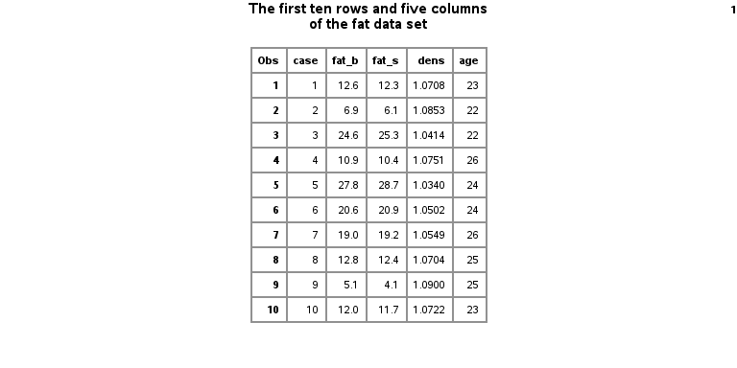
read-fat-data.sas, ouptut
Ten rows of the fat dataset
Notes:
The output from this procedure shows the first ten rows and five columns of the fat data.

Slide 8
proc-means.sas, part 1
* code-03-02-proc-means.sas written by Steve Simon 2020-09-28; options papersize=(8in 4in) nodate; filename fat "q:/5507/module03/data/fat.txt"; libname intro "q:/5507/module03/data"; ods printer printer=png file="q:/5507/module03/results/code-03-02.png";
Notes:
Here’s another simple program.

Slide 9
read-fat-data.sas, part 2
proc means n mean std min max data=intro.fat; var ht; title1 "Simple descriptive statistics for ht"; title2 "Notice the unusual minimum value"; run;
Notes:
This data set shows data various body measurements. A brief description of this file is available at
http://www.amstat.org/publications/jse/datasets/fat.txt
The means procedure will produce descriptive statistics for your data. By default, it will produce the count of non-missing values, the mean, the standard deviation, and the minimum and maximum values, but I am listing them explicitly here, just for show.
The data option tells SAS which data set you want descriptive statistics on, and the var statement tells SAS which variable(s) you want descriptive statistics on.
This data set did not have a header, a line at the very top of the file that lists variable names. For files with a header, you should consider using the import procedure, which I will describe later.

