Slide 1
Video 3 - Literature review
Steve Simon

Slide 2
Learning objectives
To demonstrate knowledge of the resources available through the university library system
To demonstrate an understanding of skills needed in order to read and evaluate scientific literature

Slide 3
Required reading
Chapters 23, 24
Note â€“ These chapters are advanced and will be covered in more detail later in the semester. For the topic of literature reviews, focus on the â€œquestionsâ€ presented in these chapters that can be used to evaluate literature.

Slide 4
Literature Reviews
Additional Resources
L.G. Portney & M.P. Watkins. Chapter 34, ?Evaluating research reports.? Foundations of Clinical Research: Applications to Practice, 3rd ed. Upper Saddle River, New Jersey: Pearson Prentice Hall.

Slide 5
Literature Reviews
Step 2 ? Conduct literature review
Purposes of literature review
What a literature review is ?
What a literature review is NOT ?
Sources to be used in literature review

Slide 6
Literature Reviews
Reviewing the literature
What is known
What questions remain
Evaluating research reports
Journal quality
What is the study about?
Are the results of the study valid?
Are the results meaningful?
What does it all mean and how does it contribute to what you want to do?

Slide 7
Evaluating Research Validity
Evaluation of the quality of the design and analysis of a study
GM&L framework ?
designed to be used with both experimental and non-experimental research
Assess research validity
Series of continua
Emphasis on methods and results

Slide 8
Evaluating Research Validity
GM&L framework ?
19 questions
8 rating scales
19 questions <U+F0E8> 3 main groups
Key aspects of the design and methods (1 ? 8)
Evaluative ratings (9 ? 16)
General evaluation questions (17 ? 19)
?? merit or worth of the study as a whole??

Slide 9
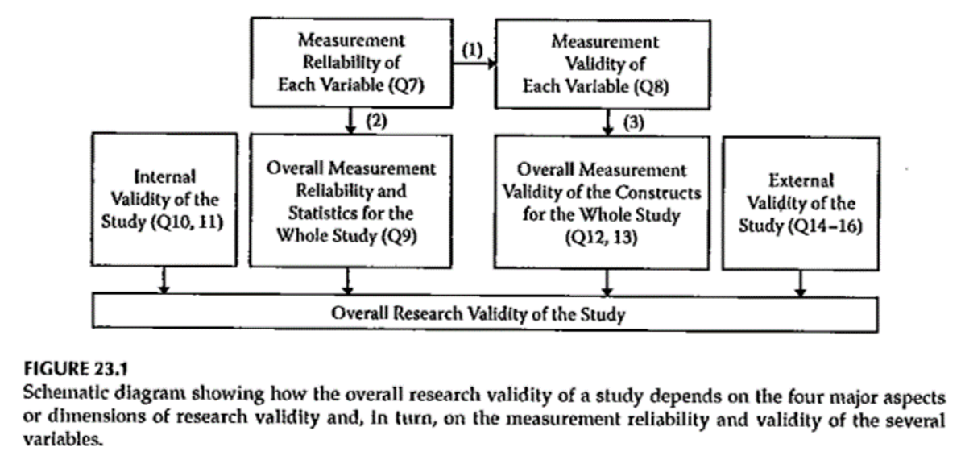
Evaluating Research Validity

Slide 10
Evaluating Research Validity
GM&L framework document

Slide 11
Evaluating Research Reports
Portney & Watkins, 2009

Slide 12
Evaluating Research Validity
Other Options - examples
MEDB 5511 Literature review form
MEDB 5511 .xls template
Proposal literature review file

Slide 13
Assignment
Nothing to be turned in next week
Work on identifying a research topic you want to work on for the final project .

Slide 14
Assignment
Work on the literature search for your research project idea
Prepare for next weekâ€™s session

Slide 15
Discussion questions
How will the library resources contribute to your research activity?
What kinds of information will you be compiling from the literature you will be reviewing for your proposal?
How do you usually organize information when reviewing literature?

Slide 16
Additional slides

