Slide 1
Video 04 - Analysis of randomized studies
Steve Simon

Slide 2
Learning objectives
To describe possible uses of existing data sets and research findings
To identify sources of data sets available for secondary analyses
Notes:
Here are the objectives for this week.

Slide 3
Required reading
Canvas â€“ Grady, D. & Hearst, N. (2007). Chapter 13, “Utilizing existing databases.” In S.B. Hulley, S.R. Cummings, W.S. Browner, D. Grady, & T.B. Newman (eds), Designing Clinical Research, 3rd edition. Philadelphia: Lippincott Williams & Wilkins.
List of Secondary Dataset resources (Week 4 folder)
Notes:
This is what you should have read already. If you haven’t done the reading yet, pause this video and read this material. You’ll get more out of the video if you do so.
There is a second video on this topic, presented by Tim Hickman.

Slide 4
Topics
Subversion of randomizaton
Intention to treat analysis
Blinding/partial blinding
Concealed allocation
The law of large numbers
Randomization approaches
Stratified randomization
Block randomization
How to randomize
Baseline measurements
Crossover designs
Criticisms

Slide 5
Experimental versus observational
Experimental
Active independent variable
Observational
Attribute independent variable
Notes:
One of the major distinctions in research design is experimental studies versus non-experimental (observational) studies.
Your book makes the distinction through the independent variable. An active independent variable allows for either a experimental or quasi-experimental study. An attribute independent variable makes your study non-experimental. That’s your book’s term, but I prefer the term observational. It is fairly common in the medical literature. Think of observational as “look but don’t touch.” You observe patients without meddling with them.

Slide 6
Experimental versus observational
Who does the choosing?
Patients or doctors? = Observational
Researcher? = Experimental
Patients in a randomized trial are giving you a gift.
Notes:
Another way of looking at it is to ask the question “Who does the choosing?” If the patient and/or the doctor has a part in deciding, then the study is observational. If the researcher is the only one who decides, and uses a coin flip to decide, that is a randomized clinical trial.
We owe a great debt of graditude to the volunteers in a randomized clinical trial. They are sacrificing a lot of autonomy over what drug or therapy to choose. And they are ceding that autonomy, not to an expert clinician but to the flip of a coin. That’s a truly amazing.

Slide 7
Randomized versus quasi-experimental
Quasi-experimental
Logistics prevent randomization
Very common in Quality Improvement
Notes:
When you have an active independent variable, you don’t always have a level of control that allows for randomization. Usually this is caused by logistical issues. Once you go down a certain path, it is impossible to go back. Or the setting that you are studying, like an emergency room is so chaotic that no one can keep track of a randomization table.
It’s easy to sneer at quasi-experimental studies and think of them as an inferior form of research. But they are not, and quasi-experimental designs form the backbone of many quality improvement studies. We’ll talk more about this in the following week.

Slide 8
Advantages of randomization
Avoids selection bias
Insures covariate balance
Both measured and unmeasured covariates
Notes:
Some of the patients in your research study may prefer one or the other of the two completing therapies being studied. The physicians who are managing the patients in your research study may also have a preference for some of their patients.
If the patients and/or their physicians pay a role, even indirectly, in choosing between the two competing therapies, then you have to potential for selection bias. Patients might differ on key prognostic variables, leading to an artefactual finding.
In theory, the two therapies you are comparing have to have equipoise. There needs to be genuine uncertainty as to which therapy is better. That’s a theoretical concept that is rarely met in practice.
Left uncontrolled,

Slide 9
Disadvantages of randomization
Expensive
Artificial
Extra tests, extra attention
Explicit acknowledgement of uncertainty
Notes:
There’s

Slide 10
Randomized Experimental Designs
Characteristics
Assignment
Type of IV
Control of IV
Purpose
Notes:
Random assignment of an active independent variable. This design allows us to talk about cause.
Causality, actually, is easier to establish with a randomized study, but you can establish causation with an observational study, but it takes more work.
Add-on design. Take existing treatment and add either a new tre
An article by Debruyn (sp?)

Slide 11
Randomized Experimental Designs
Posttest-Only Control Group
R E: X O
R C: X O
Strengths
Weaknesses
Notes:
The random assignment assures that, on average, the two groups are comparable. You do not have pre measures. That prevents us from establishing comparability by comparing the pre measure values.
You don’t have a measure of change.

Slide 12
Randomized Experimental Designs
Pretest-Posttest Control Group
R E: O1 X O2
R C: O1 ~X O2
Strengths
Weaknesses
Notes:
This is the most common type of experimental design. You still have to worry about learning effects or fatigue effects.
There is a general rule of thumb, that a sample size of 30 per group allows you to be comfortable with a posttest only design, but don’t rely on this rule. A pretest measure is very important.

Slide 13
Randomized Experimental Designs
Solomon Four-Group
R E1: O1 X O2
R E2: X O2
R C1: O1 ~X O2
R C2: ~X O2
Strengths
Weaknesses
Notes:
People are in one group only. This is useful if the pre-measure has an influence on the post-measure (learning or fatigue effects).
Notice that this design doubles the number of people needed for the research.

Slide 14
Randomized Experimental Designs
Randomized Experimental Design with Matching
M R E: X O
M R C: ~X O
Strengths
Weaknesses
Notes:
Bring in matched pairs of people. Once you have those matched pairs, you randomly assign within each pair.
This design has a post-measure only, but matching minimizes the need for this measure.
One issue is that determining what variables to match, it places a burden on recruiting, and unmatched people are not included in the design.

Slide 15
Randomized Experimental Designs
Within-Subjects Randomized Experimental (Crossover) Design
R Order 1 X O1 ~X O2
R Order 2 ~X O1 X O2
Strengths
Weaknesses
Notes:
People are randomized into two or more groups. In this case there are two groups. Both groups get the treatment and the control, but the order is reversed.
Each person serves as their control. This really reduces the amount of variance, allowing you to get by with a much smaller sample size. How much smaller depends on a lot of factors, but effectively
You cannot use this design if there are carry over effects. Interventions that involve learning or training will not work with this design.
With drug trials, you need a sufficient period of time for one drug to wash out of the system before you switch. This can be a problem if leaving a patient untreated, even for a short amount of time.

Slide 16
Delayed start design.Randomized Experimental and Q-E Designs
Find the image from D’Agostino.
Notes:
This image is from a delayed start design. D’Agostino. Column in the NEJM that is a tutorial.
During phase 1, half are getting treatment and half are getting placebo. After a certain amount of time the patients in the placebo group are switched to the treatment group. There is an allowance for a transitory time.

Slide 17
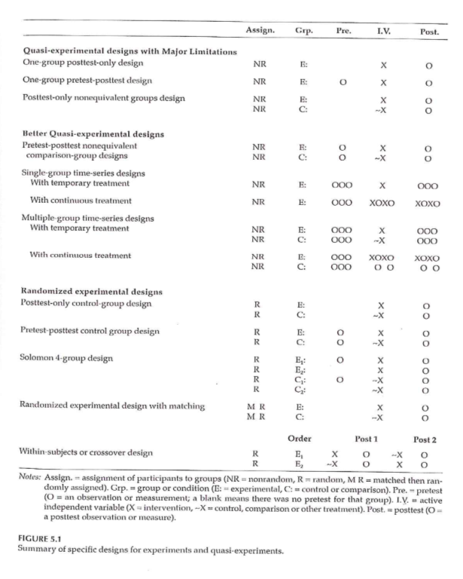
Randomized Experimental and Q-E Designs
Notes:
This image is from a delayed start design. D’Agostino. Column in the NEJM that is a tutorial.
During phase 1, half are getting treatment and half are getting placebo. After a certain amount of time the patients in the placebo group are switched to the treatment group. There is an allowance for a transitory time.

Slide 18
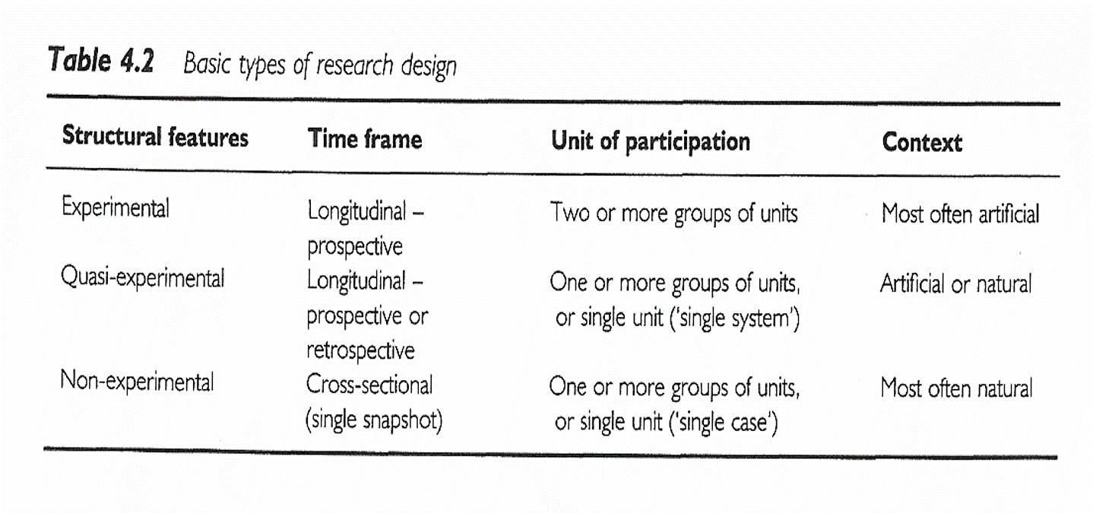
Research Design
Notes:
All of the designs talked about (other than the delayed start design), are in this figure that we saw earlier.
Sim & Wright. Research in Health Care . 2000. Table 4.2
Figure 5.1

Slide 19
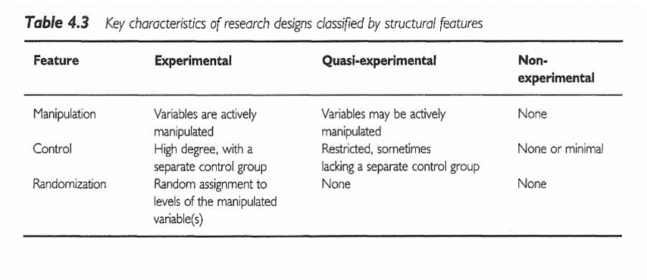
Research Design
Notes:
Sim & Wright. Research in Health Care . 2000. Table 4.3

Slide 20
Ioannidis article
[[Find image/table]]
Ioannidis found 49 articles. The first group, the contradicted studies, represent findings that were later contradicted by other studies. The next group shows where the initial findings were supported, but the strength of the effect has not been replicated. The benefit is much weaker.
The Leaf article talks about some alternatives and will be the basis of some discussion later in this class.

Slide 21
#2 Assignment
Go to a source of secondary data. Review available data types / topics on the data web site. Using the template provided in the Week 4 folder, write a brief description of a research topic you could address using this data source. Include in your description information on the variables that would be used . Use the hand-out with the list of possible web sites or your own source to identify a dataset you are interested in.

Slide 22
Assignment
Review available data types / topics on any web site that gives you access to secondary datasets. Using the template provided in the Week 4 folder, write a brief description of a research topic you could address using this data source. Include in your description information on the variables that would be used.
Prepare for next weekâ€™s session

Slide 23
Discussion questions
What are some of the pros and cons of conducting a research study using an existing dataset?
What are some of the research questions you can think of that could be addressed using an existing data set?

Slide 24
Additional slides

