Slide 1
Video 6 - Non-experimental studies
Steve Simon

Slide 2
Learning objectives
To distinguish different types of quantitative non-experimental approaches
To discuss strengths and weaknesses of qualitative research

Slide 3
Required reading
Chapters 7
Canvas â€“ Berkley-Patton et al., article
Canvas â€“ Eton et al., article.

Slide 4
Optional reading
Wolfe et al. â€œEffects of HIV-related stigma among an early sample of patients receiving antiretroviral therapy in Botswanaâ€
Rowan et al. â€œEngagement-in-care during the first 5 years after HIV diagnosis: Data from a cohort of newly HIV-diagnosed individuals in a large US cityâ€
DiLorenzo et al. â€œComparison of older and younger individuals with multiple sclerosis: A preliminary investigationâ€
Haberer et al. â€œChallenges in using mobile phones for collection of antiretroviral therapy adherence data in a resource-limited settingâ€

Slide 5
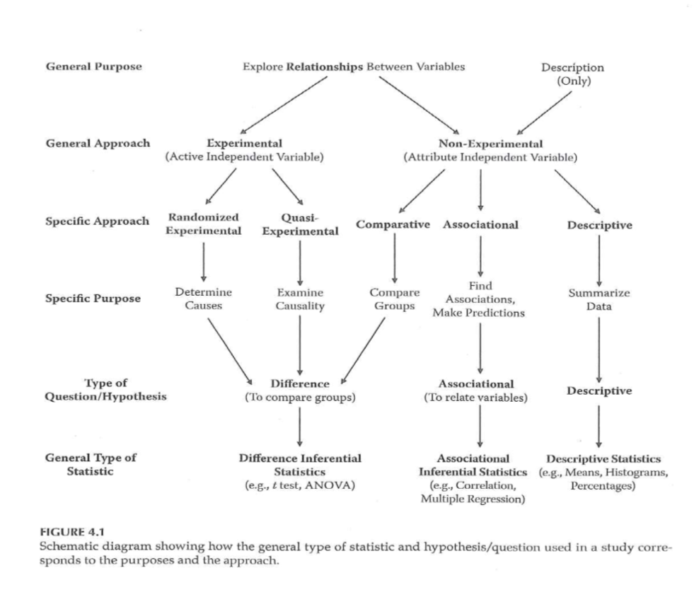
Research Approaches

Slide 6
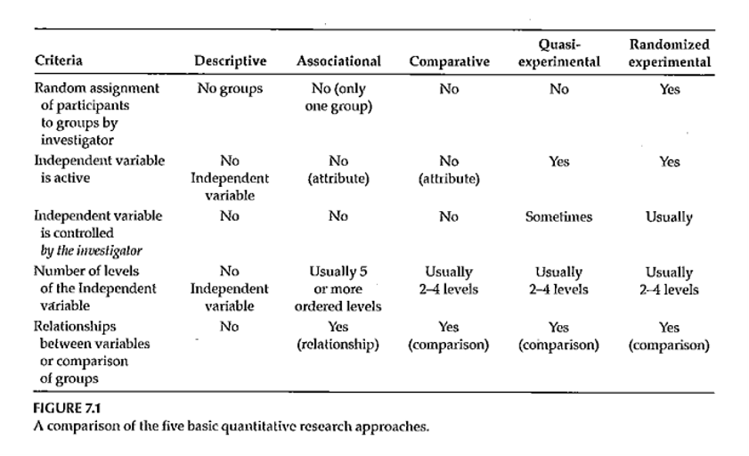
Nonexperimental Designs

Slide 7
Research Approaches
Comparative research approach
Purpose?
How is this approach similar to randomized experimental and quasi-experimental?
C an this approach tell you anything about cause and effect?

Slide 8
Nonexperimental Designs
Quantitative – Comparative
Comparing groups – 2 or more
Main IV has only a few levels
Statistical analysis –
T ypically t-test or analysis of variance
Example – DiLorenzo et al., 2004 article
Usually – research that is reported will contain elements of more than one design
Example – Haberer et al., 2010 article

Slide 9
Research Approaches
Associational research approach
Purpose?
Characteristics of the variables measured?
Can this approach tell you anything about cause and effect?

Slide 10
Nonexperimental Designs
Quantitative – Associational
IV is often continuous / has many levels of an ordered variable (typically 5 or more )
Looking at the association between the IV(s) and the DV
Statistical analysis –
Correlation-based
Multiple regression when there are multiple Ivs
Example – Rowan et al. 2014 article

Slide 11
Research Approaches
Descriptive research approach
Purpose?
When usually used?
Characteristics of the variables measured?
Can this approach tell you anything about cause and effect?

Slide 12
Nonexperimental Designs
Quantitative – Descriptive
Descriptive statistics
Averages
Percentages
Histogram
Frequency distribution
Some publication of strictly descriptive studies
More often – descriptive component of a study
Describe the sample …
Example – Wolfe et al, 2006 study

Slide 13
Nonexperimental Designs
Qualitative – 5 main approaches
Phenomenological
Grounded theory
Ethnographic
Case study
Narrative

Slide 14
Nonexperimental Designs
Qualitative – Phenomenological
A llow researcher to “… understand the meaning participants place onto “… events, phenomenon, and activities.”
Goal – “… explain the essence of experiences lived by the participants.”
Method – usually interviews

Slide 15
Nonexperimental Designs
Qualitative – Grounded Theory
Goal – “… generate theory from data collected from participants.”
“… focus on the process, actions, and interactions experienced by … participants.”
Method – usually interviews

Slide 16
Nonexperimental Designs
Grounded theory (Glaser & Strauss, 1967)
Inferences firmly “ grounded ” in the data
Prior theoretical expectations avoided
Sampling proceeds parallel to data collection & analysis
Categories regarded as provisional, subject to revision
Research maintains skepticism, seeks disconfirming examples
Ultimate purpose – construct coherent theory from the data

Slide 17
Nonexperimental Designs
Qualitative – Ethnographic
Goal - “… describe a group of individuals who share the same culture.”
Qualitative – Case-study
Goal – “…develop deep understanding of a case or cases.”
Qualitative – Narrative
Goal – “… identify and report stories from the participants.”

Slide 18
Analysis of Qualitative Data
Inductive process –
Start with the specific (raw data / transcript)
Develop a theoretical framework from the data
Conceptual categories emerge from the data

Slide 19
Analysis of Qualitative Data
Start the study with a research question
This may provide a potential starting point for analyzing text
If you do this, DO NOT let it prevent you from seeing what is in the text
Steps
From raw data <U+F0E8> theory building
“ Iterative ” process
e.g. , as you are developing categories, check them back against the raw data – do they continue to reflect the original data?

Slide 20
Analysis of Qualitative Data
Analysis process –
Given research question, may have some idea of a general conceptual structure; serve only as a starting point
Usually work from transcripts
If possible, refer back to audio recordings when needed
Q ualitative form of analysis
Content analysis – analysis of the content of communication
Thematic analysis – identifying patterns or themes in the data

Slide 21
Analysis of Qualitative Data
Category Formation – assign sections ( data bits ) to analytical categories/themes <U+F0E8> “ coding ”
Summarizing the data by identifying similarities and differences / commonalities and contrasts
Categories:
More manageable units of information
“ open coding ”
Descriptive – Concrete
Interpretive – Abstract
Relational
Cross-reference categories back to text
Makes it easier to revise coding as needed

Slide 22
Analysis of Qualitative Data
Category Formation
Faithful to the data – “ internal ” aspect
Meaningful to other categories – “ external ” aspect
Balance
Generality vs Specificity
Inclusivity vs Exclusivity
Number of times idea mentioned does NOT necessarily reflect importance

Slide 23
Analysis of Qualitative Data
Labeling / Revising Categories
Member-generated – “ first-order ” account
Observer-generated – “ second-order ” account
Labels are provisional; may be revised
Iteration – move back and forth between raw data and labeled categories
“ Zoom in ” vs “ Wide angle ” view of the coding
Revision – may end up dividing or combining categories
May establish criteria for category coding

Slide 24
Analysis of Qualitative Data
Saturation – the point at which you are not gaining any new insight, no new categories being identified, no new relationships being defined
Don ’ t need any additional analysis
Don ’ t need any additional data collection (if collection & analysis done in parallel)
Determinant – nature of the information being collection – NOT amount of information
Keeping notes – of the coding/analysis process
Help identify categories/relationships
Help if “ stuck ”
Document analysis process

Slide 25
Analysis of Qualitative Data
Role of Judgment
Balancing act –
Level of creativity by coder to identify categories/relationships
Must reflect the informants thoughts
Audit of the coding by an independent person can check for the match between the coding and the source information
Low-inference descriptors
Look for “ negative cases ”

Slide 26
Analysis of Qualitative Data
Quantifying Information
Pros & Cons
When quantifying might be of value
Simple frequency of occurrence does NOT necessarily reflect importance

Slide 27
Eton Article
Long-term Goal – “… build a general, multi-domain, patient-reported measure of burden of treatment with wide applicability across diseases and treatments”
Semi-structured qualitative interviews
“identify issues … illustrative of burden of treatment …”
“inform derivation of a general, patient-reported measure of burden of treatment flexible enough for application across any disease or treatment regimen.”

Slide 28
Eton Article
Development of interview
Content analysis process
Multiple coders
Identify key themes and subthemes
Discussion and consensus to develop coding scheme
Repeated check and update of coding process
Thematic content saturation
Resulting major themes and subthemes

Slide 29
Berkley-Patton Article
Goal – Use qualitative method to explore components of the Information-Motivation-Behavioral Skills model
Information + Motivation <U+F0E8> Behavioral Skills <U+F0E8> Adherence
Focus Groups
Content analysis – “… identify themes on expectations and information, personal and social motivation, and behavioral skills related to ART adherence.”

Slide 30
Berkley-Patton Article
Information and expectations
Motivation for ART adherence
Behavioral skills related to ART adherence
Themes for each of these areas?
Value obtained from this kind of study?

Slide 31
Nonexperimental - CBPR / PAR
Community Based Participatory Research (CBPR)
Participatory Action Research (PAR)
Takes place outside the normal research environment
Designed to meet the needs of the community in which the research is conducted
Value for the participants that goes beyond the value of the collected information

Slide 32
Nonexperimental - CBPR / PAR
Existing research data or data collected from other locations …
May not reflect conditions (e.g., disease incidence) in the community of interest
May not reflect underlying risk factors
May not indicate how an intervention will work in a specific community

Slide 33
Nonexperimental - CBPR / PAR
CBPR/PAR research may be more generalizable than research conducted in a clinical setting
Sample characteristics
Practice-Based Research Networks (PBRNs)
Physicians from community settings work together to study research questions of mutual interest

Slide 34
Nonexperimental - CBPR / PAR
How the research context influences the research process …
What issues are routinely encountered?
To whom is the research important?
Ripple effect of the research process
Level of engagement of the target population

Slide 35
Nonexperimental - CBPR / PAR
Conducting CBPR/PAR
Start simple
Think of local comparative advantage
Network
Collaborate
Top-down
Bottom-up

Slide 36
Nonexperimental - CBPR / PAR
CBPR/PAR – especially appropriate for research involving health disparities
Multiple individual and community-level determinants
Mechanism to translate basic health psychology conceptual models into interventions

Slide 37
Nonexperimental - CBPR / PAR
Contributions by researchers
Know existing research evidence
Can provide support/suggestions
Organization
Information-gathering
Action
Help community get in touch with resources

Slide 38
Nonexperimental - CBPR / PAR
Contributions by community
Unique insight into local context
Information concerning local needs and priorities
Provide “ real world ” feedback/reaction
Provide guidance for adapting programs/interventions to the community
Community involvement <U+F0E8> community capacity <U+F0E8> sustainability

Slide 39
Assignment #4
Turn in the results of a literature search on the topic you are planning to focus on for your research proposal . This is NOT expected to be a literature review; it should provide evidence that you are finding literature that is relevant to your topic. This assignment serves as the start of your References section, using the reference/citation style you plan to use in your proposal.

Slide 40
Assignment
Turn in the results of a literature search on the topic you are planning to focus on for your research proposal. What you turn in should provide evidence of the literature you have found that is relevant to the topic youâ€™ve chosen for your research proposal. This assignment serves as a start for your References section.
Prepare for next weekâ€™s session

Slide 41
Discussion questions
What kind of research topics could be addressed using non-experimental designs?
What kind of research topics could be addressed using qualitative methods?
What are the ethical issues that need to be addressed when doing these types of studies?

Slide 42
Additional slides

