Slide 1
Video 7 - Internal and external validity
Steve Simon

Slide 2
Learning objectives
To define internal validity
To define external validity
To discuss factors that determine the appropriate sample for a research project

Slide 3
Required reading
Chapters 8, 9

Slide 4
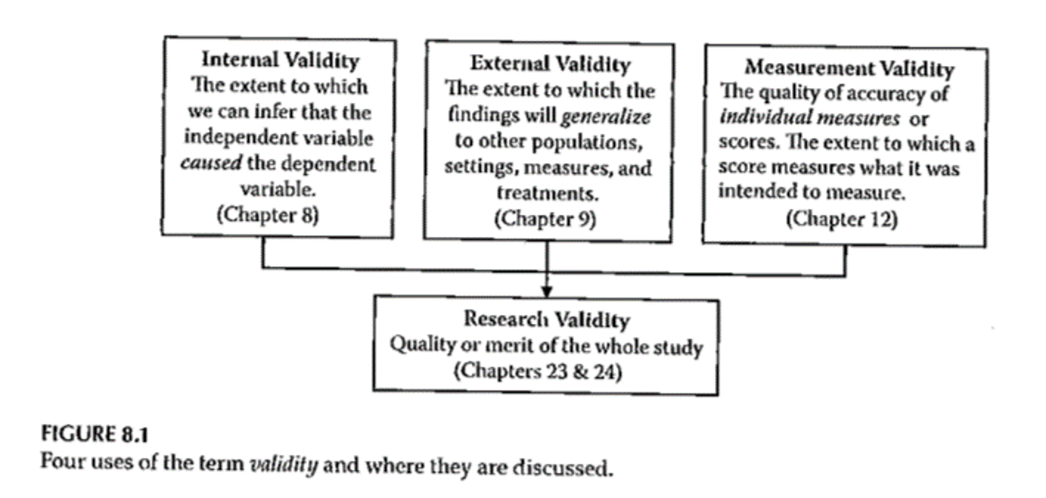
Validity

Slide 5
Internal Validity
“The extent to which we can infer that the independent variable caused the dependent variable.”
For non-experimental studies –
How “well designed and conducted” was the study?
Three criteria for causality

Slide 6
Internal Validity
“The extent to which we can infer that the independent variable caused the dependent variable.”
Three criteria for causality
IV must precede the outcome variable
IV must be related to the outcome
There must be no other variables that could explain why the IV is related to the outcome

Slide 7
Internal Validity
Three criteria for causality –
IV must precede the outcome variable
IV must be related to the outcome
There must be no other variables that could explain why the IV is related to the outcome
By Research Approach –
Randomized Exp
Quasi- Exp
Comparative
Associational
Descriptive

Slide 8
Internal Validity

Slide 9
Internal Validity
Meeting the 3 causality criteria based on –
Strength of the research design
Internal validity

Slide 10
Internal Validity
Internal validity -
Most often discussed with reference to randomized experimental and quasi-experimental designs
Can also be applied to non-experimental studies

Slide 11
Internal Validity
Evaluating the internal validity of a study –
Equivalence of the groups on participant characteristics
Control of extraneous experiences and environmental variables

Slide 12
Internal Validity
Equivalence of the groups on participant characteristics –
Are groups equivalent prior to introduction of IV?
Randomized experimental design –
Random assignment
Quasi-experimental design –
Random assignment of treatments
Matching
Checking pretest scores

Slide 13
Internal Validity
Equivalence of the groups on participant characteristics –
Are groups equivalent prior to introduction of IV?
Comparative design –
Statistical adjustment (ANCOVA) to adjust DV scores to make groups more nearly equivalent
Matching participants on variables other than the primary IV
E.g. Case-control study
Check after the study for comparability

Slide 14
Internal Validity
Equivalence of the groups on participant characteristics –
Are groups equivalent prior to introduction of IV?
Associational design –
Only 1 group
Not able to provide evidence of causation
“Equivalence” – “… whether those who score high on the IV … are similar to those … who score low in terms of other attributes that may be related to the DV.”
May be able to provide some statistical control

Slide 15
Internal Validity
Control of extraneous experiences and environmental variables –
Extraneous variables – variables other than the IV and DV
Environmental variables – conditions/variables that occur during the study
Contamination
Issue – Is one group affected more than the other(s)?
Less of an issue with a more controlled research setting

Slide 16
Internal Validity
Rating the dimensions of internal validity
Figure 8.2
Evaluating Research Validity framework
“Good” study – moderate to high internal validity on both dimensions

Slide 17
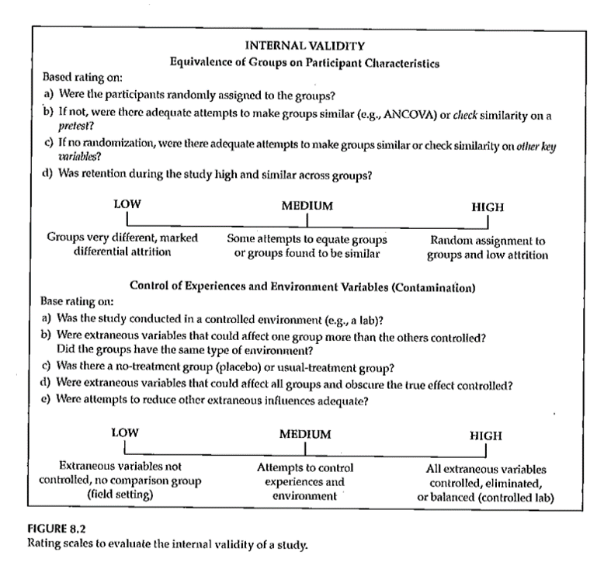
Internal Validity
Rating the dimensions of internal validity

Slide 18
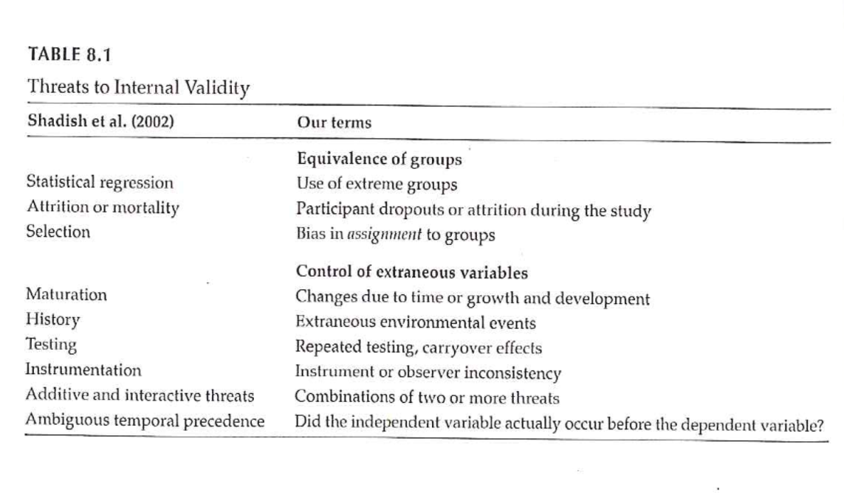
Threats to Internal Validity

Slide 19
Threats to Internal Validity
Equivalence of Groups
Use of extreme groups
Participant dropouts or attrition during the study
Bias in assignment to groups

Slide 20
Threats to Internal Validity
Control of extraneous/environmental variables
Changes due to time or growth and development
Extraneous environmental events
Repeated testing, carryover effects
Instrument or observer inconsistency
Combinations of two or more threats
Did the IV actually occur before the DV?

Slide 21
Threats to Internal Validity
Other threats
Effects of being in the control group
Expectation effect
Control for expectation
Observer / experimenter bias

Slide 22
Validity

Slide 23
Validity

Slide 24
Sampling
“… process of selecting part of a larger group of participants with the intent of generalizing from the sample (the smaller group) to the population (the larger group).”
“… representativeness of the sample is more important than its size …”

Slide 25
Sampling
Reasons for sampling
Expense
Time
Quality control

Slide 26
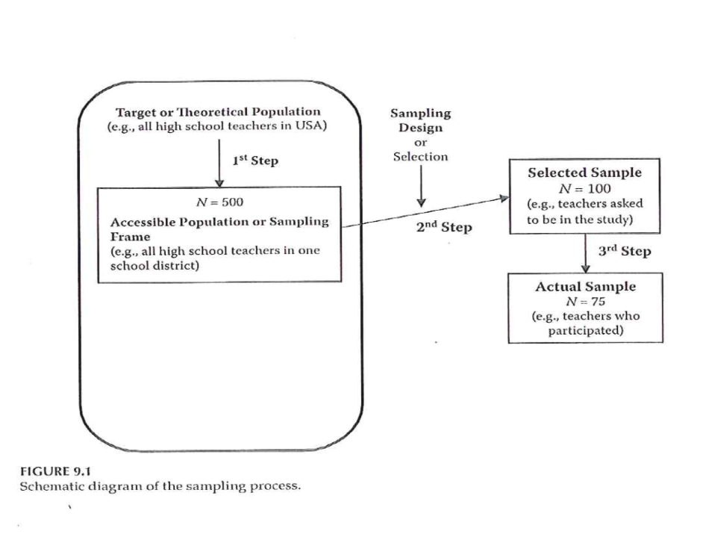
Sampling

Slide 27
Sampling
Sampling designs – Probability sampling
Simple random sampling
Systematic random sampling
Stratified random sampling
Cluster (random) sampling

Slide 28
Sampling
Sampling designs – Nonprobability sampling
Quota sampling
Purposive sampling
Purposeful sampling
Convenience sampling

Slide 29
Sampling
Sample size
General rules
Representativeness vs number
Impact of having very large sample sizes
Generally –
Need sample to be large enough so you don’t miss important findings
If very large sample, need to distinguish statistical significance vs clinically important

Slide 30
External Validity
Generalizability
Fig. 9.3
Evaluating Research Validity Framework
Two main aspects
Population external validity
Ecological external validity

Slide 31
External Validity
Population external validity
How participants were selected for the study?
Is sample representative of the target population?
Validity framework

Slide 32
External Validity
Ecological external validity
Whether the results can be generalized to real-life outcomes
Trade-off with control of study
Validity framework

Slide 33
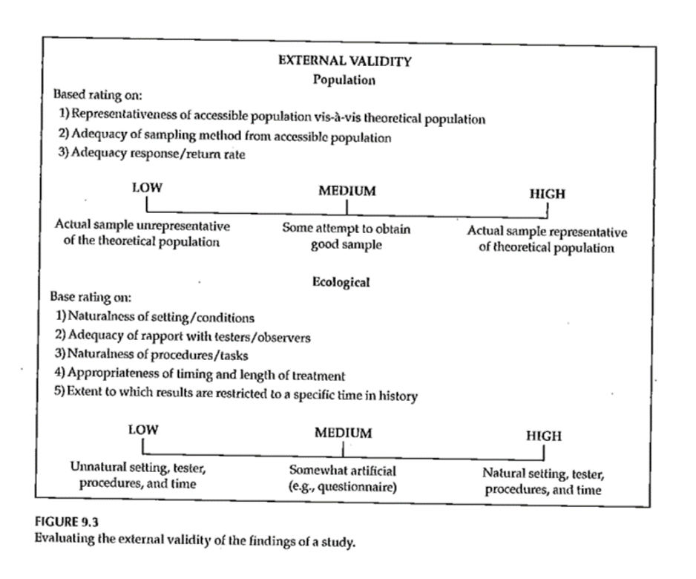
External Validity

Slide 34
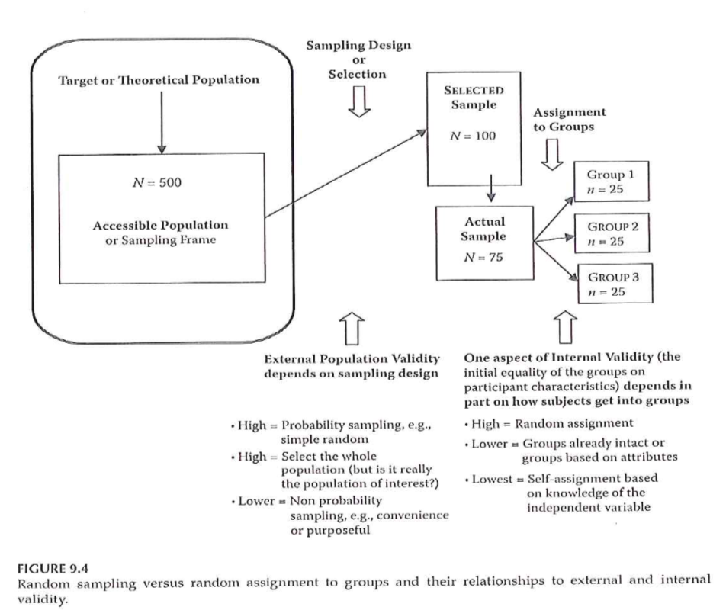
Sampling and Validity

Slide 35
Sampling
Portney & Watkins (2009)

Slide 36
Assignment #5
Prepare a first draft of the literature review that supports your research topic and provides evidence of the significance of the topic. Submit this assignment using “ Turnitin ” through Blackboard.

Slide 37
Assignment
Prepare a first draft of the literature review that supports your research topic and provides evidence of the significance of the topic. This assignment will be the starting point for the Review of the Literature section of your research proposal. This assignment will be submitted using “Turnitin” through Canvas.
Prepare for next weekâ€™s session

Slide 38
Discussion questions
What can be done to address different threats to internal validity?
How would you evaluate the external validity of your research project?
How will you define the appropriate sample for your research project?

Slide 39
Additional slides

