Slide 1
Video 04 - Analysis of randomized studies
Steve Simon

Slide 2
Learning objectives
To describe possible uses of existing data sets and research findings
To identify sources of data sets available for secondary analyses
Notes:
Here are the objectives for this week.

Slide 3
Required reading
Chapter 5.
Steve Simon. StATS: Intention to Treat. P.Mean website, January 27, 2000. Available in html format.
Richard Feinman. Intention-to-treat. What is the question?. Nutrition & Metabolism. 2009;6(1):1. Avialble in html format and PDF format.
Steve Simon. StATS: Exlcuding placebo responders. P.Mean website, June 25, 2004. Available in html format.
…
Notes:
This is what you should have read already. If you haven’t done the reading yet, pause this video and read this material. You’ll get more out of the video if you do so.

Slide 4
Experimental versus observational
Experimental: Active independent variable
Observational: Attribute independent variable
Who does the choosing?
Patients or doctors? = Observational
Researcher? = Experimental
Patients in a randomized trial are giving you a gift.
Notes:
One of the major distinctions in research design is experimental studies versus non-experimental (observational) studies.
Your book makes the distinction through the independent variable. An active independent variable allows for either a experimental or quasi-experimental study. An attribute independent variable makes your study non-experimental. That’s your book’s term, but I prefer the term observational. It is fairly common in the medical literature. Think of observational as “look but don’t touch.” You observe patients without meddling with them.
Another way of looking at it is to ask the question “Who does the choosing?” If the patient and/or the doctor has a part in deciding, then the study is observational. If the researcher is the only one who decides, and uses a coin flip to decide, that is a randomized clinical trial.
We owe a great debt of graditude to the volunteers in a randomized clinical trial. They are sacrificing a lot of autonomy over what drug or therapy to choose. And they are ceding that autonomy, not to an expert clinician but to the flip of a coin. That’s a truly amazing.

Slide 5
Randomized versus quasi-experimental
Quasi-experimental
Logistics prevent randomization
Very common in Quality Improvement
Notes:
When you have an active independent variable, you don’t always have a level of control that allows for randomization. Usually this is caused by logistical issues. Once you go down a certain path, it is impossible to go back. Or the setting that you are studying, like an emergency room is so chaotic that no one can keep track of a randomization table.
It’s easy to sneer at quasi-experimental studies and think of them as an inferior form of research. But they are not, and quasi-experimental designs form the backbone of many quality improvement studies. We’ll talk more about this in the following week.

Slide 6
Advantages of randomization
Insures covariate balance
Both measured and unmeasured covariates
Avoids selection bias
Notes:
A covariate is a variable that is not of direct interest in the research, but which could affect the outcome. If a covariate is imbalanced between the two groups you are comparing, that can interfere with your ability to detect whether there is a difference between the treatment and control group.
There was a study that looked at smoking during pregnancy and found the suprising conclusion that smoking reduced the risk of Down Syndrome. Now smoking does a lot of really bad things to you: cancer, hypertension, stroke, heart attacks, etc. So it would be quite surprising to see cigarettes being protective instead of harmful. The researchers knew, however, that this finding was not real. It turns out that younger women are more likely to smoke during pregnancy than older women. This is a covariate imbalance. The smoking group had a much younger average age than the non-smoking group. Down Syndrome occurs much more often among older women than younger. Once you control for mother’s age, the protective effect of smoking pretty much disappears.
Covariate imbalance is a big big problem for observational studies. You have to spend a lot of time and energy worrying about it during the planning phase and controlling for it in the analysis phase. We’ll talk more about this in a couple of weeks.
The value of randomization is that an older woman is just as likely to find herself in the treatment group as in the control group. So the law of large numbers assures that you will have good covariate balance.
This applies for both covariates that you can measure, like demographics, and covariates that you might not be able to measure, such as number of co-morbidities, psychological state, and severity of the illness at baseline.
There is a different perspective that is worth mentioning here. Covariate imbalance is sometimes caused by selection bias.
Some of the patients in your research study may prefer one or the other of the two completing therapies being studied. The physicians who are managing the patients in your research study may also have a preference for some of their patients.
If the patients and/or their physicians pay a role, even indirectly, in choosing between the two competing therapies, then you have to potential for selection bias. Patients might differ on key prognostic variables, leading to an biased comparison that might mask a true effect or produce an artefactual effect.
Randomization removes the patient and physician choice and prevents selection bias.

Slide 7
Disadvantages of randomization
Expensive
Artificial
Extra tests, extra attention
Explicit acknowledgement of uncertainty
Notes:
There are a fair number of researchers who get very snobbish about randomization. If it’s not randomized, it’s not real. This is wrong, wrong, wrong.
I wrote a book back in 2006 that talked about critical appraisal. It covered things like blinding, low drop out rates, patient oriented outcome measures, among other things that make a study more persuasive. I wanted to make the point that while all of these things are “nice to have”, none of them are “have to have”. So at the end of each chapter, I included a counterpoint.

Slide 8
Problems with randomized trials
Subversion of randomizaton
Volunteer bias.
Notes:
In theory, the two therapies you are comparing have to have equipoise. There needs to be genuine uncertainty as to which therapy is better. That’s a theoretical concept that is rarely met in practice.

Slide 9
When can’t you randomize
In what situations is randomization unethical, impractical, or impossible?
Retrospective prayer study. http://www.pmean.com/04/temporality.html

Slide 10
(New) Cameron and Pauling study of Vitamin C.

Slide 11
(New) Wait list control groups

Slide 12
(New) Matching, crossover designs

Slide 13
(New) Intention to treat analysis

Slide 14
(New) Equipoise, Early stopping

Slide 15
(New) Blinding/partial blinding. Who knew what when.

Slide 16
(New) Concealed allocation

Slide 17
(New) The law of large numbers

Slide 18
(New) Randomization approaches
Stratified randomization
Block randomization

Slide 19
(New) How to randomize

Slide 20
(New) Baseline measurements

Slide 21
(New) Crossover designs

Slide 22
(New) Criticisms

Slide 23
(Old) Randomized Experimental Designs
Characteristics
Assignment
Type of IV
Control of IV
Purpose
Notes:
Random assignment of an active independent variable. This design allows us to talk about cause.
Causality, actually, is easier to establish with a randomized study, but you can establish causation with an observational study, but it takes more work.
Add-on design. Take existing treatment and add either a new tre
An article by Debruyn (sp?)

Slide 24
(Old) Randomized Experimental Designs
Posttest-Only Control Group
R E: X O
R C: X O
Strengths
Weaknesses
Notes:
The random assignment assures that, on average, the two groups are comparable. You do not have pre measures. That prevents us from establishing comparability by comparing the pre measure values.
You don’t have a measure of change.

Slide 25
(Old) Randomized Experimental Designs
Pretest-Posttest Control Group
R E: O1 X O2
R C: O1 ~X O2
Strengths
Weaknesses
Notes:
This is the most common type of experimental design. You still have to worry about learning effects or fatigue effects.
There is a general rule of thumb, that a sample size of 30 per group allows you to be comfortable with a posttest only design, but don’t rely on this rule. A pretest measure is very important.

Slide 26
(Old) Randomized Experimental Designs
Solomon Four-Group
R E1: O1 X O2
R E2: X O2
R C1: O1 ~X O2
R C2: ~X O2
Strengths
Weaknesses
Notes:
People are in one group only. This is useful if the pre-measure has an influence on the post-measure (learning or fatigue effects).
Notice that this design doubles the number of people needed for the research.

Slide 27
(Old) Randomized Experimental Designs
Randomized Experimental Design with Matching
M R E: X O
M R C: ~X O
Strengths
Weaknesses
Notes:
Bring in matched pairs of people. Once you have those matched pairs, you randomly assign within each pair.
This design has a post-measure only, but matching minimizes the need for this measure.
One issue is that determining what variables to match, it places a burden on recruiting, and unmatched people are not included in the design.

Slide 28
(Old) Randomized Experimental Designs
Within-Subjects Randomized Experimental (Crossover) Design
R Order 1 X O1 ~X O2
R Order 2 ~X O1 X O2
Strengths
Weaknesses
Notes:
People are randomized into two or more groups. In this case there are two groups. Both groups get the treatment and the control, but the order is reversed.
Each person serves as their control. This really reduces the amount of variance, allowing you to get by with a much smaller sample size. How much smaller depends on a lot of factors, but effectively
You cannot use this design if there are carry over effects. Interventions that involve learning or training will not work with this design.
With drug trials, you need a sufficient period of time for one drug to wash out of the system before you switch. This can be a problem if leaving a patient untreated, even for a short amount of time.

Slide 29
(Old) Delayed start design.Randomized Experimental and Q-E Designs
Find the image from D’Agostino.
Notes:
This image is from a delayed start design. D’Agostino. Column in the NEJM that is a tutorial.
During phase 1, half are getting treatment and half are getting placebo. After a certain amount of time the patients in the placebo group are switched to the treatment group. There is an allowance for a transitory time.

Slide 30
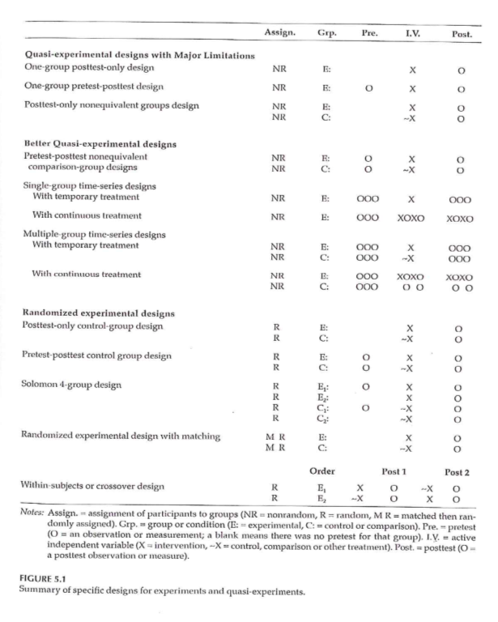
(Old) Randomized Experimental and Q-E Designs
Notes:
This image is from a delayed start design. D’Agostino. Column in the NEJM that is a tutorial.
During phase 1, half are getting treatment and half are getting placebo. After a certain amount of time the patients in the placebo group are switched to the treatment group. There is an allowance for a transitory time.

Slide 31
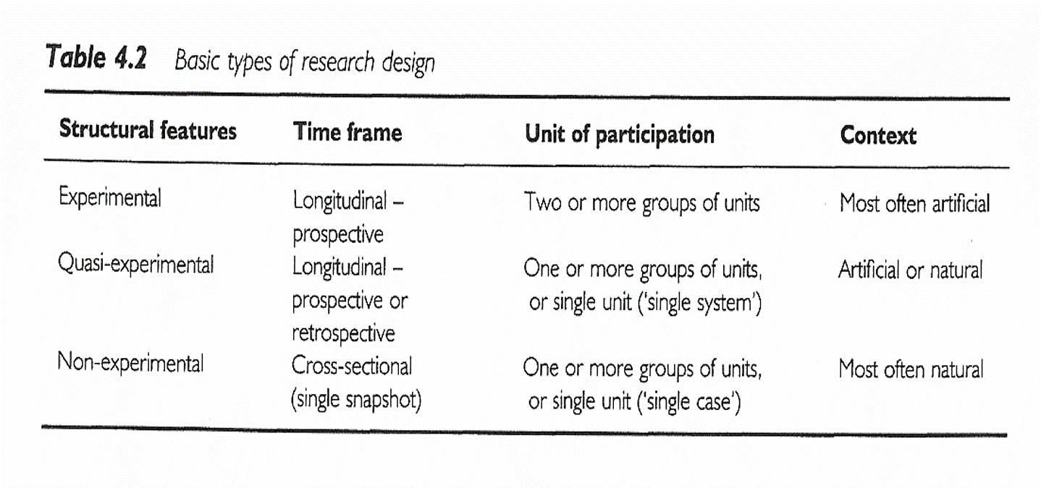
(Old) Research Design
Notes:
All of the designs talked about (other than the delayed start design), are in this figure that we saw earlier.
Sim & Wright. Research in Health Care . 2000. Table 4.2
Figure 5.1

Slide 32
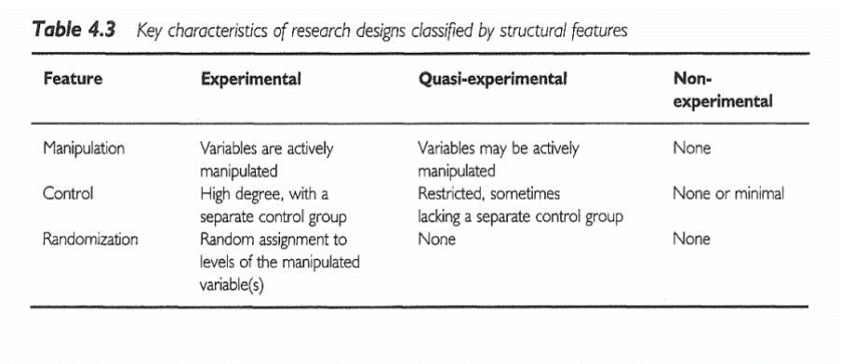
(Old) Research Design
Notes:
Sim & Wright. Research in Health Care . 2000. Table 4.3

Slide 33
(Old) Ioannidis article
[[Find image/table]]
Ioannidis found 49 articles. The first group, the contradicted studies, represent findings that were later contradicted by other studies. The next group shows where the initial findings were supported, but the strength of the effect has not been replicated. The benefit is much weaker.
The Leaf article talks about some alternatives and will be the basis of some discussion later in this class.

Slide 34
(Old) #2 Assignment
Go to a source of secondary data. Review available data types / topics on the data web site. Using the template provided in the Week 4 folder, write a brief description of a research topic you could address using this data source. Include in your description information on the variables that would be used . Use the hand-out with the list of possible web sites or your own source to identify a dataset you are interested in.

Slide 35
Assignment
Review available data types / topics on any web site that gives you access to secondary datasets. Using the template provided in the Week 4 folder, write a brief description of a research topic you could address using this data source. Include in your description information on the variables that would be used.
Prepare for next weekâ€™s session

Slide 36
Discussion questions
What are some of the pros and cons of conducting a research study using an existing dataset?
What are some of the research questions you can think of that could be addressed using an existing data set?

