Slide 1
Video 11 - Data analysis, Part 1
Steve Simon

Slide 2
Data management
Meta-data
Variable names
Variable labels
Value labels
Missing value codes
Storage options
Spreadsheet
Text file
Database
REDCap

Slide 3
Data dictionary
Also called a code book
Start before collecting data
Revise as needed
Notes:
Your meta-data belongs in a data dictionary. The data dictionary, also known as the code book, is a short document (usually one page or less) that describes your data. It helps you organize and structure your data entry process. It also helps anyone else who might be working with you on the project. Finally, it is invaluable if you plan to share your data with outside groups.
You should start a data dictionary before you collect any data. You will find, during the data collection, that you failed to specify something important, and it’s okay to revise your data dictionary. Keep it handy when you need to figure out how to handle special cases, like the person who circled both 3 and 4 on a five point Likert scale.
I’ll describe what belongs in a data dictionary after I describe the various elements of meta-data.

Slide 4
Variable names
Brief, but descriptive explanation
Roughly 4 to 16 characters
No blanks and (almost) no symbols
One to three words
Notes:
Define a brief variable name for every variable that you collect. It should be just long enough to be understandable, but short enough to minimize the typing in your data analysis program. I would recommend something between 4 to 16 characters and one or three short words.
Sometimes a very brief abbreviation is okay, like bw for birthweight or bmi for body mass index.

Slide 5
Good and bad variable names
Names to avoid (www.writersexchange.com)
systolic blood pressure
systolic-blood-pressure
Names that work
systolic_blood_pressure
systolic.blood.pressure
SystolicBloodPressure
NEVER USE ALL CAPS FOR VARIABLE NAMES
Lower case ascenders (e.g., f and l)
Lower case descenders (e.g., g and y)
Notes:
If your variable name is two or three short words (former smoker, or plasma beta carotene), you need to be careful. There’s a story about a group called Writer’s Exchange. They wanted to set up a website, www.writersexchange.com. It seemed like a good idea until they noticed that the website could be read as writer sex change.
You cannot use blanks between the words. It would work for some systems easily, for others, it would require some tedious work-arounds, and for still others, it would lead to system errors.
You can’t connect the words with dashes, because most systems will interpret the dash as a subtraction. Actually, just about any symbol (dollar sign, percent sign, asterisk) is a no-no. This can seriously stifle your creativity, but you have to live with it. Most statistical software programs reserve these symbols for special purposes, and if you use them in your variable names, you will confuse things.
There are two exceptions, the underscore character and the dot. These can be used almost anywhere. The dot is tricky in SQL and Java, as I understand it, but fine almost everywhere else. I believe the underscore is fine just about anywhere. But you can also use a mixture of upper and lower case, known as CamelCase.
Please avoid the use of all upper case for variable names. It looks bad, but more importantly is harder to read. Lower case has the advantage of ascenders, letters that creep into the upper zone, like f and l, and descenders, letters that creep into the lower zone, like g and y. These make it easier to read lower case quickly and accurately. So either use all lower case like e.e. cummings, or mixed case with only the initial letter of a word capitalized.

Slide 6
Variable labels
Longer descriptions
Can include spaces and punctuation
Ideal length is 20-40 characters
Mention units of measurement, special qualifiers
Notes:
Most statistical software programs have variable labels. These are intended to be longer text fields that can describe your variables in greater detail. They typically have no limits on spaces, punctuation, or special characters. The variable labels will appear in your output in place of the variable name, making your output easier to follow.
You want to be more expansive with your variable labels: about 20 to 40 characters in length is good. Too much longer and the labels won’t fit well on your tables or graphs.
If your variable has units of measurement, here is where you specify grams, kilograms, or pounds. If there are special qualifiers, like blood pressure measured on the leg instead of the arm, here is where you put those details.

Slide 7
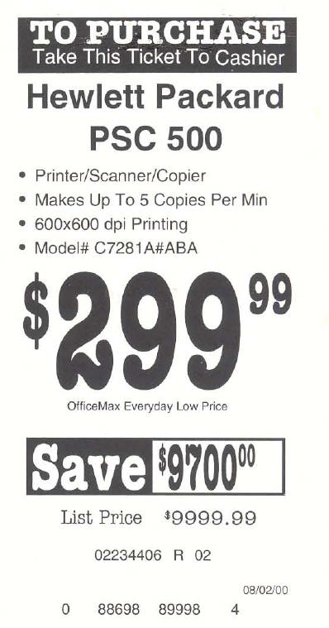
Missing value example
Price tage from computer store
Notes:
Here’s a humorous example of failure to account properly for missing values. The printer had a sales price of 299 dollars and 99 cents. The original price was listed as 9,999 dollars and 99 cents, which is an outrageous price for a printer. Clearly, a field of all nines was intended to be a missing value code. But the system that computed the savings did not recognize this as a missing value and calculated that if you bought this printer, you would be saving $9,700 dollars.

Slide 8
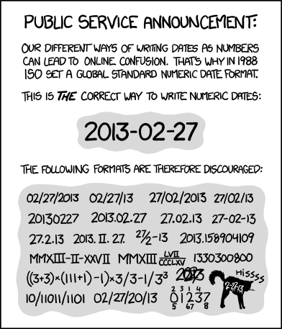
Date formats
Cartoon showing variety of data formats
Notes:
There are a variety of ways to code dates, but you should always use the ISO 8601 standard, which is the four digit year followed by a dash. Then you have two digits for the month. It is always two digits, so January is 01 rather than 1 and September is 09 rather than 9. This is followed by another dash and then the two digit day. Note that the first day of the month is 01 rather than 1.
Nobody follows this standard. Sometimes they use slashes rather than dashes. Sometimes they change the order. In America, we put the month, followed by the day, followed by the year. In Europe, they put the day followed by the month, followed by the year. Sometimes you will see the month spelled out or with a three letter abbreviation.
Sometimes they only use two digits for the year. This is a big problem and it leads to little kids being classified as 101 years old.
Do any of you remember the Y2K crisis? It was a big bust, but let me tell you about my two plans to profit from the Y2K crisis. My first plan was to go to the ATM machine at 11:59pm on December 31 and withdraw the maximum amount in the hopes that the ATM would crash one minute later and lose the record of my transaction. My second plan was to show up late for work on the Monday following Y2K and explain to my boss that I was only late because my alarm clock was not Y2K compliant.

Slide 9
Internal storage formats
Excel - number of days since December 31, 1899 (January 0, 1900)
R - number of days since January 1, 1970
SAS - number of days since January 1, 1960
SPSS - number of seconds since October 14, 1582
Notes:
Everything in the computer is stored as a number. That includes dates. Every system has a different way of calculating dates. This can sometimes lead to problems when you switch from one program to another.

Slide 10
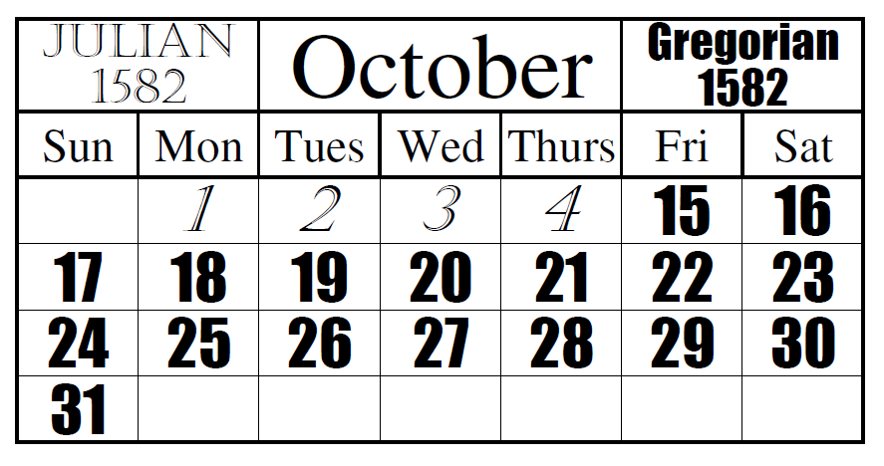
Gregorian calendar
Transition to the Gregorian calendar
Notes:
if the date of October 14, 1582 seems strange to you, it represents the start of the Gregorian calendar.
Here is an illustration of the transition, thanks to By Asmdemon - Own work, CC BY-SA 4.0, https://commons.wikimedia.org/w/index.php?curid=35391210

Slide 11

Gregorian calendar
Painting of Pope Gergory XIII
Notes:
Here’s a picture of Pope Gregory XIII, taken from Wikipedia.

Slide 12
Missing value codes
Explain WHY the value is missing.
Did not answer
Not applicable
Below the limit of detection
Notes:
Sometimes you do not have data for a particular variable for some of your patients. This is perfectly fine. You must explain why the value is missing.
Sometimes a value is missing because a patient skipped the item on your questionnaire. Sometimes, it represents not applicable, such as your spouse’s age if you are not married. Sometimes, it represents a lab value below the limit of detection. There are a whole host of other reasons.
How you handle missing values in your data analysis depends largely on the reason why that value is missing. Using the wrong approach can seriously bias your results.

Slide 13
Example of missing value codes
Use extreme number code
9, 99, 999
-1
Use symbols
NA
(asterisk)
(dot)
Never use blanks to designate missing
Note missing value code on data dictionary
Notes:
There are several ways you can code missing values. I recommend an extreme number code. 9 works well for values that can’t get any larger than 5. Use 99 or 999 if the values can get larger. You want to choose enough nines so that the value is clearly outside of any reasonable range of legitimate values. So a birthweight of 99 kilograms is obviously a missing value for anyone except for a baby elephant. An IQ score of 999 is outside the range even of Albert Einstein.
Some people use -1 for a missing value code if the variable is clearly not ever going to be a negative value. A baby could not have a birth weight of -1 kilogram, because such a baby would float up to the ceiling after being delivered.
If there are several reasons why a variable could be missing, use a separate code for each reason, such as 997 for lost test tube, 998 for insufficient volume for testing, and 999 for a result below the limit of detection.
You can also use symbols for missing values such as an asterisk or a dot. You can also use the letters NA, which is what R expects. These last three have a disadvantage for numeric variables. They end up confusing some imports and force your numeric column into a character string.

Slide 14
Codes for categorical data
Beware of ambiguities
YES, yes, and Yes are three distinct levels.
Use number codes
0, 1, 9 for binary variables
Single letter codes
M, F, and U for gender
Potentially ambiguous
Consistent case is important.
Notes:
Some people use text strings to designate categorical data. This requires more typing, which may not be too serious a concern, but it also raises the possibility of ambiguity, especially if several people are responsible for data entry.
Note that the strings YES (all upper case), yes (all lower case), and Yes (Mixed case) may look the same to you, but they are treated as separate categories by the computer.
Your book recommends number codes, and I agree with them. But you should know that others hate number codes and prefer the use of strings or single letter codes.
Single letter codes are easy to remember. The letter codes (M, F, and U) for gender are obviously Male, Female, and Unknown. These single letters are also convenient plotting codes. At times, the codes can be ambiguous. Did you code your patients W for white, or C for Caucasian?

Slide 15
Reverse coding
Context specific
Sequence of IF THEN ELSE statements
if (is.na(x)) then y=NA
else if (x=1) then y=4
else if (x=2) then y=3
else if (x=3) then y=2
else if (x=4) then y=1
else y=9
Functional transformations
0,1 to 1,0 is f(x)=1-x
1,2,3,4 to 4,3,2,1 is f(x)=5-x
0,1,2,3,4 to 4,3,2,1,0 is f(x)=4-x
Always check your results
Watch out for missing value codes
Notes:
Reverse scaling is tedious and always go slowly, because tedium tends to produce simple mistakes. SPSS has a very nice recode dialog box that is hard to mess up. You can also use a series of IF THEN ELSE commands to do the reverse coding. Notice that I took the time to code as 9 anything outside what I believed were the only possible values.
But if you want to be clever, there is usually a simple mathematical function of the form k-x or k+1-x that will reverse scale everything all at once.
If you had a variable with values 0 and 1, the function f(x)=1-x will effectively convert the 0 to a 1 and the 1 to a 0.
If you had a variable with values 1, 2, 3, and 4, the function f(x)=5-x would effectively reverse these values. But note that if 0 were legal, if the possible values were 0, 1, 2, 3, and 4, then the proper function would be f(x)=4-x.
Always account properly for missing values when reverse scaling. It’s a good idea to do a simple frequency table before and after reverse coding. It is also a good idea to store the reverse coded variable under a different name, so that you could easily undo any mistakes that you might have made.

Slide 16
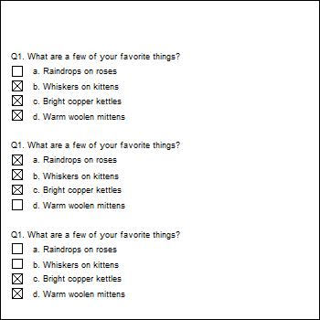
A multiple response example
Questionnaire with a multiple response question
Notes:
This is an example of a questionnaire where the patients can choose one of more of the following favorite things: Raindrops on roses, or whiskers on kittens. Bright copper kettles, or warm woolen mittens.
The first patient liked the last three things: whiskers on kittens, bright copper kettles, and warm woolen mittens.
The second patient liked the first three things: raindrops on roses, whiskers on kittens, and bright copper kettles.
The third patient liked the last two things: bright copper kettles, and warm woolen mittens.

Slide 17
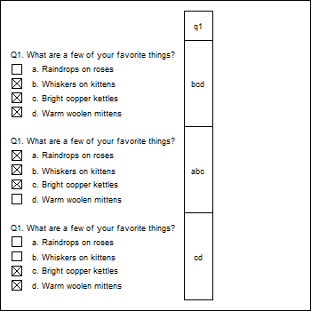
Coding multiple response with a single column
Multiple response coded into a single column
Notes:
You can code all the possible responses in a single column. Since the first person chose the last three responses, code their response as bcd. The second person chose the first three responses, and would be coded as abc. The third person only chose the last two responses, and would be coded cd.
This approach makes it difficult to compute even simple statistics, such as the proportion of patients who chose “Whiskers on kittens.” You’d have to work with a string search function. How many of the strings contain the letter b? It’s not a terribly hard amount of work, but with a bit of planning, you could make it a bit easier for yourself down the road.

Slide 18
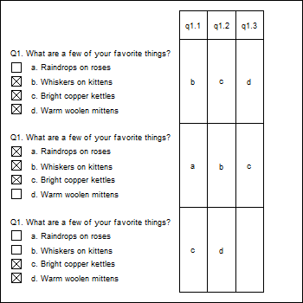
A different way to code multiple response
A multiple response question coded into three columns
Notes:
You could split this into three columns, putting the first selection in the first column, the second selection in the second column, and the third selection in the third column.
This is a bit better, but there are still some problems.
This format produces some unneeded missing values, such as for the patient who has less than three favorite things.
If you find out halfway through the survey that someone chose all four favorite things, you’d have to go back and add a new column.
This format is also a bit tricky. Notice how even though all three patients selected c, the letter appears once in the third column, once in the second column, and once in the first column. If you wanted the percentage of patients who chose “c,” you’d have to calculate the percentage of c’s in the first column, and add it to the percentage of c’s in the second column and the percentage of c’s in the third column.

Slide 19
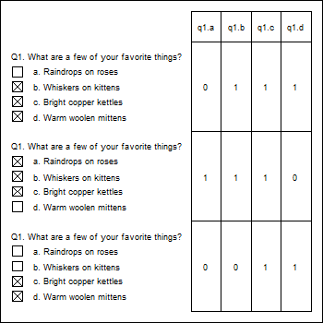
The recommended way to code multiple response
Multiple response coded with individual item indicators
Notes:
The recommended way to code multiple response is to create indicator variables for each possible response. The q1.a column is one for the second patient, as he/she was the only one who who liked raindrops on roses. The other two patients get a zero in this column. The q1.b column is one for the first and second patients, who both liked whiskers on kittens, but zero for the third patient who did not like whiskers on kittens. What’s wrong here? Who doesn’t like whiskers on kittens? The q1.c column is one for everybody because everybody liked bright copper kettles. Finally, in column q1.d, the first and third patients get ones for the like of warm woolen mittens, and the second patient gets a zero.

Slide 20
Longitudinal data, Repeated measures data
Longitunal
Multiple time points per patient
Repeated measurements
Measuring patient repeatedly under different conditions
Tall and thin format
One line per visit/measurement
Short and fat format
One line per patient
Database format
Time constant table
Time varying table
Notes:
Longitudinal data are data collected at several different time periods on the same individual. Repeated measurements data are the same measurements collected on an individual under different conditions. Both longitudinal and repeated measurements data are very powerful because each subject can serve as their own control. Data analysis is tricky, but data management is even trickier.
You have two different options for storing longitudinal or repeated measurements data. The tall and thin format has one row for each visit in a longitudinal study or one row for each measurement in a repeated measures study. This means lots of rows, but not so many columns. This makes the data set tall and thin.
The short and fat format has one row per patient and each visit or each repeated measure is spread out across multiple variables. This means fewer rows but many more columns. You typically scroll a lot left and righ when viewing a short and fat format, and this can be tedious.
Some data analyses, such as plots, work better with the tall and thin format. Other analyses, such as correlations, work better with the short and fat format. It is tedious to switch between the two formats, but you can do this.
I recommend that you split longitudinal data into two pieces. The first piece represents time constant variables. These are the variables that do not change from visit to visit or across the repeated measurements. Most demographics like sex and race are the same from visit to visit.

Slide 21
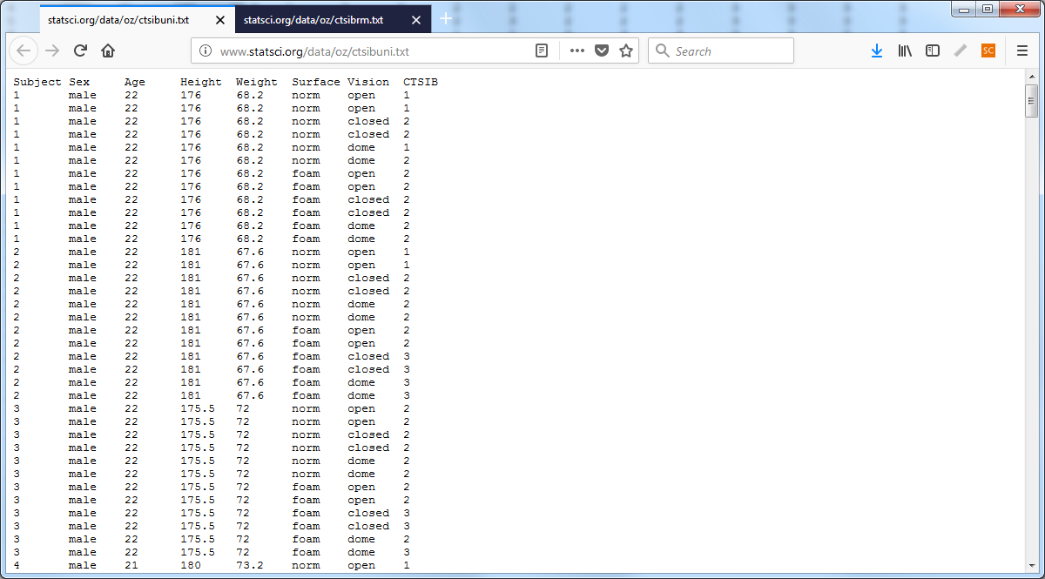
Example of tall and thin, data
Repeated measures data in tall and thin format

Slide 22
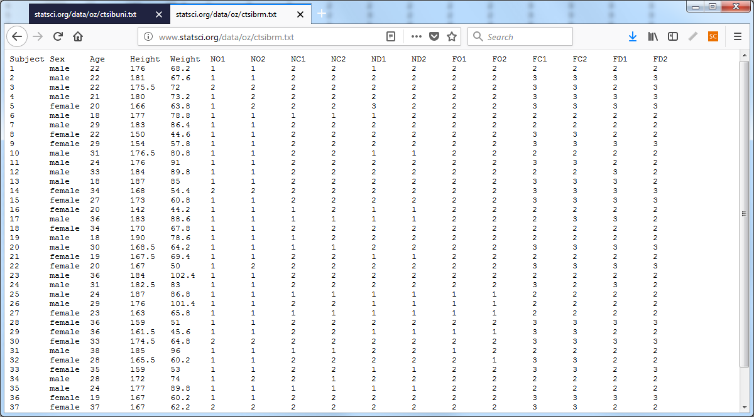
Example of short and fat, data
Repeated measures data in short and fat format

Slide 23
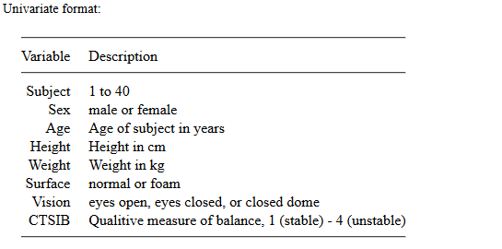
Example of tall and thin, dictionary
Data dictionary for tall and thin format

Slide 24
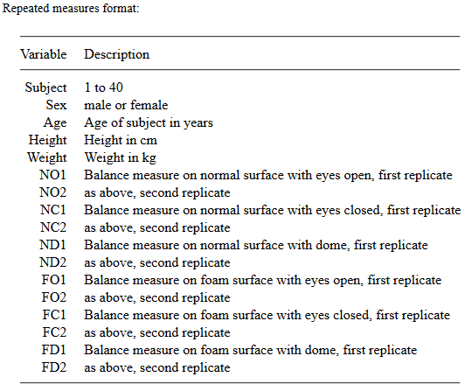
Example of short and fat, dictionary
Repeated measures example in short and fat format

Slide 25
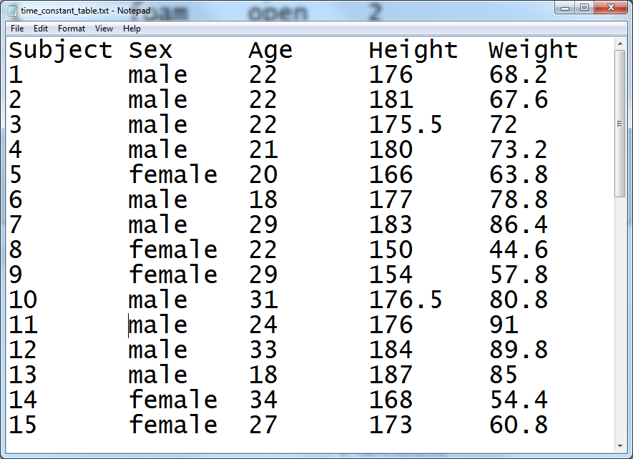
Time constant data
Table listing time constant data only

Slide 26
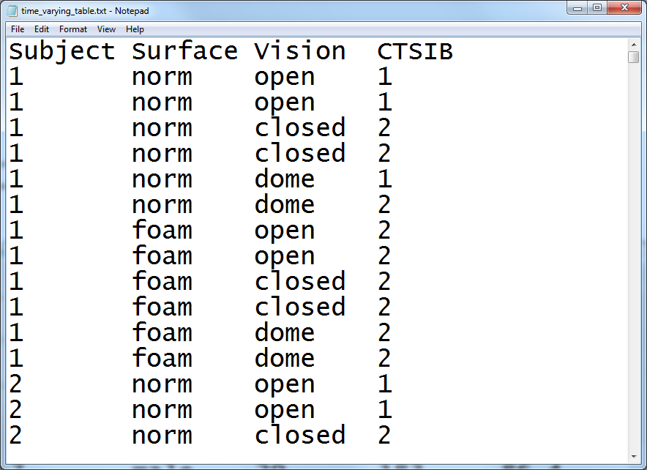
Time varying data
Table listing time varying data only

Slide 27
Contents of a data dictionary
Variable names
Variable labels
Units of measurement
Permissible/impermissible values
Value labels
Missing value codes
Source
License
Notes:
The data dictionary should list variable names. We already talked about variable names. Also include a longer description, a variable label. The variable label can use blanks, special symbols, and typically has a longer length. Be sure to specify the units of measurement, if applicable.
If there are permissible/impermissible values or a legal range, then include this information in the data dictionary. It could be put in as part of the variable label or listed as a footnote.
If your variable is categorical, specify what the categories are. There is nothing worse than not knowing whether 1 is male and 2 is female or if 1 is female and 2 is male.

Slide 28
If you enter data into Excel
Do not use colors
Do not include summary statistics
Rectangular grid
Don’t squeeze two data values into one cell
Systolic/diastolic blood pressures
44M for a 44 year old male
Variable names in first row
No blank cells
Contradicts your book
Notes:
A lot of researchers do their data entry in Microsoft Excel or some similar spreadsheet program. This is, at best, sub-optimal. REDCap is a much better option. But if you decide to use a spreadsheet, be careful. Spreadsheets are very flexible. Too flexible. You can put some of your numbers over here and others over there and then some more in the middle, and what you end up with is a muddle.
The key rule for a spreadsheet is to use a rectangular grid. A rectangular grid has a single number at the intersection of every row and column. Don’t leave holes in your grid, even if the value is missing.
Don’t try to squeeze to pieces of data into the same cell. A common problem is when researchers put 120/80 into a cell to represent the systolic and diastolic blood pressures. When you enter data like this, you have two problems. First, there is no easy way to compute the average systolic or diastolic blood pressure. Second, some statistical software will see the slash and confuse it for division, converting your 120/80 into 1.5.
Use one cell for the systolic blood pressure and a different cell for the diastolic blood pressure. Likewise, an entry of 44M for a forty four year old male is troublesome. You can’t easily compute the average age or the percentage of males.
It’s a good idea to place the variable names in the first row of the spreadsheet. It’s not a strict requirement, as you have already provided the variable names in your data dictionary. If you are nice enough to do this, however, it will be easier to import the data. the first row also makes it possibile to spot check your data to make sure that the columns are lining up properly.
Don’t use the first two or three rows to organize your variables into headings and subheadings.
A lot of people will include some brief summary statistics as the last row or two of the spreadsheet. This is a bad idea, as the summary statistics might be confused for actual data points. If you need to compute a few summary statistics, learn how to place these in a separate worksheet.
Don’t use a lot of fancy formatting in your spreadsheet. This means, no colors, no different fonts or sizes, and no merged cells. All of this is lost when you import your data into SAS, SPSS, or R.
Let me emphasize one more thing. Do not use blank cells ever in your spreadsheet. If your data is missing, use a missing value code. This contradicts your book’s advice, but your book is wrong. A blank cell could easily be converted into a zero, if you’re not careful and zero is quite different than missing.
If the structure of your data is irregular and cannot fit into a rectangular grid, re-organize. If you have measurements on 24 treatment subjects and 26 controls, don’t put the outcome measure for the 24 treatment patients in one column and the 26 control patients in a second column. Put all 50 in a single column and add an additional column with 26 ones and 24 twos to distinguish who is a treatment patient and who is a control.

Slide 29
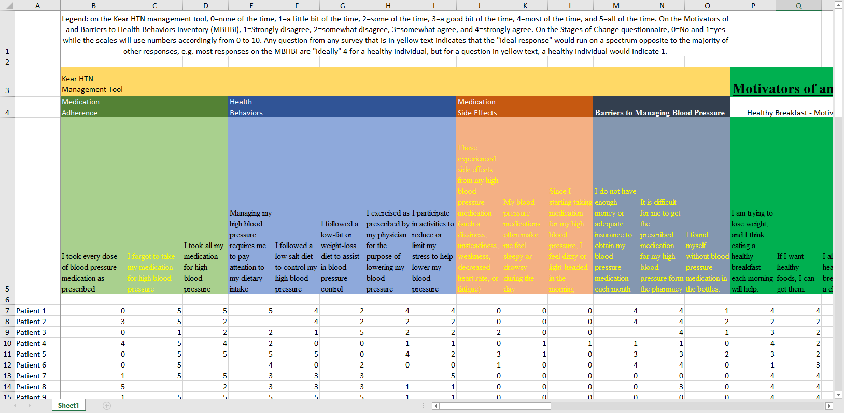
A poorly structured spreadsheet
A spreadsheet with data
Notes:
This image and the next three might be a bit tricky to see on your screen. You can download the original images from the Canvas site and magnify them, if you want to see the details.
Here is a spreadsheet that I received recently that violates many of the recommendations that I just made.
The first row contains information that should belong in the data dictionary. The second and third rows organize the variables into major groupings: the Kear HTN Management Tool, and the Motivators of and Barriers to Health-Smart Behaviors Inventory. There are subgroups within these two groups: Medication Adherence, Health Behaviors, Medication Side Effects, and Barriers to Managing Blood Pressure for the Kear HTN Management Tool, and Healthy Breakfast - Motivators, and some other subgrous for the Motivators of and Barriers to Health-Smart Behaviors Inventory.
The groupings and subgroupings belong in the data dictionary but not here.
The fourth column gives a description of each variable. The first two columns are: I forgot to take my medication for high blood pressure, I took all my medication for high blood pressure. These are much too long to serve as variable names. They would make great variable labels instead, and this information belongs in a data dictionary.
There is an important bit of information hidden in the formatting of the variable labels.
“Any question from any survey that is in yellow text indicates that the”ideal response" would run on a spectrum opposite to the majority of other responses, e.g. most responses on the MBHBI are “ideally” 4 for a healthy individual, but for a question in yellow text, a healthy individual would indicate 1."
So the ninth column (I participate in activities to reduce or limit my stress to help lower my blood pressure) is in black because a large value is good. But the tenth column (I have experienced side effects from my high blood pressure medication (such a dizziness, unsteadiness, weakness, decreased heart rate, or fatigue)) is in yellow because a small value is good.
The sixth row is totally blank which is great for readability but an annoyance when you import the data.
Finally, notice the blank cells. I found out that these represented cases where someone skipped a question.

Slide 30
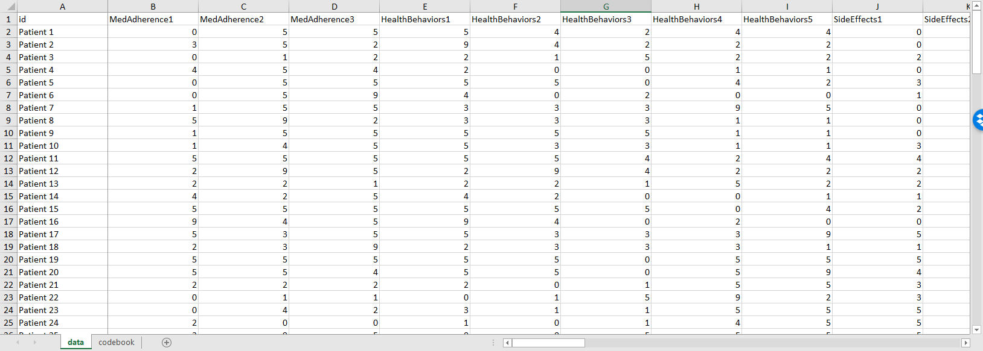
Revisions to this spreadsheet
A revised and better organized spreadsheet
Notes:
I was able to work with this data set, as is, without too much trouble, but here’s a modification that would have been a bit easier to work with.
The first row includes brief, but descriptive variable names. The column names are MedAdherence1 through 3, HealthBehaviors1 through 5, SideEffects1 through 3, and so forth. I anticipated that I would not need to distinguish among the particular questions within a subgroup, since I would probably just use an aggregate sum of each subgroup (after reverse scaling) for most of the analyses.

Slide 31
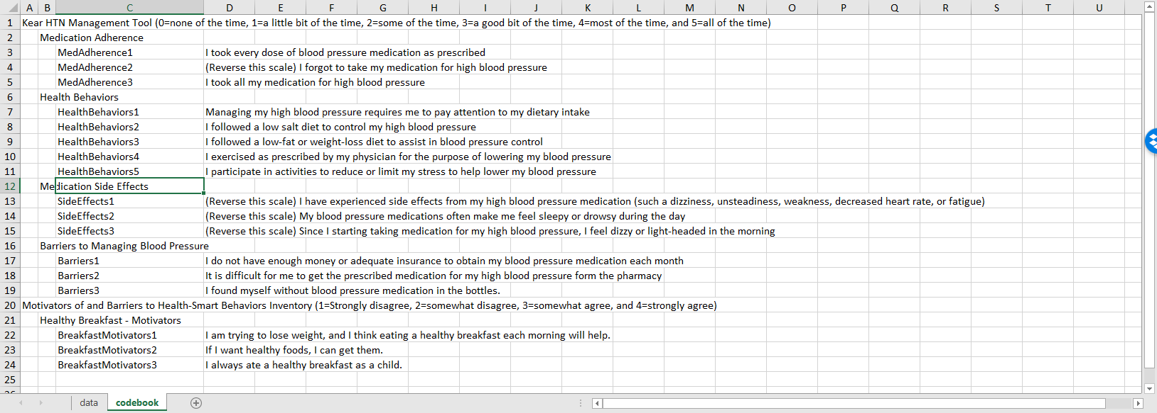
The codebook from this spreadsheet
A codebook associated with revised spreadsheet
Notes:
I also cut and pasted some of the preliminary rows in the original spreadsheet and restructured things a bit to develop a data dictionary.

Slide 32
Text files
Fixed width
Delimited
Commas
Spaces
Tabs
“Quotes around text”
Notes:
You may wish to create a text file for others to use. The text format is popular for sharing your data, because others can inspect the data easily without needing any specialized software.
You can used a fixed width format. The

Slide 33
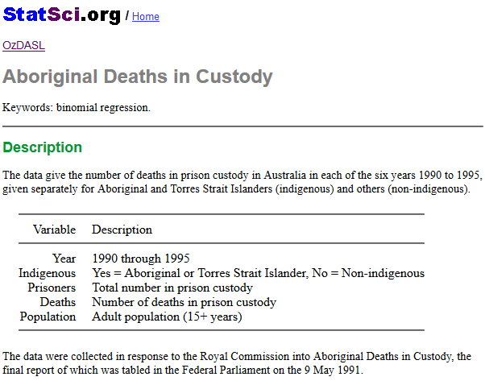
Data dictionary for aboriginal prison death study
Data dictionary
Notes:
Here is the data dictionary for a small data set that I will use to illustrate the various text formats. It comes from OzDASL, the Australian Data And Story Library. This data set represents the number of deaths in prison of both aboriginal Australians and others. The variables are
Year (1990 through 1995),
Indigenous (yes or no),
Prisoners, the number in prison custody,
Deaths, the number of deaths, and
Population, the adult population (15 years or older)

Slide 34
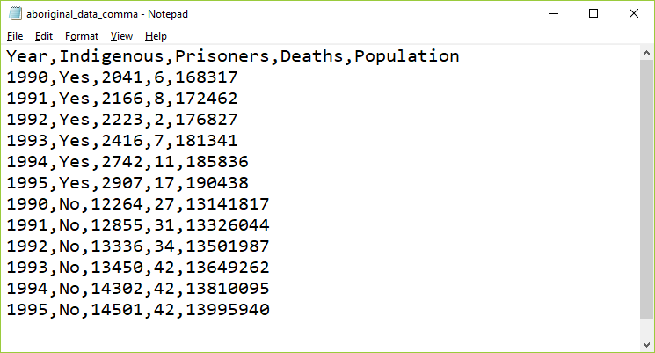
Comma separated values (csv)
Data set using a comma separated value format
Notes:
The most popular text format is the comma separated value. These files usually have a .csv extension. Each data point is separated from the other data values by a comma.

Slide 35
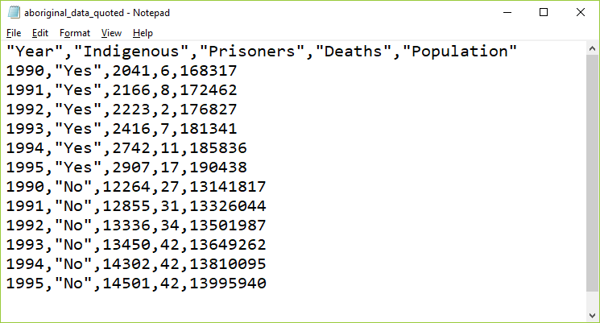
Comma separated values with quotes
Data set using a quoted format
Notes:
If your text data contains space, punctuation, or other special symbols, then it is a good idea to place quotes around your text. It’s not really needed for this data set, but I wanted to show you anyway.
There are elaborate rules for how to handle text data that contains quote marks. Use double quotes to surround text that includes single quotes and use single quotes to surround text that has double quotes. Doubling up a quote mark is another approach that usually works. It’s one of those tedious things that only Statisticians worry about.

Slide 36
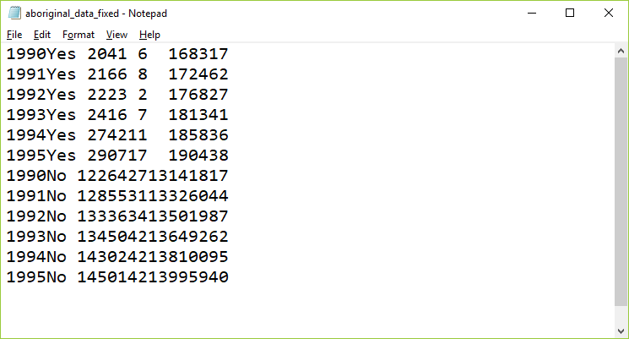
Fixed width format
Data set using a fixed width format
Notes:
In this fixed width format, the first variable, year, is listed in columns 1 through 4. Then the text variable, Indigenous, takes the next three columns, columns 5 through 7. The number of prisoners is either a four or five digit number, so it uses columns 8 through 12. The number of deaths is, thankfully small, either one or two digits, so it fits into columns 13 and 14. The population could be in the tens of millions, so it needs to use columns 15 through 22.
You need a fairly detailed data dictionary for fixed with format data, because otherwise you might not be sure where one number stops and another number begins.

Slide 37
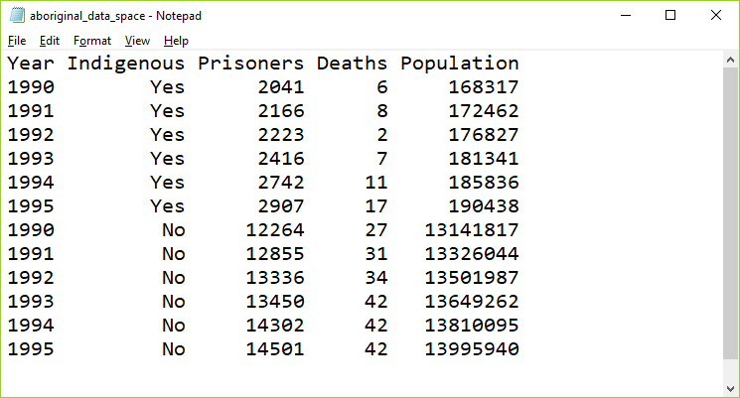
Spaced format
Data set using a spaced format
Notes:
Usually, you will encounter a fixed width format in data sets with hundreds of variables and thousands or millions of rows. In these files, saving a few characters here or there can make a big difference in download times. But for small data sets, you can insert a few extra blanks so that everything lines up nicely. Here is an example.

Slide 38
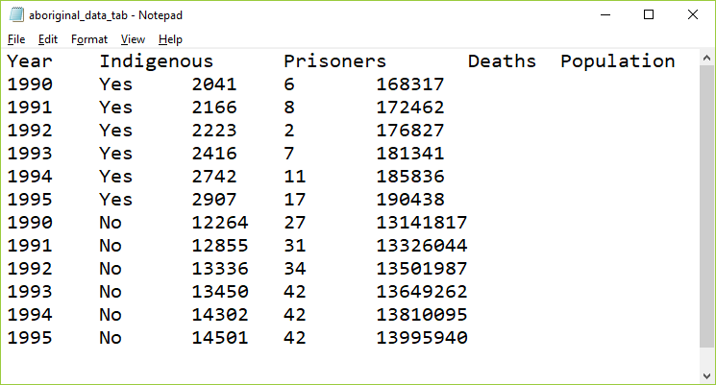
Tab separated values
Data set using a tab separated value format
Notes:
In the tab separated format, the tab character is used to separate values. The tab character effectively jumps to a specific fixed location. These locations are usually eight characters apart, starting at column 9, then 17, 25, etc.
The tab character appears to the human eye as multiple blanks but it is actually a non printing character, 09 in hexadecimal.
It’s hard sometimes to figure out if a file is using tabs or spaces as delimiters. Most text editors and word processors will let you search for the tab character, often with a code like /t (forward slash t). If you start to insert blanks in a tab delimited file, at first nothing happens, then all of a sudden, you notice a sudden jump in the text to the right of where you are inserting. Finally, look to see if the text seems to line up somewhat but with a few irregularities. This happens when some of the text data for a variable is longer than 8 characters and other text for that variable is shorter than 8 characters. In the example shown here, none of the data is longer than 8 characters, but the variable names are, which is why they don’t align perfectly with the data.

Slide 39
Database systems
Terminology
Tables
Fields
Records
Primary key
Foreign key

Slide 40
REDCap

Slide 41
Coding
Dummy coding
0/1 for absence/presence
Double entry coding
Standard coding for race/ethnicity

Slide 42
Quality checks
Minimum and maximum checks
Out of range
Zero variation
Missing value count
List five five rows, last five rows
Correlations

Slide 43
Data reduction
Create composite scores
Check Cronbach’s alpha
Examine leaving out single items
Factor analysis
Supplanted by Structural Equations Modeling

Slide 44
Data transformations
Ideal - selected a priori
Sometimes based on precedent
Sometimes motivated by theory
Sometimes based on empirical findings

Slide 45
Data Collection Techniques
Standardized vs Investigator-Developed Instruments
Development and Use
Evidence to support investigator-developed instruments
Notes:
There is a lot of work in the development of standardized instruments, manual and documentaiton, normative values, apply to a broad area. Investigator developed instruments focus on a more specialized area, but you still need to supply information on validity and reliability.
Whenever possible use instruments already in use. You can find these in places like PROQOLID. This originally started as quality of life measurements, but has expanded. NIH compilation of patient reported outcome measures (PROMIS). NIH wants the research community to use common measures to allow easier compilation of studies in a meta-analysis.

Slide 46
Researcher-Observed Measures
+ Naturalness of the setting + Observer “participation” + Amount of detail + Breadth of coverage
Notes:
The focus is on direct observation. The more natural the setting, the less control you have. This might hurt the internal validity of the study. It is a trade-off.
How much does the observer participate. In interviews and focus groups, there is a very clear high level of participation. On the other extreme, observation in public places might not have any knowledge of their participation. In the middle are studies where participants know they are being observed, but this knowledge may fade into the background.

Slide 47
Tests and Documents
+ Standardized tests + Norm referenced test + Criterion referenced test + Achievement tests + Performance and Authentic assessments + Aptitude tests + Documents + Content analysis
Notes:
Norm scores allow you to compare to other scores (historical comparisons). These tests are very objective, but there is some subjectivity, perhaps, in their interpretation.
Measuring actual performance (ecologic validity). Tries to be very relevant to the setting.
Use existing documents. Existing records might have a higher level of accuracy but there is no gauarantee. Time is shorter because the documents already exist. Data extraction takes time. Do you need consent from the people associated with these documents.
Data abstraction is tedious, but the newer systems like i2b2 allow you to get the information more directly.
Content analysis is a more qualitative review. It gives you a lot of valuable information that a quantitative approach might miss.

Slide 48
Self-Report Measures
+ Standardized Personality Inventories + Attitudes / Beliefs scales + Likert scale + Semantic differential scale + Questionnaires + How delivered / administered + Item types + Interviews + Focus groups
Notes:
Personality inventories: the validity is dependent on an individual’s self-awareness.
Attitudes and beliefs done for a variety of purposes. A “representative sample of all possible opinions or attitudes about a particularl subject.” That’s why measurement experts cringe when you ask a single question. You need a multiple set of items to get at how people feel.
The Likert scale is very popular. You may not see the semantic difference scale, but examples will follow.
Delivery by mail or Internet. There are pros and cons to all formats. Item types could include open ended, partial (responses plus other), and close ended responses.

Slide 49
Data Collection & Coding, Initial Steps
+ Planning the study + Pilot testing + Data collection + Check for completeness if possible
Notes:
How things are working, where there is lack of clarity, how long does it take, where the systems don’t work.
Make sure that your extraction process is complete as possible for secondary data. For prospective surveys, flip through a survey upside down to see if items are all filled in. Hope that you haven’t missed a page. Electronic collection can force someone to respond before they answer the next question.
[[Ethically can’t force someone to complete a questionnaire.]]
How do you handle multiple responses.
Code the maximal detail of variables like age so you can collapse as you see fit. Make sure that you code missing or ambiguous responses consistently.
REDCap is great!
[[Double entry coding]]

Slide 50
Data Collection & Coding
Data Coding, Entry, and Checking
Guidelines
Mutually exclusive levels
Code for maximum information
Record is as complete as possible
Consistency
Data entry form
Checking entry

Slide 51
Data Collection & Coding
Data Entry into Statistical Program
Layout of data sheet
Variable names
Labeling
Variables
Values
Codebook / documentation
Notes:
[[See Intro to SAS/R material]]
By thinking about the backend process, you can sometimes fix things before you collect the data.
Mary uses Excel for documentation, but never for analysis, rarely for data entry.
Summarizes factor analysis, Cronbach’s alpha. Note whether better to have high score or better to have low score.
[[EUSpRIG site]]

Slide 52
Data Summation
+ Descriptive information + Categorical variables + Continuous variables + Data checking – part 2
Notes:
Look for inconsistent values, outliers, invalid values.
Note that certain responses on one question might lead to limits on the responses to other questions. Example, ever smoked? versus How many years?

Slide 53
Measurement dichotomies
Standardized versus investigator developed measures
Researcher evaluation versus patient report
Field measurements versus laboratory measurements
Ecological validity
Standardized test

Slide 54
Researcher evaluations
Norm referenced tests
Criterion referenced tests
Achievement tests
Performance assessment
Authentic assessment
Aptitude tests
Projective technique
Documents

Slide 55
Self report
Standardized personality inventories
Paper and pencil
Machine scored

Slide 56
Questionnaires
Definitions
Survey
Questionnaire
Interview

Slide 57
Delivery
Remote administration
Mail
Internet (Survey Monkey)
Direct administration

Slide 58
Structure
Open ended
Partially open ended
Unordered closed response
Ordered closed response
Interviews
Telephone
Face-to-face
Focus groups

Slide 59
Data Collection Techniques
Standardized vs Investigator-Developed Instruments
Development and Use
Evidence to support investigator-developed instruments
Notes:
There is a lot of work in the development of standardized instruments, manual and documentaiton, normative values, apply to a broad area. Investigator developed instruments focus on a more specialized area, but you still need to supply information on validity and reliability.
Whenever possible use instruments already in use. You can find these in places like PROQOLID. This originally started as quality of life measurements, but has expanded. NIH compilation of patient reported outcome measures (PROMIS). NIH wants the research community to use common measures to allow easier compilation of studies in a meta-analysis.

Slide 60
Data Collection Techniques
Researcher-Observed Measures
Naturalness of the setting
Observer “participation”
Amount of detail
Breadth of coverage
Notes:
The focus is on direct observation. The more natural the setting, the less control you have. This might hurt the internal validity of the study. It is a trade-off.
How much does the observer participate. In interviews and focus groups, there is a very clear high level of participation. On the other extreme, observation in public places might not have any knowledge of their participation. In the middle are studies where participants know they are being observed, but this knowledge may fade into the background.

Slide 61
Data Collection Techniques
Tests and Documents
Standardized tests
Norm referenced test
Criterion referenced test
Achievement tests
Performance and Authentic assessments
Aptitude tests
Documents
Content analysis
Notes:
Norm scores allow you to compare to other scores (historical comparisons). These tests are very objective, but there is some subjectivity, perhaps, in their interpretation.
Measuring actual performance (ecologic validity). Tries to be very relevant to the setting.
Use existing documents. Existing records might have a higher level of accuracy but there is no gauarantee. Time is shorter because the documents already exist. Data extraction takes time. Do you need consent from the people associated with these documents.
Data abstraction is tedious, but the newer systems like i2b2 allow you to get the information more directly.
Content analysis is a more qualitative review. It gives you a lot of valuable information that a quantitative approach might miss.

Slide 62
Self-Report Measures
+ Standardized Personality Inventories + Attitudes / Beliefs scales + Likert scale + Semantic differential scale + Questionnaires + How delivered / administered + Item types + Interviews + Focus groups
Notes:
Personality inventories: the validity is dependent on an individual’s self-awareness.
Attitudes and beliefs done for a variety of purposes. A “representative sample of all possible opinions or attitudes about a particularl subject.” That’s why measurement experts cringe when you ask a single question. You need a multiple set of items to get at how people feel.
The Likert scale is very popular. You may not see the semantic difference scale, but examples will follow.
Delivery by mail or Internet. There are pros and cons to all formats. Item types could include open ended, partial (responses plus other), and close ended responses.

Slide 63
Surveys
+ Survey question format – + Open ended + Close ended + Wording of questions + Scales + Scale of measurement + Response options
Notes:
Even as simple as something like age, you can ask it in an open ended format that allows you to categorize any way you like or even to forgo categorization.
Wording is important. Simplicity and reading level. Use standardized scales whenever you can.
Double-barreled questions. [[Ask option about supervisors and managers]]
How many times questions, think about the time frame (over the past 24 hours, past week, past month). Shorter time frames better recall, but subject to more external variations.
Building a level of trust. Don’t ask people to admit to “bad behavior”. Think of it from the perspective of the person providing the information.
[[Income: actual versus categories]]

