Slide 1
Video 1 - Introduction to Clinical Research Methods
Steve Simon

Slide 2
Learning objectives
To demonstrate an understanding of the course structure and expectations
To define clinical research
To demonstrate an understanding of the role of clinical research in health care
Notes:
Here are the objectives for this week.

Slide 3
Required reading
Gliner, Morgan, and Leech, Chapter 1
Conroy. Where do research ideas come from? Available in html format.
Locklear. Patient Reported Outcomes. Available in html format. (Recommended, not required)
Deshpande. Patient-reported outcomes: A new era in clinical research. Available in html format and pdf format. (Recommended, not required)
Notes:
This is what you should have read already. If you haven’t done the reading yet, pause this video and read this material. You’ll get more out of the video if you do so.

Slide 4
What is research?
" systematic investigation, including research development, testing, and evaluation, designed to develop or contribute to generalizable knowledge"
45 CFR 46.102
“Disciplined method” or “disciplined inquiry”
“dispassionate search for truth”
not dependent on surface plausibility or the status of the author.
Gliner, Morgan, Leech. Research Methods in Applied Settings.
Notes:
Let’s define the three words “clinical research methodology.” Start with “research.” I like the federal government’s definition. The key words in this definition are “generalizable knowledge.” If you don’t hope to extrapolate beyond the range of the data you collect, it isn’t research.
Gliner, Morgan, and Leech emphasize research as a disciplined method. The quote from a 1981 source that emphasizes a dispassionate search for truth and independence from preconceived notions.
Both definitions are good, but I like the government definition for its simplicity.

Slide 5
What is clinical? What is methodology?
Clinical: “concerned with or based on actual observation and treatment of disease in patients rather than experimentation or theory.”
Dictionary.com
Methodology: “a body of methods, rules, and postulates employed by a discipline : a particular procedure or set of procedures”
Merriam-Webster dictionary
Notes:
The classic dictionary definitions for “clinical” and “methodology” work just fine. “Clinical” places the emphasis on patients and methodology is a body of rules.
Now some of you may be interested in non-clinical research, such as laboratory studies or computer simulations. These types of research will not be covered explicitly in this course, but there is enough commonality that you can still learn a lot of things that will help you in your research career.

Slide 6
Where do research ideas come from?
Ronan Conroy has an excellent summary.
Exploring your environment.
Don’t focus prematurely on a single idea.
Extending the ideas of others.
Getting a research idea by reading papers.
Notes:
There’s an excellent summary of how to come up with a research idea that I was asked to host on my website. It was collated from various postings on an email discussion group by Ronan Conroy.
The ideas are all good, but let me emphasize the importance of reading. Almost every research paper includes suggestions for further research in their discussion section. This is free advice from researchers who have proved that they can get their work published.

Slide 7
Uses of clinical research
Theory development.
Practical application.
Development of research tools.
Professional development.
Notes:
There are many reasons to conduct research. You can develop knowledge for its own sake or for a practical application. You can also conduct research to improve the research process (this is an area I am very interested in). You can also conduct research for your own professional development. Nothing makes you a better consumer of other people’s research than doing a bit of research yourself.

Slide 8
Research dichotomies
Dichotomies are always wrong.
Trichotomies.
Monochotomies.
But they are still useful.
Shorthand for others.
Guidance for statistical analysis.
Helpful for critical appraisal.
Mixed methods.
Notes:
Your book emphasizes six (actually seven) research dichotomies. All dichotomies are false dichotomies. Some dichotomies are actually three levels (trichotomies) or more and some dichotomies are creating a division that doesn’t really exist (monochotomies).
But these are still useful because classifying research into category A versus category B provides a shorthand that helps others understand your research. It also provides guidance as to what sort of statistical analysis is most appropriate and helps with critical appraisal of the research literature.

Slide 9
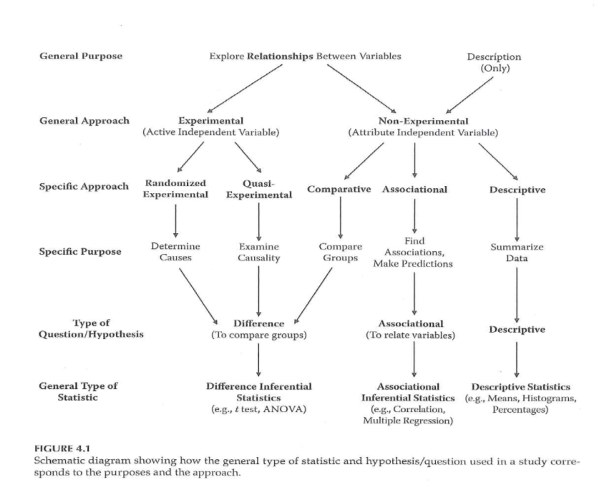
Schematic diagram of research
Schematic diagram of research
Notes:
I wanted to share this image with you early because it shows some of the dichotomies in research and how it influences what statistics you should use. I have never liked these sorts of diagrams because there are always so many exceptions to the rules they propose. But a diagram like this is still useful because it gives you a starting point for your work. Just don’t let yourself be constrained too much by this diagram. Consider it a recommendation rather than a requirement.
We’ll come back to this diagram later in this video.

Slide 10
Theoretical versus applied
Theoretical: no benefit to patients now.
Applied: potential for immediate benefit.
“Experience by itself teaches nothing… Without theory, experience has no meaning. Without theory, one has no questions to ask. Hence, without theory, there is no learning.”
W. Edwards Deming, in The New Economics for Industry, Government, Education.
Notes:
The distinction between theoretical and applied research is in when you expect to see something of value to your patients. Theoretical research has no immediate benefit to your patients, and could potentially never offer direct benefits to your patients.
There’s a tendency of some applied researchers to sneer at theoretical research. But this is terribly wrong as this quote from W. Edwards Deming explains. Theory is what allows us to make sense of our observations of the world.
Without a theoretical framework to support it, applied research is impossible. The other value of theory is that it allows you to generalize to new settings where observations have never been made before. So I’m a big fan of theory, myself.

Slide 11
Laboratory versus field.
Laboratory: controlled setting
Unnatural.
Control extraneous variables.
Field setting: in the clinic
Ecologic validity: “the methods, materials and setting of the study must approximate the real-world that is being examined.”
Source: Wikipedia.
Notes:
The second dichotomy is laboratory versus field research. Laboratory research is done in a controlled setting and has a greater level of control. The big criticism of laboratory studies is that they are “unnatural” and do not reflect how clinical care is actually provided. In fairness, almost all research has an artificiality associated with it. It’s just that the laboratory is even more artificial than field research.
Field settings provide what the authors describe as “ecologic validity.” This is a term I’d not heard before but the definition is quite simple. The Wikipedia definition is as good as any.

Slide 12
Participant report versus researcher observation
Participant report.
Either written or oral.
Only practical approach for pain, quality of life.
Also known as Patient Reported Outcomes (PRO).
Researcher observation.
Also includes instruments like a heart rate monitor.
Perceived as more objective.
Notes:
Another dichotomy in research involves who is providing the data for the research study. If the patient is providing the data (either through an interview or through their writing), you get something “straight from the horse’s mouth.” There’s always the concern that patients might say things to please the researcher or hide things that they might be embarrassed about. Certain things like pain and quality of life can be measured in no other way. Note that a lot of the resources for patient report appears under the acronym PRO (Patient Reported Outcome). Two good PRO references are a chapter in the NIH Collaboratory Living Textbook of Pragmatic Clinical Trials and a nice 2011 overview article in Perspectives in Clinical Research. See the readings slide for more details.
In contrast to a patient report, the physician or other care giver could provide the data. The data could also come from a machine like a blood pressure cuff or a heart rate monitor. Researcher observation is perceived by many to be more objective, but I disagree.

Slide 13
Schematic diagram of research
Schematic diagram of research
Notes:
Here’s that diagram again.

Slide 14
Assignment
Complete and send in Syllabus Quiz. Quiz must be submitted by midnight, to be eligible to receive full credit..
Prepare for next week’s session.
Notes:
This is your homework assignment for this week.

Slide 15
Discussion questions
Please submit your posts by and comment on at least one other post by the following Wednesday.
Briefly describe your background and explain why are you interested in this course?
Find a research paper that is relevant to your work or area of study. This must be a paper with full free text available. Post the abstract of this article and a link to the full text. Review the dichotomies discussed in Chapter 1 and classify the paper into one of the two levels in each dichotomy, or classify it as a mixture of both levels of the dichotomies. If you are unsure about any classification, be honest about your uncertainty.
Review at least one paper posted by another student and comment on their classifications.

Slide 16
Title Slide

Slide 17
A little background, intro type of material. This reflects chapter 1 and some other material.

Slide 18
Clinical Research Introduction

Slide 19
This talk represents material from Chapter 1 of
What do we mean when we say clinical research. The government has a definition of research: the systematic collection of data that develops or contributes to generalizable knowledge.
It is a structured process.
What is clinical research Structured process Investigate facts & theories, explore connections Examine clinical conditions and outcomes How is clinical research used? Drug development Evaluation of best practices Health care quality assessment Public policy

Slide 20
New slide
Clinical conditions, outcomes, etc. Things that have an impact on people’s health. Evidence Based Practice in healthcare is a result of research. We’re not relying just on clinical
Conscientous use of evidence. Allows you to develop ability to make decisions. Evidence to be current, objective (free from individual biases), verifiable, relevant, applicable.

Slide 21
What is clinical research?

Slide 22
There are dichotomies.
Theoretical versus applied. Theoretical research might be done to accumulate knowledge without a concern of how it might be applied today.
Laboratory versus field. Lab studies are held in a controlled setting. You control the environment and you can set the conditions of the research. A field setting is a real world setting. It could be a doctor’s office. It reflects the conditions under which
Participant report versus researcher observation. The observation could be lab results.
Quantitative versus qualitative. This is a crude dichotomy. Positivist versus constructivist. Positivist is a specific plan, constructivist uses less structure. Responding and reacting to what is discovered during the research.
Objective versus subjective. Objective are things that are easily classified. Subjective could be reported differently by different people.
Statistical versus descriptive. Do you have data that you can run statistical tests on?
Despite these dichotomies, most research is mixed methods, where different kinds of techniques are combined.

Slide 23
How is clinical research used?

Slide 24
Dichotomies describing research

Slide 25
Mixed methods

Slide 26
Schematic diagram

Slide 27
This diagram is a useful outline of the research process. It starts with the idea of exploring relationships versus gathering and describing information. The latter is used when there is novelty.
There is a split between experimental and non-experimental. The former involves manipulation of an active independent variable. The latter uses an attribute independent variable. You do not have control over this independent variable.
In experimental studies, there are randomized experimental versus quasi experimental designs. The latter, you still have an active independent variable, but you do not randomize this variable.
In the non-experimental study, you are comparing two or more groups. You could be comparing people with the disease to people without the disease.
The purpose of randomized and quasi experimental design, you are trying to determine causality. In a quasi experimental design, the strongest you can say is that you are examining causality. In associational studies, you see to what extent variables correlate with one another.
The purpose of the study determines the type of statistic you use. For randomized, quasi-experimental, and comparative study, you are looking at difference inferential statistics like ANOVA or t-tests. In associational studies, you will use correlation and regression models. A descriptive study uses
As before, there is often a mix among these “paths”.

Slide 28
The research process

Slide 29
What is it that is not already known. Where is there a gap in knowledge. There is a distinction between a research question and a research hypothesis.
How am I going to collect the data that addresses your research question.
The most important step in this process is communicating your results.

Slide 30
Diagram of the research process

Slide 31
This figure is a model of the research process. Identify the problem and research what is already known. Figure out what kind of information you need to collect. What type of sample do you need to collect.
Your interpretation will lead to asking a new question. What you have done becomes part of the literature base that needs to be done.

Slide 32
The role of theory in research

Slide 33
You might not think a lot about research. But it has a really important role. What a theory does is it gives you an idea of structure, provides a context where you place your results, helps explain what goes on and why it goes on, it helps you predict the results of the research, and can help you develop new knowledge (if this theory is true, I should be able to find this information). It can provide a basis of support of why your research is justified.
Theory and models both represent a way of describing an important issue that we need a more complete knowledge of. The data can lead to rejection of a theory, support of the theory, or an adaptation of the theory.

Slide 34
Characteristics of a theory

Slide 35
The structure of a theory

Slide 36
The process of theory development can be inductive versus deductive. Deductive is a downward process where you are using a broad theory to develop specific results. Inductive is an upward process where specific results are combined to develop a broad theory, an understanding, or a conceptual framework.
In a new field where there is not yet a lot of understanding, much of the research is inductive. The process is very fluid. Analysis allows for concepts and themes to emerge. You are looking for patterns.
A deductive process involves testing an established theory or framework in a specific setting. Test or make predictions of some new aspect of this broad theory.

Slide 37
A model of scientific thought

Slide 38
Assignment

Slide 39
Review the syllabus. There is a syllabus quiz. Read Chapter 1. There are some exemplar articles in the book, but we have some articles that may be a bit more relevant.
The next reading assignment will be the first one where you develop your assessment items in advance of the class.

Slide 40
Activity/discussion

Slide 41
Introductions. Provide a brief description of your background and why you are taking this class. Tell us how you expect to use the information in this class and how this fits into your career plans.

