Slide 1
Video 02 - Planning and ethics
Steve Simon

Slide 2
Learning objectives
To describe the variety of research that can be conducted while doing clinical research.
To describe what is needed in order to identify and define a research question that could be the basis for a research project.
To learn what is expected in terms of professional ethics and ethical research with humans.
Notes:
Welcome back. Here’s what we plan to cover in this video.

Slide 3
Required reading
Chapters 2, 3, 14
Canvas - Chen article; Price article; Lidz article; Simon article

Slide 4
Optional reading
Rebecca Skloot. The Immortal Life of Henrietta Lacks
Willyard. “Should you blow the whistle?” (Week 2 folder)
Notes:
If you haven’t done these readings yet, please do so before continuing with this video.

Slide 5
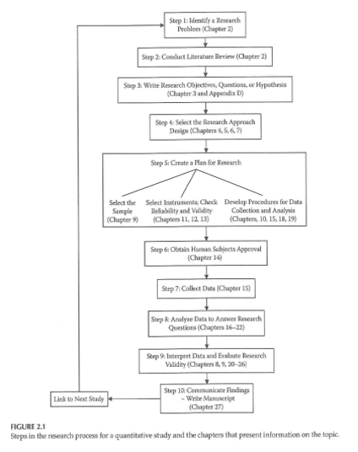
Planning a Research Project
Notes:
This figure from your book provides a nice overview of the research process. The first two steps, identifying a research problem and conducting a literature review are steps we will discuss today. The remaining steps are topics for later weeks. This table includes the chapters associated with each step.
Figure 2.1 from Gliner 2017. This image is included under the fair use provisions of copyright law.

Slide 6
Planning a Research Project
Step 1 - Identify a research problem
What is a research problem?
Sources of research problems
Existing research literature
Theory
Personal experience
Clinical observation

Slide 7
Planning a Research Project
Characteristics of a good research problem?
Broad vs Narrow
Widespread vs Limited interest
Well-researched vs Unknown territory

Slide 8
Planning a Research Project
Considerations in Choosing a Topic
Interest and enthusiasm
Time
Cost
Scope of the problem
Contribution to the profession
Support and expertise
Access issues/human subjects
Degree of control
Design considerations
Values and comfort level of the researcher
Cottrell & McKenzie. Health Promotion & Education Research Methods . 2005.

Slide 9
Planning a Research Project
What should NOT drive picking a research question
A specific research methodology
A specific funding opportunity
A publication-focused motivation

Slide 10
Planning a Research Project
Importance and feasibility of the research question
?So What? test
Is the question answerable?
Is it feasible?

Slide 11
Planning a Research Project
Characteristics of a good research project
FINER
Feasible
Interesting
Novel
Ethical
Relevant
Hulley, Cummings, Browner, Grady, Hearst, & Newman. Designing Clinical Research . 2001.

Slide 12
Planning a Research Project
Hulley, Cummings, Browner, Grady, Hearst, & Newman. Designing Clinical Research . 2001.

Slide 13
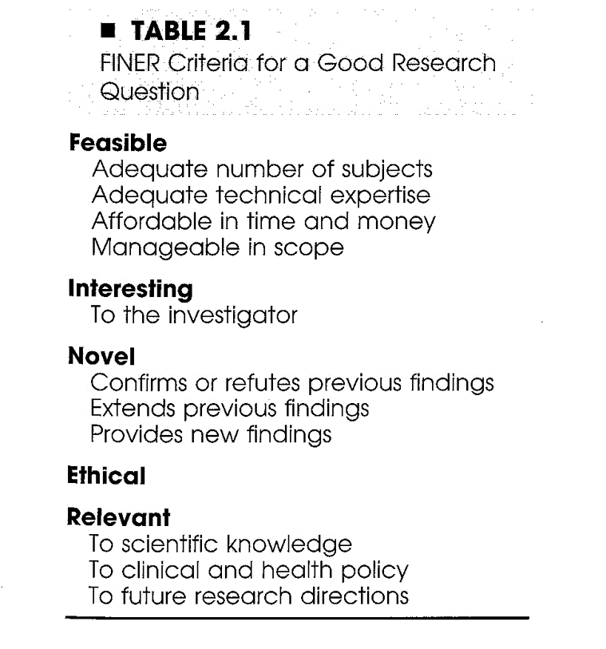

Slide 14
Planning a Research Project
Step 2 ? Conduct literature review
Purposes of literature review
What a literature review is NOT ?
What a literature review is ?
Sources to be used in literature review

Slide 15
Planning a Research Project
Reviewing the literature
What is known
What questions remain
Evaluating research reports
Journal quality
What is the study about?
Are the results of the study valid?
Are the results meaningful?
What does it all mean and how does it contribute to what you want to do?

Slide 16
Research Project ? Key Concepts
Variables
Independent variables
Active or Manipulated
Attribute or Measured
Dependent variables
Extraneous variables

Slide 17
Research Project ? Key Concepts
Research Hypotheses vs Research Questions
Difference
Associational
Descriptive
Analyses associated with each type of RH/RQ

Slide 18
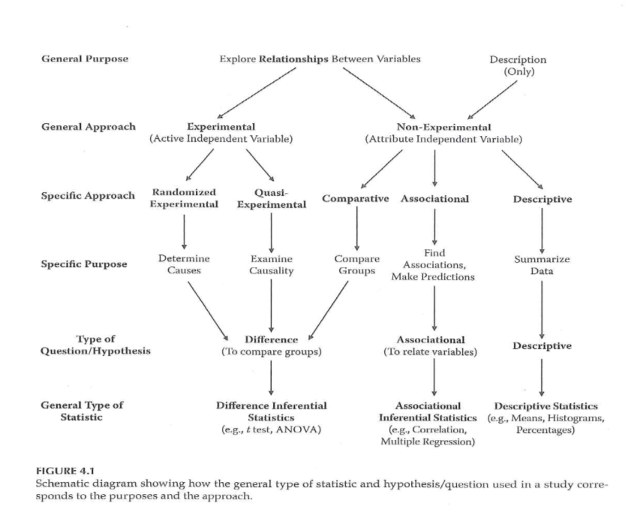
Clinical Research Introduction

Slide 19
Research Ethics
Basic sources of research ethics
Professional codes
Government regulations
Institutional policies
Personal convictions and responsibility
Mentors

Slide 20
Research Ethics
Integrity of the researcher
?The buck stops here?
Protection of human rights in clinical research
Guiding Principles (Belmont Report)
Autonomy of each individual
Beneficence
Justice
Use of control groups

Slide 21
Research Ethics
Central issues in research ethics
Informed consent
Privacy and confidentiality
Anonymity
Deception
Risk of harm
Exploitation
Vulnerable populations

Slide 22
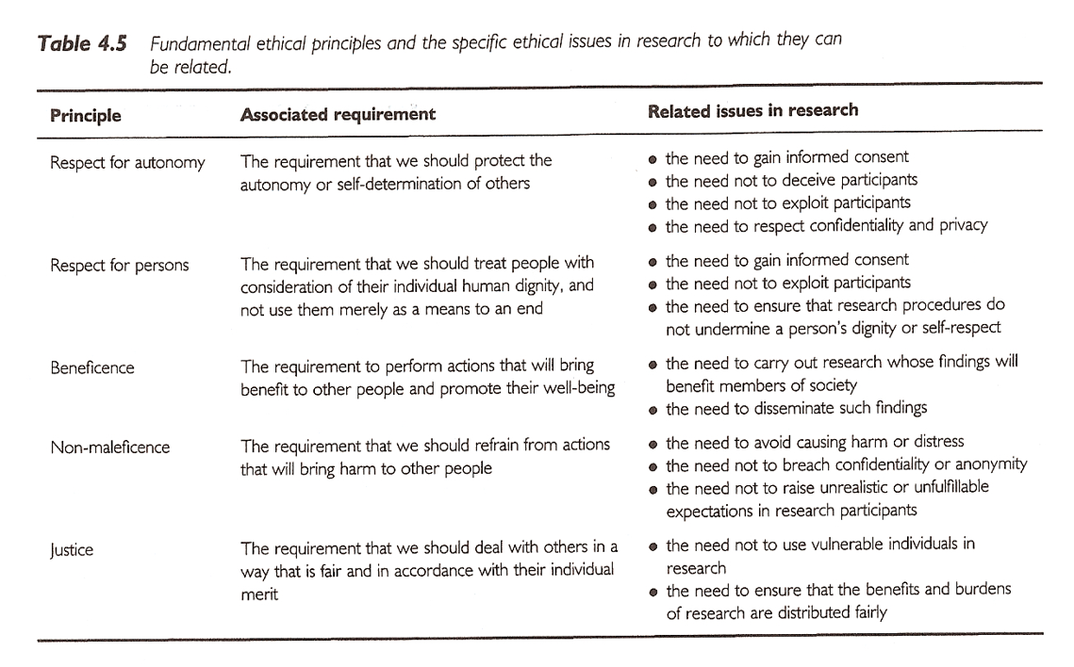
Research Ethics
Notes:
Sim & Wright. Research in Health Care . 2000.

Slide 23
Research Ethics
Institutional Review Board
Purpose
Composition
Responsibilities
Elements of Informed Consent
Information elements
Consent elements
Authorization

Slide 24
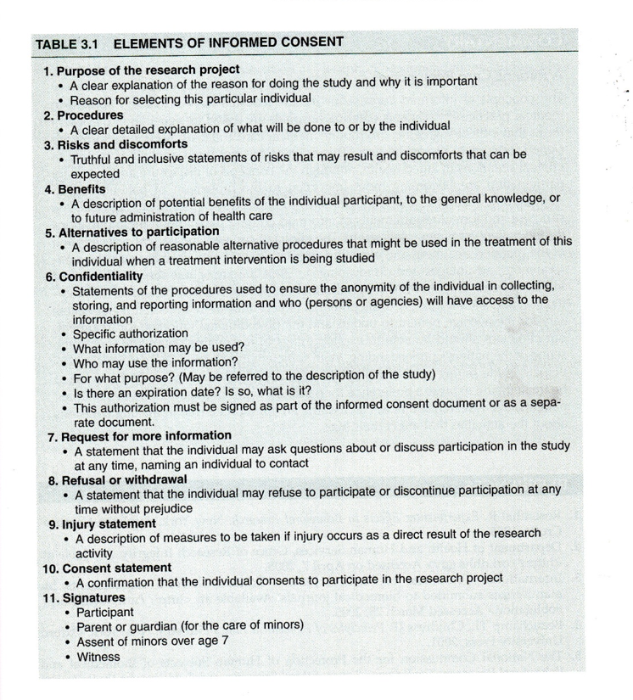
Research Ethics
Notes:
Portney & Watkins, 2009.

Slide 25
Research Ethics
Other research ethics issues
Scientific misconduct
Conflict of interest
Reporting research results
Plagiarism
Duplication
Fragmentation
Authorship
Use of animals in research

Slide 26
Research Ethics
NIH definition (NIH Catalyst, 2001)
Scientific/research misconduct is ?
Fabrication ? inventing data or results
Falsification ? manipulating research materials, equipment, or processes, or changing or omitting data or results
Plagiarism ? appropriation of ideas, processes, results, or words of another person without giving appropriate credit

Slide 27
Research Ethics
Training ?
CITI training ? used by multiple institutions
IRBs ?
UMKC IRB
IRBs at other institutions (CMH, St. Luke?s ?)
Research committees ?

Slide 28
Assignment #1
Complete the UMKC IRB training.
Get to this from the UMKC Research Support page
http://www.umkc.edu/ors/irb/training.cfm
http://www.citiprogram.org/
Select ?Group 1 ? Biomedical Investigator?
Send a copy of the Certificate of Completion to Dr. Gerkovich ( gerkovichm@umkc.edu ); this copy will be kept by me so make sure to also print out a copy for your own file.
http://www.umkc.edu/ors/irb/training.cfm http://www.citiprogram.org/ gerkovichm@umkc.edu

Slide 29
Assignment
Complete the UMKC IRB training. Get to this from the UMKC Research Support page, or directly by registering on the CITI Program web site. Select “Group 1 - Biomedical Investigator”. Send a copy of the Certificate of Completion to Dr. Simon (simons@umkc.edu); this copy will be kept by the instructor so make sure to also print out a copy for your own file. Certificate must be submitted by midnight, Wednesday 1/31/2018 to be eligible to receive full credit.
Prepare for next week’s session

Slide 30
Discussion questions
Please submit your posts by Friday, February 01, 2019 and comment on at least one other post by the following Wednesday.
How will you go about deciding on a research project?
How will you decide whether you will be proposing research questions or hypotheses?
What will you need to take into account in order to make sure you are conducting research in an ethical and responsible manner?

