Slide 1
Video 6 - Non-experimental studies
Steve Simon

Slide 2
Learning objectives
To distinguish different types of quantitative non-experimental approaches
To discuss strengths and weaknesses of qualitative research
Notes:
Here are the objectives for this week.
There will be a separate recording on single subject designs for those who are curious about it.

Slide 3
Required reading
Chapters 7
Canvas â€“ Berkley-Patton et al., article
Canvas â€“ Eton et al., article.

Slide 4
Optional reading
Wolfe et al. “Effects of HIV-related stigma among an early sample of patients receiving antiretroviral therapy in Botswana”
Rowan et al. “Engagement-in-care during the first 5 years after HIV diagnosis: Data from a cohort of newly HIV-diagnosed individuals in a large US city”
DiLorenzo et al. “Comparison of older and younger individuals with multiple sclerosis: A preliminary investigation”
Haberer et al. “Challenges in using mobile phones for collection of antiretroviral therapy adherence data in a resource-limited setting”
Notes:
This is what you should have read already. If you haven’t done the reading yet, pause this video and read this material. You’ll get more out of the video if you do so.

Slide 5
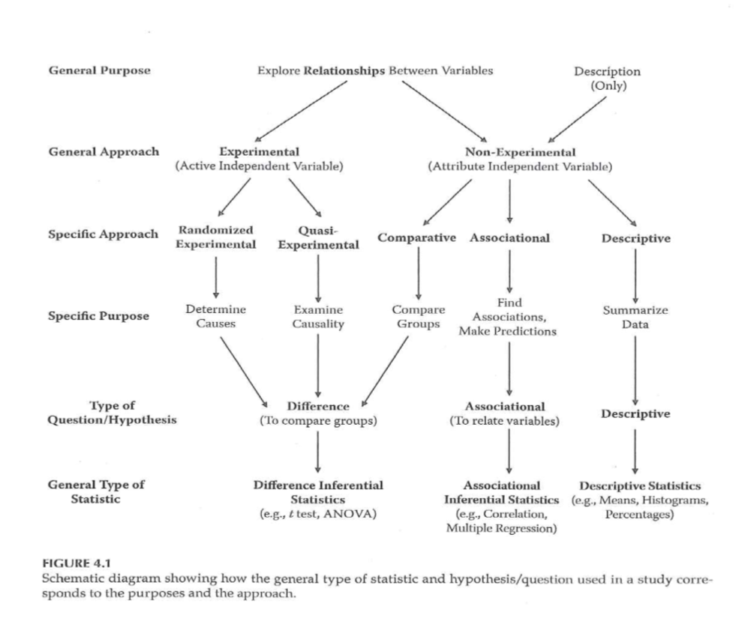
Research Approaches
Notes:
Going back to the figure that we have used. Now we will talk about comparative, associational, and descriptive studies.
Now you are talking about an attribute independent variable, one that you cannot manipulate or control. You can talk about causality easily for a randomized design but these three designs do not allow you to say anything about causality.

Slide 6
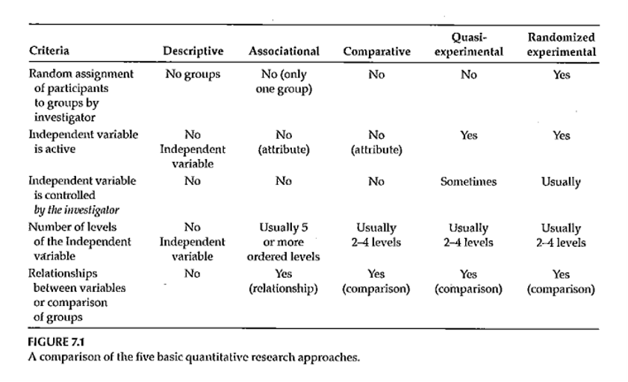
Nonexperimental Designs
Notes:
Figure 7.1 identifies the five types of designs (descriptive, associational, comparative, quasi-experimental, and randomized experimental).
These three non-experimental approaches differ the levels of the independent variable. A large number of ordered levels (equivalent to a continuous independent variable) falls in the associational research type.
DiLorenzo compared older patients to younger patients.
Haberer article includes both quantitative and qualitative research. Interactive voice response (IVR) versus short message service (SMS) as a way of collecting adherence. It is an HIV study where adherence is very important. Mobile technology has a lot of penetration in places like Africa. Parents that could read were randomized, but parents who could not read were assigned to IVR.
They did qualitative interviews with all participants. The first theme was poor understanding of the responses. A second theme was challenges in training. The participants did not feel able to speak up and say that they don’t understand.

Slide 7
Research Approaches
Comparative research approach
Purpose?
How is this approach similar to randomized experimental and quasi-experimental?
C an this approach tell you anything about cause and effect?
Notes:
Look at the very end of the introduction to get at the purpose of the research. Review the participant.
Random selection is a better representation of the population. (External validity?)
In any prospective study, you are only getting information for those people who are willing to be part of the study.

Slide 8
Nonexperimental Designs
Quantitative – Comparative
Comparing groups – 2 or more
Main IV has only a few levels
Statistical analysis –
T ypically t-test or analysis of variance
Example – DiLorenzo et al., 2004 article
Usually – research that is reported will contain elements of more than one design
Example – Haberer et al., 2010 article
Notes:
Often your research has the elements of more than one design.

Slide 9
Research Approaches
Associational research approach
Purpose?
Characteristics of the variables measured?
Can this approach tell you anything about cause and effect?
Notes:
The compliance study is a good example of when you often end up with mixed methods to get more out of
The purpose is to find associations among variables. The variables collected are typically continuous. This type of approach does not tell you about cause and effect directly. The association might allow you to predict. Continuous really means many levels. The analyses are typically correlation based or multiple regression.
An article by Rowan illustrates this well. Clinical record review and state HIV data. Variations in the engagement in care continuum. Impact of outmigration and death. When you don’t have data is it because they are no longer engaged in care, or maybe they have moved on to a different provider. Has care improved over the last five years?
What variables are associated with getting treatment to reduce viral loads. This paper also addresses how to handle people who you do not have complete follow-up on.
Example of smoking cessation usually assumes that anyone who disappears is categorized as a treatment failure.

Slide 10
Nonexperimental Designs
Quantitative – Associational
IV is often continuous / has many levels of an ordered variable (typically 5 or more )
Looking at the association between the IV(s) and the DV
Statistical analysis –
Correlation-based
Multiple regression when there are multiple Ivs
Example – Rowan et al. 2014 article

Slide 11
Research Approaches
Descriptive research approach
Purpose?
When usually used?
Characteristics of the variables measured?
Can this approach tell you anything about cause and effect?
Notes:
Usually used for an exploratory. It could be characterization of surveys or polls. It might be performance reports.

Slide 12
Nonexperimental Designs
Quantitative – Descriptive
Descriptive statistics
Averages
Percentages
Histogram
Frequency distribution
Some publication of strictly descriptive studies
More often – descriptive component of a study
Describe the sample
Example – Wolfe et al, 2006 study
Notes:
The Wolfe study is a good example. This study is in Botswana. Effects of stigma and its effect on health related behaviors. Structured questions followed by open ended questions. They are reporting percentages.

Slide 13
Nonexperimental Designs
Qualitative – 5 main approaches
Phenomenological
Grounded theory
Ethnographic
Case study
Narrative
Notes:
Phenomenological: try to understand the meaning that people place on events in their life. Try to understand from the perspective of the individual.
Grounded theory: the goal is to generate theory from data collection: process, actions, interactions. The inferences that you take away need to be grounded in the data you collect. Try to avoid any prior expectations. Some people even recommend limiting the literature review because it might box you in.
You won’t know your sample size until you start collecting your data. As you are coding this information, you will be developing categories. These are provisional, there may be revisions as you go along and so the coding process is dynamic and iterative. As coding develops, you may go back to earlier data. Seek disconfirming examples. This is a check of your validity. You can also have audits by an independent reviewer. You are trying to reflect the reality of human experience.
Ethnographic. Group of people who share the same culture.
Case study. A single case or group of related cases.
Narrative. Develop stories.
These approaches are all inductive. You are trying to develop a framework of understanding. Don’t go in with a heavy set of expectations.

Slide 14
Nonexperimental Designs
Qualitative – Phenomenological
A llow researcher to “… understand the meaning participants place onto “… events, phenomenon, and activities.”
Goal – “… explain the essence of experiences lived by the participants.”
Method – usually interviews

Slide 15
Nonexperimental Designs
Qualitative – Grounded Theory
Goal – “… generate theory from data collected from participants.”
“… focus on the process, actions, and interactions experienced by … participants.”
Method – usually interviews

Slide 16
Nonexperimental Designs
Grounded theory (Glaser & Strauss, 1967)
Inferences firmly “ grounded ” in the data
Prior theoretical expectations avoided
Sampling proceeds parallel to data collection & analysis
Categories regarded as provisional, subject to revision
Research maintains skepticism, seeks disconfirming examples
Ultimate purpose – construct coherent theory from the data

Slide 17
Nonexperimental Designs
Qualitative – Ethnographic
Goal - “… describe a group of individuals who share the same culture.”
Qualitative – Case-study
Goal – “…develop deep understanding of a case or cases.”
Qualitative – Narrative
Goal – “… identify and report stories from the participants.”

Slide 18
Analysis of Qualitative Data
Inductive process –
Start with the specific (raw data / transcript)
Develop a theoretical framework from the data
Conceptual categories emerge from the data

Slide 19
Analysis of Qualitative Data
Start the study with a research question
This may provide a potential starting point for analyzing text
If you do this, DO NOT let it prevent you from seeing what is in the text
Steps
From raw data <U+F0E8> theory building
“ Iterative ” process
e.g. , as you are developing categories, check them back against the raw data – do they continue to reflect the original data?
Notes:
Keep alert and look for things that come out in the material that you were not anticipating. As your categories, go back and compare them against the raw data. Make sure that you allow the data to guide you. Often coding from transcripts. But it is also good to have access to the original recordings. Sometimes there is a doubt about what some was saying (joking or sarcasm). Look for tone of voice and non-verbal cues.
Content analysis is a generic term, but you can look at things like ad messages in magazines that appeal to young adults.
Thematic analysis is looking for patterns.

Slide 20
Analysis of Qualitative Data
Analysis process –
Given research question, may have some idea of a general conceptual structure; serve only as a starting point
Usually work from transcripts
If possible, refer back to audio recordings when needed
Qualitative form of analysis
Content analysis – analysis of the content of communication
Thematic analysis – identifying patterns or themes in the data
Notes:
Break up the text into “bits” that represent specific thoughts. Open coding lots of themes. Axial coding looks at the relationships between themes, builds a superstructure of ideas.

Slide 21
Analysis of Qualitative Data
Category Formation – assign sections (data bits) to analytical categories/themes “coding”
Summarizing the data by identifying similarities and differences / commonalities and contrasts
Categories:
More manageable units of information
“open coding”
Descriptive – Concrete
Interpretive – Abstract
Relational
Cross-reference categories back to text
Makes it easier to revise coding as needed
Notes:
Software allows you to go back and forth between themes and the original text. Cross-referencing is important. Find examples easily. It helps provide validity checks. Does someone agree with your categorization.
Categories need to be faithful to the data. This is internal validity. But you need to place this in a broader understanding.
You need to be careful about trying to quantify this too much. Keep in mind that just because someone talks about something a lot does not mean that this is the most important thing to them. The most important thing might be something that people are uncomfortable talking about.

Slide 22
Analysis of Qualitative Data
Category Formation
Faithful to the data – “internal” aspect
Meaningful to other categories – “external” aspect
Balance
Generality vs Specificity
Inclusivity vs Exclusivity
Number of times idea mentioned does NOT necessarily reflect importance

Slide 23
Analysis of Qualitative Data
Labeling / Revising Categories
Member-generated – “ first-order ” account
Observer-generated – “ second-order ” account
Labels are provisional; may be revised
Iteration – move back and forth between raw data and labeled categories
“ Zoom in ” vs “ Wide angle ” view of the coding
Revision – may end up dividing or combining categories
May establish criteria for category coding
Notes:
Phrasing of the person versus observations generated by the researcher. Labels should be considered as provisional as you work with more complete information. It is an iterative process. Go back to original data. You’re looking at the specific of what’s been told versus a broader understanding.
Establishing the criteria may depend on how many people are doing the coding. If you don’t have a pre-existing structure, the coding may evolve and may involve 100% review (both raters review everything and resolve discrepancy). Then a third person does an audit.

Slide 24
Analysis of Qualitative Data
Saturation – the point at which you are not gaining any new insight, no new categories being identified, no new relationships being defined
Don’t need any additional analysis
Don’t need any additional data collection (if collection & analysis done in parallel)
Determinant – nature of the information being collection – NOT amount of information
Keeping notes – of the coding/analysis process
Help identify categories/relationships
Help if “stuck”
Document analysis process
Notes:
Saturation is a way to assess your sample size. Have you gotten a representative amount of data.
Really important to keep notes of the coding and analysis process, so you can check your work. Allows you to do qualirty checks on the process.

Slide 25
Analysis of Qualitative Data
Role of Judgment
Balancing act –
Level of creativity by coder to identify categories/relationships
Must reflect the informants thoughts
Audit of the coding by an independent person can check for the match between the coding and the source information
Low-inference descriptors
Look for “negative cases”
Notes:
You develop a framework, but that framework must always represent what the subjects have said.
Low inference descriptors are those things involving just the basic words or text.

Slide 26
Analysis of Qualitative Data
Quantifying Information
Pros & Cons
When quantifying might be of value
Simple frequency of occurrence does NOT necessarily reflect importance
Notes:
This was mentioned earlier.

Slide 27
Eton Article
Long-term Goal – “… build a general, multi-domain, patient-reported measure of burden of treatment with wide applicability across diseases and treatments”
Semi-structured qualitative interviews
“identify issues … illustrative of burden of treatment …”
“inform derivation of a general, patient-reported measure of burden of treatment flexible enough for application across any disease or treatment regimen.”
Notes:
The Eton article has a great description of the coding process. The long term goal develop a burden of treatment with wide applicability across a wide range of treatments.
Identify issues associated with burden of treatment. Derivation of patient report that is flexible enough to apply across any disease.

Slide 28
Eton Article
Development of interview
Content analysis process
Multiple coders
Identify key themes and subthemes
Discussion and consensus to develop coding scheme
Repeated check and update of coding process
Thematic content saturation
Resulting major themes and subthemes
Notes:
Checked for a logical flow from broad to specific. Framework from first five interviews. Reviewed after ten more interviews. Saturation reached after 25 interviews, but they had 7 more that they included anyway.
Described patient population.
Figure 1 shows the themes that emerged.
The third theme was factors that exacebate burdens had subthemes.

Slide 29
Berkley-Patton Article
Goal – Use qualitative method to explore components of the Information-Motivation-Behavioral Skills model
Information + Motivation Behavioral Skills Adherence
Focus Groups
Content analysis – “… identify themes on expectations and information, personal and social motivation, and behavioral skills related to ART adherence.”
Notes:
Another example on Canvas is an article by Jannette Berkley-Patton et al. Done using focus groups and content analysis.
Information and expectations with subthemes. Specific text included as examples of themes.

Slide 30
Berkley-Patton Article
Information and expectations
Motivation for ART adherence
Behavioral skills related to ART adherence
Themes for each of these areas?
Value obtained from this kind of study?

Slide 31
Nonexperimental - CBPR / PAR
Community Based Participatory Research (CBPR)
Participatory Action Research (PAR)
Takes place outside the normal research environment
Designed to meet the needs of the community in which the research is conducted
Value for the participants that goes beyond the value of the collected information

Slide 32
Nonexperimental - CBPR / PAR
Existing research data or data collected from other locations …
May not reflect conditions (e.g., disease incidence) in the community of interest
May not reflect underlying risk factors
May not indicate how an intervention will work in a specific community
Notes:
Community Based Participatory Research.
This is increasingly used and make a big contribution. Extent to which the population that you are interested in are very much a part of the process of designing the research. It takes place outside the research process. It hurts internal validity but it is far more relevant, improving external validity. The value goes way beyond. Develop community capacity, improves sustainability, builds skills. More emphasis on these models using PCORI. Most of this work involves the community from the beginning.

Slide 33
Nonexperimental - CBPR / PAR
CBPR/PAR research may be more generalizable than research conducted in a clinical setting
Sample characteristics
Practice-Based Research Networks (PBRNs)
Physicians from community settings work together to study research questions of mutual interest

Slide 34
Nonexperimental - CBPR / PAR
How the research context influences the research process …
What issues are routinely encountered?
To whom is the research important?
Ripple effect of the research process
Level of engagement of the target population
Notes:
Other research may not reflect what the community is interested in. Research in a carefully constrained environment may not be sustainable.
Collaboration among practitioners where they can combine efforts. Also valuable for networks of pharmacists.
Issues important to the population and community. There can be a ripple effect. When community members get engaged, they can learn skills that can help in a different context, and inform them about resources that they can use in other areas. The community gains from the whole process.

Slide 35
Nonexperimental - CBPR / PAR
Conducting CBPR/PAR
Start simple
Think of local comparative advantage
Network
Collaborate
Top-down
Bottom-up
Notes:
Simple. What is important and what is needed. Add value to the community. Identify people who can be resources. This is very much a collaboration. It can be top-down, where you make yourself available to the community. A bottom-up is where you offer your expertise to help them develop a project.

Slide 36
Nonexperimental - CBPR / PAR
CBPR/PAR – especially appropriate for research involving health disparities
Multiple individual and community-level determinants
Mechanism to translate basic health psychology conceptual models into interventions
Notes:
There are some many community level issues associated with health disparities.

Slide 37
Nonexperimental - CBPR / PAR
Contributions by researchers
Know existing research evidence
Can provide support/suggestions
Organization
Information-gathering
Action
Help community get in touch with resources
Notes:
You biring in your knowledge of existing resources, and provide support and suggestions. Advice about resources that they can tap.

Slide 38
Nonexperimental - CBPR / PAR
Contributions by community
Unique insight into local context
Information concerning local needs and priorities
Provide “real world” feedback/reaction
Provide guidance for adapting programs/interventions to the community
Community involvement community capacity sustainability
Notes:
They understand needs and real world feedback. Does this fit in to individual people’s needs.

Slide 39
Secondary Analysis
Definition – using existing database/dataset to re-examine variables and answer questions
Research question different from what was originally addressed
Differences could be …
Variables that are analyzed
Relationships that are explored
Different subsets of cases
Different analysis techniques
Notes:
Let’s have a common definition. You are re-purposing the data.
Some secondary datasets are available strictly for this purpose. These are often national databases collected user taxpayer money and made available to anyone who wants to use them.
Sometimes we collect more data than what we strictly need for our purposes.
Example: One of the interventions used motivational interviewing. Autonomous regulation scale. Some additional information came out that that there was a third subscale after the data was collected. So Mary was approached to see if her data would support this third subscale.
Identifying people who have common data sets that can be combined.
NIH supports secondary analysis of data. Example of RFA on secondary analysis. Publicly available data sets for aging related analysis" document.

Slide 40
Secondary Analysis
Could be done when able to combine different/compatible data sets
Advantages
Cost
Working with large dataset
Time efficiency
May be a good first step in a research area
Notes:
The data are already collected, so you don’t have to wait around.
Secondary analyses are great for exploratory studies. Initial analysis was changes in rate of adherence. Sixteen different adherence studies contributed by fourteen different groups.
The combination of disparate data sets is one of the hallmarks of big data (the “variety” V of the three V’s of big data).

Slide 41
Secondary Analysis
Disadvantages
Lack of control over data collection process
Quality control
Specifics of variables and wording
Missing data or data entry errors
Consider possible sources of error
Make judgment on possible impact on research question
What can be done to address problems
Notes:
One of the big ones is the lack of control over the data collection process. You can’t change how the data was collected without access to a time machine. You lose control over the variables that were collected, the wording of the questionnaires, the quality checks.
Data quality issues can be an issue at times. Why conduct rigorous quality checks now for data that will only be used by someone else in the future?
Example of depression: some of the data sources might use CESD, BDI, SCID.

Slide 42
Secondary Analysis
Two types of secondary data sets
Individual
Aggregate
Notes:
Data sets that have individual level records: there is separate records an indvidual unit (usually a person, but it could be an event like an emergency department visit).

Slide 43
Secondary Analysis
Individual – separate information available for each subject/unit
Can use to measure associations between characteristics among individuals/units
Source
Previous research study
Large regional and national data sets
Surveillance, Epidemiology, and End Results (SEER)
National Death Index
Notes:
The book gives several resources, and there is a document on Canvas that lists some of the secondary data sets that DBHI has worked with.

Slide 44
Secondary Analysis
Aggregate – information available only for groups of subjects
Can study associations among groups by comparing them on risk factors or variables of interest (ecologic studies)
Advantage – availability of data
Notes:
Aggregated data avoids some privacy concerns.

Slide 45
Secondary Analysis
Aggregate (cont ’ d)
Disadvantage –
Associations are especially susceptible to confounding
Associations seen in aggregate don’t always hold at the individual level (ecologic fallacy)
Most appropriately used –
Test the plausibility of a new hypothesis, or
Generate new hypotheses
Notes:
An example of the ecologic fallacy. Sales of cigarettes are greater in states that have higher suicide rates. You don’t know whether an individual who smokes is more likely to commit suicide.

Slide 46
Secondary Analysis
Chicken or the egg!
Identify existing database and determine what can be done with it – that you are interested in!
Get familiar with the data set – available variables
Consider possible new questions that can be addressed
Go to the literature
How has database been used previously?
What has already been answered?
Develop a theoretical framework for your research
Notes:
You can have a question and find what secondary data sets might help answer that question. Or you can explore a data set that you find interesting and see if there are interesting research questions that this data set might help with.
For the latter, do a literature search where others have used this data set and see what questions they were able to answer.

Slide 47
Secondary Analysis
Table 13.1
Steps in Finding Research Questions to Fit an Existing Database
Choose a database.
Become thoroughly familiar with the database. Make a flow sheet of all variables and how they were measured.
Identify pairs or groups of variables whose association may be of interest.
Review the literature and consult experts to determine if these research questions would be novel and important.
Formulate specific hypotheses and settle on the statistical methods.
Analyze the data.
[Hearst et al. Research using existing data … In Hulley et al. (2001). Designing Clinical Research 2nd edition.]

Slide 48
Secondary Analysis
Chicken or the egg!
Search for an existing database that will address the research question you are interested in
Start with the research question you are interested in
Have a list of variables that are relevant
Have an idea of what databases are available
Find out if there are special qualifications for working with the database

Slide 49
Secondary Analysis
Table 13.2
Steps in Finding Databases to Fit a Specified Research Question
Choose a research question and review the literature thoroughly.
List combinations of predictor and outcome variables whose relationship might help answer the research question.
Identify databases that might include the variables of interest.
Become familiar with each of these databases and consult with individuals who know them well.
Choose the best database(s) and gain access to the data.
Formulate specific hypotheses and settle on the statistical methods.
Analyze the data.
[Hearst et al. Research using existing data … In Hulley et al. (2001). Designing Clinical Research 2nd edition]
Notes:
Gaining access can mean different things. Some datasets, you can directly download (no cost). Others are free, but you have to prepare a research proposal and get approval before you can use that data. Others require a small payment. Some data sets require you to sign an agreement first.

Slide 50
Secondary Analysis
Sources – where to find out about them
Journal articles / conference presentations
Data libraries
U.S. government
Census Bureau
National Center for Health Statistics (NCHS)
Framingham Heart Study
Multiple Risk Factor Intervention Trial (MRFIT)
NIH Data Sharing Plan requirement
Notes:
There are lots of resources available in the genetics community that are not covered here.

Slide 51
Secondary Analysis
Sources – where to find out about them
Community-based data sets
Evaluate patterns of utilization and clinical outcomes of medical treatment
Examples
Administrative and clinical database
Registries
Useful for
Examining rare outcomes
Assessing real-world utilization and effectiveness of an intervention
Study effectiveness rather than efficacy
Importance of replication
Notes:
Truman is setting up a system, i2b2, that allows you to study research cohorts. Health Facts.
Kansas City Quality Improvement Consortium. Mid America Research Council.
Data from CMS, Department of Veteran Affairs.
Missouri Information for Community Assessment (MICA). Helps local health agencies and their partners.
Useful for assessing the magnitude of the problem.
[[Contrast national with community level data sets.]]

Slide 52
Ancillary Studies
Adds new measurements to an existing/ongoing study
Advantages
Similar to advantages of secondary analysis
Inexpensive & efficient
Can be added to any type of study
Disadvantages
Not as valuable as if measures were part of original study
Not a complete set of data
Have no control over what the other measures are
Need to get the buy-in of the primary investigators
Notes:
Find a study that is already collecting data and ask them to add some measures that you are interested in.
Example, there are many ways to collect data on adherence. Add some extra measures after the fact to explore interrelationships or to see if newer measures are more sensitive.

Slide 53
Ancillary Studies
Not unusual for additional measure to be added to longitudinal studies
How to get started
Identify ongoing studies of interest
Either predictor or outcome measures of interest
NIH RePORTER (Research Portfolio Online Reporting Tool)
ClinicalTrials.gov
Pharmaceutical companies
Contacting experts / researchers
Get cooperation of investigators
Notes:
NCCAM example.

Slide 54
Ancillary Studies
How to get started (cont ’ d)
Work out the logistics (measures, where to insert it, is there a cost associated with adding the measure?)
Get all appropriate approvals (e.g., IRB to document change in data that are being collected)
Work out what data from the main study you will have access to and how you will get the data you need
Discuss and agree on issues such as manuscript publication and authorship
Notes:
An ancillary study requires IRB approval. You need to discuss with the coordinators of the study that you are piggy baking on

Slide 55
Secondary Analysis
Examples of available secondary analysis data sets …
MEPS (Medical Expenditure Panel Survey)
YRBSS (Youth Risk Behavior Surveillance System)
NSQIP (National Surgical Quality Improvement Proram)
…
Notes:
MEPS and YRBSS are individual based. NSQIP are event based.
http://www.meps.ahrq.gov
MEPS is nationally representative maintained by the Agency for Health Care Research and Quality. MEPS is largely cross-sectional, but has panels that can address longitudinal questions.
The YRBSS focuses on six health risk behaviors among youths (unintentional injuries and violence, tobacco use, alcohol and other drug use, sexual behaviors. dietary behaviors, and physical activity).
Review the list of secondary datasets prepared by DBHI.

Slide 56
Assignment #4
Turn in the results of a literature search on the topic you are planning to focus on for your research proposal . This is NOT expected to be a literature review; it should provide evidence that you are finding literature that is relevant to your topic. This assignment serves as the start of your References section, using the reference/citation style you plan to use in your proposal.
Notes:
I don’t expect this to be your final literature review but it will help form the literature review. Looking for progress in finding relevant references. No need to turn in a reference section. Use a reference or citation style. Pick a style that is used in your field. Just be consistent. Show me evidence of the literature that is relevant.

Slide 57
Assignment
Turn in the results of a literature search on the topic you are planning to focus on for your research proposal. What you turn in should provide evidence of the literature you have found that is relevant to the topic youâ€™ve chosen for your research proposal. This assignment serves as a start for your References section.
Prepare for next weekâ€™s session

Slide 58
Discussion questions
What kind of research topics could be addressed using non-experimental designs?
What kind of research topics could be addressed using qualitative methods?
What are the ethical issues that need to be addressed when doing these types of studies?

Slide 59
Additional slides

