Slide 1
Video 9 - Validity and reliability
Steve Simon

Slide 2
Learning objectives
To discuss the importance of measurement reliability
To describe methods of assessing measurement reliability
To discuss the importance of measurement validity
To describe methods of assessing measurement validity

Slide 3
Required reading
Chapters 11, 12
Green et al. â€œDevelopment and evaluation of the Kansas City Cardiomyopathy Questionnaire: A new health status measure for heart failureâ€

Slide 4
Optional Resources
Radloff. â€œThe CES-D Scale: A self-report depression scale for research in the general populationâ€
L.G. Portney & M.P. Watkins. Chapter 5 â€œReliability of measurements;â€ Chapter 6 â€œValidity of measurements.â€ Foundations of Clinical Research: Applications to Practice, 3rd ed. Upper Saddle River, New Jersey: Pearson Prentice Hall.

Slide 5
Measurement
“Study quality also depends on the consistency (measurement reliability) and accuracy (measurement validity) of the specific instruments …”

Slide 6
Measurement Reliability
What is measurement reliability?
“… consistency of a series of measurements. ( Cronbach )
“… a property of scores and is not immutable across all conceivable uses of a given measure.” (Thompson)
Importance – without reliable measures, can’t have confidence in study results.

Slide 7
Measurement Reliability
Example – Want to determine change in some relevant measure after treatment/intervention.
Baseline measure
Treatment
Follow-up measure
C hange from baseline to follow-up –
Due to effect of treatment?
Due to random variation in the measure?

Slide 8
Measurement Reliability
Observe score
Lab value
Test result
Self-report measure
Classical test theory
Observed score = True score + Error
Change in value – due to change in true score or error?

Slide 9
Measurement Reliability
Goal – Use measure that
B est reflects the true score
As little “error” as possible
As “reliable” as possible
Measurement reliability –
Coefficient
Ratio – True score / Observed score

Slide 10
Measurement Reliability
How much confidence can we have that the measure we obtain reflects the true score?
Reliability of the measure
How variable is the measure
Standard error of measurement –
Allows you to “… establish a range of scores (i.e., confidence interval) within which should lie … true score.”

Slide 11
Measurement Reliability
Standard error of measurement –
SEM = SD * SqRt (1 – r)
SEM – Standard error of measurement
SD – standard deviation
r – correlation coefficient
r – indication of the relationship between 2 measures

Slide 12
Measurement Reliability
In order to know the range of true scores that are indicated by the observed score –
Need the SEM to compute a confidence interval around the observed score
Confidence interval –
U sually 95% CI (2 standard deviations)
To have 95% confidence that the range will include the true score

Slide 13
Measurement Reliability
Example – Intelligence test #1
SD = 15; r = .92
SEM = 4.24
Observed score = 110
95% CI <U+F0E8> SEM * 1.96 (z score for 2 SD)
95% CI <U+F0E8> Observed +/- SEM * 1.96
95% CI <U+F0E8> 101.68 – 118.32
Range of scores that includes the true score given 95% CI

Slide 14
Measurement Reliability
Example – Intelligence test #2
SD = 15; r = .65 (less reliable measure)
SEM = 8.87
Observed score = 110
95% CI <U+F0E8> SEM * 1.96 (z score for 2 SD)
95% CI <U+F0E8> Observed +/- SEM * 1.96
95% CI <U+F0E8> 92.61 – 127.61
Range of scores that includes the true score given 95% CI

Slide 15
Measurement Reliability
Correlation coefficient
For measurement reliability, general rules –
“reliable” .7 <U+F0E8> 1.0
More strict criteria
= .90 for measures used to make decisions about individuals
.80 acceptable for research
.70 - .80 somewhat lower than desirable
In practice
Measures used with reliability of .60 and higher

Slide 16
Measurement Reliability
Test-retest
Parallel forms
Internal consistency
Split-half
Kuder -Richardson 20
Cronbach’s alpha
Interrater
Percentage agreement methods
Intraclass correlation coefficients
Interrater

Slide 17
Measurement Reliability
Measurement reliability
Generally established when a measure is developed
For your study
Check past reliability of measure
If test-retest, is time period comparable?
Is sample comparable?
Report both established reliability AND reliability coefficient found in your study

Slide 18
Measurement Reliability
Test-retest
Parallel forms
Internal consistency
Split-half
Kuder -Richardson 20
Cronbach’s alpha
Interrater
Percentage agreement methods
Intraclass correlation coefficients
Interrater

Slide 19
Measurement Reliability
Test – retest reliability
Coefficient of stability ( Cronbach )
Test score will be stable if measured at different time points
Timing of testing interval is critical
Test-retest reliability – previously established
Concern if reliability is < .70

Slide 20
Measurement Reliability
Test-retest
Parallel forms
Internal consistency
Split-half
Kuder -Richardson 20
Cronbach’s alpha
Interrater
Percentage agreement methods
Intraclass correlation coefficients
Interrater

Slide 21
Measurement Reliability
Parallel forms reliability
Addresses concerns about “testing” or “carryover” effects
Second or parallel form
Reordering the items
New items
Reliability coefficient of at least .80 is desirable

Slide 22
Measurement Reliability
Test-retest
Parallel forms
Internal consistency
Split-half
Kuder -Richardson 20
Cronbach’s alpha
Interrater
Percentage agreement methods
Intraclass correlation coefficients
Interrater

Slide 23
Measurement Reliability
Internal consistency – Split-Half method
Correlate 2 halves of the same test/survey
1 st half vs 2 nd half
Odd items vs even items
Random sample of half the items vs the other half
Issue – reducing ###of items
Reduces strength of relationship
Underestimate reliability
Adjust using the Spearman-Brown formula

Slide 24
Measurement Reliability
Internal consistency – Kuder -Richardson 20
Measures inter-item reliability
Assuming instrument measures a single trait/construct
Dichotomous item score

Slide 25
Measurement Reliability
Internal consistency – Cronbach’s Alpha
Measures inter-item reliability
Assuming instrument measures a single trait/construct
Interval response scale
Alpha values .70 and higher - acceptable

Slide 26
Measurement Reliability
Test-retest
Parallel forms
Internal consistency
Split-half
Kuder -Richardson 20
Cronbach’s alpha
Interrater
Percentage agreement methods
Intraclass correlation coefficients
Interrater

Slide 27
Measurement Reliability
Interrater Reliability – Percentage Agreement
Two or more raters
Agreement on what will be rated
Each person rates independently
Compute ratio of agreement
Issue –
Agreement on ###of events
Agreement on when events occurred?

Slide 28
Measurement Reliability
Interrater Reliability – Intraclass Correlation Coefficients (ICCs)
Calculate reliability coefficient for more than 2 raters
Must have interval response scale
Computation – ANOVA with repeated measures
How related are the rating by different raters?

Slide 29
Measurement Reliability
Interrater Reliability – Kappa
Calculate reliability coefficient for 2 or more raters
Nominal data
Compute agreement between 2 raters, taking into account “ marginals ”

Slide 30
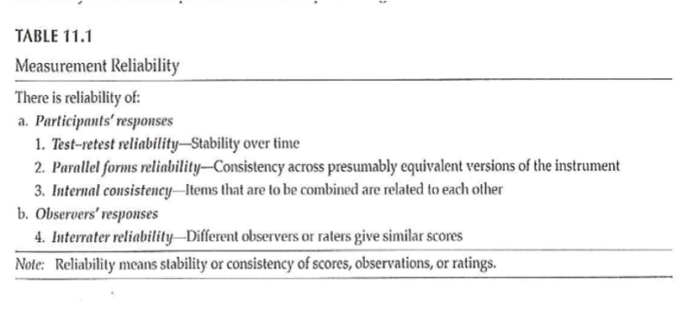
Measurement Reliability

Slide 31
Measurement Reliability
Theories
Classical test theory
Observed = True score + random error
Generalizability theory
Different components of error
Random error
Test-retest error
Rater error
Other identifiable sources of error
Item response theory
Separate test characteristics from participant characteristics

Slide 32
Measurement Validity
“… establishing evidence for the use of a particular measure or instrument in a particular setting with a particular population for a specific purpose.”
Providing evidence for validity
NOT “test is valid” or “test is invalid”
MUST have reliable measure before you can have validity
May have reliability without validity

Slide 33
Measurement Validity
Evidence of validity reported when measure is developed
Not routinely reported in research reports when measure is used
Types of evidence for validity –
Content
Response processes
Internal structure
Relations to other variables
Consequences

Slide 34
Measurement Validity
Content evidence –
“… whether the content that makes up the instrument is representative of the concept that one is attempting to measure.”
Include major aspects of the concept
Does not include irrelevant material

Slide 35
Measurement Validity
Content evidence –
Definition of the concept
Literature search to determine how concept has been measured previously
Generate items to represent concept
Use experts to reduce items to a final set to represent the concept

Slide 36
Measurement Validity
Response processes evidence –
“… the extent to which the types of participant responses match the intended construct.”
NOT socially desirable responses
NOT “test-taking” skills
Observe respondents as they complete measure
Question respondents about reasons for responses
Also, observation of raters / judges

Slide 37
Measurement Validity
Internal structure evidence –
“Evidence from several types of analysis, including factor analysis and differential item functioning …”
Does an analysis of the internal structure of a measure match the conceptual framework?

Slide 38
Measurement Validity
Factor analysis – Beliefs about ART measure
The following questions involve your personal views about the HIV medications that have been prescribed for you. Please indicate the extent to which you agree or disagree with the following statements.
Response scale: 1 (strongly disagree), 2 (disagree), 3 (uncertain), 4 (agree), 5 (strongly agree)

Slide 39
Measurement Validity
Relations to other variables evidence –
Are there relations with other measures that would be predicted from the theoretical framework of the measure?
Test-criterion
Predictive-criterion
Concurrent-criterion
Convergent
Discriminant
Validity generalization

Slide 40
Measurement Validity
Motivation/Readiness/Confidence to Adhere

Slide 41
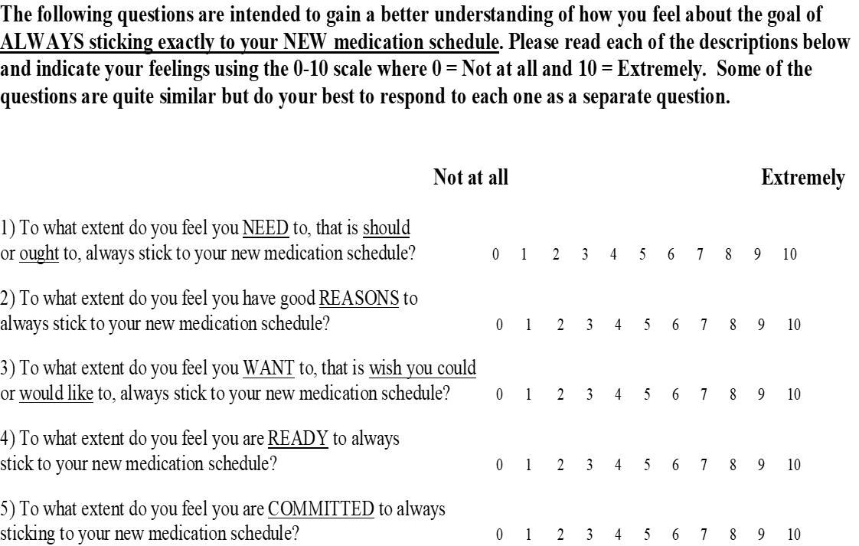

Slide 42
Measurement Validity
Consequences evidence –
“… includes both positive and negative anticipated and unanticipated consequences of measurement.”
How do the use of measures affect respondents?

Slide 43
Measurement Validity
Evaluation of measurement validity
For content, response process, internal structure, and consequence –
Subjective, depends on logical judgment by researcher
Relations with other variables –
Often correlations
Judgment; no established cut-offs

Slide 44
Measurement Validity
Evaluation of measurement validity
Cohen’s guidelines – strength of relationship
Correlation coefficient – most common
Applied behavioral sciences
r >= .5 <U+F0E8> large effect / strong support
r > .3 <U+F0E8> acceptable level of support
r > .1 <U+F0E8> weak support (if statistically significant)
Table 12.2

Slide 45
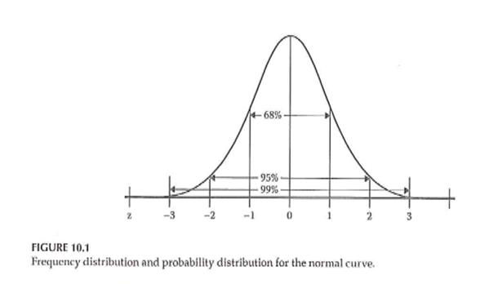
Measurement Validity

Slide 46
Measurement Validity
Validity of diagnostic tests
Sensitivity
A test ’ s ability to obtain a positive result when the target condition is really present
True positive rate
Specificity
A test ’ s ability to obtain a negative result when the target condition is really absent
True negative rate

Slide 47
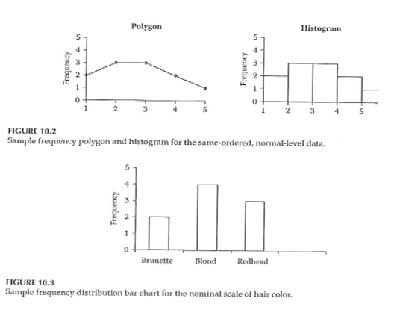
Measurement Validity
Notes:
.footnote[Portney & Watkins, 2009]

Slide 48
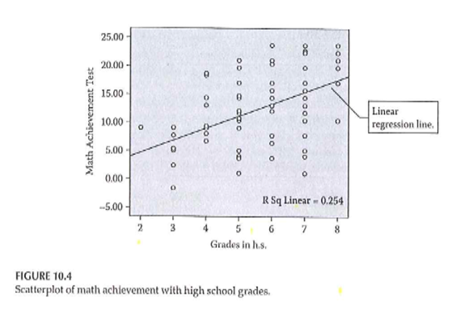
Measurement Validity
Notes:
Sim & Wright . 2000.

Slide 49
Measurement
Validity vs Reliability
The chicken and the egg!

Slide 50
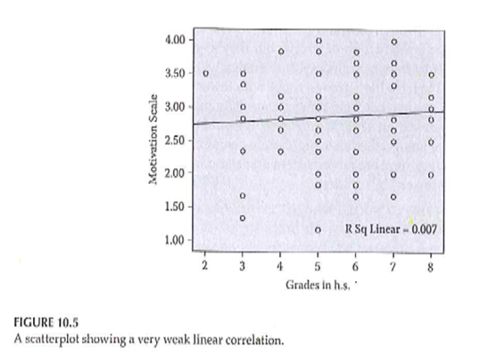
Measurement
Notes:
[Portney & Watkins, 2009]

Slide 51
Measurement
Validity vs Reliability
“ … a high degree of validity presupposes a high degree of reliability… ”
“ … reliability does not presuppose. ”
To establish reliability – only need to know where points are in relation to each other
To establish validity – need to know where the “ target ” is in order to evaluate how close points are to this “ target ”

Slide 52
Measurement
Validity vs Reliability (Table 9.1)

Slide 53
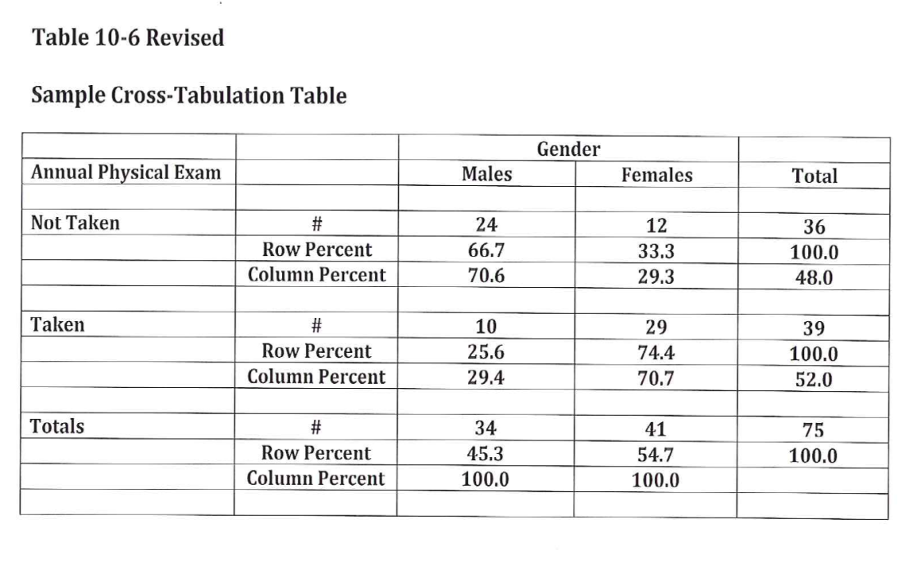
Measurement
Notes:
.footnote[Sim & Wright. 2000.]

Slide 54
Assignment #7
Generate a list of variables that you plan to include in your research proposal. Include in the list both dependent and independent variables. In the list include:
Variables you will need to describe your sample,
Variables you will need to control for in your analysis, and
Variables you will need in order to test your RQ/RH.

Slide 55
Assignment
Generate a list of measures that you plan to include in your research proposal. This should be a general list of measures and not necessarily a detailed list of the specific type of measure to be used. For instance, you might list the outcome measure â€œhealthâ€ and not specify the exact measure of health status that you will use. This assignment will be a first draft of the “measures” description included in the Methods section of your research proposal.
Prepare for next weekâ€™s session

Slide 56
Discussion questions
What procedures will you put into place in order to ensure reliability and validity?
How will reliability and validity be tested with the data that are collected?

Slide 57
Additional slides

