Slide 1
Video 12 - Hypothesis testing
Steve Simon

Slide 2
Pop quiz
A research paper computes a p-value of 0.45. How would you interpret this p-value?
Strong evidence for the null hypothesis.
Strong evidence for the alternative hypothesis.
Little or no evidence for the null hypothesis.
Little or no evidence for the alternative hypothesis.
More than one answer above is correct.
Notes:
I gave a talk about ten years ago, and I had a “pop quiz” to start out the talk. It turns out that I was a bit careless in how I worded the question, but I decided to keep it in for future talks about p-values to help illustrate an important point. I won’t ask you for the answer just yet, but here is the question.
A research paper computes a p-value of 0.45. How would you interpret this p-value?
Strong evidence for the null hypothesis;
Strong evidence for the alternative hypothesis;
Little or no evidence for the null hypothesis;
Little or no evidence for the alternative hypothesis;
More than one answer above is correct.

Slide 3
Another question
A research paper computes a confidence interval for a relative risk of 0.82 to 3.94. What does this confidence interval tell you that the result is:
statistically significant and clinically important.
not statistically significant, but is clinically important.
statistically significant, but not clinically important.
not statistically significant, and not clinically important.
ambiguous.
Notes:
Here’s another question to toss out, but this time it is not poorly worded.
A research paper computes a confidence interval for a relative risk of 0.82 to 3.94. What does this confidence interval tell you.
The result is statistically significant and clinically important, is not statistically significant, but is clinically important, and so forth. The last answer, the result is ambiguous, is the correct one, which you’ll see in a little bit.
By the way, if you weren’t writhing in the floor in agony when you saw this interval, I want to change that.

Slide 4
What is a population?
A population is a collection of items of interest often defined in terms of
demography,
geography,
occupation,
time,
care requirements,
diagnosis, or
some combination of the above.
Notes:
Here’s a definition of a population that I found somewhere but then I lost the link. So if anyone ever runs across this list of characteristics of a population, please let me know. It is too clever a list for me to have figured it out by myself.
A population is a collection of items of research. In clinical research, the population is often a collection of people, sharing some commmon features. They may all be in the same demographic group, the may all come from the same area, they may all have the same job, they may be getting the same type of medical care, they may have the same diseases, or it may be a combination of these items.

Slide 5
Example of a population
Population: All infants born in the state of Missouri during the 1995 calendar year who have one or more visits to the Emergency Room during their first year of life.
Notes:
Here’s an example that hits on about all these. All infants born in the state of Missouri during the 1995 calendar year who have one or more visits to the Emergency Room during their first year of life.
Let’s look at the different pieces.
All infants (demography)
born in the state of Missouri (geography)
during the 1995 calendar year (time)
who have one or more visits to the Emergency Room (care requirements)
during their first year of life (time, again)

Slide 6
What is a sample?
A sample is a subset of a population
Small and manageable
Is your sample representative?
Your goal
Make inferences about the population
Using information from the sample
Notes:
A sample is a subet of a population. Usually it is of a much smaller size than the population. It has to be small enough to be manageable.
The primary goal of much research is to use information collected from a sample to try to characterize a certain population. As such, you should pay a lot of attention to how representative the sample is of the population.
If there are problems, with representativeness, consider redefining your population a bit more narrowly. For example, a sample of 85 smokers between the ages of 13 and 18 in Rochester, Minnesota who respond to an advertisement about participation in a smoking cessation program might not be considered representative of the population of all teenage smokers, because the participants selected themselves. The sample might be more representative if we restrict our population to those teenage smokers who want to quit.

Slide 7
More definitions for hypothesis testing
Parameter
Computed for a population
Almost always unknown
Statistic
Computed for a sample
Estimate of population parameter
Sampling error
Notes:
A parameter is a number computed from a population. Since the population is often very large, it is often impossible to compute a parameter.
A statistic is a number computed from a sample. Since the sample is small enough to be manageable, the values of the statistic are computed with the hope that they will be good estimates of the corresponding population parameter.
Sampling error is the uncertainty created by the sampling process.

Slide 8
Hypotheses
Null hypothesis
Designated by $H_{0}$
No change, no effect
Alternative hypothesis
Designated by $H_{a}$
Decision rule
Notes:
Researchers will often designate a null and alternative hypothesis. The null hypothesis (H0) is traditionally reserved for a hypothesis involving no effect, no change, or no trend. Let me emphasize that this is no change in a parameter.
The alternative hypothesis implies some type of change, either an improvement or decrement. It could also imply some type of association: a positive association (as one variable increases, the other variable also increases), or a negative association (as one variable increases, the other variable decreases).
Hypotheses are statements about population parameters. Because you new know exactly what a parameter is, you can never state with certainty whether a hypothesis about a parameter is true or false. Remeber this, as it becomes important later.
The decision rule is a statement about what particular values in the sample would lead you to accept the null hypothesis and what values would lead you to reject the null hypothesis.

Slide 9
Comparison of continuous outcome for two populations
Most common research problem
Population parameters ($μ_{1}$ and $μ_{2}$)
Sample statistics (${\overline{X}}_{1}$ and ${\overline{X}}_{2}$)
$H_{0} μ_{1}−μ_{2}=0$
Accept $H_{0}$ if ${\overline{X}}_{1}−{\overline{X}}_{2}$ is close to zero.
Notes:
The most frequent hypothesis involves a comparison of continuous outcomes between two groups, a treatment group and a control group. These are designated by the subscripts 1 and 2, but there is no standard that says that 1 is the treatment and 2 is the control. It is just as likely to be the reverse. You have to look for some context to make sure you know which subscript is which.
The null hypothesis is that the difference in population means is zero. You compute the difference in sample means and accept the null hypothesis if that difference is close to zero.
How close is close? It depends on how much sampling error you have.
Example: In a study of nulvadapine in Alzheimer disease, this drug was compared to placebo on the one year decline in cognition, as measured by the Alzheimer’s Disease Assessment Scale Cognitive Subscale-12. The null hypothesis was that the average difference in cognitive decline between the drug and placebo was zero. The decline was 6.41 units in the placebo group and 5.75 in the control group, a difference in the sample of 0.66. Since the difference in the two means was close to zero, the researchers accepted the null hypothesis. They concluded “The results do not suggest benefit of nilvadipine as a treatment in a population spanning mild to moderate Alzheimer disease.”

Slide 10
Comparison of binary outcome for two populations
Population parameters ($π_{1}$ and $π_{2}$)
Sample statistics ($p_{1}$ and $p_{2}$)
$H_{0} π_{1}−π_{2}=0$
Accept $H_{0}$ if $p_{1}−p_{2}$ is close to zero.
Notes:
Another common hypothesis involves a comparison of binary outcomes between two groups, a treatment group and a control group. The population parameters are proportions instead of means, but otherwise the concept is the same.
Close to zero, as before, means close to zero relative to the amount of sampling error.
Example: in the same study, the researchers hypothesized that the difference in proportions for patients experiencing serious adverse events was zero. The sample proportions were 20% (50/252) and 16% (42/257). Since the differrence in proportions was small, the researchers accepted the null hypothesis and concluded that “Nilvadipine appeared to be safe and well tolerated”

Slide 11
Regression models
Population parameters, $β_{0}$ and $β_{1}$
$β_{1}$ quantifies a relationship
$β_{1}=0$ implies no relationship
Sample statistics $b_{0}$ and $b_{1}$
$H_{0} β_{1}=0$
Accept $H_{0}$ if $b1$ is close to zero
Notes:
I’ll talk a lot about regression models later, but let me introduce a hypothesis involving a regression model. Typically, but not always, a regression model has an intercept term and a slope term. The slope term quantifies the relationship between your independent variable and your dependent variable. If the population parameter is zero that means there is no relationship in the population. Like the other models, you compute a sample statistic and accept the null hypothesis if that sample statistic is close to zero.
Example: in a study of endothelial function and cognitive preformance in patients with coronary heart disease, the researchers hypothesized that there was no linear relationship between change in reactive hyperemia index (RHI) and the change in overall cognition. The regression coefficient was 0.55 which was not close to zero, so the researchers rejected the null hypothesis and concluded that “an increased RHI was significantly associated with an improvement in overall cognition.”
Saleem M, Herrmann N, Dinoff A, et al. Association Between Endothelial Function and Cognitive Performance in Patients With Coronary Artery Disease During Cardiac Rehabilitation. Psychosom Med. 2019;81(2):184–191. doi:10.1097/PSY.0000000000000651.
Regression models are quite flexible. They can incorporate a variety of measurements for your outcome variable and can provide for risk adjustments to your outcome variable.
This is not a data analysis class, but I do want to provide you with enough information so you can write a good data analysis plan. More likely than not, your data analysis plan will involve a regression model of some type.

Slide 12
First break
What have you learned
Poulation, sample
Parameter, statistic
Basic hypotheses
What’s coming next
Directional alternatives
Text hypotheses
Type I and Type II errors

Slide 13
Directional alternatives
Used when changes in opposite direction are
Impossible
Irrelevant/equivalent to no change
$H_{0} μ_{1}−μ_{2}≤0$
$H_{a} μ_{1}−μ_{2}>0$
Reject $H_{0}$ if ${\overline{X}}_{1}−{\overline{X}}_{2}>t×se$
Must be stated a priori
“Wrong” direction now interesting
Switch for better power
Notes:
It is a bit unusual, but there are situations where changes in the “wrong” direction are considered impossible or irrelevant or equivalent to no change.
Example: in a study of a robotic object hitting game, patients with Parkinson’s disease were compared to age matched controls. Here the first group is Parkinson’s and the second group is the control.
The null hypothesis was that the score was equivalent between the two groups. The alternative was that the score would be worse in the Parkinson’s group. An improved score for the Parkinson’s group would not be interesting because there is no scientifically reason to believe that having a condition like Parkinson’s would provide a benefit in a test of motor skills. The mean scores for the control group and the Parkinson’s group were 8.40 and 4.85 respectively. The difference in the sample means was 3.65 which was sufficiently large to reject the null hypothesis. The game was intended to be a test of motor skills and showing a difference in the Parkinson’s group would demonstrate validity of this measure. Other tests involved just the Parkinson’s disease patients on and off a drug, levodopa, that can relieve some of the symptoms of Parkinson’s disease. The authors concluded that there was a “dynamic interaction between cognitive and kinematic skills while the PD patients performed a virtual reality game.”
Consider the situation where you are testing a new drug versus placebo. A drug could be worse than a placebo. It happens all the time. But there is no reason to test for this. You would not adopt a new drug if it were equivalent to placebo and you would not adopt a new drug if it were inferior to placebo. So your null hypothesis is that the new drug is not better than placebo, meaning equal to placebo or worse than the placebo.
The actual orientation of a directional hypothesis depends on whether a larger value of the outcome measure is good or a smaller value is good. So for an outcome like pain, pain is like golf. A lower score on a pain scale is good. It also depends on which group gets labelled with a 1 and which gets a 2. And it depends on whether you consider a good effect to be impossible/irrelevant or a bad effect to be impossible/irrelevant.
Let’s assume that you are testing a new pain relief drug versus placebo, that the placebo is group 1 and that higher values of pain with the new drug are irrelevant because that leads to the same decision as equivalent values of pain.
In this case, mu1-mu2 a measure where positive values are good and worth reporting, and where negative values are bad and lead to the same decision as zero values. So the null hypothesis uses a less than or equal to sign and the alternative hypothesis uses a greater than sign.
In this setting, you would compute the sample average pain levels in the placebo minus the sample average pain in the treatment group. If that difference was large and positive, you would reject the null hypothesis. How large? Typically you would compare this difference in sample means to a percentile from the t-distribution times the standard error for the difference in sample means.
You must specify a directional alternative prior to data collection, and once you commit to a directional alternative, you can’t back out. You run the risk of being accused of fraud. The concern is that a researcher might start with the directional alternative because it provide a bit of a boost to the power of a study. But when the results come back and the results are pointing in the opposite direction, all of a sudden things change. The researcher now thinks that the “wrong” direction is no interesting and relevant and comes up with all sorts of reasons why this finding, which was not anticipated prior to data collection, is now so obvious and worth pursuing.
The opposite type of fraud can occur when you get a p-value for a two-sided alternative and it is just a bit too large. You want to shrink the p-value, and switching to a directional alternative (in the direction that you observed, of course) is what you really wanted all along. The switch cuts your p-value in half and now you have a statistically significant result.

Slide 14
Passive smoking controversy
EPA meta-analysis of passive smoking
Criticized for using a one-sided hypothesis
Samet JM, Burke TA. Turning science into junk: the tobacco industry and passive smoking. Am J Public Health. 2001;91(11):1742–1744. Available in html format or PDF format.
Notes:
Consider a study of the effects of second-hand smoke. These studies always use directional alternatives. From what we know about active cigarette smoking is that it increases the risk of cancer and cardiovascular disease. So there is no reason to expect that passive smoke exposure should be any different than active smoking. Maybe it is less toxic, because of dilution and because the smoking coming off a cigarette from one end is different than the smoke coming off the cigarette from the other end. Fair enough, but there is not reason to believe that things are so different that all of a sudden the smoke becomes protective.
Since there is no scientific basis for a protective effect of passive smoking, it makes sense to test that passive smoking has no effect versus it having an increase in bad outcomes compared to the control group. So your null hypothesis is “not harmful” and your alternative is “harmful”. The beneficial hypothesis is lumped into the null hypothesis, but no one would dare claim that passive smoking was protective.
Actually, the tobacco companies did complain that the use of a directional alternative violated the norms of science. They won in a court battle in North Carolina, but lost on appeal.
As another aside, I was involved with prayer study. We planned this study using a one-sided hypothesis (remote prayer has a positive effect on health). The Institutional Review Board suggested changing this to a two-sided hypothesis (remote prayer has either a positive or a negative effect on health). Thankfully, we did not observe an outcome in the opposite tail as that would have been very difficult to explain.

Slide 15
Hypothesis in English instead of Greek
Only statisticians like Greek letters
Translate to simple text
For two group comparisons
Safer, more effective
For regression models
Trend, association
Notes:
As a researcher, you should always think about your hypothesis in terms of population parameters, but your writing should use text. Translate the Greek letters to English.
If you have a hypothesis that compares two groups, look for comparative words like “safer” or “more effective”. If your hypothesis involves some type of regression model, you should consider terms like “trend” or “association”.

Slide 16
Example of text hypotheses (1 of 1)
“… the objective of this 78-week randomised, placebo-controlled study was to determine whether treatment with nilvadipine sustained-release 8 mg, once a day, was effective and safe in slowing the rate of cognitive decline in patients with mild to moderate Alzheimer disease.”
Lawlor B, Segurado R, Kennelly S, et al. Nilvadipine in mild to moderate Alzheimer disease: A randomised controlled trial. PLoS Med. 2018; 15(9): e1002660. DOI: 10.1371/journal.pmed.1002660
Notes:
Here’s an example of a two group comparison. One group gets nilvadipine and the other group gets a placebo. Safety was measured as the proportion of patients who experienced an adverse event. The researchers also measured the proportion of patients who experienced a serious adverse event. So the Greek hypothesis would involve pi’s.
Effectiveness was measured using the Alzheimer’s Disease Assessment Scale Cognitive Subscale-12 and the Clinical Dementia Rating Scale sum of boxes. Both of these outcome measurements are continuous, so the Greek hypothesis would involve mu’s.

Slide 17
Example of text hypotheses (2 of 2)
“… we investigated trends in BCC incidence over a span of 20 years and the associations between incident BCC and risk factors in a total population of 140,171 participants from 2 large US-based cohort studies: women in the Nurses’ Health Study (NHS; 1986–2006) and men in the Health Professionals’ Follow-up Study (HPFS; 1988–2006).”
Wu S, Han J, Li WQ, Li T, Qureshi AA. Basal-cell carcinoma incidence and associated risk factors in U.S. women and men. Am J Epidemiol. 2013; 178(6): 890–897. DOI: 10.1093/aje/kwt073
Notes:
This study used a regression model, a Cox regression model, to study trends and associations, so the Greek hypotheses would involve beta’s.

Slide 18
What is a Type I Error?
Type I error
Rejecting the null hypothesis when the null hypothesis is true.
False positive result
Example: allowing an ineffective drug on the market
$α$ = P[Type I error]
Notes:
In your research, you specify a null hypothesis (typically labeled H0) and an alternative hypothesis (typically labeled Ha, or sometimes H1). By tradition, the null hypothesis corresponds to no change. When you are using Statistics to decide between these two hypothesis, you have to allow for the possibility of error. Actually, if you are using any other procedure, you should still allow for the possibility of error, but we statisticians are the only ones honest enough to admit this.
A Type I error is rejecting the null hypothesis when the null hypothesis is true.
Consider a new drug that we will put on the market if we can show that it is better than a placebo. In this context, H0 would represent the hypothesis that the average improvement (or perhaps the probability of improvement) among all patients taking the new drug is equal to the average improvement (probability of improvement) among all patients taking the placebo. A Type I error would be allowing an ineffective drug onto the market.
Remember that the hypotheses involve population paramters. Population parameters are impossible to compute. So you can only talk about Type I errors in an abstract sense. You will never know for certain if you have made a Type I error.
Alpha is the probability of a Type I error, and alpha is a value that you can compute. In most studies, researchers work hard to keep the probability of a Type I error low, typically at 5%.

Slide 19
What is a Type II Error?
Type II error
Accepting the null hypothesis when the null hypothesis is false.
False negative result
Example: keeping an effective drug off of the market
$β$ = P[Type II error]
Power = $1−β$
Notes:
A Type II error is accepting the null hypothesis when the null hypothesis is false. You should always remember that it is impossible to prove a negative. Some statisticians will emphasize this fact by using the phrase “fail to reject the null hypothesis” in place of “accept the null hypothesis.” The former phrase always strikes me as semantic overkill.
Many studies have small sample sizes that make it difficult to reject the null hypothesis, even when there is a big change in the data. In these situations, a Type II error might be a possible explanation for the negative study results.
Consider a new drug that we will put on the market if we can show that it is better than a placebo. In this context, H0 would represent the hypothesis that the average improvement (or perhaps the probability of improvement) among all patients taking the new drug is equal to the average improvement (probability of improvement) among all patients taking the placebo. A Type II error would be keeping an effective drug off the market.
It bears repeating that population parameters are impossible to compute. So you will never know for certain if you have made a Type I error.
Beta is the probability of a Type II error. Beta is a known quantity. Typically researchers try to keep beta small. 10% is a typical value, though in some settings, a Type II error rate as large as 20% could be tolerated.
Power is defined as 1-beta. I will talk more about power in a little bit.

Slide 20
Second break
What have you learned?
Directional alternatives
Text hypotheses
Type I and Type II errors
What’s combing next
p-values
p-hacking

Slide 21
What is a p-value?
p-value = $P[{\overline{X}}_{1}−{\overline{X}}_{2}>t×se | μ_{1}−μ_{2}=0]$
Probability of sample results OR a result more extreme, given that $H_{0}$ is true
Notes:
Here’s the formula for the p-value. It changes depending on what your hypothesis is, but this formula gets the general idea across. Don’t worry for now about details like the absolute value sign and the “2 times” in front of the probability.
In English, this formula is telling you that the p-value is the probability that you observe the sample results or a result more extreme, assuming that the null hypothesis is true.
The p-value is, by far, the most popular statistic reported in research studies. In spite of its popularity, the p-value is quite controversial. One journal, Basic and Applied Social Psychology, banned the use of p-values in its journal.
Fricker (2019) American Statistician, 73(S1): 374-384.

Slide 22
Alternate explanations of the p-value
The p-value is a measure of consistency between the data and the null hypothesis
Small value implies inconsistent
Large value implies consistent
The p-value as a measure of evidence against the null hypothesis
Small value implies lots of evidence
Large value implies little or no evidence
Notes:
There are two interpretations that I feel are more practical. You can think of the p-value as a measure of consistency between the data and the null hypothesis. A small value implies inconsistency. It is very unlikely that you will get a value like you’ve seen in your sample or a value more extreme under the assumption that the null hypothesis is true. So you should reject that assumption.
On the other hand if the sample results or anything more extreme has a high probability under the assumption that the null hypothesis is true, then you should feel comfortable accepting that assumption.
I have argued that the p-value is a measure of evidence. Some have called it a poor measure of evidence, but I stand by my interpretation.
If the p-value is small, you have lots of evidence against the null hypothesis. If the p-value is large, you have little or no evidence against the null hypothesis.

Slide 23
What the p-value is NOT (1 of 2)
Not the probability that the null hypothesis is true
Don’t reverse the condition
p-value $=P[{\overline{X}}_{1}−{\overline{X}}_{2}>t×se | μ_{1}−μ_{2}=0]$
p-value $≠P[μ_{1}−μ_{2}=0 | {\overline{X}}_{1}−{\overline{X}}_{2}>t×se]$
Notes:
The p-value is a conditional probability, and you always need to be careful about conditional probabilities. It is a probability about a sample result given an assumption about the population result. It is not a probability about a population result given the sample result. There are two reasons for this.
First, you can’t reorder a conditional probability. The probability of A given B is almost never the same as the probability of B given A. The example I give for this is the probability of being happy given that you are rich. That’s a pretty high number, I hope you’ll agree. There are a few rich people who lead miserable lives, but from everything I’ve seen, most rich people are pretty darn happy. The reverse of this is the probability of being rich given that you are happy. That number is much smaller. Because although I believe that money can buy happiness, a lot of other things can also buy happiness just as well. It’s not quite as easy to find happiness if you’re poor, but somehow, a lot of poor people find a way to be happy anyway.
A second reason that you can’t reverse the order is that you cannot make a probability statement about population parameters. They are numbers computed from the entire population, and are fixed values. You cannot make a probability statement about something that has no sampling error.

Slide 24
Pop quiz, revisited
A research paper computes a p-value of 0.45. How would you interpret this p-value?
Strong evidence for the null hypothesis
Strong evidence for the alternative hypothesis
Little or no evidence for the null hypothesis
Little or no evidence for the alternative hypothesis
More than one answer above is correct.
I do not know the answer.
Notes:
Here’s that pop quiz again. Take a look at it quickly. Note that the p-value is of evidence against the null hypothesis. So each of the first four responses is wrong.
I wrote this question quickly, so shame, shame on me. But I’ve reproduced the example because it illustrates an important point.

Slide 25
What the p-value is not (2 of 2)
Not a measure FOR either hypothesis
Little evidence against the null $≠$ lots of evidence for the null
Not very informative if it is large
Need a power calculation, OR
Narrow confidence interval
Not very helpful for huge data sets
Notes:
The p-value is not a measure for either hypothesis. It is always a measure against a particular hypothesis. Now when the p-value is small, you can make a strong statement. We have lots of evidence against the null hypothesis. That translates into lots of evidence in favor of the alternative hypothesis.
When the p-value is large, however, you are in a quandry. Little or no evidence against the null hypothesis is not the same as lots of evidence for the null hypothesis.
It’s possible to have little or no evidence against the null and also have little or no evidence against the alternative. This happens whenever you have a really small sample size combined with a lot of noise.
You can’t prove a negative, so the saying goes. Well, you can prove a negative, but you have to work harder at it. A large p-value by itself is not persuasive, but if you combine it with a power calculation done prior to data collection, that’s pretty good evidence in support of the null hypothesis.
You could also combine a large p-value with a narrow confidence interval to support the null hypothesis. I’ll talk about that more in just a bit.
In general, the p-value is not very helpful for large samples. We’re seeing this more and more. Just about everything pops up as statistically significant with these huge data sets, and you can’t use the p-value to separate the important stuff from the trivial stuff. You need to look instead at the magnitude of the sample estimates and calculate how much uncertainty you can remove in your future predictions.

Slide 26
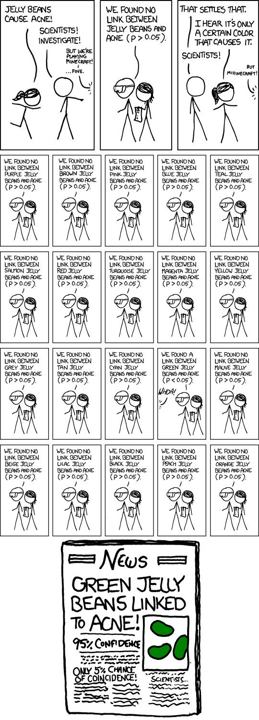
p-hacking (1 of 2)
xkcd cartoon about jelly beans and cancer
Notes:
This cartoon is impossible to read, but you can find it on the Canvas site or in the readings. Here’s a brief run down.
In the first panel, a woman runs up to a man and shouts: Jelly beans cause acne!
The man replies : Scientists! Investigate!
In the second panel, one scientist, holind a clipboard announces: We found no link between jelly beans and acne (p > 0.05).
In the third panel, the woman says: I hear it’s only a certain color that causes it.
In a bunch of small panels, the scientist with a clipboard reports: We found no link between purple jelly beans and acne (p > 0.05).
We found no link between brown jelly beans and acne (p > 0.05).
We found no link between pink jelly beans and acne (p > 0.05).
The same for blue, teal, salmon, red, and so forth. And then…
We found a link between green jelly beans and acne (p < 0.05). An off-screen voice goes: Whoa!
The next six panels show
We found no link between mauve jelly beans and acne (p > 0.05).
We found no link between beige jelly beans and acne (p > 0.05).
We found no link between lilac jelly beans and acne (p > 0.05).
We found no link between black jelly beans and acne (p > 0.05).
We found no link between peach jelly beans and acne (p > 0.05).
We found no link between orange jelly beans and acne (p > 0.05).
At the bottom is a newspaper with the headline: Green Jelly Beans Linked To Acne! 95% Confidence. Only 5% chance of coincidence!
If you are interested in a transcript and a detailed explanation, https://www.explainxkcd.com/wiki/index.php/882:_Significant

Slide 27
p-hacking (2 of 2)
Abuse of the hypothesis testing framework.
Run multiple tests on the same outcome
Test multiple outcome measures
Remove outliers and retest
Defenses against p-hacking
Bonferroni
Primary versus secondary
Published protocol
Notes:
This is an example of p-hacking. You change the testing process to increase the probability of a Type I error (Rejecting the null hypothesis when the null hypothesis is true). This increases the chance of getting a positive result, which you may find desirable, but only by increasing the probability of a false positive result.
Some examples of p-hacking. Run multiple tests on the same outcome measure. Start with the regular t-test, include the t-test that allows for unequal variances, and run two different non-parametric tests, the Wilcoxon-Mann-Whitney test and the sign test. Choose the test with the smallest p-value.
You also might consider multiple outcome measures. Compare the mortality rate, the relapse rate, and the rehospitalization rate. If any of the three is statistically significant, claim victory.
You could also do this with longitudinal data. Compare pain relief at one hour and at four hours. If you see a difference at one hour, claim that your new medication is faster acting. If you see a difference at four hours, claim that your medication is longer lasting.
You might run a test with the full data set and then with an outlier or two removed. Report for the data set that has the smaller p-value and pretend that this was your original choice all along.
These are only a few of the choices. I don’t want to say more because I feel like I’m the devil tempting you.
There are two defenses against p-hacking. Well three if you count being honest. But what I mean is there are two things that you can do that will satisfy others that you are playing fairly.
First, you can adjust your decision rule by using a Bonferroni correction. Bonferroni divides alpha by the number of tests. If you are using three different outcome measures, compare your p-value of 0.0133 instead of 0.05.
Second, you can designate one of your outcome measures as primary. If you achieve statistical significance on your primary outcome, great. The remaining outcome measures are secondary. If you achieve statistical significance on a secondary outcome meausure only, report the results as provisional and requiring independent replication.
You should publish a detailed protocol, either through a clinical trial registry, or now there are journals which accept publications of the research protocols before any data are collected. It’s a paper with literature review and methods section, but no results and no discussion section.
Now p-hacking has happened because some people have a skewed view of research. They are interested in using research to promote their own agenda rather than using research to uncover the truth. Perfectly understandable if you are a drug company, but you as an independent researcher should never try to skew the data. It hurts you and it hurts your patients. You need to adopt a disinterested posture in that you are glad when the research points in one direction and you are glad when it points in the opposite direction, because either way, you know more than you did before and you can treat your patients better because of this knowledge.

Slide 28
Third break
What have you learned?
p-values
p-hacking
What’s coming next?
Confidence intervals
Range of clinical indifference

Slide 29
What is a confidence interval?
Dear Professor Mean: Can you give me a simple explanation of what a confidence interval is?
A confidence interval is a range of values that quantifies the size of sampling error.
Also, a range of plausible values.
Not a probability statement about a parameter
Notes:
We statisticians have a habit of hedging our bets. We always insert qualifiers into our reports, warn about all sorts of assumptions, and never admit to anything more extreme than probable. There’s a famous saying: “Statistics means never having to say you’re certain.”
We qualify our statements, of course, because we are always dealing with imperfect information. In particular, we are often asked to make statements about a population (a large group of subjects) using information from a sample (a small, but carefully selected subset of this population). No matter how carefully this sample is selected to be a fair and unbiased representation of the population, relying on information from a sample will always lead to some level of uncertainty.
A confidence interval is a range of values that tries to quantify this uncertainty. Consider it as a range of plausible values.
A narrow confidence interval implies high precision; we can specify plausible values to within a tiny range. A wide interval implies poor precision; we can only specify plausible values to a broad and uninformative range.
I also like to think of the confidence interval as a range of plausible values. It is not a probability statement, however, because the confidence interval is a statement about a population parameter, which does not have sampling error.

Slide 30
Example of a confidence interval
Homeopathic treatment of swelling after oral surgery
95% CI: -5.5 to 7.5 mm
Lokken P, Straumsheim PA, Tveiten D, Skjelbred P, Borchgrevink CF. Effect of homoeopathy on pain and other events after acute trauma: placebo controlled trial with bilateral oral surgery BMJ. 1995;310(6992):1439-1442. http://www.bmj.com/content/310/6992/1439.full
Notes:
Always look for confidence intervals that are wide enough to drive a truck through. They are very good indicators of small sample sizes.
Consider a recent study of homoeopathic treatment of pain and swelling after oral surgery (Lokken 1995). When examining swelling 3 days after the operation, they showed that homoeopathy led to 1 mm less swelling on average. The 95% confidence interval, however, ranged from -5.5 to 7.5 mm. From what little I know about oral surgery, this appears to be a very wide interval. This interval implies that neither a large improvement due to homoeopathy nor a large decrement could be ruled out.
Now, you can’t drive a truck through an interval that goes from -5.5 to 7.5 mm, but from the perspective of a human mouth, this interval is huge. Generally when a confidence interval is very wide like this one, it is an indication of an inadequate sample size, an issue that the authors mention in the discussion section of this paper.

Slide 31

Confidence interval interpretation (1 of 7)
Interval that contains the null value
Notes:
When you see a confidence interval in a published medical report, you should look for two things. First, does the interval contain a value that implies no change or no effect? For example, with a confidence interval for a difference look to see whether that interval includes zero. With a confidence interval for a ratio, look to see whether that interval contains one.
Here’s an example of a confidence interval that contains the null value. This interval implies no statistically significant change.

Slide 32

Confidence interval interpretation (2 of 7)
Interval entirely above the null value
Notes:
Here’s an example of a confidence interval that excludes the null value. If we assume that larger implies better, then the interval would imply a statistically significant improvement.

Slide 33

Confidence interval interpretation (3 of 7)
Interval entirely below the null value
Notes:
Here’s a different example of a confidence interval that excludes the null value. This interval implies a statistically significant decline.

Slide 34

Confidence interval interpretation (4 of 7)
Interval entirely inside the range of clinical indifference
Notes:
You should also see whether the confidence interval lies partly or entirely within a range of clinical indifference. Clinical indifference represents values of such a trivial size that you would not want to change your current practice. For example, you would not recommend a special diet that showed a one year weight loss of only five pounds. You would not order a diagnostic test that had a predictive value of less than 50%.
Clinical indifference is a medical judgment, and not a statistical judgment. It depends on your knowledge of the range of possible treatments, their costs, and their side effects. As statistician, I can only speculate on what a range of clinical indifference is. I do want to emphasize, however, that if a confidence interval is contained entirely within your range of clinical indifference, then you have clear and convincing evidence to keep doing things the same way.

Slide 35

Confidence interval interpretation (5 of 7)
Interval partly inside/outside range of clinical indifference
Notes:
One the other hand, if part of the confidence interval lies outside the range of clinical indifference, then you should consider the possibility that the sample size is too small.
The interval contains zero, so it is plausible to behave as if the difference in population means or proportions is zero. But the interval also contains values that are clinically important. So it is plausible to behave as if there is a clinically important difference in means. How can you have two such different interpretations being plausible at the same time? That’s the definition of ambiguity. If you don’t like it, get used to it. Statisics will often identify areas of ambiguity, which is a good thing, because it tells us to not act prematurely, but instead demand more data before you make a definitive decision.

Slide 36
Quiz question, revisited
A research paper computes a confidence interval for a relative risk of 0.82 to 3.94. What does this confidence interval tell you that the result is:
statistically significant and clinically important.
not statistically significant, but is clinically important.
statistically significant, but not clinically important.
not statistically significant, and not clinically important.
ambiguous.
Notes:
Let’s go back to that question I posed earlier.
A research paper computes a confidence interval for a relative risk of 0.82 to 3.94. What does this confidence interval tell you.
Well, it tells you that a relative risk of 1 (equal risks) is plausible, but that a relative risk of 2 (a doubling of risk) is also plausible. A tripling of risk is plausible. Good grief! This is an ambiguous result.
Doesn’t this bother you? It should. Someone ran a terrible experiment. An experiment so poorly designed that it can’t distinguish between no change in risk, or a tripling of risk.
It’s a terrible thing, but it happens all the time and it doesn’t seem to bother anyone but me. This is wretched. You got a hundred patients to let you poke and prod them. They took some bitter pills or maybe placebos. They are sacrificing their bodies in the name of science. And the best you can do is a confidence interval that goes from 0.82 to 3.94. Hang your head in shame!

Slide 37

Confidence interval interpretation (6 of 7)
Confidence interval that contains the null value
Notes:
Some studies have sample sizes that are so large that even trivial differences are declared statistically significant, especially in this era of big data. If your confidence interval excludes the null value but still lies entirely within the range of clinical indifference, then you have a result with statistical significance, but no practical significance.

Slide 38

Confidence interval interpretation (7 of 7)
Confidence interval entirely outside the range of clinical indifference
Notes:
Finally, if your confidence interval excludes the null value and lies outside the range of clinical indifference, then you have both statistical and practical significance.
Let’s talk about one more case. I don’t have a picture, but imagine a confidence interval that is mostly in the white region, the region of clinical importance, but the lower limit stretches into the range of clinical indifference. It doesn’t quite include the null value, but it comes within kissing distance. That’s a result that achieves statistical significance, but it does not provide definitive proof of clinical importance. No one ever talks about this case, but they should. Your confidence interval indicates statistical significance, but just barely. So don’t pretend that your results are the final word. You should not stop researching until you get a confidence interval that lies entirely inside or entirely outside the range of clinical indifference.

Slide 39
Fourth break
What have you learned?
Confidence intervals
Range of clinical indifference
What’s coming next?
Non-inferiority testing
Sample size justification

Slide 40
Non-inferiority testing
Reasons for adopting a new drug/therapy
Greater efficacy
Lower cost
Better compliance
Fewer side effects
$H_{0} π_{1}−π_{2}≤−Δ$
$H_{a} π_{1}−π_{2}>−Δ$
$Δ$ is the non-inferiority margin
Reject $H_{0}$ if $p_{1}−p_{2}>−Δ+z×se$
Trade-off between efficacy and cost, compliance, or side effects
Notes:
Why does a new drug replace an old drug? I should talk about therapies instead of drugs, but it is easier to pretend that the only thing that doctors do is hand out pills.
There are several reasons to switch. First, the new drug might be more efficacious. It cures more people.
But there are other things that are important as well. The new therapy might be cheaper. Money is never the only consideration, of course, but you can’t ignore it either. Even when the cost of drugs is hidden by insurance coverage, there is a price that all of society pays when you ignore simple economics.
Another reason to switch is compliance. If you can replace needles with a pill or replace three times a day dosing with twice a day dosing, you’ll find that a lot more of your patients will take the drug.
A third reason to switch would be a change in side effects. All drugs have side effects, of course, but sometimes you can reduce the number of patients that experience these side effects. Sometimes, you can replace serious side effects with more mild side effects.
If you expect a new drug to show reduced cost, better compliance, or fewer side effects, you might be willing to tolerate a deficit in efficacy. Now, it would have to be a small deficit, often a very small deficit.
Non-inferiority testing addresses the problem where you want to show that a new drug, superior in other ways, does not give away too much in efficacy. So you want to test that your new drug is not substantially inferior than the old drug with respect to therapy.
A formal hypothesis test to demonstrate that a new drug is not substantially worse on an efficacy endpoint is called a non-inferiority test. To conduct this test, you need to define a non-inferiority margin. This a value that separate an intolerable loss in efficacy from a tolerable loss. How do you pick a non-inferiority margin?
Sometimes it’s easy. So in testing a flu vaccine, you might tolerate a 20% decline in the number of colds if you could knew that you would be getting at least a 20% increase in the number of people who would be getting vaccinated.
Other times, it’s tricky. A side effect of the flu vaccine is localized soreness, and while we want to minimize this, experiencing localized soreness and experiencing the flu are not the same thing. You might want to set up a ratio, say, that ten localized soreness events equals one flu event. Then, if you knew that the new vaccine would have 20% fewer problems with localized soreness, you’d be able to only tolerate a 2% decline in efficacy. Anything worse, and you’d have less than a 10 to 1 ratio.
If the new vaccine were 50% cheaper, you’d just have to figure out the dollar value associated with a single case of the flu and do make sure that the proportion of fewer cures times cost of a single cure was smaller than the cost savings. So if all the bad things associated with the flu, the suffering, the lost work time, and the increased risk of other bad things like pneumonia had a dollar value of five thousand dollars, and you could save two hundred dollars per dose of vaccine, then you’d need to need to make sure that the decline in efficacy was not 4% or worse.
I’m vastly oversimplifying things here. I’m not talking, for example, about the complexities associated with absolute versus relative risk. And some of my math calculations might be a bit dicey. But to be honest, no one even tries to look at things from this simpilistic of an approach. They just pick a number out of thin air, and don’t offer any justification. If you need to set a non-inferiority margin, talk to a bunch of people and make sure that you are assessing the trade-offs properly.
Once you have your non-inferiority margin, the rest is easy. Your alternative hypothesis is that the difference in means is above the non-inferiority margin. The way I have described the hypotheses might need to change the direction of the sign depending on whether you label the group with the new drug with a 1 or a 2. Instead of rejecting H0 if you are above zero by a certain amount determined by sampling error, you reject

Slide 41
Sample size justification
Rules of thumb
Rule of 50
Rule of 16
CI width
Power calculations
research hypothesis
standard deviation
minimum clinically important difference
Effect sizes - never!
Notes:
There area lot of formulas out there and a lot of software that will help you justify your sample size, but I don’t want to talk in detail about them. I do want to mention a few quick rules of thumb that you can apply to see if you are on the right track.
The first of these is the rule of 50. If you are measuring a binary outcome, you need to plan for a large enough sample size so that you see 25 to 50 events in each group. This is a very useful rule for seeing if your sample size needs to be in the hundreds, or if it needs to be in the thousands.
I was working with a researcher who wanted to study infants who were breastfeeding while at the hospital, go home and then come back in seven days with breastfeeding jaundice. I said, okay, about how often does this happen. And he said maybe somewhere between a half a percent and two percent of the babies. So I did the math. If the rate is on the high end, 2%, that means one out of every 50 patients will be readmitted. So you needs to get 50 times as many babies to assure that you will get 50 events. Thats 2,500. In one group. And with the numbers on the high end of his interval. So I tell him, you’ll probably need to study around 5,000 infants. He was not happy.
No one every got thrown in jail for violating a rule of thumb. But when you do the formal sample size formula, you sure as heck won’t get a sample size of 100. A sample of 100 patients would mean that you’d expect to see two infants readmitted. Do you want to hang your hat on two infants?
The other rule, called the rule of 16, is useful for continuous outcomes. If you believe that a clinically important difference is a certain size, and that size is x% of a standard deviation, then you need to have 16/x-squared patients in each group. So if you believe that the clinically important difference is half a standard deviation, divide 16 by 0.5 squared to get 64 patients per group. If the clinically important difference is only one tenth of a standard deviation, watch out. You need to collect 16 divided by 0.1 squared or 1600 patients per group.
You can also justify your sample size by specifying how narrow you’d like your confidence intervals to be. This is especially useful in settings where there is no formal research hypothesis. The calculations here are a bit tedious, but manageable. Suppose you are running a diagnostic test and you want sensitivity and specificity to both have very narrow confidence intervals. You plan to recruit in a population where the prevalence of the disease is only 10%. This means that sensitivity, which has the proportion of diseased patients in the denominator, is your most crucial confidence interval. Trial and error works well here. You’d like any interval to have a maximum width of plus or minus 0.1. If sensitivity were 90%, your 95% confidence interval would be 0.871 to 0.928. Now try 70% sensitivity. Your interval is 0.655 to 0.745. It looks like we could get by with a slightly smaller sample size.
A formal power calculation is the most common way to justify your sample size. I won’t show the details, but justificaiton using a power calculation requires you to specify a research hypothesis (using Greek symbols like mu, pi, or beta), the standard deviation of your outcome measure (assuming a continuous outcome measure), and the minimum clinically important difference.
Never try to justify your sample size after the fact. It is called a post hoc power calculation. It is very bad. If you didn’t have the foresight to justify your sample size before collecting your data, rely on the width of your confidence intervals to show that your sample size was adequate.

Slide 42
Fifth break
What have you learned?
Non-inferiority testing
Sample size justification
What is coming next?
Criticisms of hypothesis testing
Bayesian data analysis

Slide 43
Criticisms of hypothesis testing (1 of 4)
Criticisms of the binary hypothesis
Dichotomy is simplistic
Point null is never true
Cannot prove the null

Slide 44
Criticisms of hypothesis testing (2 of 4)
Criticisms of the p-value
Not intuitive, easily misunderstood
“results more extreme”
Ignores clinical importance
Does not measure uncontrolled biases

Slide 45
Criticisms of hypothesis testing (3 of 4)
General criticisms
Too hard to reject H0
Too easy to reject H0
Too reliant on a single study
Thoughtless application

Slide 46
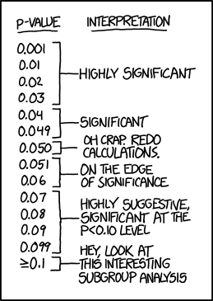
Criticisms of hypothesis testing (4 of 4)
Cartoon showing interpretation of various p-values
Notes:
I have to end with another cartoon. Both of these cartoons were drawn by Scott Munro, the creator of the xkcd comic series.
This is a cartoon showing a table of p-values with various labels.
0.001, 0.01, 0.02, and 0.03 are labeled “Highly Significant”.
0.04 and 0.049 are labeled “Significant”.
0.050 is labeled “Oh crap. Redo calculations.” This is because no one knows what exactly to do with a p-value that is right on the boundary.
0.051, 0.06 are labeled “On the edge of significance”. If these values are on the edge of significance then the 0.04 and 0.049 should share that same label. But no one uses these hedging terms unless they are on the “wrong” side of 0.05.
0.07, 0.08, 0.09, 0.099 are labeled “Highly suggestive, relevant at the p<0.10 level”. I personally don’t have a complaint here, but others consider this a post hoc modification and a form of p-hacking.
≥0.1 is labeled “Hey, look at this interesting subgroup analysis”. This is a reference to p-hacking. If your primary p-value is not statistically significant, hunt for some other p-values.

Slide 47
A simple example of Bayesian data analysis.
ECMO study
Treatment versus control, mortality endpoint
Treatment: 28 of 29 babies survived
Control: 6 of 10 babies survived
Source: Jim Albert in the Journal of Statistics Education (1995, vol. 3 no. 3) which is available on the web at www.amstat.org/publications/jse/v3n3/albert.html.
Notes:
Bayesian data analysis seems hard, and it is. Even for me, I struggle with understanding Bayesian data analysis. In fairness, I must admit that much of my discomfort is just lack of experience with Bayesian methods. In fact, I’ve found that in some ways, Bayesian data analysis is simpler than classical data analysis. You, too, can understand Bayesian data analysis, even if you’ll never be an expert at it. There’s a wonderful example of Bayesian data analysis at work that is simple and fun. It’s taken directly from an article by Jim Albert in the Journal of Statistics Education (1995, vol. 3 no. 3) which is available on the web at www.amstat.org/publications/jse/v3n3/albert.html.
I want to use his second example, involving a comparison of ECMO to conventional therapy in the treatment of babies with severe respiratory failure. In this study, 28 of 29 babies assigned to ECMO survived and 6 of 10 babies assigned to conventional therapy survived. Refer to the Albert article for the source of the original data. Before I show how Jim Albert tackled a Bayesian analysis of this data, let me review the general paradigm of Bayesian data analysis.

Slide 48
Wikipedia introduction
P(H|E) = P(E|H) P(H) / P(E)
H = hypothesis
E = evidence
P(H) = prior
P(E|H) = likelihood
P(H|E) = posterior
Notes:
Wikipedia gives a nice general introduction to the concept of Bayesian data analysis with the following formula:
P(H|E) = P(E|H) P(H) / P(E)
where H represents a particular hypothesis, and E represents evidence (data). P, of course, stands for probability.

Slide 49
Prior distribution
Degree of belief
Based on previous studies
Subjective opinion (!?!)
Examples of subjective opinions
Simpler is better
Be cautious about subgroup analysis
Biological mechanism adds evidence
Flat or non-informative prior
Notes:
The first step is to specify P(H), which is called the prior probability. Specifying the prior probability is probably the one aspect of Bayesian data analysis that causes the most controversy. The prior probability represents the degree of belief that you have in a particular hypothesis prior to collection of your data. The prior distribution can incorporate data from previous related studies or it can incorporate subjective impressions of the researcher. What!?! you’re saying right now. Aren’t statistics supposed to remove the need for subjective opinions? There is a lot that can be written about this, but I would just like to note a few things.
First, it is impossible to totally remove subjective opinion from a data analysis. You can’t do research without adopting some informal rules. These rules may be reasonable, they may be supported to some extent by empirical data, but they are still applied in a largely subjective fashion. Here are some of the subjective beliefs that I use in my work:
You should always prefer a simple model to a complex model if both predict the data with the same level of precision.
You should be cautious about any subgroup finding that was not pre-specified in the research protocol.
if you can find a plausible biological mechanism, that adds credibility to your results.
Advocates of Bayesian data analysis will point out that use of prior distributions will force you to explicitly state some of the subjective opinions that you bring with you to the data analysis.
Second, the use of a range of prior distributions can help resolve controversies involving conflicting beliefs. For example, an important research question is whether a research finding should “close the book” to further research. If data indicates a negative result, and this result is negative even using an optimistic prior probability, then all researchers, even those with the most optimistic hopes for the therapy, should move on. Similarly, if the data indicates a positive result, and this result is positive even using a pessimistic prior probability, then it’s time for everyone to adopt the new therapy. Now, you shouldn’t let the research agenda be held hostage by extremely optimistic or pessimistic priors, but if any reasonable prior indicates the same final result, then any reasonable person should close the book on this research area.
Third, while Bayesian data analysis allows you to incorporate subjective opinions into your prior probability, it does not require you to incorporate subjectivity. Many Bayesian data analyses use what it called a diffuse or non-informative prior distribution. This is a prior distribution that is neither optimistic nor pessimistic, but spreads the probability more or less evenly across all hypotheses.

Slide 50
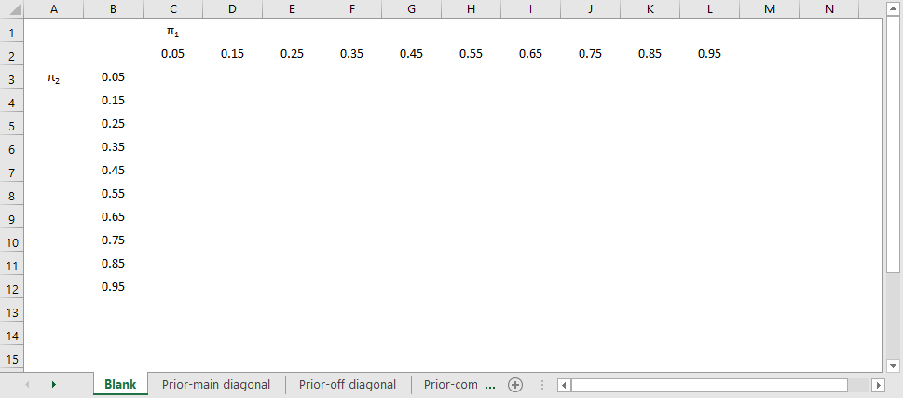
Lay out the parameters
Blank sheet listing ECMO and control probabilities
Notes:
Here’s an example of a very simple Bayesian analysis. The columns, pi1, represent the population proportion of infants on ECMO who survive. We hope that the results will be on the right hand side, but we don’t know until we run the experiment.
The rows represent the population proportion of infants in the control group who survive. We’d like to see the values near the bottom rather than the top, but in a population of very premature births, this is not guaranteed.

Slide 51
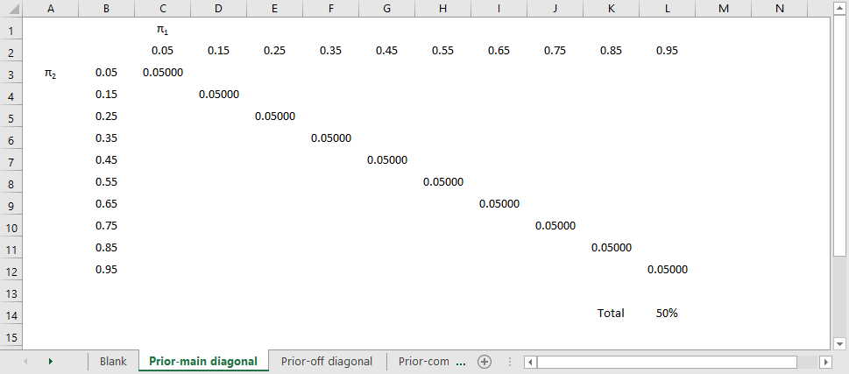
Place half the probability on the diagonal
ECMO and control main diagonal prior probabilities
Notes:
We don’t know if ECMO is better or worse, so let’s start out by placing half the probability along the diagonal. The diagonal here represents all the cases where the survival probability on ECMO equals the survival probability in the control group. There are ten diagonal cells, so it seems fair to divide the 50% probability into ten pieces of 5% each.

Slide 52
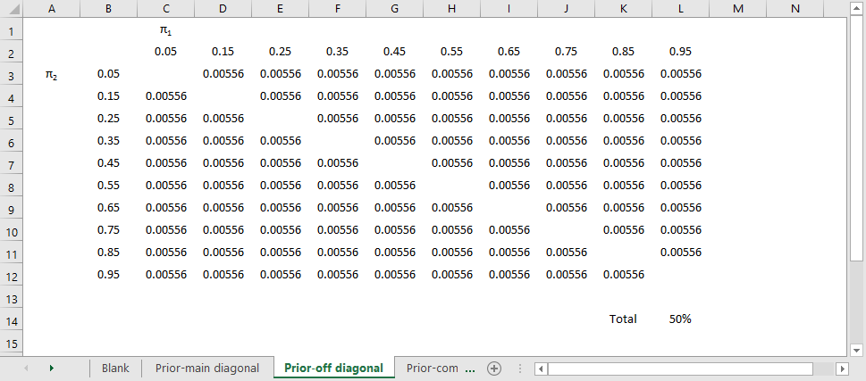
Difuse prior
ECMO and control off diagonal prior probabilities
Notes:
Now spread out the remaining 50% of the probability across the remainder of the table. There are 90 cells remaining, so when you divide 50% by 90, you get 0.56%. Notice that the upper triangle gets just as much probabilty as the lower triangle. if the parameter were found in the upper triangle, that would represent cases where ECMO has a higher survival rate than the control group.

Slide 53
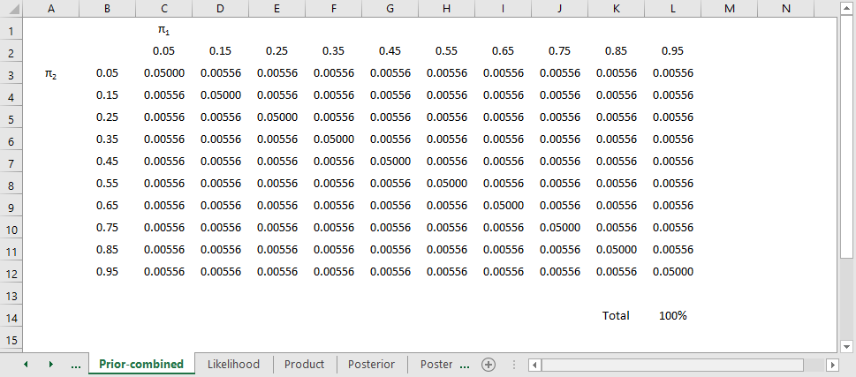
Difuse prior
ECMO and control combined prior probabilities
Notes:
Put these two together and check that the total probability is 100%. These represents your prior belief, and since this study was run before there was much research, it makes sense to spread the probability more or less evenly across the table, but also spliting the data so that the probability on the diagonal, the probability of the null hypothesis, is the same as the probabilty off the diagonal, the probability of the alternative hypothesis.
Now if the thought of assigning probabilities to hypotheses prior to collecting data makes you feel queasy, you are in good company. But bear with me for a moment.

Slide 54
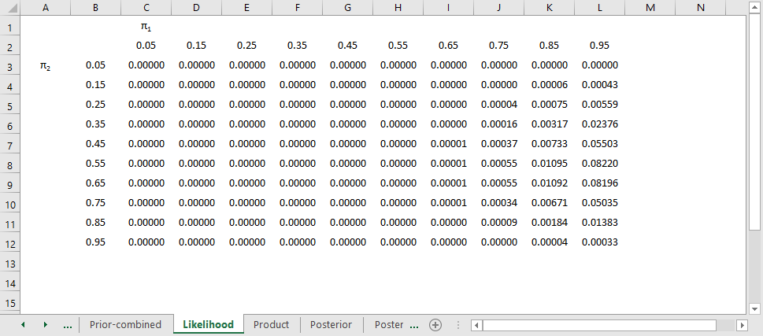
Likelihood
Likelihoods
Notes:
The second step in a Bayesian data analysis is to calculate P(E | H), the probability of the observed data under each hypothesis. If the ECMO survival rate is 90% and the conventional therapy survival rate is 60%, then the probability of observed 28 out of 29 survivors in the ECMO group is 152 out of one thousand, the probability of observing 6 out of 10 survivors in the conventional therapy group is 251 out of one thousand. The product of those two probabilities is 38,152 out of one million which we can round to 38 out of one thousand. If you’ve forgotten how to calculate probabilities like this, that’s okay. It involves the binomial distribution, and there are functions in many programs that will produce this calculation for you. In Microsoft Excel, for example, you can use the following formula.
binomdist(28,29,0.95FALSE)*binomdist(6,10,0.65,FALSE)
The table above shows the binomial probabilities under each of the 100 different hypotheses. Many of the probabilities are much smaller than one out of one thousand. The likelihood of seeing 28 survivals out of 29 babies in the ECMO survivals is very small when the hypothesized survival rate is 15%, 35%, or even 55%. Very small probabilities are represented by zeros.

Slide 55
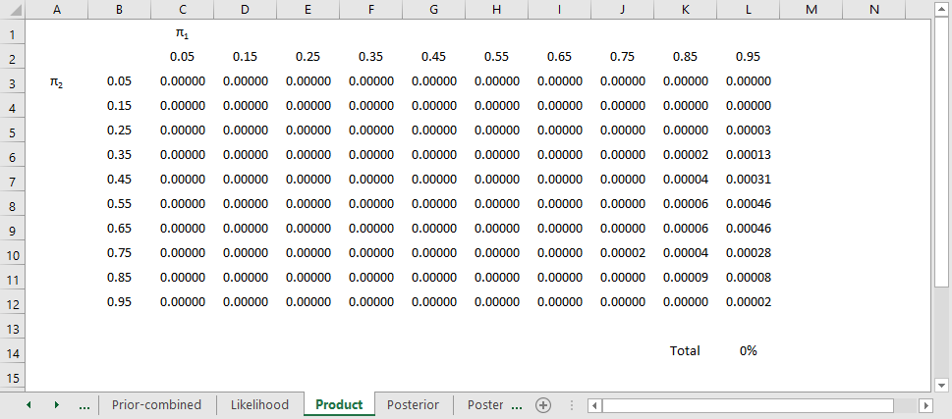
Multiply
Product of prior and Likelihood
Notes:
Now multiply the prior probability of each hypothesis by the likelihood of the data under each hypothesis. For ECMO=0.9, conventional therapy=0.6, this product is 5 out of a thousand times 38 out of a thousand, which equals 190 out of a million (actually it is 173 out of a million when you don’t round the data so much). For ECMO=conventional=0.8, the product is 45 out of a thousand times 1 out of a thousand, or 45 out of a million.
This table shows the product of the prior probabilities and the likelihoods. We’re almost done, but there is one catch. These numbers do not add up to 1 (they add up to 794 out of a million), so we need to rescale them. We divide by P(E) which is defined in the wikipedia article as
P(E) = P(E|H1) P(H1) + P(E|H2) P(H2) + …
In the example shown here, this calculation is pretty easy: add up the 121 cells to get 794 out of a million and then divide each cell by that sum. For more complex setting, this calculation requires some calculus, which should put some fear and dread into most of you. It turns out that even experts in Calculus will find it impossible to get an answer for some data analysis settings, so often Bayesian data analysis requires computer simulations at this point.

Slide 56
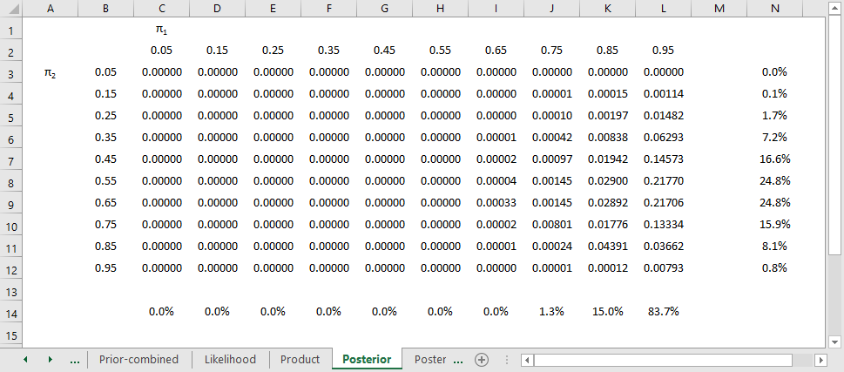
Standardize
Posterior probabilities
Notes:
Here’s the table after standardizing all the terms so they add up to 1.
This table is the posterior probabilities, P(H | E). You can calculate the probability that ECMO is exactly 10% better than conventional therapy (0+0+…+1+13+84+0 = 98 out of a thousand), that ECMO is exactly 20% better (0+0+…+13+218+0 = 231 out of a thousand), exactly 30% better (0+0+…+7+178+0 = 185 out of a thousand), and so forth.
Here’s something fun that Dr. Albert didn’t show. You could take each of the cells in the table, compute a ratio of survival rates and then calculate the median of these ratios as 1.5 (see above for details). You might argue that 1.33 is a “better” median because 448 is closer to 500 than 666, and I wouldn’t argue too much with you about that choice.

Slide 57
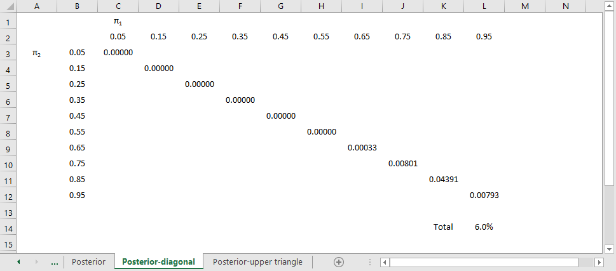
Posterior
Posterior probabilities, main diagonal
Notes:
You can combine and manipulate these posterior probabilities far more easily than classical statistics would allow. For example, how likely are we to believe the hypothesis that ECMO and conventional therapy have the same survival rates? Just add the cells along the diagonal to get 6.0%. Prior to collecting the data, we placed the probability that the two rates were equal at 500 out of a thousand, so the data has greatly (but not completely) dissuaded us from this belief.

Slide 58
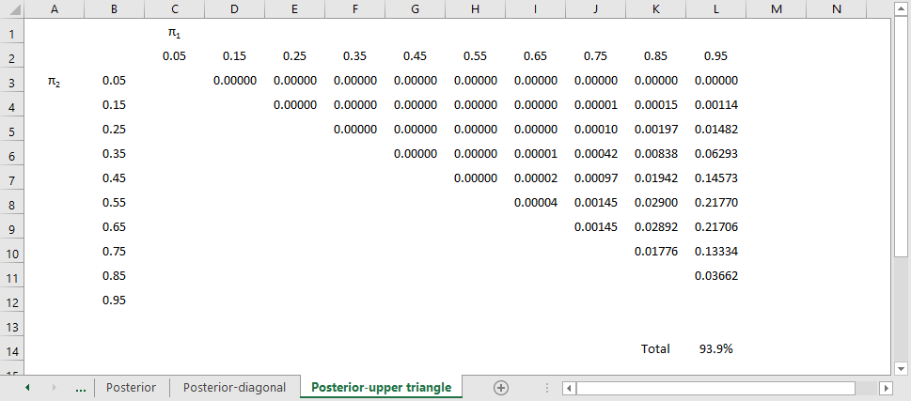
Posterior
Posterior probabilities, upper triangle
Notes:
The probability of the upper triangle is 93.9%. That’s pretty strong evidence that ECMO is superior. There’s a lot more you can do with this data, but I just wanted to give you a small taste of how a Bayesian analysis works. First, you lay out the possible values for the population parameters. Then specify probabilities for these parameters. If you do not have a strong prior belief, or if you do not want to incorporate your prior beliefs into the analysis, spread out the probabilities in a more or less uniform fashion. Then calculate the likelihood of the data for each set of population parameters. In a survival setting, this is just a binomial distribution. Multiply the prior times the likelihood and standardize. The resulting matrix is a set of probabilities that you can sum up or manipulate in other ways.

Slide 59
Sixth break
What have you learned?
Criticisms of hypothesis testing
Bayesian data analysis
What’s coming next?
Scales of measurement
Ordinal verus interval controversy

Slide 60
Measurement
Traditional levels (scales) of measurement
Nominal
Ordinal
Interval
Ratio
Special cases
Binary data
Count data, rate data
Time-to-event
Notes:
Measurement scales are an important, but controversial, categorization of the types of variables used in research. They help you decide what statistics are appropriate for your data. I don’t want to get to deeply into this, but I do want to give you enough context so that you can write a decent data analysis plan for your methods section.
There are four categories: nominal, ordinal, interval, and ratio, that were first described by a psychologist, S.S. Stevens, over 80 years ago.
Nominal data is categorical, meaning a small number of values. An additional requirement for nominal data is that order is not important. If you can re-order the list of categories without causing too much fuss, you have nominal data. Examples of nominal data include race, gender, and geographic region.
Ordinal data is also categorical, but you cannot re-order the list without changing things. Order is important. All Likert scale items are ordinal. Military ranks are ordinal. Education levels are ordinal, more or less, but if you make distinctions along the level of M.D. versus Ph.D., it is not. Use a bit of common sense. It works just fine for High school, some college, two year degree, four year degree, graduate/professional degree. Stages of cancer is another example.
Interval data and ratio data are two types of continuous data. Don’t worry too much about the distinction between interval and ratio. It is not that important. The very important distinction is between ordinal data and interval data.
For an interval scale, the difference of one unit means the same thing when you are on the low end versus the high end of the scale. Examples of interval scales include temperature and IQ tests.
for a ratio scale, the ratio of two measurements means the same thing when you are on the low end versus the high end of the scale. Concepts such as “twice as much” are meaningful for ratio data. Ratio data also have a fixed zero point. Examples of ratio scales include birth weight, age, income.
There are three special cases worth describing.
Binary data is data that only has two possible values. Examples include yes/no responses, gender (male/female, assuming that transgender is not an issue), and correct/incorrect responses on a test. Don’t bother making a distinction between nominal or ordinal data if your variable is binary. There is no way to re-order the data if there are only two values, except for the trivial case of reversing the two levels. It is best to treat binary data as a subset of nominal data.
Count data is a type of ratio data, but it is a bit unsual because it cannot include fractional or decimal values. It is also bounded below by zero. For the most part, you can treat count data as ratio data, except that linear regression does not work well for count data. Count data almost always violates the linear regression assumptions of normality and homogeneity of variance.
Time-to-event data is also a type of ratio data, but it is also a bit unusual. Time-to-event data almost always has censored values, values where the event has not occurred yet. It also is bounded below by zero. It also tends to violate the same assumptions in linear regression: normality and homogeneity.
A neagtive requirement for ordinal data is that sums computed on an ordinal scale are meaningless. You can’t talk about how a private plus a sergeant is equal to two corporals, even though you might code private=1, corporal=2, sergeant=3.

Slide 61
ordinal verus interval controversy
Example: grade point average
Two B’s equal and A plus a C?
Shift from A to B versus a shift from D to F?
Likert scale
Is an average meaningful?
Independent variable for linear regression?
Dependent variable for linear regression?
Is a sum of Likert scale items different?
Purist versus pragmatist

Slide 62
Permissible statistical summaries
Nominal: percentage, mode
Ordinal: median
Interval: mean, standard deviation
Ratio: Coefficient of variation
Special cases
Notes:
For nominal data, there are very few numeric summaries that are meaningful. You can’t compute a standard deviation for gender or an average race. About the only meaningful numeric summary for nominal data is percentages. You could compute a mode, the most frequently occurring value, but this is not used all that often.
For ordinal data, you can compute the median in addtion to percentages. You might also compute other percentiles like the quartiles. But an average is not a good option here.
You can, however, compute an average for interval data, as well as a standard deviation.
The ratio scale allows you to calculate one additional statistic, the coefficient of variance, but this is hardly worth mentioning. The coefficient of variance, if you are curious, is computed as the standard deviation divided by the mean. It is a unitless measure of spread, which is helpful at times. But quite honestly, there is almost no practical difference between interval data and ratio data.
There is a natural hierarchy to these measurements in that any statistic that can be used to summarize nominal data can also be used to summarize ordinal, interval, or ratio data. Any statistic that can be used to summarize ordinal data can also be used to summarize interval or ratio data. Finally, any statistic that can be used to summarize interval data can also be used to summarize ratio data.

Slide 63
Permissible models
Special cases
Binary: Logistic regression
Counts: Poisson regression
Time-to-event data: Cox proportional hazards regression
Nominal: Chi-square tests
Ordinal: Non-parametric tests
Interval/ratio: linear regression
Notes:
In addition to the permissible statistical summaries, there are permissible statistical models. Let’s deal with the special cases first.

Slide 64
Seventh break
What have you learned?
Scales of measurement
Ordinal verus interval controversy
What’s coming next?
Descriptive statistics
Linear regression

Slide 65
Descriptive statistics
Part of every quantitative study
Table 1, overall summaries
Outcomes and covariates
Means and standard deviations
Percentages (always show denominator)
Key subgroup comparisons
Crosstabulations
Means/standard deviations by subgroup
Notes:
Your descriptive statistics should be a part of any research study. This is done in almost every research paper and it almost always appears as the first table in your paper. So we sometimes call these table 1 statistics.
Your descriptive statistics should include your outcome variables, most certainly, but also your covariates. Covariates are variables that are not of direct interest but which can potentially influence your outcome anyway. This includes, in any human study, things like age and gender.
if your data are continuous (interval or ratio scale), summarize your data with a mean and standard deviation. Some people advocate a different summary if your data is skewed, using the median and the range, for example, instead of the mean and standard deviation. There is no consensus on how much the data has to be skewed, or even if you need to switch at all. I, for one, see the mean and standard deviation as useful summaries, even for skewed data, but I am in a minority on this.
For categorical outcomes summarize using a percentage. Always show what your numerator and denominator would be if you report percentages.
If you want to compare across key demographic groups, use crosstabulations for categorical outcomes and means/standard deviations by subgroup for continuous outcomes.
Let me talk a bit about crosstabulations because these are almost always done poorly.

Slide 66
Rules for crosstabulations
Never display multiple statistics
Place treatment/exposure categories in the rows
Summarize using row percentages
Many rows, not many columns
Round liberally.
Notes:
When you are deciding how to display two by two (or larger) tables, you have a variety of ways to do this. No way is correct all the time, and some of choices reflect subjective judgment. But here are some rules I use.
Never display more than one type of number in a table. Statistical software like SPSS can produce counts, row percents, column percents, cell percents, expected counts, residuals, and/or cell contribution to chi-squared values. At one time or another you might want to use each of these statistics, but never all at one time. Two or more numbers in a table causes confusion and makes your tables harder to interpret.
Present a single summary statistic in the table if at all possible. If you need to display two summary statistics (for example, both counts and row percentages), then place the counts in one table and the row percentages in a different table. If you have to fit them in the same table, place the two numbers side by side with the less important number appearing second and in parentheses For example, 54% (257).
Row percentages are usually best. Row percentages are the percentages you compute by dividing each count by the row total. Row percentages place the comparison between two numbers within a single column, so that one number is directly beneath the number you want to compare it to. This is usually better than column percents, where the numbers you want to compare are side by side. If you find that column percentages make more sense. Consider swapping the rows and columns.
If you find that cell percentages make the most sense, consider creating composite categories that combine the row and column categories. Cell percentages are the percentages that you get when you divide each cell count by the overall total. When cell percents are interesting, it usually means that you are interested in the four distinct categories in your two by two table. For example, you are interested in seeing what fraction of job candidates are white males, rather than seeing how the probability of being male influences the probability of being white. For this type of data, treat it as a single categorical variable with four levels (white males, white females, black males, black females) rather than two categorical variables with each having two levels (black/white, male/female).
Place the treatment/exposure variable as rows and outcome variable as columns. This relates to the above item. You usually are interested in the probability of an outcome like death or disease, and you are interested in how this probability changes when the treatment or exposure changes. Arranging the table thusly and using row percents usually gets you the comparison you are interested in.
If one variable has a lot more levels than the other variable, place that variable in rows. A table that is tall and thin is usually easier to read than a table that is short and wide. It is easier to scroll up and down rather than left and right. For a really large number of levels, you might have to print your table on two or more pages. Usually it is a lot easier to align these pages if the table is tall and thin. A short wide table that is split on two or more pages is often a disaster.
Whenever you report percentages, always round. A change on the order of tenths of a percent are almost never interesting or important. Displaying that tenth of a percent makes it harder to manipulate the numbers to see the big picture.
Don’t worry about whether your percentages add up to 99% or 101%. First of all, it can’t happen with a two by two table unless you round incorrectly. For a larger table, it can happen, but your audience is sophisticated enough to understand why this is the case. No one, for example, is going to be upset when 33% plus 33% plus 33% adds up to less than 100%.
When in doubt, write out your table several different ways. Pick out the one that gives the clearest picture of what is really happening. Don’t rely on the first draft of your table, just like you would never rely on the first draft of your writing.

Slide 67
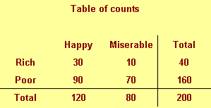
Table of percentages
Notes:
A simple fictitious example will help illustrate these points.
We classify people by their income (rich/poor) and also by their attitude (happy/miserable). There are, for example, 30 rich happy people in our sample and 70 poor miserable people.

Slide 68
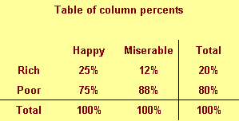
Table of column percentages
Notes:
This figure shows column percentages. We compute this by dividing each number by the column total.
We see for example that only 25% of all happy people are rich. This is a conditional probability and is usually written as P[Rich | Happy]. Read the vertical bar as “given.” So this probability is read as the probability of being rich given that you are happy.

Slide 69
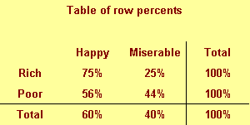
Table of row percentages
Notes:
This figure shows row percentages. We compute this by dividing each number by the row total.
We see, for example that 75% of rich people are happy. This is a different conditional probability, P[Happy | Rich]. Read this as the probability of being happy given that you are rich.
Notice the distinction between the two probabilities. Only a few happy people are rich, but most rich people are happy.

Slide 70
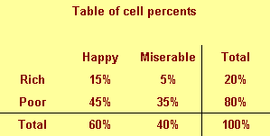
Table of cell percentages
Notes:
This figure shows cell percentages. We compute this by dividing each number by the grand total. Each percentage represents the probability of having two conditions. For example, there is a 15% chance of being rich and happy.

Slide 71
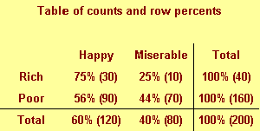
Combining two numbers
Notes:
The table above shows a good format for combining two numbers in a single table.

Slide 72
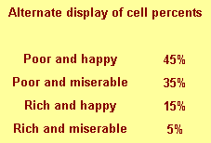
Table of percentages
Notes:
This is an alternate way of displaying cell percentages.
If we had a six categories for attitude rather than just two, we might arrange the table differently.

Slide 73
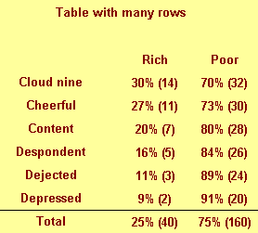
Table of percentages
Notes:
Notice that this table would not require any sideways scrolling.

Slide 74
Rules for crosstabulations
Never display multiple statistics
Place treatment/exposure categories in the rows
Summarize using row percentages
Many rows, not many columns
Round liberally.
Notes:
Here are those rules again.
Never display more than one type of number in a table.
Place the treatment/exposure variable as rows and outcome variable as columns.
Row percentages are usually best.
If one variable has a lot more levels than the other variable, place that variable in rows.
Whenever you report percentages, always round.
Don’t worry about whether your percentages add up to 99% or 101%.
When in doubt, write out your table several different ways.

Slide 75
Graphs
Overall summaries
Histograms for continuous data
Bar/pie charts for categorical data
Assessing relationships
Side by side pie/bar charts
Boxplots
Scatterplots

Slide 76
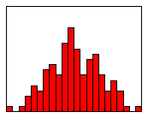
Histogram examples (1 of 3)
Histogram showing a roughly bell shaped curve

Slide 77
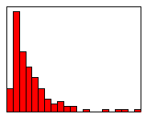
Histogram examples (2 of 3)
Histogram showing a skewed right distribution

Slide 78
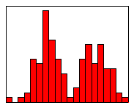
Histogram examples (3 of 3)
Histogram showing a bimodal distribution

Slide 79
Side by side pie/bar charts
Pies and bars only work well for 2 or 3 categories
Pacman charts
No good graphs for more categories
Avoid cheap 3D effects

Slide 80

Boxplot
Notes:
The box plot is a graphical display of a five number summary. Sometimes the box plot is also known as a box and whiskers plot. It is very useful for examining relationships between a categorical variable and a continuous variable.
Here are the four steps you follow to draw a boxplot.
Draw a box from the 25th to the 75th percentile.
Split the box with a line at the median.
Draw a thin lines (whisker) from the 75th percentile up to the maximum value.
Draw another thin line from the 25th percentile down to the minimum value.
The length of the box in a box plot, i.e., the distance between the 25th and 75th percentiles, is known as the interquartile range. You can use this box length to detect outliers. If any whisker is more than 1.5 times as long as the length of the box, then we have evidence of outliers. A common variation on the box plot is to draw the whisker to the value which is just shy of 1.5 box lengths away, and highlight each individual data point more than 1.5 box lengths away.
The boxplot is useful for comparing the distributions of two different groups. If the median in one box exceeds the end of the box of the other group, that is evidence of a “large” discrepancy between the two groups. What passes as the median for one group would actually be the 25th or 75th percentile of the other group.
Just about any statistical software program (SAS, SPSS, Stata, R, etc.) can produce boxplots and you can find code to produce boxplots in many programming languages.
Notice that these boxplots are horizontal rather than vertical. The main reason to turn these 90 degrees is if your labels and axes fit better this way.

Slide 81
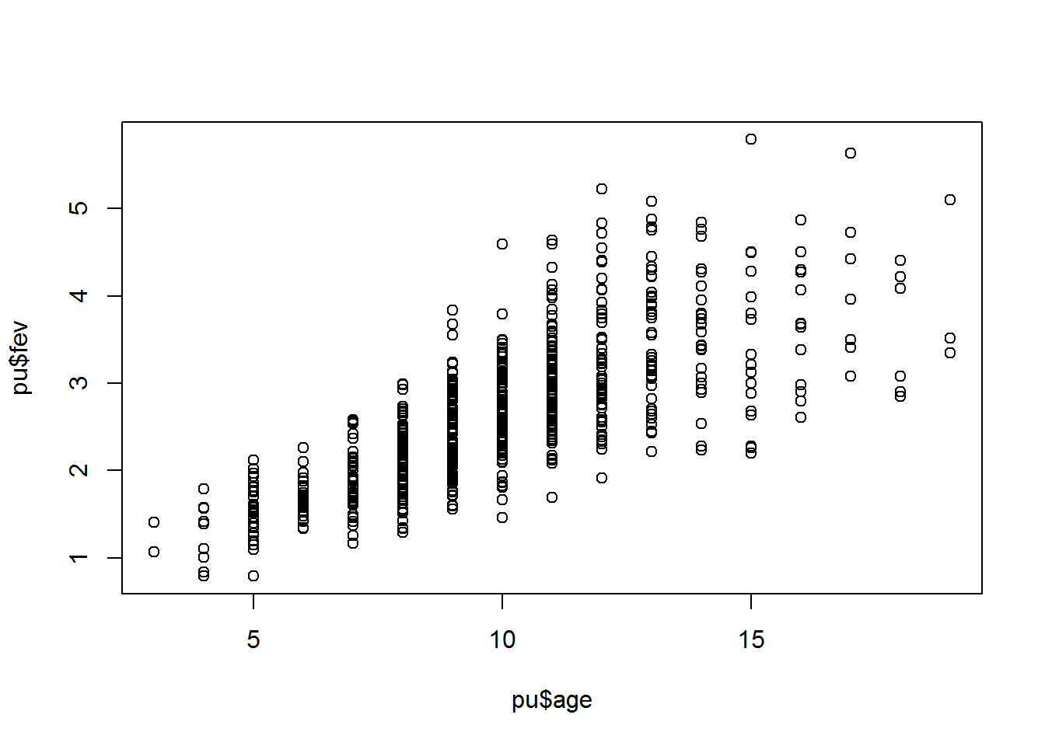
Scatterplot
Notes:
This is a scatterplot, a useful way to summarize the association between two continuous variables.
Often a trend line or a smoothing curve helps. This seems to be the case when you have a lot of data, meaning a lot of overprinting, and the data is fairly noisy.

Slide 82
Quality checks (internal use, mostly)
Minimum and maximum checks
Out of range
Zero variation
Missing value count
List five five rows, last five rows
Correlations
Notes:
There are some descriptive statistics that you should run just for your own benefit. Check the minimum and maximum values for every numeric variable in your data set. I received a data set with a bunch of 5 point Likert scale items and for most of the variables, the minimum was 1, but the maximum was 33 or 55. Guess what happened?
Get a missing value count and monitor it closely. See if there are odd patterns, such as the missing values declining over time but then jumping back up at the end. It could be normal, but it could be an indication of a problem.
When you get correlations, look for unexpected patterns, such as a negative correlation where a positive one was expected. It could be okay, or it could mean that the scales on a Likert scale got switched around halfway through the survey due to a misprint.

Slide 83
Data reduction
Check composite scores
Check Cronbach’s alpha
Examine leaving out single items
Factor analysis, Structural Equations Modeling

Slide 84
Data transformations
Ideal - selected a priori
Sometimes based on precedent
Sometimes motivated by theory
Sometimes based on empirical findings
Log transformation
Collapse low frequency categories

Slide 85
Linear regression
High school algebra
Y = m X + b
m = Δy / Δx
The slope represents the estimated average change in Y when X increases by one unit.
The intercept represents the estimated average value of Y when X equals zero.
Notes:
When I ask most people to remember their high school algebra class, I get a mixture of reactions. Most recoil in horror. About one in every four people say they liked that class. Personally, I thought that algebra, and all the other math classes I took were great because they didn’t require writing a term paper.
One formula in algebra that most people can recall is the formula for a straight line. Actually, there are several different formulas, but the one that most people cite is
Y = m X + b
where m represents the slope, and b represents the y-intercept (we’ll call it just the intercept here). They can also sometimes remember the formula for the slope:
m = Δy / Δx
In English, we would say that this is the change in y divided by the change in x.
In linear regression, we use a straight linear to estimate a trend in data. We can’t always draw a straight line that passes through every data point, but we can find a line that “comes close” to most of the data. This line is an estimate, and we interpret the slope and the intercept of this line as follows:
The slope represents the estimated average change in Y when X increases by one unit.
The intercept represents the estimated average value of Y when X equals zero.
Be cautious with your interpretation of the intercept. Sometimes the value X=0 is impossible, implausible, or represents a dangerous extrapolation outside the range of the data.

Slide 86
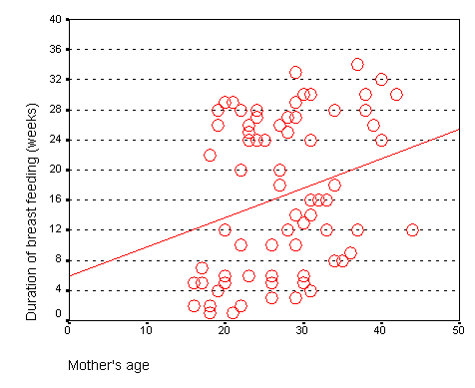
Age vs duration
Notes:
The graph shown below represents the relationship between mother’s age and the duration of breast feeding in a research study on breast feeding in pre-term infants.
The regression coefficients are shown below. The intercept, 6, is represented the estimated average duration of breast feeding for a mother that is zero years old. This is an impossible value, so the interpretation is not useful. What is useful, is the interpretation of the slope.
Notice that a 20 year old mother has a duration of 13 weeks. A 40 year old mother has a duration of 21 weeks.
Calculate 21-13 divided by 40-20 equals 8 divided by 20 equals 0.4. The estimated average duration of breast feeding increases by 0.4 weeks for every extra year in the mother’s age.

Slide 87
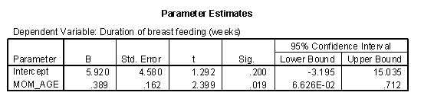
Age vs duration

Slide 88
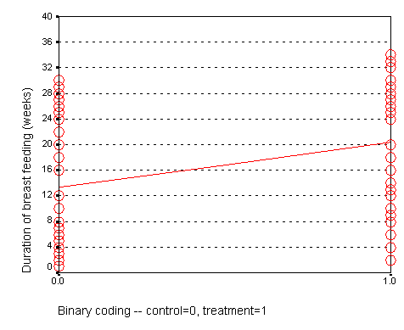
Treatment vs duration
Notes:
When X is categorical, the interpretation changes somewhat. Let’s look at the simplest situation, a binary variable. A binary variable can have only two possible categories. Some examples are live/dead, treatment/control, diseased/healthy, male/female. We need to assign number codes to the categories. Most people assign the codes 1 and 2, but it is actually better to assign the codes 0 and 1.
In a study of breast feeding, we have a treatment group and a control group. Let us label the treatment group as 1 and the control group as 0. The outcome variable is the age when breast feeding stopped.
In this situation, the intercept, 13, represents the average duration for the control group.
Calculate 20-13 divided by 1-0.
The slope is 7, which is the change in the average duration when we move from the control group to the treatment group.
When we represent a binary variable using 0-1 coding, the slope represents the estimated average change in Y when you switch from one group to the other.
The intercept represents the estimated average value of Y for the group coded as zero.

Slide 89
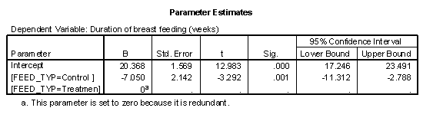
Treatment vs duration

Slide 90
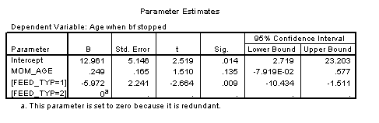
Adjusted
Notes:
There are two types of models, crude models and adjusted models. A crude model looks at how a single factor affects your outcome measure and ignores potential covariates. An adjusted model incorporates these potential covariaties. Start with a crude model. It’s simpler and it helps you to get a quick overview of how things are panning out. Then continue by making adjustments for important confounders.
A crude model for comparing duration of breast feeding to feeding group would be a t-test. I prefer, however, to present a general linear model because it provides a unifying framework for diverse statistical methods like analysis of variance, analysis of covariance, multiple linear regression, repeated measures designs, and t-tests.
Shown below is the table of tests from the general linear model procedure.
The general linear model uses an F test instead of the t test, but in this context, these two tests are mathematically equivalent. The p-value for comparing feeding groups is .001, which indicates a significant difference between the two groups.
The general linear model also has a table of estimates, which is presented below.
The intercept represents the average duration of breast feeding for the NG tube group. We see that the average duration is 20 weeks for the NG tube group. The (FEED_TYP=1) term is an estimate of how much the average duration changes when we move from the NG tube group to the bottle group. We see that the bottle group has an average duration that is 7 weeks shorter.
Shown below is a table of means from the general linear model.
We see that the difference between the two means is roughly 7 weeks, which confirms the results shown previously.
The previous model was a crude model. We see a seven week difference between the two groups, but could some of all of this difference be due to the fact that the NG tube group had older mothers? To answer this, we need to fit an adjusted model.
Shown below is the table of tests for a general linear model that includes mother’s age in the model.
The p-value for feeding group is .009, which is still significant, even after adjusting for the effect of mother’s age.
Shown below is the table of estimates from the same general linear model.
This table shows that the effect of bottle feeding is to decrease duration of breast feeding by about six weeks, after adjusting for mother’s age. Each year that a mother is older increase the duration of breast feeding by a quarter of a week.
A previous descriptive analysis of this data revealed that the average age for mothers in the treatment group is 29 years and the average age for mothers in the control group is 25 years. When you see a discrepancy like this in an important covariate, you need to assess whether the four year gap in average ages could account for part or all of the effect of the treatment group.
This analysis shows that the four year gap only accounts for a small portion of the difference. Since each year of age changes the duration by a quarter week, this means that the difference between mother’s ages acounts for just one week in the 7 week difference we saw in the crude model.
Shown below is the table of means.
This table now adjusts for mother’s age. The mean for the bottle fed group is adjusted upward to what it would be if the average age of the mothers in this group were 27 rather than 25. The mean for the NG tube group is adjusted downward to what it would be if the average age were 27 instead of 29. Note that the adjusted mean duration is half a week higher than the crude mean duration in the bottle group and that the adjusted mean duration is half a week lower than the crude mean duration for the NG tube group. This confirms that the difference between the two feeding groups is roughly 6 weeks, after adjusting for mother’s age. This is one week less than the crude model.
This is not the final model. We should examine the effect of delivery type and account for the fact that we have some data on twins. I hope, though, that this presentation gives you a general idea of what crude and adjusted models are.

Slide 91
Seventh break
What have you learned?
Descriptive statistics
Linear regression
What’s coming next?
Logistic regression
Poisson regression

Slide 92
Eight break
What have you learned?
Logistic regression
Poisson regression
What’s coming next?
Cox regression

Slide 93
Ninth break
What have you learned?
Cox regression
What’s coming next?
Qualitative data analysis

Slide 94
Analysis of Qualitative Data-resources
Typically, a one-hour interview requires a minimum of three to four hours (or more) of analysis.
Involve the participants in the process, especially for narrative research.
Tools:
focus groups
semi-structured interviews
participant observation
archival records

Slide 95
Tools

Slide 96
Inductive process
Start with the specific (raw data / transcript)
Develop a theoretical framework from the data
Conceptual categories emerge from the data
Iterative process
Define the process
Who does the work
Privacy protections
How you will adapt
Notes:
Quantitative analysis is almost always structured and defined in detail prior to data collection. But qualitative analysis is different. You are trying to build a theoretical frame work from data, so you are moving from specific data to a generality. This is known as inductive research. You are using small pieces of text to develop broad themes and establish an overarching pattern or framework.
You data collection may change as you collect information. I was helping a group of nurses who were running some focus groups (I didn’t do too much other than observe from a distance). A big pattern emerged with the very first focus group. There was a generational difference in norms and expectations. So much so that the first focus group almost devolved into a shouting match. So the nurses decided to ask lots of questions about generational issues and they also decided wisely to separate the boomer generation from the Xers.
So if things can and should change as you collect data, how do you write a methods section? You have to focus on the process. Well there are small things, such as who does the questions in the interviews, how the interviews will be recorded and transcibed, and so forth. You should mention privacy protections.
Most importantly, if you expect to let the early data drive how you will collect later data collection efforts, say this explicitly and explain what you will be looking for as you decide how and when to make mid-course adaptations.

Slide 97
Analysis process for qualitative data
Your research question is only your starting point.
Don’t let your question blind you to new information
Build themes before you complete your data collection
Check back against the raw data
Look for negative examples
Don’t ignore infrequently voiced themes
When have you achieved saturation?
Notes:
Software allows you to go back and forth between themes and the original text. Cross-referencing is important. Find examples easily. It helps provide validity checks. Does someone agree with your categorization.
Categories need to be faithful to the data. This is internal validity. But you need to place this in a broader understanding.
You need to be careful about trying to quantify this too much. Keep in mind that just because someone talks about something a lot does not mean that this is the most important thing to them. The most important thing might be something that people are uncomfortable talking about.
Phrasing of the person versus observations generated by the researcher. Labels should be considered as provisional as you work with more complete information. It is an iterative process. Go back to original data. You’re looking at the specific of what’s been told versus a broader understanding.
Establishing the criteria may depend on how many people are doing the coding. If you don’t have a pre-existing structure, the coding may evolve and may involve 100% review (both raters review everything and resolve discrepancy). Then a third person does an audit.
The point at which you are not gaining any new insight, no new categories being identified, no new relationships being defined. Saturation is a way to assess your sample size. Have you gotten a representative amount of data.
Really important to keep notes of the coding and analysis process, so you can check your work. Allows you to do qualirty checks on the process.

Slide 98
Role of Judgment
Balancing act
Level of creativity by coder to identify categories/relationships
Must reflect the informants thoughts
Audit of the coding by an independent person can check for the match between the coding and the source information
Look for “negative cases”

Slide 99
Tenth break
What have you learned?
Qualitative data analysis
What’s coming next?
Writing a methods section

Slide 100
What purpose does a methods section serve?
Assessment of the quality of your research
Brag here about your rigor
Save limitations for discussion
Allow others to replicate

Slide 101
What should not be included in the methods section
“The Methods section should include only information that was available at the time the plan or protocol for the study was being written; all information obtained during the study belongs in the Results section.”
International Commitee of Medical Journal Editors. Uniform requirements for manuscripts submitted to biomedical journals: Writing and editing for biomedical publication. J Pharmacol Pharmacother. 2010;1(1):42–58.

Slide 102
Sections of a methods section
Participants, Procedure, Measures/Materials, Analysis section (Frye, no date)

Slide 103
Sections of a methods section
Subjects, Ethical considerations, Preparations, Protocol design, Measurements and calculations, Data analysis (Kallet 2004)

Slide 104
Sections of a methods section
Participants, Materials (Stimuli, Testing materials, Background questionnaire), Procedure (Tasks, Design and analyses)

Slide 105
Sections of a methods section
What materials did you use? Who were the subjects of your study? What was the design of your research? What procedure did you follow? (Kallestinova 2011)

Slide 106
Sections of a methods section
Selection and description of participants, Technical information, Statistics. International Commitee of Medical Journal Editors 2010.

Slide 107
Sections of a methods section
Materials (Chemical, Experimental materials, Experimental animals, Human subjects), Methods (Study design, Measurements/assessments, Statistical analyses) (Ghasemi 2019)

Slide 108
Standard boilerplate
“Continuous variables were summarized as means and SDs, and categorical variables were summarized as percentages.” Saleem 2019.
“All tests were two sided, and P values below the 5% level were regarded as significant.” Lokken 1995.
Notes:
Boilerplate refers to text that is used so often and without any changes that you can safely use it in your publication without fear of being accused of plagiarism. The first boilerplate comes early in your data analysis methods, and describes how you are summarizing continuous variables using means and standard deviations and summarizing categorical variables using percentages. The second boilerplate mentions that all of your statistical tests are two sided (which they are 90% of the time) and that you use an alpha level of 0.05 to decide what is statistically significant (which you do 99.99% of the time).

Slide 109
Conclusion
Hypothesis testing
p-values and confidence intervals
Sample size justification
Scales of measurement
Descriptive statistics
Linear, logistic, Poisson, and Cox regression
Analysis of qualitative data
Writing a methods section

