Slide 1
Video 01 - Introduction to Clinical Research Methods
Steve Simon

Slide 2
Learning objectives
To demonstrate an understanding of the course structure and expectations
To define clinical research
To distinguish between qualitative and quantitative research and identify when each type of research is called for.
Notes:
Here are the objectives for this week.

Slide 3
Required reading
Gliner, Morgan, and Leech, Chapter 1
Conroy. Where do research ideas come from? Available in html format.
Locklear. Patient Reported Outcomes. Available in html format. (Recommended, not required)
Deshpande. Patient-reported outcomes: A new era in clinical research. Available in html format and pdf format. (Recommended, not required)
Notes:
This is what you should have read already. If you haven’t done the reading yet, pause this video and read this material. You’ll get more out of the video if you do so.

Slide 4
What is research?
" systematic investigation, including research development, testing, and evaluation, designed to develop or contribute to generalizable knowledge"
45 CFR 46.102
“Disciplined method” or “disciplined inquiry”
“dispassionate search for truth”
not dependent on surface plausibility or the status of the author.
Gliner, Morgan, Leech. Research Methods in Applied Settings.
Notes:
Let’s define the three words “clinical research methodology.” Start with “research.” I like the federal government’s definition. The key words in this definition are “generalizable knowledge.” If you don’t hope to extrapolate beyond the range of the data you collect, it isn’t research.
Gliner, Morgan, and Leech emphasize research as a disciplined method. The quote from a 1981 source that emphasizes a dispassionate search for truth and independence from preconceived notions.
Both definitions are good, but I like the government definition for its simplicity.

Slide 5
What is clinical? What is methodology?
Clinical: “concerned with or based on actual observation and treatment of disease in patients rather than experimentation or theory.”
Dictionary.com
Methodology: “a body of methods, rules, and postulates employed by a discipline : a particular procedure or set of procedures”
Merriam-Webster dictionary
Notes:
The classic dictionary definitions for “clinical” and “methodology” work just fine. “Clinical” places the emphasis on patients and methodology is a body of rules.
Now some of you may be interested in non-clinical research, such as animal studies or computer simulations. These types of research will not be covered explicitly in this course, but there is enough commonality that you can still learn a lot of things that will help you in your research career.

Slide 6
Where do research ideas come from?
Ronan Conroy has an excellent summary.
Exploring your environment.
Don’t focus prematurely on a single idea.
Extending the ideas of others.
Getting a research idea by reading papers.
Notes:
There’s an excellent summary of how to come up with a research idea that I was asked to host on my website. It was collated from various postings on an email discussion group by Ronan Conroy.
The ideas are all good, but let me emphasize the importance of reading. Almost every research paper includes suggestions for further research in their discussion section. This is free advice from researchers who have proved that they can get their work published.

Slide 7
Uses of clinical research
Theory development.
Practical application.
Development of research tools.
Professional development.
Notes:
There are many reasons to conduct research. You can develop knowledge for its own sake or for a practical application. You can also conduct research to improve the research process (this is an area I am very interested in). You can also conduct research for your own professional development. Nothing makes you a better consumer of other people’s research than doing a bit of research yourself.

Slide 8
Research dichotomies
Dichotomies are always wrong.
Trichotomies.
Monochotomies.
Spectrum.
But they are still useful.
Shorthand for others.
Guidance for statistical analysis.
Helpful for critical appraisal.
No “best” level in these dichotomies.
Mixed methods.
Notes:
Your book emphasizes six (actually seven) research dichotomies. All dichotomies are false dichotomies. Some dichotomies are actually three levels (trichotomies) or more and some dichotomies are creating a division that doesn’t really exist (monochotomies).
What you might call a dichotomy may actually be a continuum like a spectrum or gradient and the choice between what goes on the left side versus what goes on the right is purely arbitrary. Imagine a sunrise on a cloudy day. It starts out dark but gradually gets a bit brighter until eventually is becomes daylight. Where is the dividing line between day and night when you can’t see when, exactly, the sun peeks over the horizon?
But these are still useful because classifying research into category A versus category B provides a shorthand that helps others understand your research. It also provides guidance as to what sort of statistical analysis is most appropriate and helps with critical appraisal of the research literature.
There is a tendency for some people to embrace one end of the dichotomy and sneer at anyone who adopts the other end. This is a big mistake and something that I have very little patience for. A good researcher uses more than one approach to research. To say, for example, that quantitative research is “hard” science and qualitative research is “soft” science is both inaccurate and fails to recognize that both approaches are needed if we want to make any scientific progress.
There’s nothing wrong with using both ends of a dichotomy in a single research study. This goes by the term “mixed methods.”

Slide 9
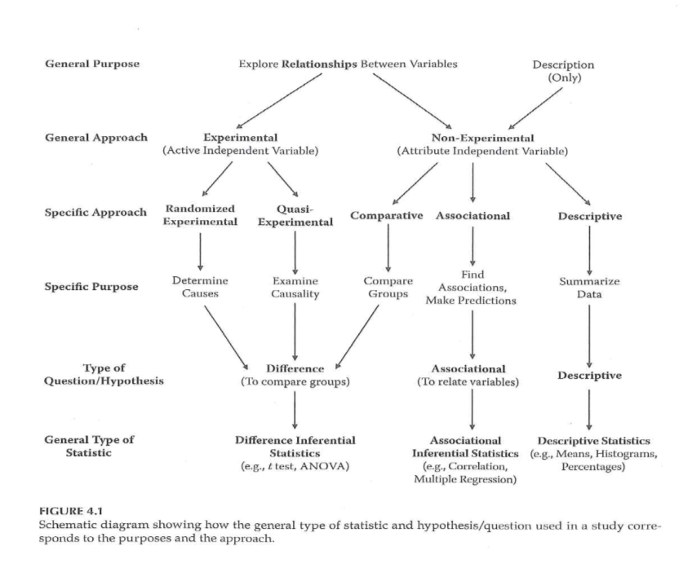
Schematic diagram of research
Schematic diagram of research
Notes:
I wanted to share this image with you early because it shows some of the dichotomies in research and how it influences what statistics you should use. I have never liked these sorts of diagrams because there are always so many exceptions to the rules they propose. But a diagram like this is still useful because it gives you a starting point for your work. Just don’t let yourself be constrained too much by this diagram. Consider it a recommendation rather than a requirement.
We’ll come back to this diagram later in this video.

Slide 10
Theoretical versus applied
Theoretical: no benefit to patients now.
Applied: potential for immediate benefit.
“Experience by itself teaches nothing… Without theory, experience has no meaning. Without theory, one has no questions to ask. Hence, without theory, there is no learning.”
W. Edwards Deming, in The New Economics for Industry, Government, Education.
Notes:
The distinction between theoretical and applied research is in when you expect to see something of value to your patients. Theoretical research has no immediate benefit to your patients, and could potentially never offer direct benefits to your patients.
There’s a tendency of some applied researchers to sneer at theoretical research. But this is terribly wrong as this quote from W. Edwards Deming explains. Theory is what allows us to make sense of our observations of the world.
Without a theoretical framework to support it, applied research is impossible. The other value of theory is that it allows you to generalize to new settings where observations have never been made before. So I’m a big fan of theory, myself.

Slide 11
Laboratory versus field.
Laboratory: controlled setting
Unnatural.
Control extraneous variables.
Field setting: in the clinic
Ecologic validity: “the methods, materials and setting of the study must approximate the real-world that is being examined.”
Source: Wikipedia.
Notes:
The second dichotomy is laboratory versus field research. Laboratory research is done in a controlled setting and has a greater level of control. The big criticism of laboratory studies is that they are “unnatural” and do not reflect how clinical care is actually provided. In fairness, almost all research has an artificiality associated with it. It’s just that the laboratory is even more artificial than field research.
Field settings provide what the authors describe as “ecologic validity.” This is a term I’d not heard before but the definition is quite simple. The Wikipedia definition is as good as any.

Slide 12
Participant report versus researcher observation
Participant report.
Either written or oral.
Only practical approach for pain, quality of life.
Also known as Patient Reported Outcomes (PRO).
Researcher observation.
Also includes instruments like a heart rate monitor.
Perceived as more objective.
Notes:
Another dichotomy in research involves who is providing the data for the research study. If the patient is providing the data (either through an interview or through their writing), you get something “straight from the horse’s mouth.” There’s always the concern that patients might say things to please the researcher or hide things that they might be embarrassed about. Certain things like pain and quality of life can be measured in no other way. Note that a lot of the resources for patient report appears under the acronym PRO (Patient Reported Outcome). Two good PRO references are a chapter in the NIH Collaboratory Living Textbook of Pragmatic Clinical Trials and a nice 2011 overview article in Perspectives in Clinical Research. See the readings slide for more details.
In contrast to a patient report, the physician or other care giver could provide the data. The data could also come from a machine like a blood pressure cuff or a heart rate monitor. Researcher observation is perceived by many to be more objective, but I disagree.

Slide 13
Quantitative research versus qualitative research
Quantitative research.
Synonym(?): Positivistic.
Highly structured, A priori specifications.
Separates the researcher from the research.
Qualitative research.
Synoynms(?): Constructivist, humanist.
Covers five sub-areas: phenomological, grounded theory, ethnographic, case study, and narrative research.
Open ended questions. Research guides and is guided by the research process.
Postpositivism tries to reconcile quantitative and qualitative approaches.
Notes:
The next dichotomy is between qualitative research and quantitative research, but represents more of a philosohpical approach to research rather than any particular method of research.
There are synonyms for these approaches: positivism for quantitative research and constructivism for qualitative research.
The quantitative/positivist approach to research tries to separate the researcher from the research process. You specify all (or as many as possible) details of the research prior to data collection so that the researcher does not influence the objective collection of data.
The qualitative/constructivist approach to research rejects the idea of objective collection of data. Biases in the data collection process are inevitable because they are dependent on the paradigm or common way of thinking that researchers share. Rather than separate the researcher from the data collection once the protocol is writen, a qualitative approach inserts the researcher directly into the data collection and explicitly specifies the paradigm that should be used during the research process. The researcher influences the data collection and is simultaneously influenced by the data collection.
A defining characteristic of the qualitative/constructivist approach is the use of open ended questions that allow the participants to describe things from their own perspective.
There are attempts to reconcile these two philosophies. Postpositivism recognizes that you can’t totally remove the researcher from the data collection process but sees the quantitative philosophy as a way to minimize the unavoidable biases that all researchers have.
I tried to find some good resources on the web that discuss the quantitative and qualitative approaches to research, but I was not happy with any of them. I’d encourage you students to google this and share any resources that you find helpful.

Slide 14
Qualitative data versus quantitative data
Quantitative data.
Synonym(?): Objective data.
Easily quantified or classified.
Qualitative data.
Synoym(?): Subjective data.
Perceptions, feelings, attitudes.
“When you can measure what you are speaking about, and express it in numbers, you know something about it, when you cannot express it in numbers, your knowledge is of a meager and unsatisfactory kind; it may be the beginning of knowledge, but you have scarely, in your thoughts advanced to the stage of science.”
Lord Kelvin, as quoted at Goodreads
Notes:
Your book uses the adjectives quantitative/qualitative again to describe not the research approach, but the data itself.
If this weren’t confusing enough, qualitative data is sometimes defined as categorical data. I will try to avoid that language, because it makes qualitative data a subset of quantitative data. I prefer the terms categorical and continuous.
Although I don’t agree with it, I have to include this Lord Kelvin quote that argues for the superiority of quantitative data.
Quantitative data is data that is easily reduced to a number or category, while qualitative data is not so easily reduced. This is kind of a squishy definition because you can create categories (themes) from qualitative data, but it takes a lot of effort.
Why would you ever use qualitative data if it takes more effort? Qualitative data offers a richness that cannot often get captured by quantitative data.

Slide 15
Quantitative versus qualitative analysis
Quantitative analysis.
Synonyms(?): Statistical, inferential, confirmatory.
Numerical summaries.
Qualitative analysis.
Synonyms(?): Descriptive, exploratory.
Verbal summaries.
Notes:
Your book uses the adjectives quantitative and qualitative yet one more time to describe the analysis. Possible synonyms for quantitative analysis are statistical analysis and inferential analysis. I dislike the term “statistical analysis” because it fails to recognize the wide range of statistical analyses that can be done.
I tend to view this dichotomy as inferential statistics (statistics used to test a research hypothesis) versus descriptive statistics (statistics used to describe without a particular test in mind). The former includes p-values and confidence intervals, while the latter includes means, medians, ranges, standard deviations, and percentages.
I suspect that your book would draw the line further to one side. Means and percentages are numeric summaries and are therefore part of quantitative analysis, according to your book. This limits qualitative analysis to a verbal descriptions of the data.
I dislike this attempt to overload the words “quantitative” and “qualitative” with research approaches, data types and analysis methods. I will try to avoid these adjectives and use an appropriate synonym instead.

Slide 16
Translational versus basic
Basic research: “without thought of practical ends.”
National Science Foundation (1953) “What is Basic Research” published in the Third Annual Report of the National Science Foundation.
Translational research: transition from “bench to bedside.”
Called T1 research.
Next step (T2): transition from bedside to community.
T3, T4, T5???
Notes:
I find the term “translational” to be abused a lot, but it helps to understand the original definition. The translational/basic dichotomy is not too much different from the applied/theoretical dichotomy. Basic research is research done mostly in the laboratory and “without thought of practical ends.” Translational research represents a bridge between the laboratory and the real world. You’ll see the phrase “from bench to bedside” used in this context.
Some people subdivide translational research into two types with T1 research representing a bridge from the laboratory to the patient and T2 research representing a bridge from a the carefully controlled clinical trial to actual practice settings in the regular community.
Some people further divide translational research into even more categories, T3, T4, and even T5. If you have a good resource that explains clearly what T5 research is, I’d encourage you to share it with the rest of the class.
Like every other dichotomy, it is a mistake to view one side of the dichotomy as superior to the other.

Slide 17
Inductive versus deductive
Not the same as inductive/deductive reasoning.
Deductive: use theory to test a specific hypothesis
from general to specific.
Inductive: collect specific facts to build a theory
from specific to general.
often relies on qualitative research (grounded theory)
Notes:
Another important dichotomy is deductive versus inductive research. Note that this is not quite the same thing as inductive versus deductive reasoning.
With deductive research, you rely on a broad theory to identify specific hypotheses to test. You are moving from a general knowledge base to identify and test specific hypotheses that the theory would predict.
Inductive research collects specific facts and uses them to develop a novel theory. You are moving from the specific to the general. Often (but not always), an inductive research project relies on qualitative methods in general and a grounded theory approach.

Slide 18
Interrelationships
Examples of typical associations
Laboratory research and theoretical research.
Constructivist research and subjective data.
Plenty of exceptions, though.
Mixed methods studies.
Combination of constructivist and positivist approaches.
Sometimes called triangulation.
Pragmatic approach.
Notes:
With six dichotomies, there are two raised to the sixth power or 64 different types of research. But some of these dichotomies are more likely to appear together than others.
A laboratory study, for example, is fairly likely to be a theoretical study and a field study is fairly likeloy to be an applied study. A constructivist (qualitative) approach to research is fairly likely to collect subjective (qualitative) data.
But there are plenty of exceptions to these associations. Some field studies are theoretical and some lab studies are applied. A qualitative approach to research might often require the collection of quantitative data.
The term mixed methods means a mixture of both ends of the dichotomy: a collection of both quantitative and qualitative data, for example.
There is a term, triangulation, which is worth mentioning here, though it is not in your book. Have you ever wondered how a sailboat can sail into the wind? If the wind is coming from the west, how can you get a sailboat to go west? You sail for a short while to the northwest and then changes to turn southwest. Enough alternating, and you end up heading due west, not as fast as you’d like but you do end up getting there.
Triangulation in research is alternating between a constructivist approach that generates research ideas and a positivist approach that tests these new ideas. This leads to an exploration of more research ideas, more tests of those ideas, and so forth.
At the end of the chapter, your book offers what I think is a thoughtful choice: the pragmatic approach. A good researcher does not specialize in one particular type of research, but uses whatever approach is best for the particular research question.
I need to emphasize again that you never stand at one end of a dichotomy and criticize the other end. Don’t be an applied researcher who sneers at theoretical research.

Slide 19
Schematic diagram of research
Schematic diagram of research
Notes:
Here’s that diagram again. The “quantitative” parts of the dichotomy (positivist approach, objective data, and inferential statistics) tend to congregate on the left side of this chart and the “qualitative” parts of the dichotomy (constructivist approach, subjective data, and descriptive statistics) tend to congregate on the right side of this chart.
Don’t take this chart as a mandate, and certain research approaches are not confined unfailingly to one region or one path on this diagram. But when the seemingly infinite number of choices that you face in designing a research study can lead you to despair, the ability to focus on a smaller number of choices can help a lot.

Slide 20
Assignment
Complete and send in Syllabus Quiz. Quiz must be submitted by midnight, to be eligible to receive full credit.
Prepare for next week’s session.
Notes:
This is your homework assignment for this week.

Slide 21
Discussion questions
Please submit your posts by and comment on at least one other post by the following Wednesday.
Briefly describe your background and explain why are you interested in this course.
Find a research paper that is relevant to your work or area of study. This must be a paper with full free text available. Post the abstract of this article and a link to the full text. Review the dichotomies discussed in Chapter 1 and classify the paper into one of the two levels in each dichotomy, or classify it as a mixture of both levels of the dichotomies. If you are unsure about any classification, be honest about your uncertainty.
Review at least one other paper posted by another student and comment on their classifications.
Extra credit (one point). Find a peer-reviewed article or an article in the popular press on research methodology that relates to this week’s lecture material. Provide a three or four sentence summary and include a link, if the article is available openly, or attach a copy if it is not openly available. Please do not include any articles that are listed in the readings for this class or any articles that you have found on my website or blog.

