Slide 1
Video 7 - Formatting your literature review
Steve Simon

Slide 2
Learning objectives
To distinguish different types of quantitative non-experimental approaches
To discuss strengths and weaknesses of qualitative research
Notes:
Here are the objectives for this week.

Slide 3
Required reading
School of Graduate Studies. UMKC Guide to Formatting Theses and Dissertations. October 2010. Available in PDF format.
Notes:
This is what you should have read already. If you haven’t done the reading yet, pause this video and read this material. You’ll get more out of the video if you do so.

Slide 4
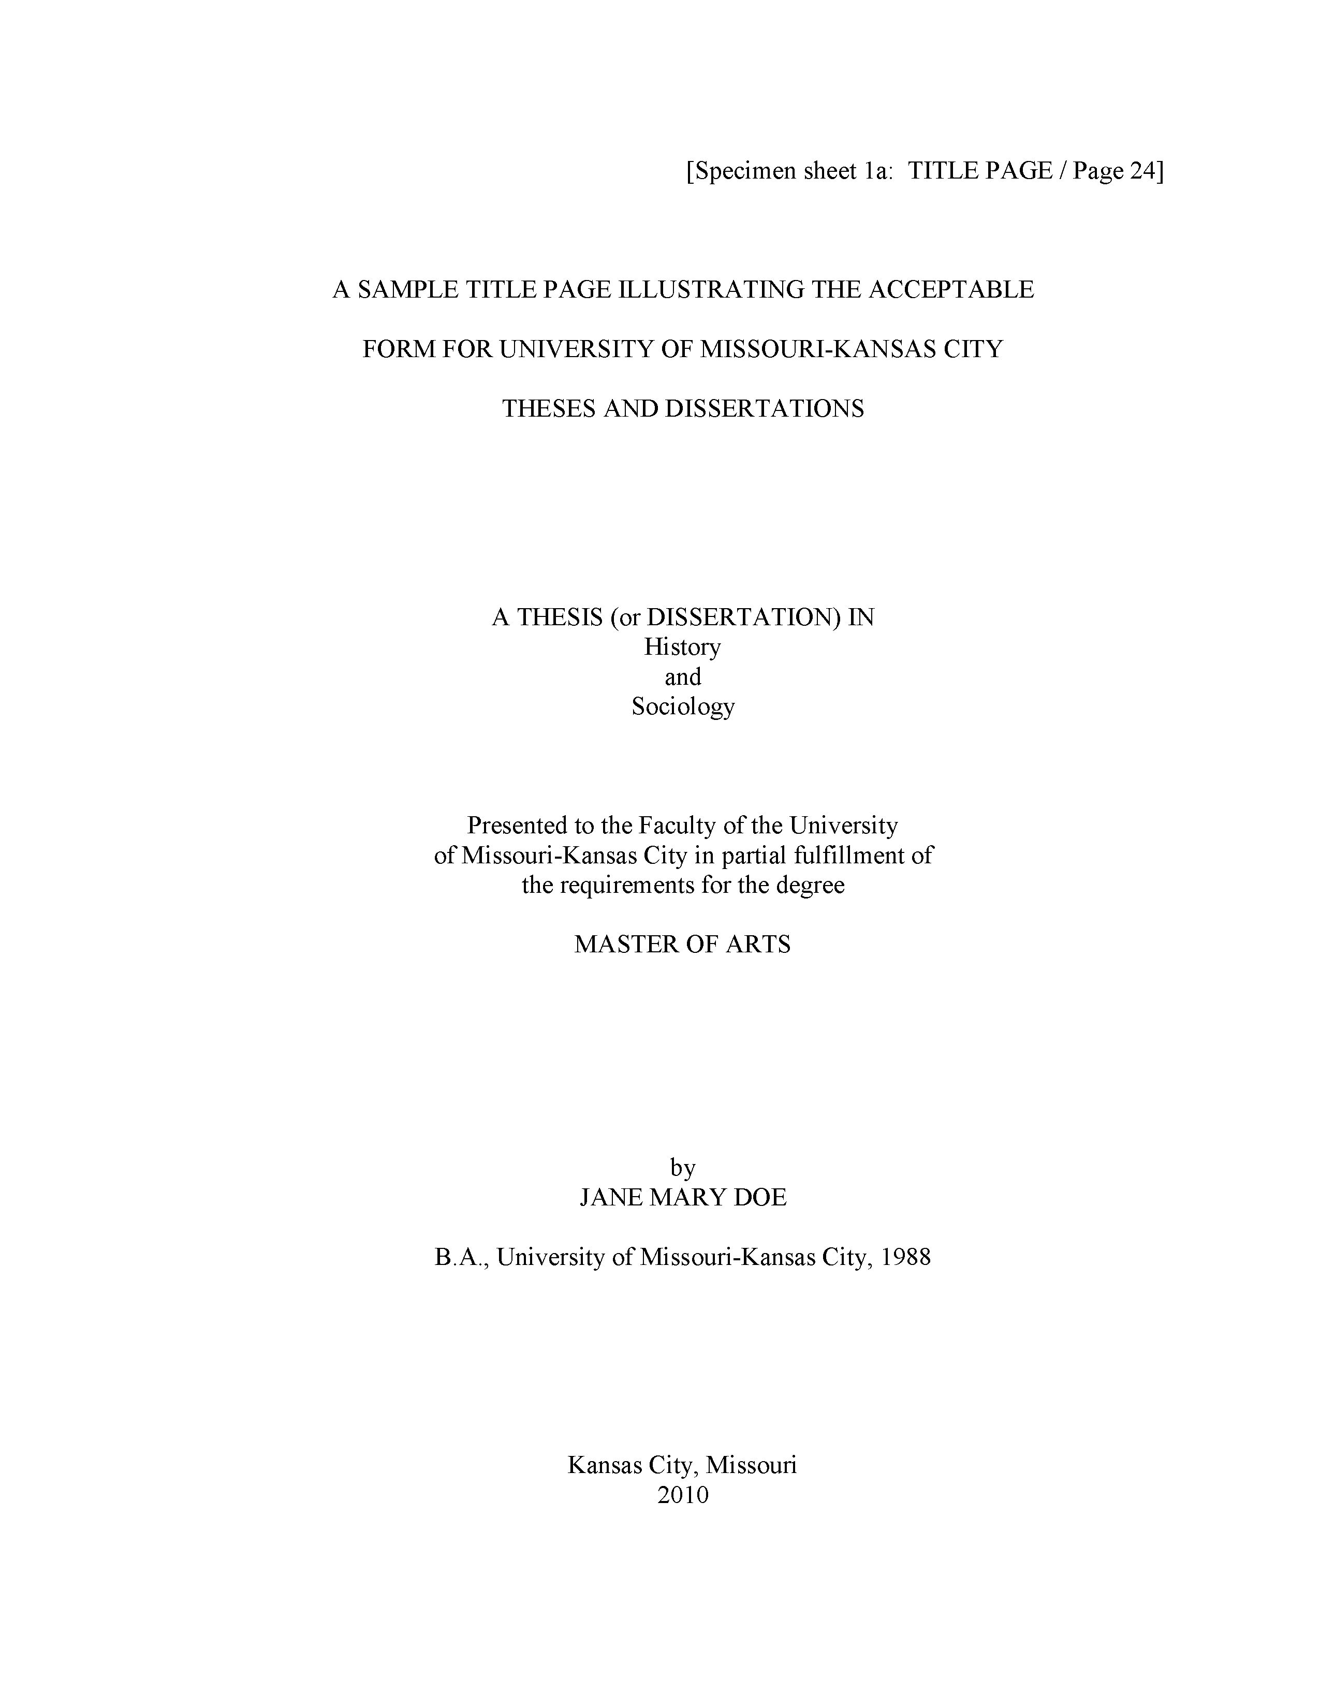
The title page
Notes:
Here is what your title page should look like. The fonts are small and hard to read, so I will zoom in on several sections.

Slide 5

The title page
Notes:
Don’t type the line in brackets.
Notice the extra generous top margin here. Also your title is centered in all caps and double spaced.
Change “History and Sociology” to your degree area.

Slide 6
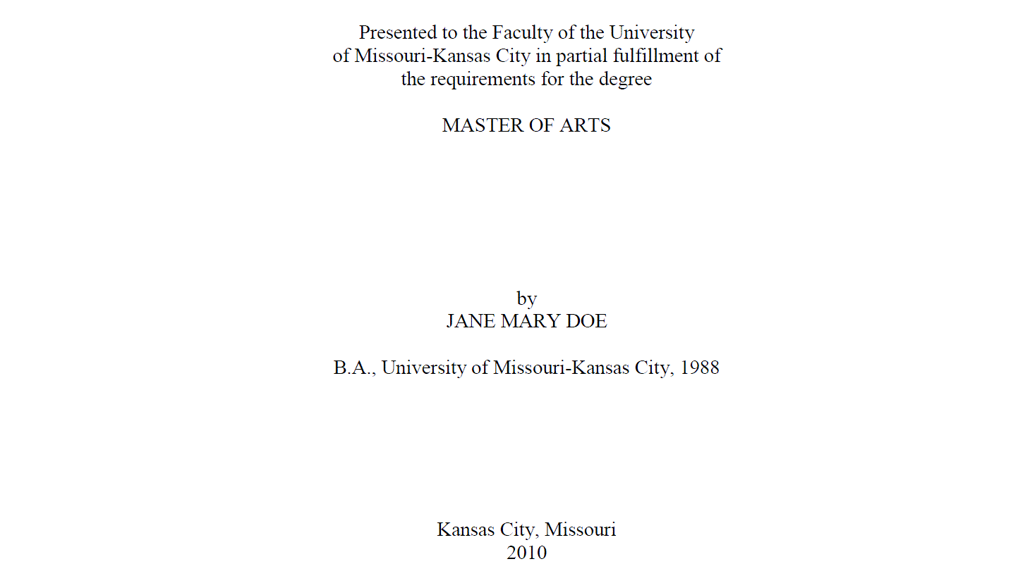
The title page
Notes:
Note the single spacing of the “Presented to” paragraph. Your degree is probably a Master of Science. Your full name is in all caps. Put the year you expect to graduate at the bottom. You can’t tell from this snip, but there is a generous bottom margin as well.

Slide 7
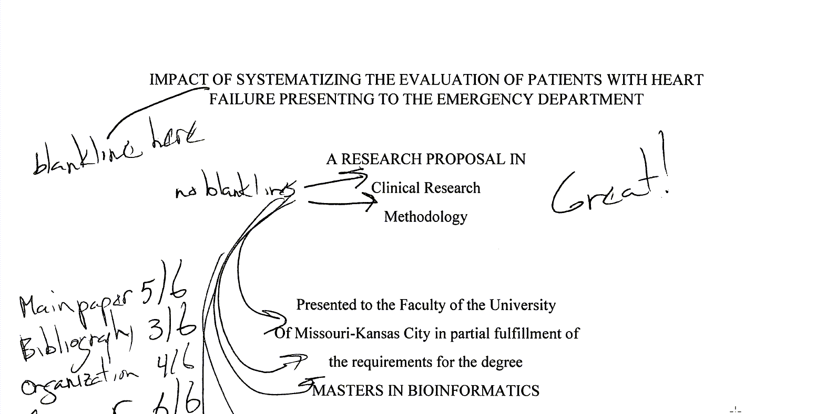
The title page
Notes:
Ths student single spaced where double spacing was needed and double spaced where single spacing was needed. Note that the “Great!” refers to the overall paper, adnd not the title page.

Slide 8
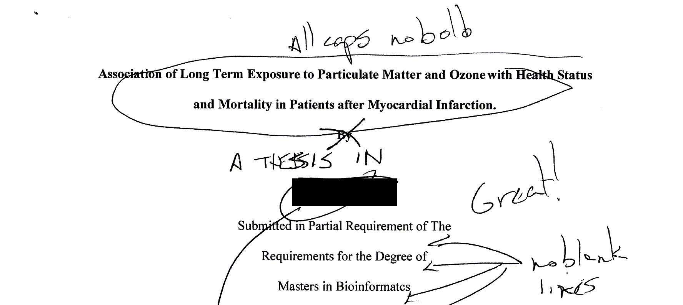
The title page
Notes:
This is a more serious deviation from the standard. The title should be all caps and no bold. The students name (which I have blacked out) comes in way to early. This student also forgot the “A THESIS IN” section. Notice again the problem of using double spacing in the wrong section.

Slide 9
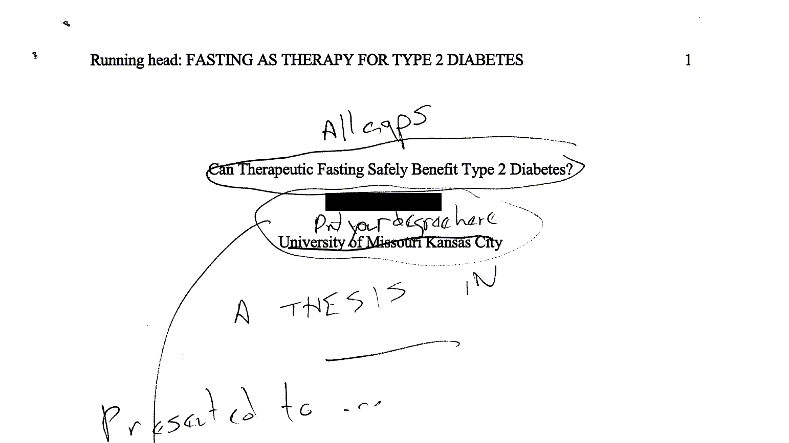
The title page
Notes:
This student, whose name is blocked out made many mistakes. There is no running head in a thesis, no page numbers in the upper right corner. Page numbers go in the bottom center and do not start until after the first two pages. The title needed to be all caps and the students name comes after the “A THESIS IN” and “Presented to” sections.

Slide 10
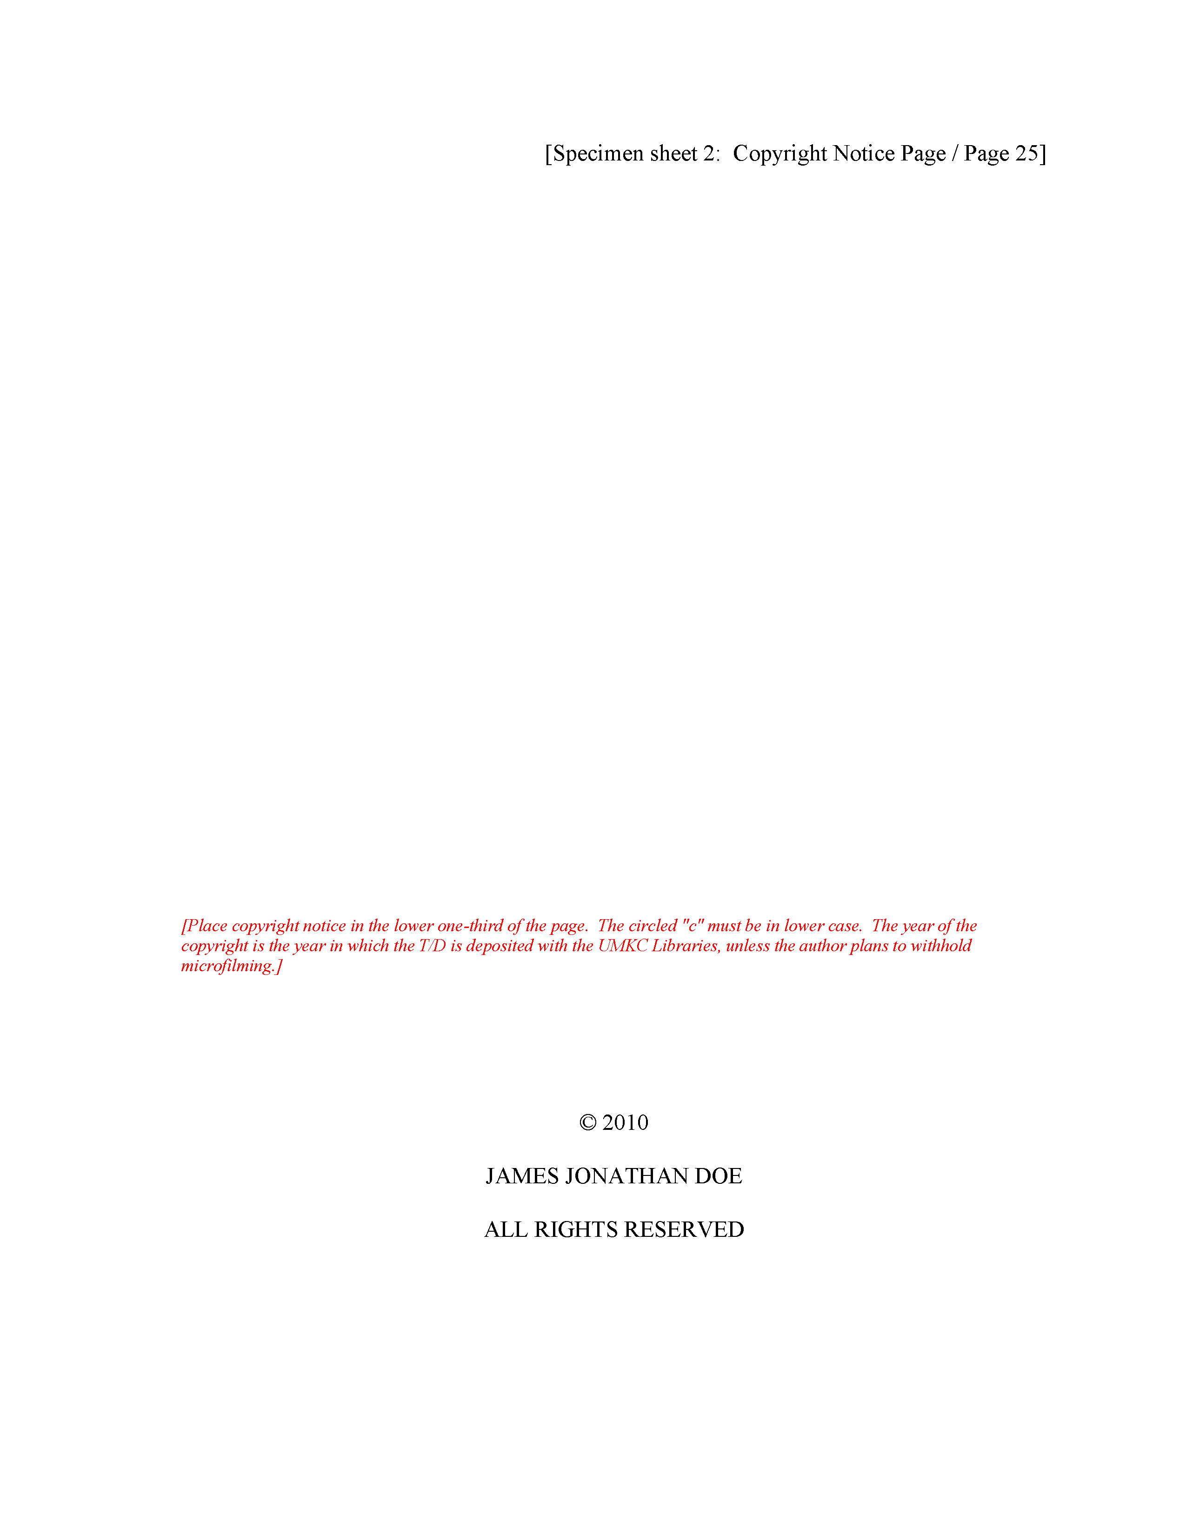
The copyright page
Notes:
Put in a second page, to keep with the format. This is the copyright page. Put your name in, and you have the option of using an open source license if you like.
It may seem wasteful to add a page like this, but I want you to get comfortable with the general thesis format. Anyway, you are submitting a PDF rather than a paper copy, so no trees will be lost in the process.

Slide 11

The copyright page
Notes:
Watch for little details. One student used bold which I commented on. I failed at the time to notice that everything on the copyright page is all uppercase. There’s also no copyright symbol (C within a circle). This is a minor deviation and probably did not lead to loss of more than a single point.
But please try to get these details down now. I do look for strict consistency to the published guidelines.

Slide 12
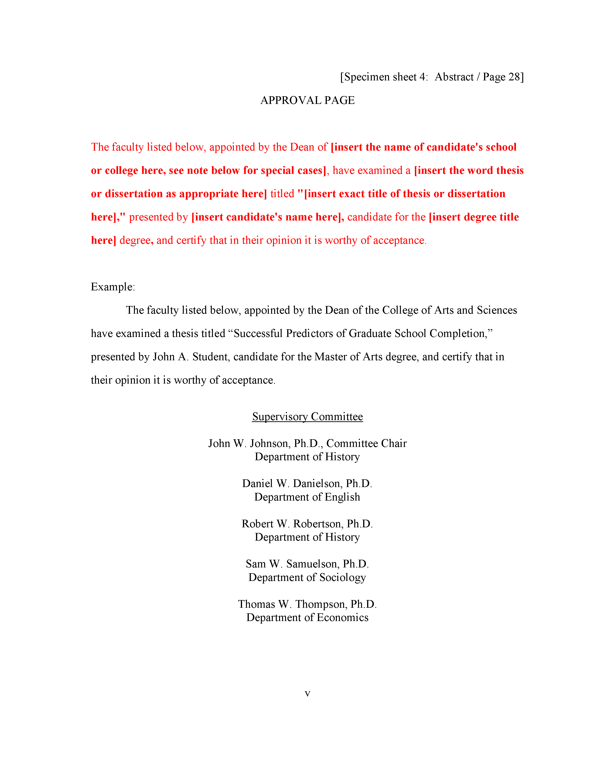
The approval page
Notes:
Also put in an approval page. Just make up some names, put my name in, put in some “To be added later” text. It doesn’t matter. Just make sure that you get the format right.

Slide 13
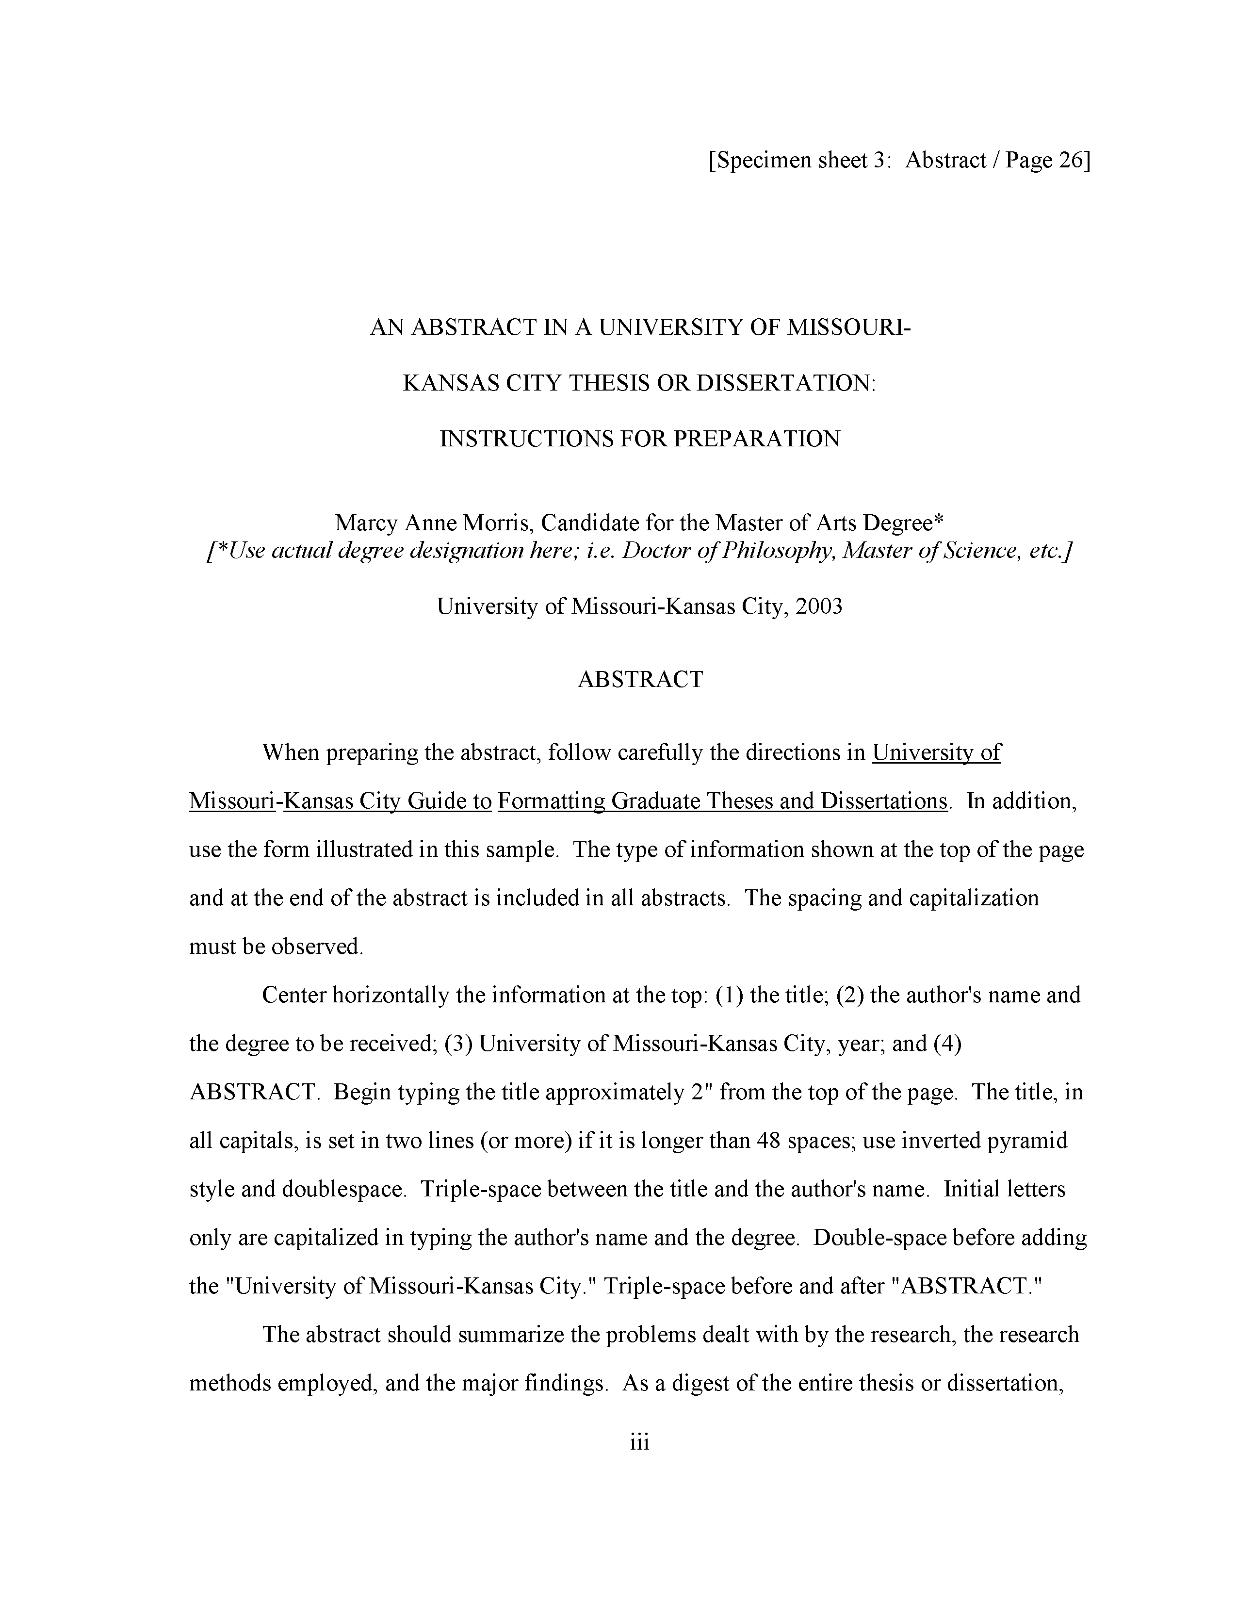
The abstract page
Notes:
Put in an abstract page, but list the abstract itself as “To be added later”. I am more interested in seeing if you can follow the format. ABSTRACT is centered and in all caps for example. Some of my students last year put in an abstract and that’s fine. I offered some comments and suggestions, but did not grade on the basis of what was in the abstract.
Of course, if you do include an abstract, do not talk about results. You don’t have any results, and don’t try to make them up.

Slide 14
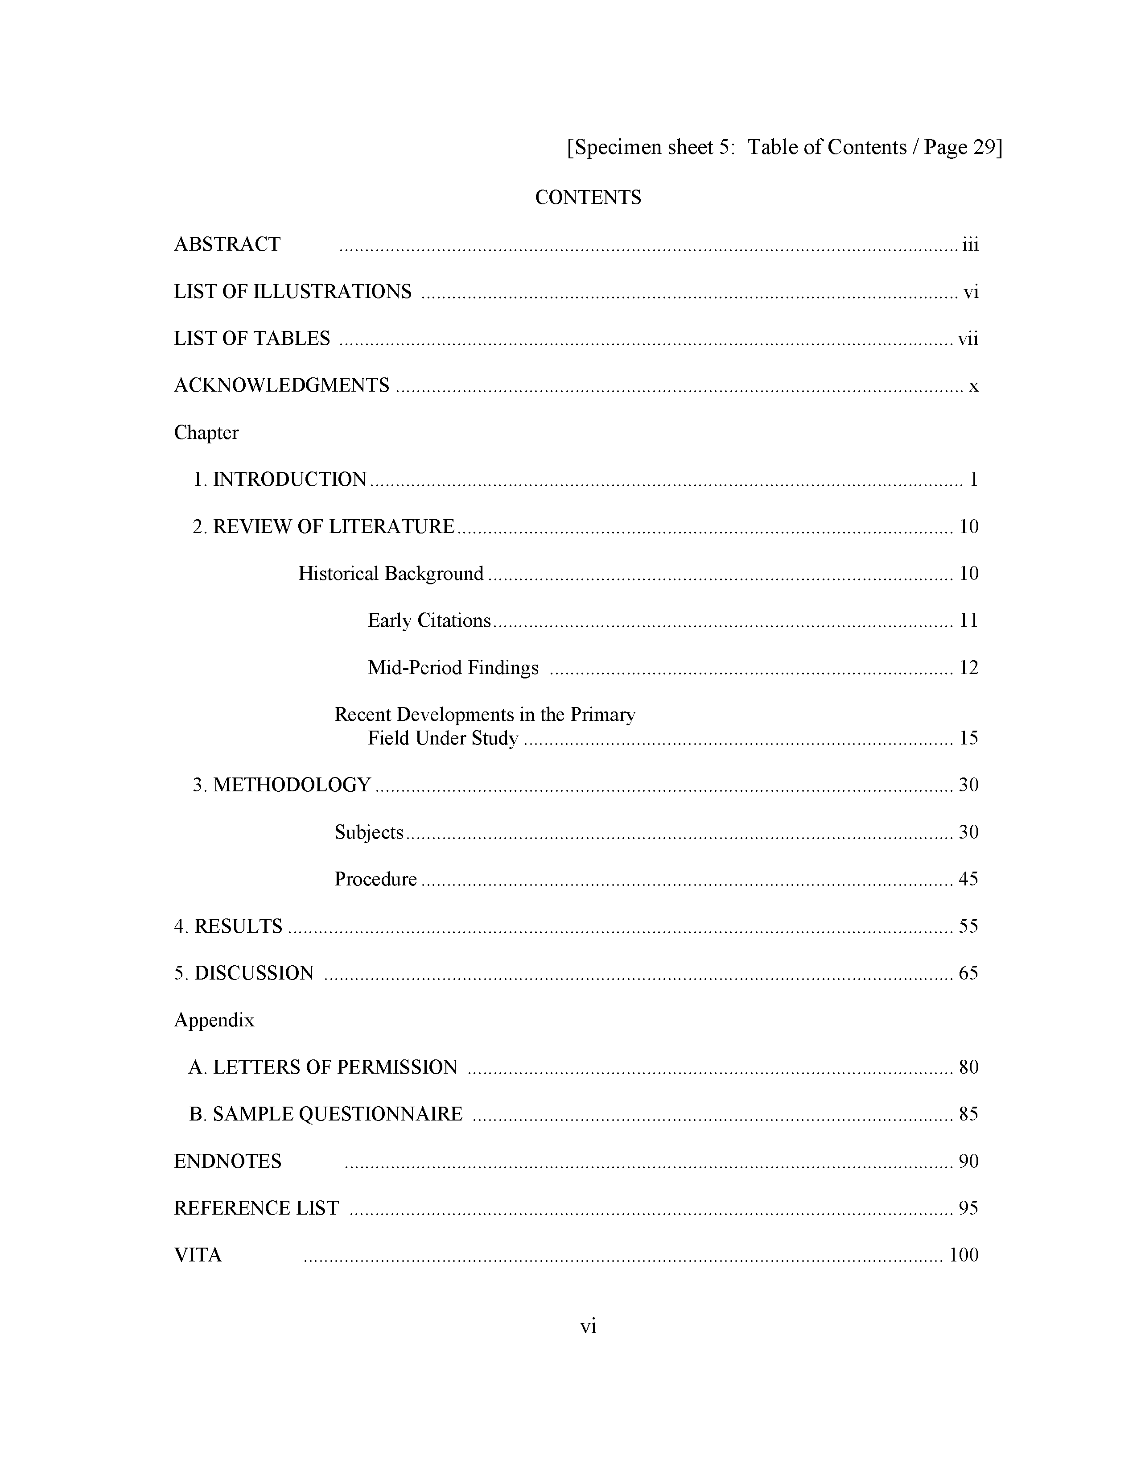
Table of contents page
Notes:
Put in a Table of Contents. I know you don’t know the page numbers yet. You don’t even know what the sections are yet. Just put in some reasonable guess. Notice the use of Roman numbers for the first few sections and regular numbers for the rest. I want you to get all these little details down accurately.

Slide 15
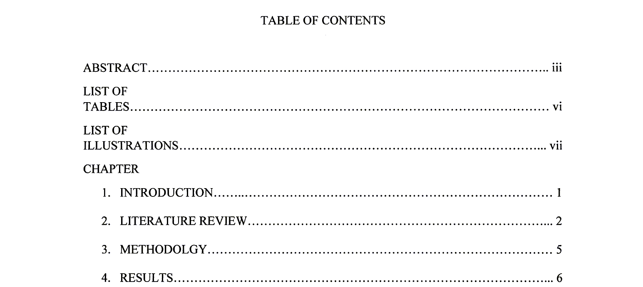
Table of contents page
Notes:
THis one is not too bad. I missed a few details when I graded it thought. The words “TABLE OF CONTENTS” should just be “CONTENTS”. The “LIST OF TABLES” and “LIST OF ILLUSTRATIONS” should be on a single line and not broken across two lines. The word “CHAPTER” should not be all upper case. These are fairly minor deviations and if I would have noticed them I would not have taken off more than a single point.

Slide 16
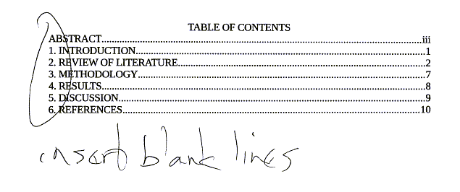
Table of contents page
Notes:
This one made several mistakes, but the most glaring is forgetting to insert blank lines everywhere.

Slide 17
Section heads and subheads
Main (chapter) heads
Centered
No bold
All uppercase
First subheads
Centered
Bold or italic
Headline (title) case
Second, third, etc. subheads
See guidelines
Notes:
There are fairly strict rules for section heads and subheads. The main heads (the names of each chapter) have to be centered, no bold, and all uppercase.
If you have a subheading within a chapter, that is also centered, with a bold or italic font, and headline case.

Slide 18
Headline (title) case
Initial capital for “important” words
Nouns, pronouns, verbs, adjectives, adverbs
Lower case for short and “unimportant” words
Articles, prepositions, conjunctions
Initial capital for very first word and very last word
Even “unimportant” words
Longer “unimportant” words also use initial caps
Five letters or longer
Some other details
Minor contradictions from one source to another
Notes:
Headline case is initial capital letters for all “important” words (nouns, pronouns, verbs, adjectives, adverbs). Do not capitalize most unimportant words: articles (a, an, the), prepositions (of, to, from), and conjunctions (and, but, or, if, who). Some exceptions are made for prepositions that are five letters or longer (among, between).
There are minor details involving words following marks of punctuation (colons and dashes).
Also there are contradictions from one source to another, but these are fairly minor.

