Slide 1
Video 7 - Formatting your literature review
Steve Simon

Slide 2
Learning objectives
To distinguish different types of quantitative non-experimental approaches
To discuss strengths and weaknesses of qualitative research
Notes:
Here are the objectives for this week.

Slide 3
Required reading
School of Graduate Studies. UMKC Guide to Formatting Theses and Dissertations. October 2010. Available in PDF format.
Notes:
This is what you should have read already. If you haven’t done the reading yet, pause this video and read this material. You’ll get more out of the video if you do so.

Slide 4
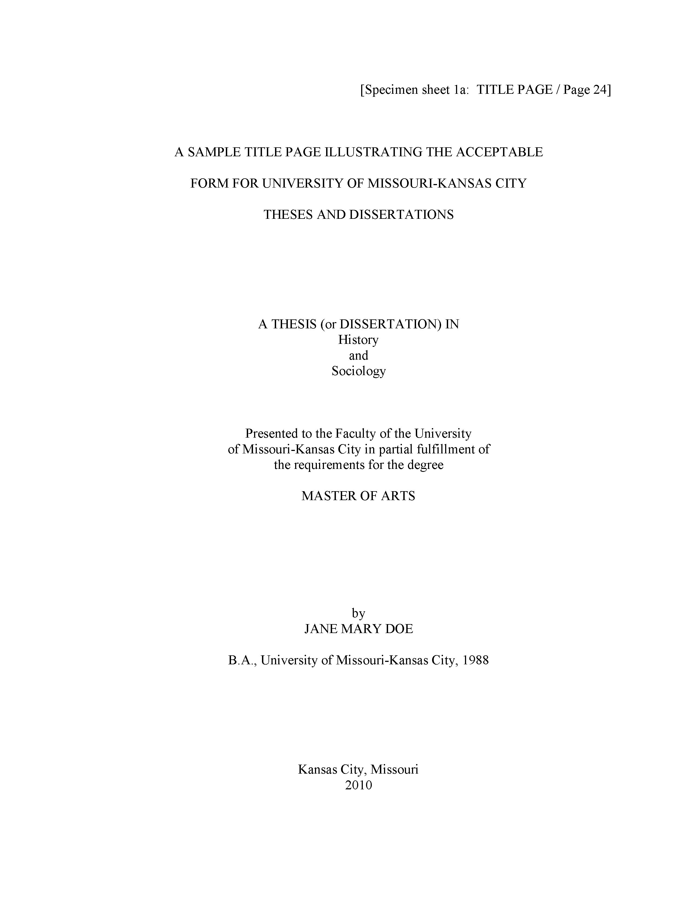
The title page
Notes:
Here is what your title page should look like. The fonts are small and hard to read, so I will zoom in on several sections.

Slide 5
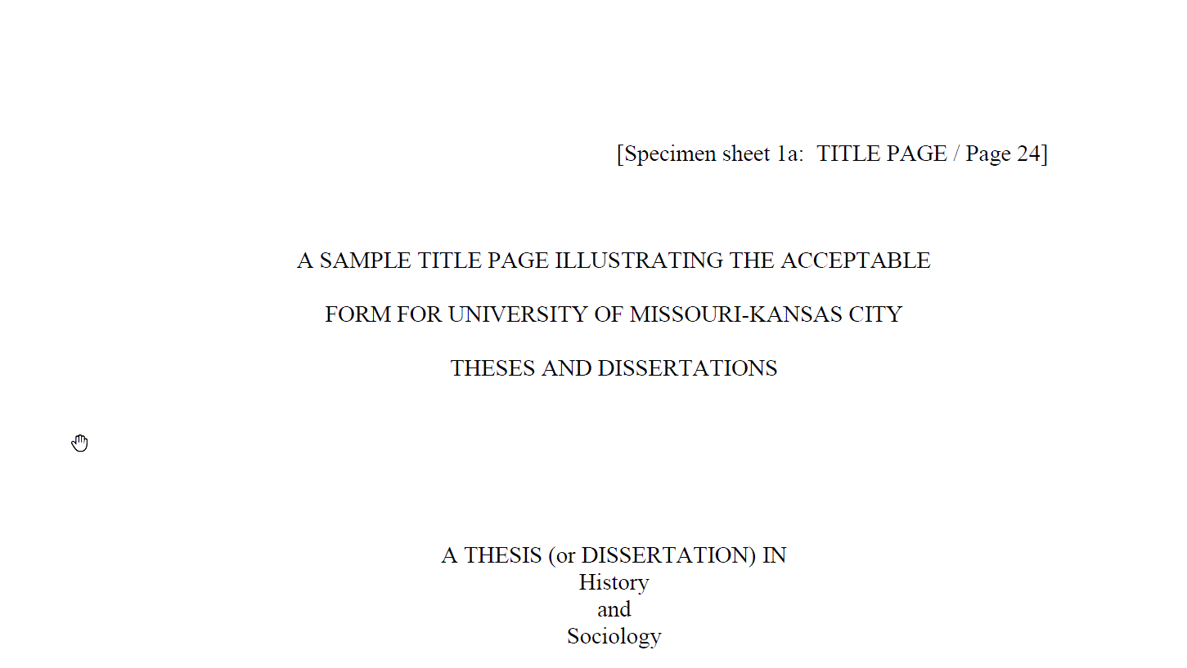
The title page
Notes:
Don’t type the line in brackets.
Notice the extra generous top margin here. Also your title is centered in all caps and double spaced.
Change “History and Sociology” to your degree area.

Slide 6
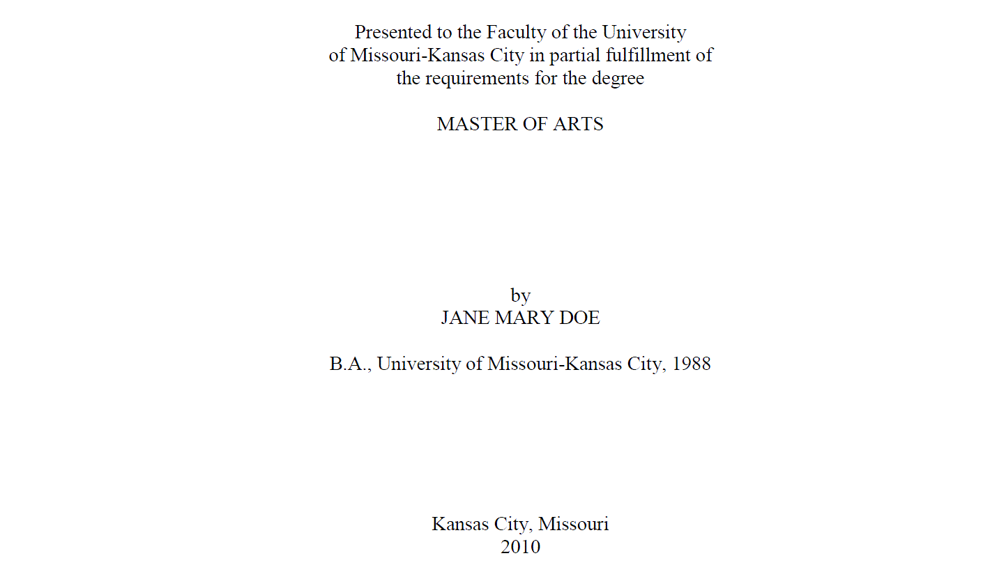
The title page
Notes:
Note the single spacing of the “Presented to” paragraph. Your degree is probably a Master of Science. Your full name is in all caps. Put the year you expect to graduate at the bottom. You can’t tell from this snip, but there is a generous bottom margin as well.

Slide 7
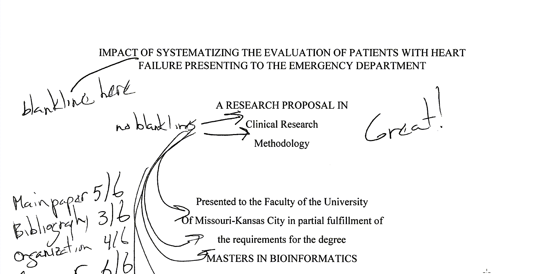
The title page
Notes:
Ths student single spaced where double spacing was needed and double spaced where single spacing was needed. Note that the “Great!” refers to the overall paper, adnd not the title page.

Slide 8
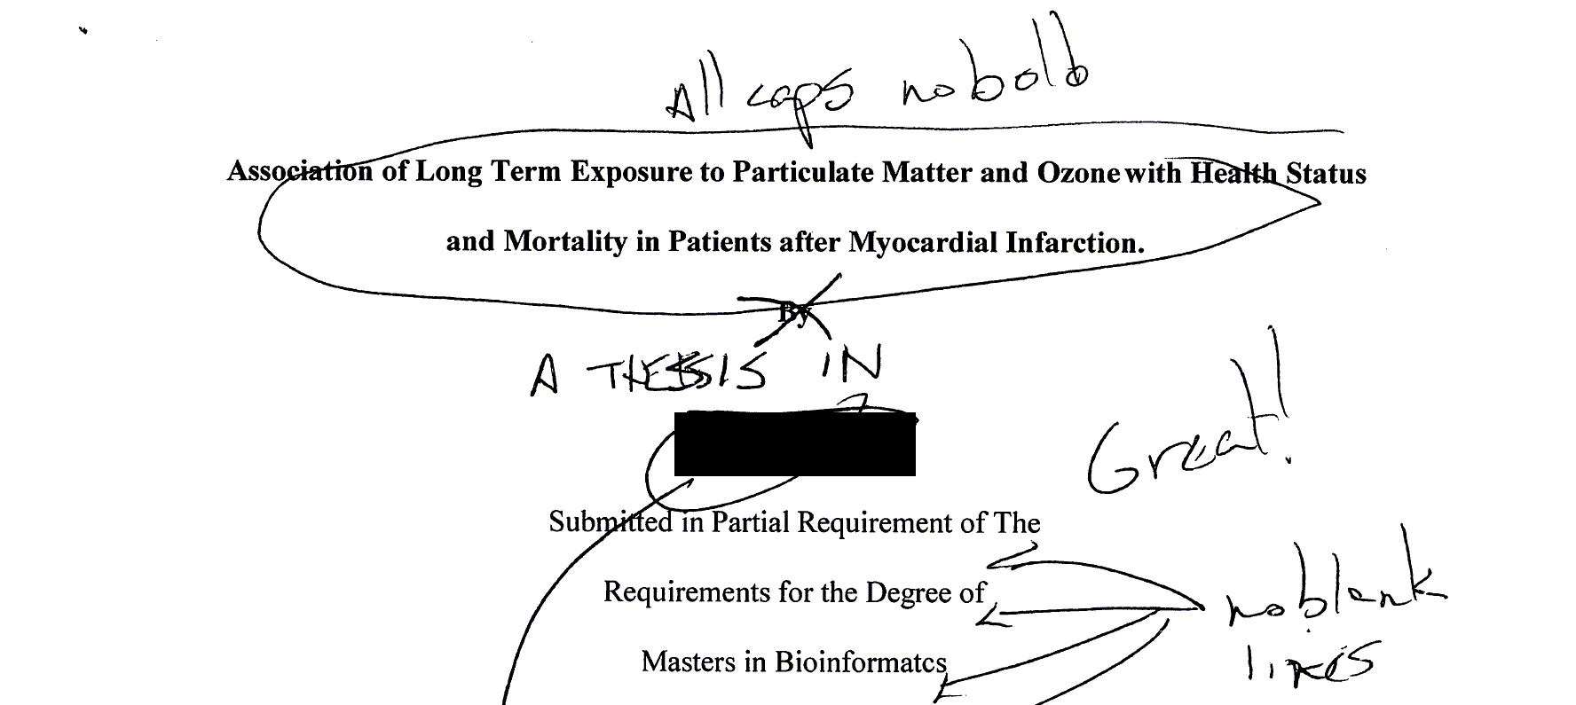
The title page
Notes:
This is a more serious deviation from the standard. The title should be all caps and no bold. The students name (which I have blacked out) comes in way to early. This student also forgot the “A THESIS IN” section. Notice again the problem of using double spacing in the wrong section.

Slide 9
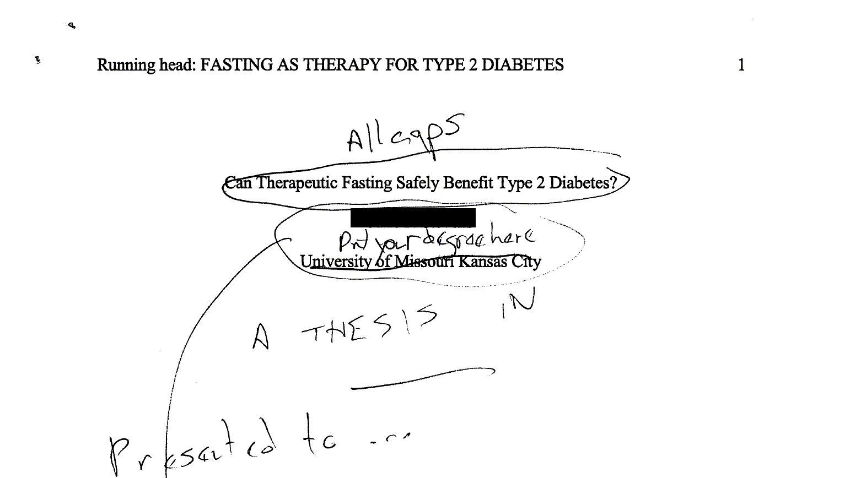
The title page
Notes:
This student, whose name is blocked out made many mistakes. There is no running head in a thesis, no page numbers in the upper right corner. Page numbers go in the bottom center and do not start until after the first two pages. The title needed to be all caps and the students name comes after the

