Slide 1
Video 5 - Quasi-experimental studies
Steve Simon

Slide 2
Learning objectives
To contrast the features of a quality improvement study with a research study
To describe the various quasi-experimental approaches
Notes:
Here are the objectives for this week.

Slide 3
Required reading
Chapter 6 (also re-read Chapter 5)
Optional reading
Mike Evans. Quality Improvement in Healthcare. YouTube, November 26, 2014. Available as a video (11 minutes).
Health Resources and Services Administration. Quality Improvement. Available in PDF format.
…
Notes:
This is what you should have read already. If you haven’t done the reading yet, pause this video and read this material. You’ll get more out of the video if you do so.

Slide 4
What is quality improvement?
Systematic approach
Commitment to teams
Organization-wide support
Passion for measurement
Differences from research
Systems approach
Little or no attention to generalizability
Continuous and Cyclical process
Major reliance on quasi-experimental studies
Notes:
Some of the material discussed on this page was taken from
https://www.hrsa.gov/sites/default/files/quality/toolbox/508pdfs/qualityimprovement.pdf
Quality Improvement (QI) is a systematic approach to changing how a health care organization works with the goal of providing better health care delivery. The QI process makes a strong commitment to teams and emphasizes the importance of broad representation on the team and careful elicitation of viewpoints from every persepctive. While it is possible to run a QI team in a small corner of an organiation, the PI process can only function well with organization-wide support, especially support from upper management. The QI process has a strong commitment to measurement, as measurement is the only way to evaluate the success or failure of changes made by the QI process.
There is substantial overlap between QI and health care research, but you should be aware of several important differences. QI takes a systems approach to solving problems. Some research takes a systems approach as well, but it’s not really a research requirement. QI pays little or no attention to generalizability. The focus of QI is on your particular organization, and ateempts to generalize to other organizations is not a priority. The QI process is not a single step but a continuous effort. This effort is usually represented by the PDCA or PDSA processs (Plan, Do, Check/Study, and Act) and each time you reach the end of a PDCA cycle, you start over again with a new plan.
The final distinction and the reason I am talking about the QI process in this class it that QI relies heavily (but not exclusively) on quasi-experimental studies.

Slide 5
The SMART approach
Specific
Measurable
Actionable
Relevant
Time Bounded
Notes:
Aim is SMART (Specific, Measurable, Actionable, Relevant, Time Bounded)

Slide 6
The PDSA cycle
Plan
Do
Study
Act

Slide 7
Process measures

Slide 8
The control chart

Slide 9
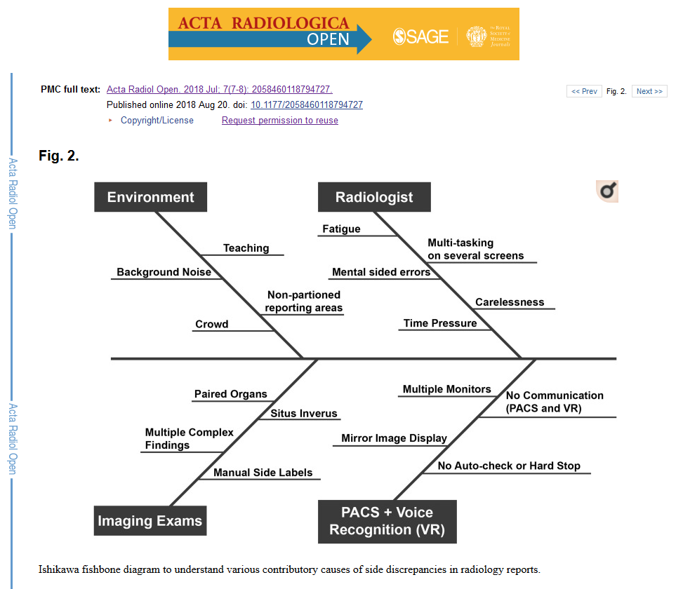
The fishbone diagram
Fishbone diagram

Slide 10
The Pareto chart

Slide 11
What is a quasi-experimental study?
Could but does not use randomization
Never sneer at quasi-experimental studies
Make a loud mistake
Problems with randomization
Cost
Logistical constraints
Contamination
Small n
Difficult to get buy-in
Notes:
A quasi-experimental study uses an active independent variable, but does not use a formal process of randomization to control that variable.
The choice to forgo randomization is usually a deliberate choice. Many people, including the authors of your book, dismiss the quasi-experimental design as an inferior alternative to a randomized design, but that are wrong. In some settings, randomization puts you at a disadvantage. If you decide to use a quasi-experimental design, recognize that you are choosing this design because it is superior to a randomized trial.
I dated a piano major in college and I tried, with very limited success, to learn how to play the piano myself. She told me, “If you’re going to make a mistake, make a loud mistake.” You don’t want to play the piano nervously and hesitantly. The same is true in research.
If you deviate from a well-established research norm, do so boldly and explicitly. Say something like “Although this quasi-experimental study has some limitations, it avoids many of the well-documented problems with a randomized trial” And then elaborate. Don’t apologize for your research design. Brag about how it is the best approach for this particular problem and explain what advantages it offers over a randomized trial.
What are the problems with randomization? First, it is expensive. It takes a lot of money (and a lot of time=remember that time is money). The machinery associated with randomization does not come cheap.
Contamination is the tendency for a particular intervention to “bleed over” into the control group. You may ask a health care provider to use a new approach for patients, but it is soemtimes very easy to let some of the new approach slip in when that person is treating a randomly selected control patient.
Certain interventions, such as changes to the physical layout of a work area are one directional and cannot be undone. This is also true of certain training interventions (Uh-oh! A control patient is next on my randomization list. Time to forget everything that I’ve just learned.)
The sample size available to randomize may be too small to assure that randomization would work. This is especially true when you are looking at an intervention that can be implemented only at a very broad scale, such as with an entire floor or wing of a hospital.
Even when you have enough control to randomize, the people that have to implement your randomization process may rebel. This especially true in a difficult and hectic environment like an emergency room. Randomization is one more distraction that they just don’t need. They are more likely to support your research if you implement the intervention without randomization.

Slide 12
Notation for research designs
O means a measurement is made
X means an intervention is given.
~X means no intervention or a control intervention
R means randomized assignment
NR means non-randomized assignment
E means the experimental group
C means the control group
Notes:
There is a fairly standard notation with the letter O representing a measurement and the letter X representing an intervention.
The symbols here mean all subjects were assigned to an exposure group, that two measurements were made, then an intervention was given and then two more measurements were made.

Slide 13
Example of a design
R E: O1 X O2 O3 R C: O1 O2 X O3
Notes:
This is an example of a waiting list control group. The patients are randomly assigned to E or C. They both get a baseline, O1. Then the E group gets an intervention X that does not happen for the control group just yet. The second measurement is done, and after the second measurement, the same intervention is offered to the control group. Then both groups are measured a third time. The comparison of O2 between the experimental and control groups is the key measure, and you can adjust for baselines using a change score or analysis of covariance. But there are other interesting comparisons. With the experimental group, the comparison of O2 with O3 represents an assessment of whether the effect of X persists over a longer period of time.

Slide 14
Single group post-test only design
NR E: X O
Simplest design
Useful for pilot work
Notes:
The simplest possible design is a single group post-test only design. There is no randomization. The treatment given to everyone and you get a measurement only after the treatment.
It reminds me of a story, that I have not been able to verify. If you find a link to this story, let me know. The famous philosopher Karl Popper asked his wife “How much do you love me?” She responded “I love you eleven”.
Eleven compared to what? Maybe she loves bagels fifteen? Maybe he only loves her eight? There’s no comparison to be made at all.
Although no comparisons can be done. It could be useful for pilot or feasibility studies.

Slide 15
Single group comparison post-treatment to baseline
NR E: O1 X O2
Allows a comparison.
Confounded with temporal trends.
Notes:
One group, pre-test versus post-test. You can look at change before and after the intervention. You still don’t know if the change would have occured even without this intervention.
There are effects such as maturation or carry-over effects that could easily account for any difference seen in this design.
You can improve this design by including extra outcome variables. Half of these outcome variables would be expected to be changed by the intervention and half would be expected to be unchanged, even if the intervention is successful.
If you see that the first half changes from baseline and the second half does not, then you have some assurance that there is no temporal trend, at least no trend that might influence all the outcome variables that you are considering.
So a teaching intervention, for example, might teach lessons in X1 and X2, but not X3 and X4. Test all four areas prior to the intervention and afterwards. If you see a change in just X1 and X2 great! If you see a change in all four, though, you’re in trouble.

Slide 16
Two group comparison, without a baseline
NR E: X O NR C: O
Nonrandomized comparison
Confounded with baseline imbalance
Notes:
If you have two groups, assigned without randomization, you do have a comparison, but without a baseline measurement, you can’t be sure that the difference that you do see is the same as the difference that existed between the two groups prior to the intervention.
Here’s where randomization would have helped a lot. Randomization controls for unmeasured covariates and the baseline value in this study is an unmeasured covariate.
The three quasi-experimental studies described so far are called pre-experimental because you cannot draw any conclusions without making some untestable assumptions.
This sounds terrible, but we make untestable assumptions all the time in science. For example, Carbon-14 dating relies on the assumption that the rate of decay of carbon-14 is the same now as it was a thousand years ago. There’s no good way to test this assumption, but we accept it as reasonable.
It’s okay to make untestable assumptions if there is no way that you could collect the extra data that you would need to turn it into a testable assumption. Just be explicit about what assumptions you are making and your readers can for themselves whether they agree with you that the assumption is reasonable.
One way to indirectly test the assumption that the two groups were comparable at baseline is to compare the two groups by some demographic variables like age or gender that might be associated with your baseline. If the demographic variables are comparable, then you have some assurance that the baselines would have been comparable, if you had an opportunity to measure and test them.

Slide 17
Two group comparison with a baseline
NR E: O1 X O2 NR C: O1 O2
Best design so far.
Can check for
temporal trends in the control group.
baseline imbalances
Cannot check for unmeasured covariates
Cannot check for treatment interaction

Slide 18
Interrupted time series design
NR E: O1 O2 O3 X O4 O5 O6
Best with three or more measures at baseline
Check for most temporal trends
Notes:
If you have the option of taking multiple measurements over time, then this can help avoid the problems with using a single group.

Slide 19
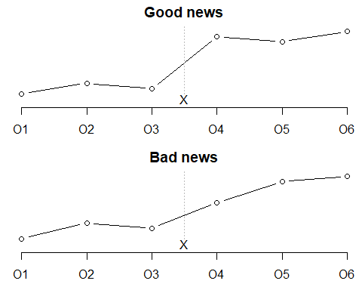
Hypothetical patterns in the interrupted time series design

Slide 20
Notes:
If the measurements are flat from O1 through O3, show a jump from O3 to O4, and then becomes flat again from O4 through O6, then you have pretty good evidence against most temporal trends, except for a temporal trend with the bad luck of occuring right at the time of your intervention.
If you see a jump between O3 and O4, but you also see jumps at most of the other time points, that’s bad news.

Slide 21
Phased design
NR E: O1 O2 X1 O3 O4 O5 X2 O6 O7 O8 X3 O9 O10
Split intervention into three or more pieces
Phase in the intervention piece by piece

Slide 22
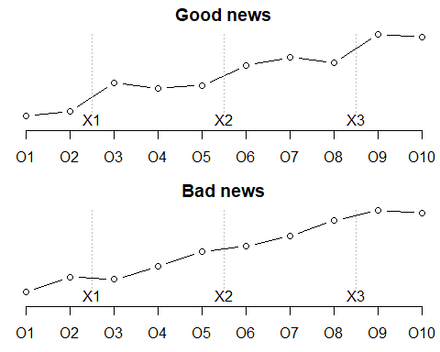
Phased design

Slide 23
Quasi-Experimental Designs
Better Q-E Designs
Pretest-Posttest Nonequivalent Comparison Group
NR E: O1 X O2
NR C: O1 ~X O2
3 strengths based on
How participants got into the groups/conditions
How much control investigator has over IV
Strong
Moderate-strength
Weak
Improvement - Wait-List Comparison Group
Immediate Group O1 X O2
Wait-List Group O1 ~X O2 X O3
Notes:
A wait list comparison, one group gets the treatment immediately and the second group has to wait before getting the treatment.
This is an attractive design when the clinicians want to avoid giving the placebo to anyone.
From a recruitment point of view, people who want the treatment may be willing to tolerate a delay.
Note that there are two changes (O2 minus O1) and (O3 minus O2).
Introducing a pre-test measurement offers a further improvement. The pre-measure allows us to test for differences before the intervention was introduced.
A stronger version of this design. Can you randomize which group gets the intervention, even if you can’t randomize individuals?
If people self-select, but not on the basis of which group they get into, that strengthens the design. But you can’t rule out the possibility of systematic differences that might still influence the outcome.

Slide 24
Quasi-Experimental Designs
Better Q-E Designs
Single-Group Time-Series
Characteristics
Temporary treatment vs Continuous treatment
Multi-Group Time-Series
Characteristics
Temporary treatment vs Continuous treatment
Notes:
Multiple measures over time in your outcome variable.

Slide 25
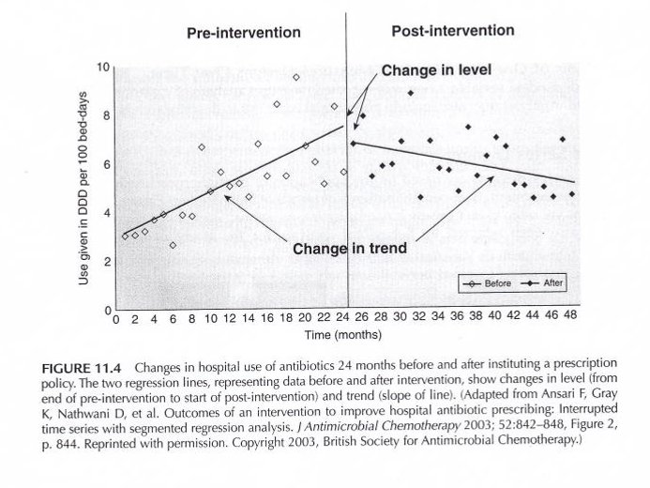
Q-E Time Series Designs
Portney & Watkins, 2009
Notes:
With time series designs, you are frequently looking at two different kinds of signals. You get a feel for change in the trend before and after. You also have the possibility of a jump (shift) at the time of the intervenion.
Notice in this graph.

Slide 26
Q-E Time Series Designs
Notes:
Figure 11.5 shows three different patterns. Four measurements before treatment and four measurements after treatment. Notice the bottom line shows an up and down pattern. If you looked only at O4 and O5, you might think, Wow! but the values at O6, O7, etc.
The middle line B shows an increasing trend but this increase appears to be unrelated to the intervention.
The top line shows a shift that is temporally associated with the intervention.
These designs show some evidence of causation without a concurrent control group.
Portney & Watkins, 2009

Slide 27
Quasi-Experimental Designs
Typical examples of Q-E designs
Case-control study
Cohort study
Non-equivalent control group design
Interrupted time-series design
Single system design
Notes:
You identify a group of cases matched with controls. These are, for the most part, retrospective comparisons.
Cohort design, you get a group of patients at risk of something and follow them over time. Cohort studies can be prospective or retrospective.
Two or more pre-existing groups of people. You introduce an intervention to one group.
Case studies.
Withdrawal design.
The Tucker article is a good example of a quasi-experimental design.

Slide 28
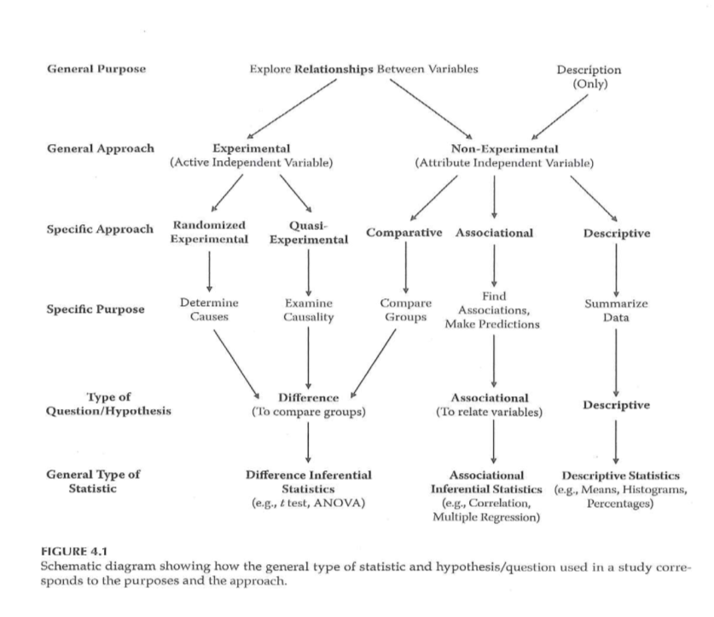
Research Approaches
Notes:
We are using this figure a lot because it helps us organize information. Are you trying to explore relationships or describe. Experimental designs almost always explore relationships.
An experimental design has an active independent variable (one that is manipulated).
The split in experimental designs
Institute for Healthcare Improvement
Any model is fine, but it has to be consistent across the organization.
The QI model is one that is open to failure, but controls the process so that failure doesn’t have a large cost.
What are we trying to accomplish?
How will we know that a change is an improvement? (How do you measure?)
What change can we make that will result in improvement? (Interventions)
Quality improvment typically is measured over time and this leads to a different type of statistical analysis.
Plan, Do, Study, Act
Aim is SMART (Specific, Measurable, Actionable, Relevant, Time Bounded)
Don’t try to boil the ocean.
Types of waste mnemonic: Downtime
D=Defects O=Overproduction W=Waiting (patient or staff) N=Non-utilized intellect T=Transportation I=Inventory (have it and have it where we need it, too many suppl) M=Motion E=Extra processing (Perfectionist)

Slide 29
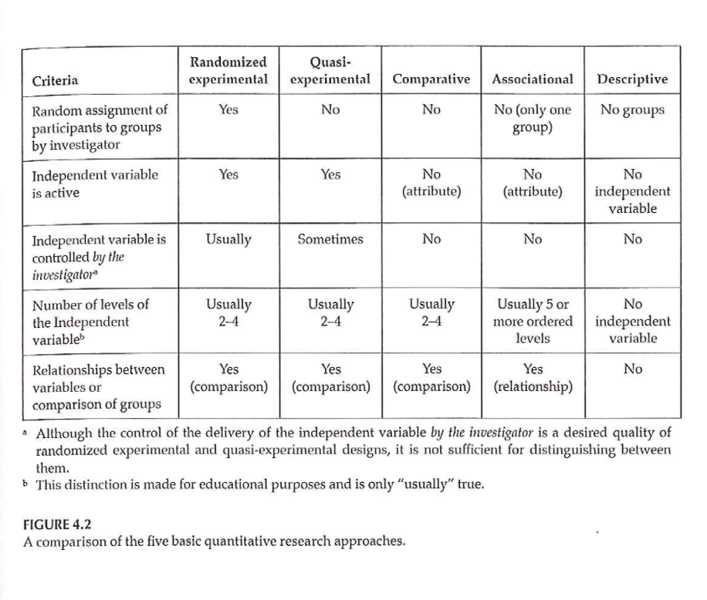
Research Approaches
Notes:
Figure 4.2 walks you through the major designs. Note that the random assignment of patients to groups is not the same as the random selection of groups.
In a quasi-experimental design, sometimes the active independent variable is manipulated by the investigator, sometimes not.

Slide 30
Research Approaches
Randomized Experimental
Criteria
Random assignment
Active independent variable
(Experimenter control of active independent variable)
What is “treatment”
When it will be given
Who it will be given to
Notes:
Random assignment of people into groups or conditions. Controling the type of treatment or when it is given.
Sometimes the treatment is delivered by someone other the investigator, but gives randomization information to someone else.

Slide 31
Research Approaches
Randomized Experimental
Importance of random assignment
Bias
Equivalence of groups before treatment
Random selection (sampling)
What does this mean?
How does it relate to random assignment?
Value of random selection?
Notes:
Random sample does not rely on any characteristics of an individual.
You can use a random number generator to assign or a random number table.
Randomization gives you the best chance of the two groups being equivalent.
Note that alternating assignment is not the same as random assignment. Does a temporal trend cause bias?
Also note that haphazard assignment is not the same as random assignment.
Alternatives to random assignment leaves you with a good chance that your study will not end up getting included in a systematic overview.
Random sampling. How do people get included in a study?
Most random assignment studies use a non random selection.
It is quite difficult to do random selection, but easy to do random assignment.

Slide 32
Research Approaches
Quasi-Experimental
What criteria of Experimental not met?
Categories of Q-E approach
Q-E with major limitations
Pretest-Posttest designs
Time-series designs
Single-subject designs
Notes:
Quasi-experimental designs fail to meet the goal of randomization. It could be that we do not have control over the treatment assignment. A quasi-experimental design does not allow you to establish causality.
Single subject designs are covered separately.

Slide 33
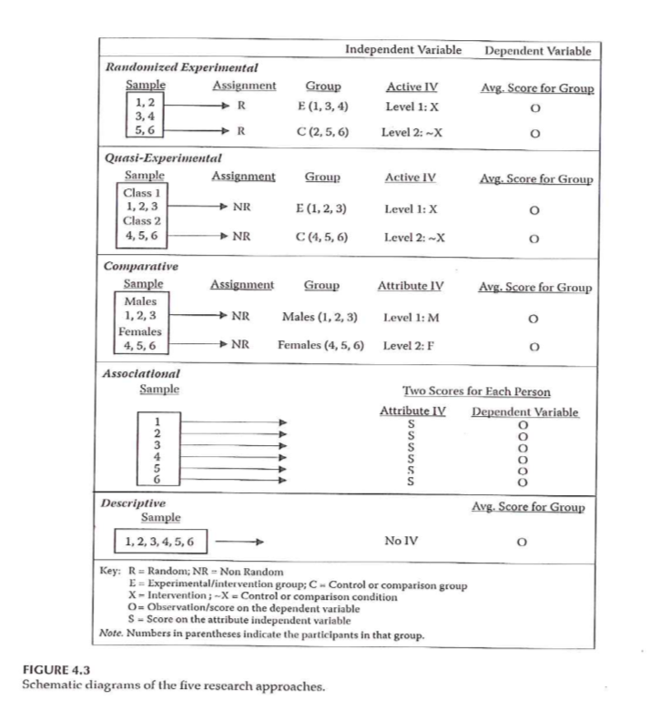
Research Approaches
Notes:
Figure 4.3. The way notations are used to describe designs.
R = randomized, NR = not randomized.
E = experimental, C = control
Active vs Attribute variable.
This notation is used as we talk about different designs.

Slide 34
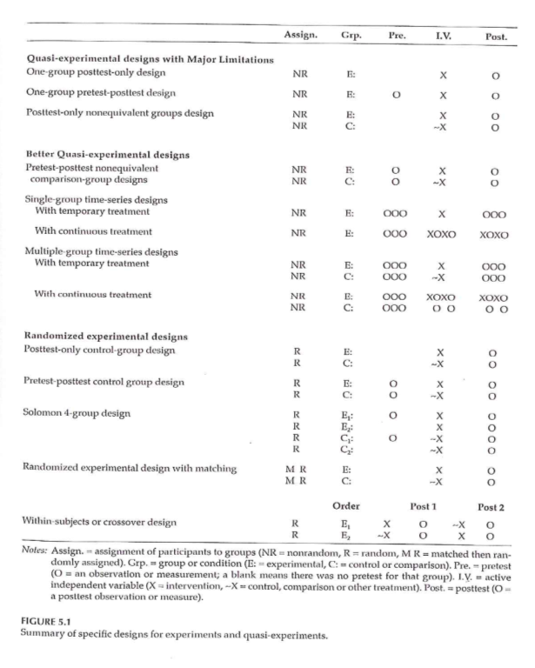
Randomized Experimental and Q-E Designs
Notes:
Figure 5.1 talks about verious experimental and quasi-experimental designs. Designs increase in rigor as you go down the table. When are measurements made.

Slide 35
Quasi-Experimental Designs
Categories of Q-E approach
Q-E with major limitations
Pretest-Posttest designs
Time-series designs
Single-subject designs

Slide 36
Assignment #3
Prepare a brief description of the topic you are planning to focus on for your research proposal. (Introduction)
Notes:
A single paragraph that might serve as your introduction. There is a template available on the Canvas site. If you want to start creating your proposal using a structure, feel free to use this template.

Slide 37
Assignment
Prepare a summary of one of the quality improvement studies listed below or a study you find on your own. Did the team use a SMART aim? Describe the research design that the team used. Was it quasi-experimental? How might the design have been improved?
Ali F, Qasim Mehdi M, Akhtar S, et al. Impact of Congenital Cardiac Catheterization Project on Outcomes-Quality Improvement (C3PO-QI) in LMICs. Heart Asia. 2019;11(1):e011105. Published 2019 Jan 10. doi:10.1136/heartasia-2018-011105. Available in html format or PDF format.
A Mistry DA, Rainer TH. Concussion assessment in the emergency department: a preliminary study for a quality improvement project. BMJ Open Sport Exerc Med. 2018;4(1):e000445. Published 2018 Dec 27. doi:10.1136/bmjsem-2018-000445. Available in html format or PDF format.
Rogers AJ, Lye PS, Ciener DA, Ren B, Kuhn EM, Morrison AK. Using Quality Improvement to Change Testing Practices for Community-acquired Pneumonia. Pediatr Qual Saf. 2018;3(5):e105. Published 2018 Sep 20. doi:10.1097/pq9.0000000000000105. Available in html format or PDF format.
Liu Z, Zhao Y, Liu D, et al. Effects of Nursing Quality Improvement on Thrombolytic Therapy for Acute Ischemic Stroke. Front Neurol. 2018;9:1025. Published 2018 Nov 29. doi:10.3389/fneur.2018.01025. Available in html format or PDF format.
Norman S, DeCicco F, Sampson J, Fraser IM. Emergency Room Safer Transfer of Patients (ER-STOP): a quality improvement initiative at a community-based hospital to improve the safety of emergency room patient handovers. BMJ Open. 2018;8(12):e019553. Published 2018 Dec 14. doi:10.1136/bmjopen-2017-019553. Available in html format or PDF format.
Marino LV, Fudge C, Pearson F, et al. Home use of breast milk fortifier to promote postdischarge growth and breast feeding in preterm infants: a quality improvement project. Archives of Disease in Childhood Published Online First: 14 December 2018. doi: 10.1136/archdischild-2018-315951. Available in html format or PDF format.
Karamagi E, Sensalire S, Muhire M, et al. Improving TB case notification in northern Uganda: evidence of a quality improvement-guided active case finding intervention. BMC Health Serv Res. 2018;18(1):954. Published 2018 Dec 12. doi:10.1186/s12913-018-3786-2. Available in html format or PDF format.
Manyazewal T, Mekonnen A, Demelew T, et al. Improving immunization capacity in Ethiopia through continuous quality improvement interventions: a prospective quasi-experimental study. Infect Dis Poverty. 2018;7(1):119. Published 2018 Nov 30. doi:10.1186/s40249-018-0502-8. Available in html format or PDF format.
Olita’a D, Barnabas R, Vali Boma G, et al. Simplified management protocol for term neonates after prolonged rupture of membranes in a setting with high rates of neonatal sepsis and mortality: a quality improvement study. Archives of Disease in Childhood 2019;104:115-120. Available in html format or PDF format.
Parthiban A, Warta A, Marshall JA, et al. Improving Wait Time for Patients in a Pediatric Echocardiography Laboratory - a Quality Improvement Project. Pediatr Qual Saf. 2018;3(3):e083. Published 2018 Jun 6. doi:10.1097/pq9.0000000000000083. Available in html format or PDF format.

Slide 38
Discussion questions
What kind of clinical research questions are you interested in pursuing?
Do you have previous experiences that factor into the research questions you are interested in?
What kind of design do you think would be most appropriate for the topic you are interested in?

Slide 39
Additional slides

