Slide 1
Medium Age influence on Social Spending in Japan and The United States
By: Daniel Rodriguez-Katakura

Slide 2
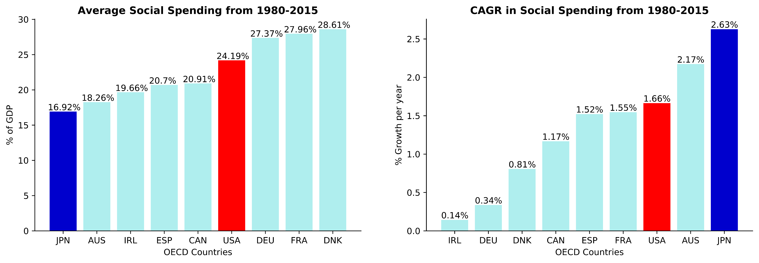
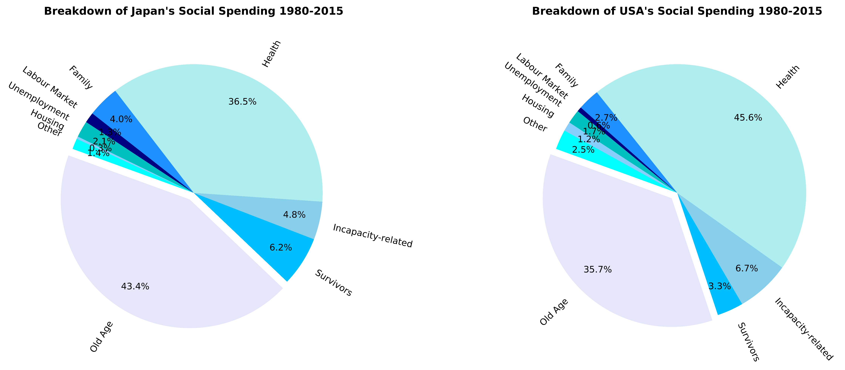
- Japan has a small average Social Spending, but has a very high CAGR in Social Spending
Japan’s largest component of Social Spending is Old Age-related
This could show that Japan’s older medium age is affecting the total social spending

Slide 3
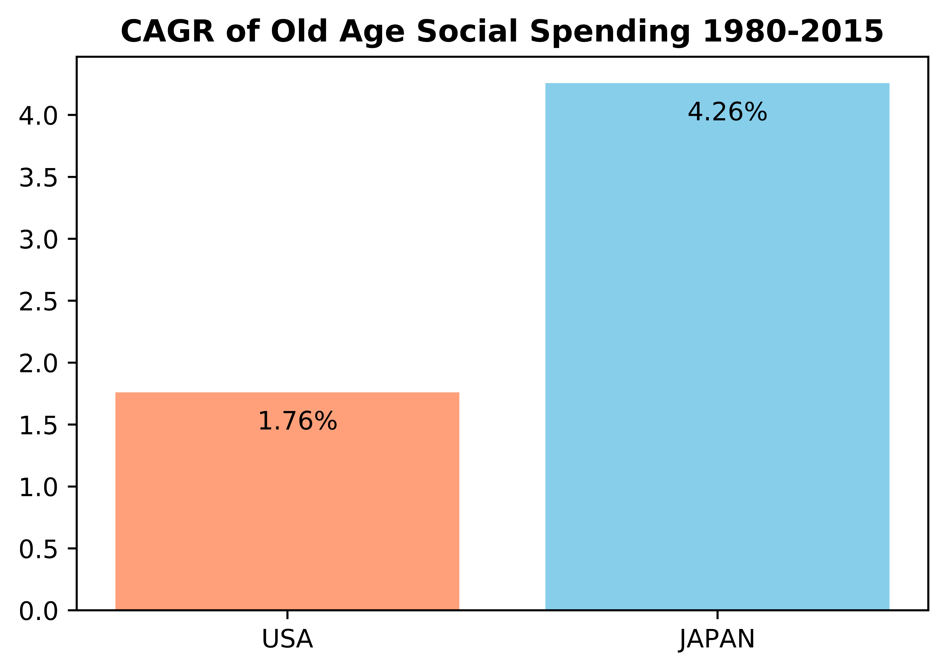
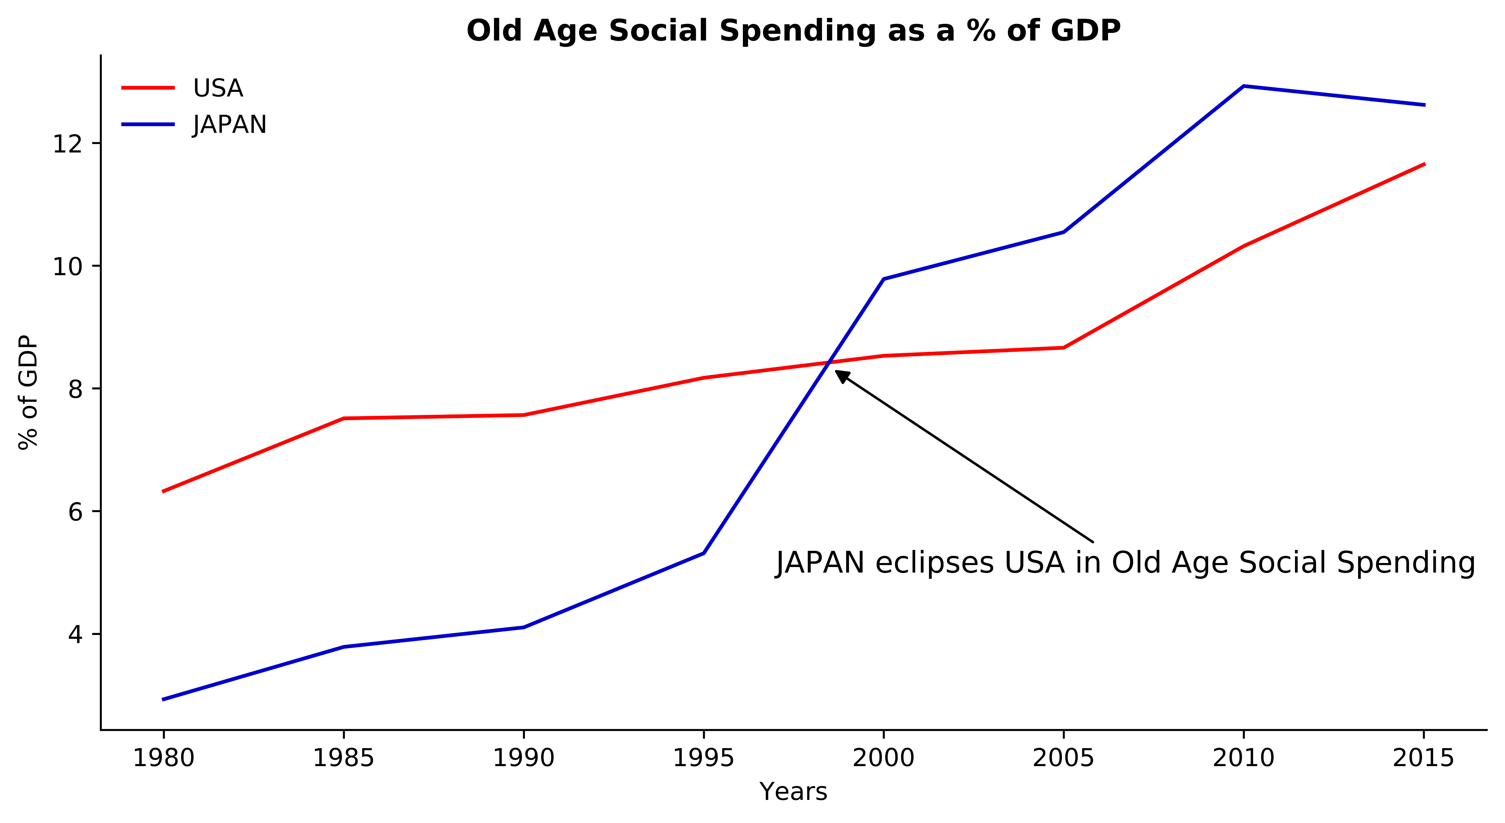
Japan’s Old Age related social spending CAGR is more than double the US’s. This may be due to higher medium age
Japan’s Old Age Social Spending eclipsed the US’s spending in between 1995 and 2000.

Slide 4
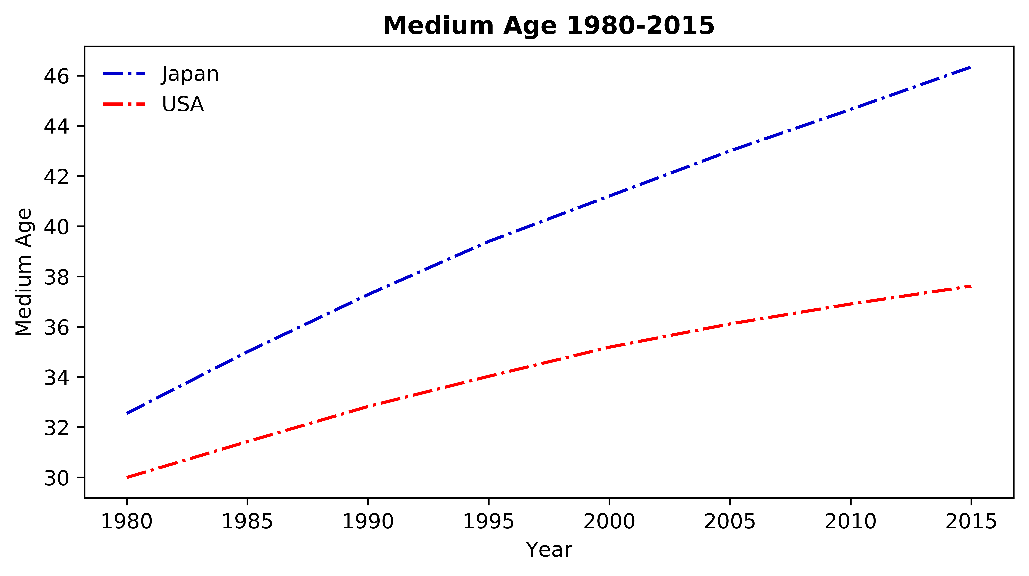
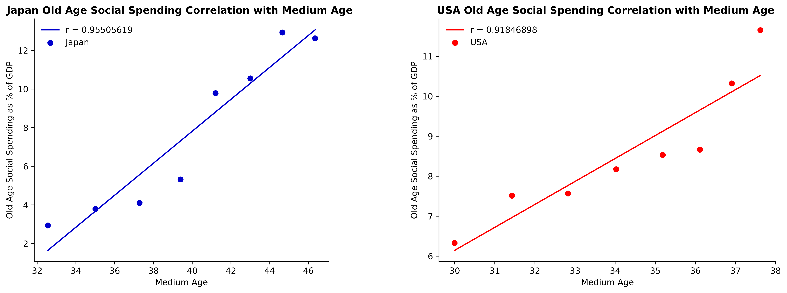
Japan’s medium age has steadily increased from around 32 to around 46 years old
US’s medium age has also steadily increased from around 30 to 37 years old
Japan’s has a much higher medium age
The correlation graphs below show how Japan’s old age related social spending is highly correlated to its increasing medium age (r = 0.955)
The US correlation is also very high at r = 0.918, but is slightly lower. Potentially because of higher medium age.

