Slide 1

Manager + Operator
Training
Your warehouse experience, connected through one shared system
60 MINUTES
PRODUCT 1.27
Client session • 10 August 2026
1 min
1 / 20
Notes:
Timing: 1 minute(s) Welcome the team as experienced warehouse people. Say: ‘You already know the work. Today we are connecting the decisions you make every day to where Warehouse Wizard records them.’ Confirm this is product version 1.27 and local safety practice remains the authority.

Slide 2
By the end, the system should feel familiar
YOUR WORK
ONE SHARED MEMORY
The pallet journey you already manage
Scans and updates everyone can see
GOOD JUDGMENT
CLEAR HANDOFFS
Pause when the floor and screen disagree
The next person knows what happened
Questions are welcome; configuration topics will be parked for the final follow-up.
2 min
2 / 20
Notes:
Timing: 2 minute(s) Ask who receives, who releases work, who solves problems, and who closes the shift. Say this is a conversation built on their experience, not a test. The manual is the reference so nobody needs to memorize every screen.

Slide 3
The system follows the same questions you already ask
STANDARD WORK
WHAT IS IT? → WHERE IS IT? → WHAT HAPPENED? → WHO NEEDS TO KNOW?
The scan gives the team a shared answer without replacing the walk-around, count, or conversation.
2 min
3 / 20
Notes:
Timing: 2 minute(s) Ask the room how they answer these questions today. Then connect each answer to pallet scan, location scan, action confirmation, and visible handoff. Typing the exact printed code is a valid fallback; guessing is not.

Slide 4
The work stays familiar—the handoff becomes visible
1
2
3
4
5
MANAGER
CLERK
OPERATOR
SUPERVISOR
MANAGER
Plan capacity
Release executable work
Receive + label
Control master data
Scan-confirm
Move one task at a time
Resolve exceptions
Review counts
Reconcile + close
Assign every owner
A task is not handed off until the physical state and system state match.
3 min
4 / 20
Notes:
Timing: 3 minute(s) Walk left to right and ask who normally speaks to whom at each point. The system does not replace those conversations; it keeps the answer visible after the conversation ends or the shift changes.

Slide 5
A good shift starts the way it always has
MANAGER — 5 TO 10 MIN
OPERATOR — 2 TO 5 MIN
Choose warehouse + Dashboard view
Review open work and staffing
Check holds, quarantine, space, RF alerts
Assign owners; release finishable work
Sign in; verify active warehouse
Check scanner, network, battery, printer
Confirm PPE + equipment
Read priority; open assigned queue
The system supports the walk-around: people, space, stock, equipment, and priority still have to agree.
4 min
5 / 20
Notes:
Timing: 4 minute(s) Ask what their best shift-start routine looks like now. Map those checks to the Dashboard and notification bell. Red connectivity deserves attention before amber reorder information.

Slide 6
Every pallet already has a story—the system keeps it together
01
02
03
04
05
06
RECEIVE
LABEL
PUT-AWAY
VERIFY
PICK
STAGE / TRANSFER
Counts, moves, status controls, and audit protect the journey at every stage.
2 min
6 / 20
Notes:
Timing: 2 minute(s) Invite someone to describe the story of a pallet from the gate to dispatch. Use that story for the rest of the presentation. One physical pallet should not become two system identities; a label reprint keeps the same story.

Slide 7
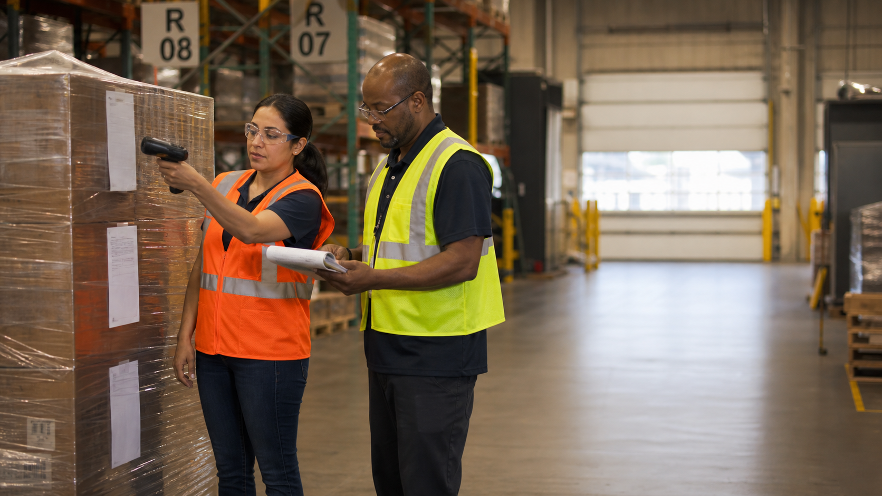
Receiving: scan → commit → count → expiry
CONTEXT
Warehouse · container · PO
1
PRODUCT
Scan/search, then press the right-arrow
2
QUANTITY
Total → qty/pallet → pallets
3
TRACE
Expiry · lot · batch · packaging
4
RECEIVE
Verify once · print labels · create Put-Away
5
The physical count always wins. A learned suggestion never replaces the count.
5 min
7 / 20
Notes:
Timing: 5 minute(s) Live demo if safe. Show the highlighted product commit arrow and Enter-to-advance sequence. Explain that the green container candidate is checked before use. End by matching each printed label to one physical pallet.

Slide 8
Put-Away: two scans, every pallet, every time
01
PALLET
02
EXACT LOCATION
Who/what is moving?
Where did it physically go?
A bay code opens the grid; it is not the final cell
Check physical capacity, safety, and temperature
Confirm once, then verify the task cleared
STOP: inactive, full, blocked, unsafe, or temperature-incompatible cell.
4 min
8 / 20
Notes:
Timing: 4 minute(s) Use a pallet label and both bay/exact location props. Ask which scan identifies the object and which identifies the destination. Mention Return to Receiving when the receipt itself needs correction.

Slide 9
Inventory Search is the truth check
Status
Quantity
Owner
PALLET RECORD
Lot / expiry
Movement history
Exact location
Use it before substitution, correction, status change, transfer, or variance resolution.
3 min
9 / 20
Notes:
Timing: 3 minute(s) Explain that dashboards are signals, not transaction detail. Held or quarantined stock can be excluded from availability by filters. Demonstrate a pallet detail/history if time allows.

Slide 10
Manager gate: release only work the floor can finish
Correct warehouse + order
Available eligible stock
Whole-pallet plan
Staging capacity
Owner + due time
RELEASE PICK LIST
Shortfall or split required? Replan before release.
4 min
10 / 20
Notes:
Timing: 4 minute(s) State the current design clearly: normal picks are whole-pallet. Order demand is not permission to split a pallet. The manager prevents failure by reviewing shortage and staging before release.

Slide 11
Pick Execution: location first, pallet second
TRAVEL
Read rack · aisle · bay · level
1
LOCATION
Scan exact cell or select assigned bay cell
2
PALLET
Verify condition + whole quantity; scan
3
CONFIRM
Use the highlighted Confirm pick
4
STAGE
Move to directed outbound lane
5
One pallet = one task. Confirm the whole assigned pallet or stop.
3 min
11 / 20
Notes:
Timing: 3 minute(s) Ask the operator what they do before touching another task: confirm the current pick. Explain the yellow confirmation signal after the correct pallet scan.

Slide 12
When something looks wrong, pause before it becomes tomorrow’s problem
ANDON / STOP THE LINE
KEEP THE PALLET SAFE
TRIGGERS
1
Short quantity
Missing pallet
Damage / contamination
Unknown barcode
Full or blocked cell
Offline device
2
CHECK PALLET · LOCATION · TASK
3
LOOK UP THE LIVE RECORD
4
AGREE THE NEXT ACTION
5
CONTINUE ONCE THE STORY MATCHES
5 min
12 / 20
Notes:
Timing: 5 minute(s) Frame the pause as experienced judgment, never user failure. Ask: ‘What would make you stop this pallet today?’ Scenario: task expects 100, physical pallet has 80. The team keeps it safe, verifies, records the justified status, corrects the record, and replans.

Slide 13
Move or Transfer? Let the warehouse boundary decide
LOCATION MOVE
TRANSFER
Same warehouse
Scan pallet + exact destination
Preserves identity + movement history
Cancel queued/in-progress move if plan changes
Different warehouse
Create → stage → driver sign-off
In-transit → destination receive
Immediate directed Put-Away
Never strand transferred stock in a receiving lane while the system implies it is stored.
3 min
13 / 20
Notes:
Timing: 3 minute(s) Use the simplest decision question: does the warehouse change? Explain the departure quality gate: sign-off only after physical departure. At destination, receipt is followed by Put-Away.

Slide 14
Cycle Counts: count what you see, then learn from the variance
PLAN SCOPE
ROOT CAUSE + CONTROL
BLIND PHYSICAL COUNT
VARIANCE =
UPSTREAM SIGNAL
SUPERVISOR REVIEW
SUBMIT ONLINE
A variance points upstream: receiving, put-away, movement, pick, transfer, label, or status.
2 min
14 / 20
Notes:
Timing: 2 minute(s) Explain CCT work. Operators count blind and enter truth. Supervisors separate threshold variance from exceptions and use notes before approve/reject/return. Do not approve stale state after reconnect.

Slide 15
Offline means freeze the commit — not invent a workaround
1
SIGNAL LOST
Keep the pallet in its current safe state
2
DO NOT REPEAT
No forced save, receive, move, pick, or approval
3
RECONNECT
Confirm backend connection is restored
4
REFRESH + RECHECK
Task · pallet · location · quantity · status
5
POST ONCE
Verify completion from live state
4 min
15 / 20
Notes:
Timing: 4 minute(s) Distinguish preserved local typing from a live commit. Acknowledge a critical RF alert only after reconnect, refresh, and floor safety verification. Never repeat a physical move under a second task number.

Slide 16
Controlled status makes restricted stock visible
HOLD
Review needed; disposition unknown
QUARANTINE
Quality / expiry / contamination / temperature
DAMAGED
Verified physical damage
MISSING
Verified search/count supports it
AVAILABLE
Authorized and verified for normal work
Every change needs a reason. Add a System Log owner when follow-up is required.
3 min
16 / 20
Notes:
Timing: 3 minute(s) Ask the room why Hold is safer than guessing Damaged or Missing. The status is not the narrative; the reason and System Log connect it to follow-up.

Slide 17

The dashboard backs up the walk-around—it does not replace it
START
MID-SHIFT
END
Open work · people · space · RF
Backlog · staging · holds · expiry
Floor vs queues · owners · safe handoff
THE FOUR QUESTIONS
WHERE IS WORK ACCUMULATING?
WHAT IS BLOCKED?
WHO OWNS IT?
WHEN IS IT DUE?
3 min
17 / 20
Notes:
Timing: 3 minute(s) Ask what the manager notices first while walking the floor. Show how Floor, Dock, and Office views keep those observations visible across the team. Dashboard tiles invite a closer look; they do not overrule the floor.

Slide 18
Tabletop: the pallet is short and the device just reconnected
Pick task expects 100. The pallet has 80. The operator scanned before RF dropped; the screen now reconnects.
QUESTION 1
QUESTION 2
What must the operator NOT do?
What live facts must be refreshed?
QUESTION 3
QUESTION 4
What status is justified now?
Who owns correction and replanning?
Stop → refresh live pick + pallet → recount/verify → Hold if disposition unknown → log + supervisor → correct stock → replan.
4 min
18 / 20
Notes:
Timing: 4 minute(s) Give pairs 60 seconds, then debrief. Correct misconceptions: do not confirm 80, do not trust the old scan, do not choose Damaged/Missing without evidence, do not repeat the physical movement.

Slide 19
Confidence comes from doing it once with your own examples
OPERATOR
CLERK
MANAGER
Sign-in + warehouse
Put-Away · Pick · Move · Count
Stop rule + offline recovery
Receipt + labels
Master-data correction
Status with reason
Shift control
Executable release
Exception + count review
Safe handoff
Attendance is not competency — each person demonstrates normal work and at least one exception.
2 min
19 / 20
Notes:
Timing: 2 minute(s) Avoid test language. Explain that each person should get a supported first run using familiar stock, locations, and exceptions. Record what was practiced and what needs another coached run.

Slide 20
Your reference set after today
TAKE-AWAY
✓
In-app contextual Help + searchable Help Center
✓
WW-UM-001 User Manual (PDF, DOCX, Markdown)
✓
Role-based Standard Work Cards
✓
Training deck + facilitator notes
Your people know the warehouse. Warehouse Wizard keeps their decisions visible.
1 min
20 / 20
Notes:
Timing: 1 minute(s) Close by thanking the room for the operational knowledge they contributed. Confirm the client owner for site-specific terms, coached practice, and approved distribution. Record their decisions instead of improvising policy.

