Slide 1
Sky Inventorium - Soaring Beyond Retail Limits

Slide 2
TABLE OF CONTENTS
01
02
03
04
05
06
USE CASE
SERVICE USED
DIAGRAM
BENEFITS
PRICING
Q&A

Slide 3
USE CASE

Slide 4
PROBLEM
Company A has an E-commerce platform for daily products. On an average use, the inventory and point-of-sales system work swiftly together. However, as a large amount of immigrants are moving into Canada, the demand for their products increase significantly.
THE GOAL
The goals is to integrate Azure cloud products into scaling the inventory dynamically and analysis of data to further expand the business.

Slide 5
Service used
Azure SQL Database
Azure function
Cloud SQL manages databases automatically, so your business can run without disruption. It automates applications and give business the reliability, scalability, and security they need.
Azure Functions is a serverless solution that allows you to write less code, maintain less infrastructure, and save on costs. The cloud infrastructure provides all the up-to-date resources needed to keep your applications running.
Azure IOT Central
Other Azure products
IoT Central gives you a ready to use UI and API surface built to connect, manage, and operate fleets of devices at scale.
Stream Analytics
Event Hub
Notification Hub
Data Lake Storage
API management

Slide 6
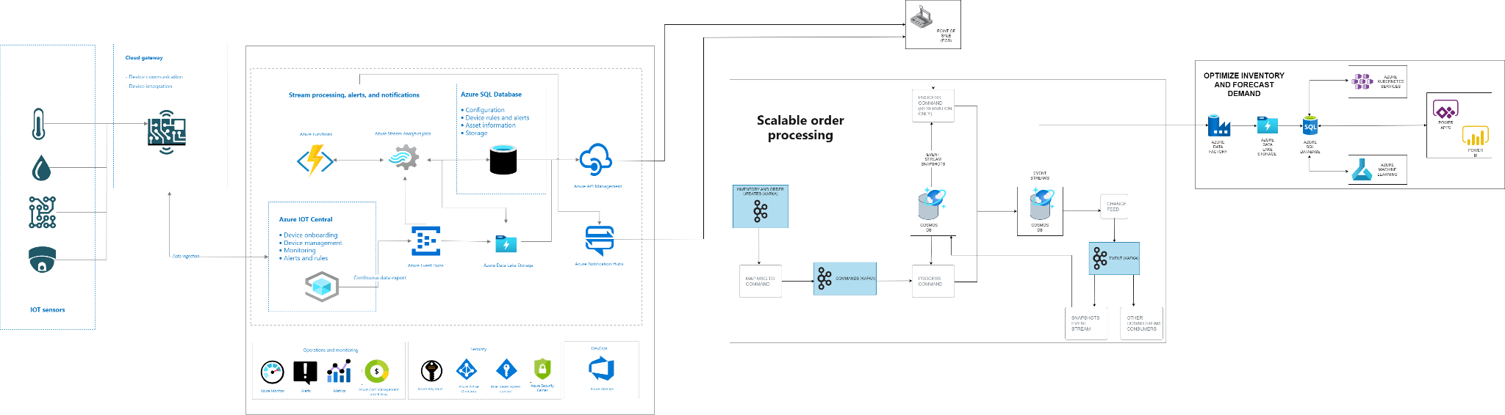
DIAGRAM

Slide 7

WHAT ARE THE BENEFITS?

Slide 8
PROJECT ACTIVITIES
1. Real-time Visibility and Analytics | 2.Scalability and Flexibility | 3.Enhanced User Engagement and Communication
- The integration of Azure IoT Central, Stream Analytics, and Event Hub allows for real-time monitoring of inventory data from IoT devices. | Azure SQL Database, Azure Functions, and Azure Data Lake Storage accommodates the growth of your inventory and business operations. | Azure Notification Hub enables targeted and platform-agnostic push notifications to inform users or administrators about critical inventory events.
Swift and accurate insights into inventory changes enable proactive decision-making and timely responses to stock levels. | Serverless architecture provided by Azure Functions allows for cost-effective and efficient execution of code. | Improved user engagement through timely notifications enhances overall user experience.
Azure Stream Analytics facilitates complex event processing, identifying patterns and trends in real-time.. | Azure Data Lake Storage supports the storage of large volumes of structured and unstructured data. | The implementation of Azure API Management ensures secure and governed access to APIs.

Slide 9
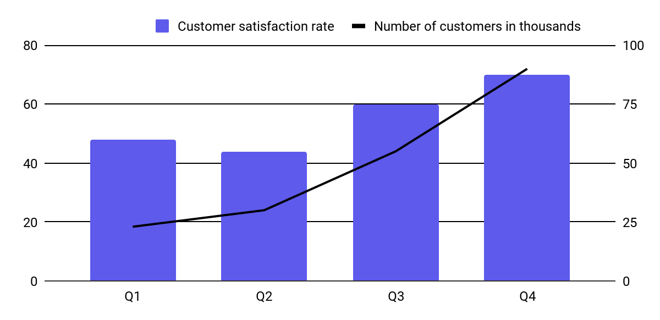
PRICING
RESOURCE | UTILIZATION | COST
Azure SQL Database | Increase workload | $50 - $100 per month
Azure Functions | Increased executions | $50 - $100 per month
Azure IoT Central | Increased connected devices | $50 - $100 per month
Azure Stream Analytics | Increased streaming units | $50 - $100 per month
Azure Event Hub | Increased events and throughput units | $30 - $60 per month
Azure Notification Hub | Increased push notifications | $20 - $40 per month
Azure Data Lake Storage | Increased storage capacity and data transfer | $30 - $60 per month
Azure API Management | Increased API calls | $30 - $60 per month

Slide 10
Q&A SECTION

Slide 11
THANK YOU FOR LISTENING

