Slide 1
BUSINESS
ECONOMICS

Slide 2
WHAT IS BUSINESS ECONOMICS
What Is Business Economics?
Business economics is a field of applied economics that studies the financial, organizational, market-related, and environmental issues faced by corporations. Economic theory and quantitative methods form the basis of assessments on factors affecting corporations such as business organization, management, expansion, and strategy.
Studies might include how and why corporations expand, the impact of entrepreneurs, the interactions among corporations, and the role of governments in regulation.

Slide 3
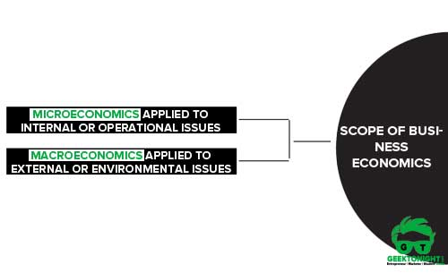
SCOPE OF BUSINESS ECONOMICS
scope of business economics
. Business economics involves the application of various economic tools, theories, and methodologies for analyzing solving different business problems.
Two Categories
There are two categories of business issues to which economic theories can be directly applied, namely:
Microeconomics applied to internal or operational issues
Macroeconomics applied to external or environmental issues
Therefore, the scope of Business Economics may be discussed under the above two heads.

Slide 4
The following Microeconomic theories deal with most of these issues:
1)DEMAND ANALYSIS
2)PRODUCTION ANALYSIS
3)COST ANALYSIS
4)PRICING ANALYSIS
5)PROFIT ANALYSIS
6)INVESTMENT ANALYSIS
7)MANAGERIAL TECHNIQUES.

Slide 5
1.DEMAND ANALYSIS
Demand analysis involves understanding the customer demand for a product or service in a particular market. Companies use demand analysis techniques to determine if they can successfully enter a market and generate expected profits to advance their business operations. Demand analysis is one of the most important considerations for a variety of business decisions including sales forecasting, pricing products/services, marketing and advertisement spending, manufacturing decisions, and expansion planning.
Thus, demand plays a crucial role in the success of any business enterprise. And it must be remembered that demand is always at a price and a particular time period in which it is created. For example as demand for woolen clothes will be more in winters than in any other season. Hence, demand analysis is always done in terms of the price and the relevant time period.

Slide 6
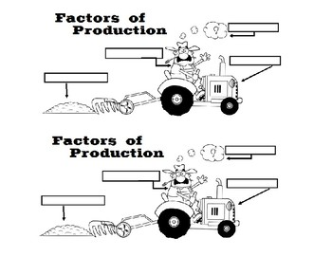
2.PRODUCTION ANALYSIS
"Production may be defined as the process by which inputs may be transformed into output" – Robert.
Production Analysis :
Production analysis basically is concerned with the analysis in which the resources such as land, labor, and capital are employed to produce a firm’s final product. To produce these goods the basic inputs are classified into two divisions −
Variable Inputs :
Inputs those change or are variable in the short run or long run are variable inputs.
Fixed Inputs :
Inputs that remain constant in the short term are fixed inputs.

Slide 7
3.COST ANALYSIS
Definition: In economics, the Cost Analysis refers to the measure of the cost – output relationship, i.e. the economists are concerned with determining the cost incurred in hiring the inputs and how well these can be re-arranged to increase the productivity (output) of the firm.
In other words, the cost analysis is concerned with determining money value of inputs (labor, raw material), called as the overall cost of production which helps in deciding the optimum level of production.
The following points highlight the top thirteen types of cost in cost concept analysis.
Some of the types are:
1. Private Cost and Social Cost
2. Actual Cost and Opportunity Cost
3. Past Cost and Future Cost
.

Slide 8

4. Explicit Cost and Implicit Cost
5. Incremental Costs and Sunk Costs
6. Short-run Costs and Long-run Costs and Others.

Slide 9
4.PRICING ANALYSIS
Price Analysis is the process of deciding if the asking price for a product or service is fair and reasonable, without examining the specific cost and profit calculations the vendor used in arriving at the price.
It is basically a process of comparing the price with known indicators of reasonableness. Some reasons that could affect adequate price competition are: specifications are not definitive, tolerances are restrictive, or production capacity limits those eligible to bid.
Examples of other forms of price analysis information include:
• analysis of previous prices paid
• comparison of vendor’s price with the in-house estimate.

Slide 10
5. Profit Analysis
In managerial economics, profit analysis is a form of cost accounting used for elementary instruction and short run decisions. A profit analysis widens the use of info provided by breakeven analysis. An important part of profit analysis is the point where total revenues and total costs are equal. At this breakeven point, the company does not experience any income or any loss.
Profits depend on many factors like changing prices ,market conditions, etc. The profit theories help firms in measuring and managing profits under such uncertain conditions. Further, they also help in planning future profits.

Slide 11
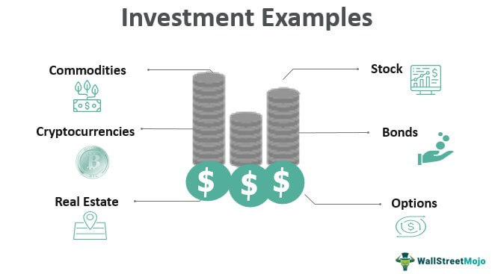
6.Investment Analysis
Investment analysis is defined as the process of evaluating an investment for profitability and risk. It ultimately has the purpose of measuring how the given investment is a good fit for a portfolio.
Investment analysis means the process of judging an investment for income, risk, and resale value. It is important to anyone who is considering an investment, regardless of type. Investment analysis methods generally evaluate 3 factors: risk , cash flows, and resale value

Slide 12

7.MANAGERIAL TECHNIQUES
A managerial technique is 'a recognised method of analysing or solving a recognised type of management problem in a detailed, systematic way'. A management problem is any situation in which a manager has to take a management decision.
This Photo by Unknown Author is licensed under CC BY-NC
Programming, is a wonderful example of a technique which helps to solve a problem—in fact it solves a particular sort of problem so much better than any manager can that one has little option but to accept the solution. Each management technique can be unambiguously described.

Slide 13


